Slide 1
Functional programming

Slide 2
What is it?
Recursion
Immutability
Non strict evaluation
Referential transparency
Category theory
Semigroup
Monoid
Monad
Functor
Applicative functors

Slide 3
What is it, again?
“Functional programming (FP) is based on a simple premise with far-reaching implications: we construct our programs using only pure functions – in other words, functions that have no side effects.”

Slide 4
What is a pure function?
def add2(a: Int): Int = a + 2
A function f with input type A and output type B is pure if it relates every value a of type A to exactly one value b of type B such that b is determined solely by the value of a.

Slide 5
What are side effects?
A function has a side effect if it does something other than simply return a result, for example:
Modifying a variable
Modifying a data structure in place
Setting a field on a object
Throwing an exception or halting with an error
Printing to the console or reading user input
Reading from or writing to a file
Drawing on the screen

Slide 6
Why pure functions?
They’re easier to reason about
They’re easier to combine
They’re easier to test
They’re easier to debug
They’re easier to parallelize
They are idempotent
They offer referential transparency
They are memoizable
They can be lazy

Slide 7
How can I do my work???
As already mentioned, pure code should not have unmanaged side effects, but that does not preclude a program from explicitly describing and managing effects. This idea is central to Haskell's IO monad, where an object of type IO a can be seen as containing the current state of the world outside the program, and computing a value of type a.

Slide 8
What is a IO-Monad?
Let's worry about that another time
Because...

Slide 9
Information overload
There is no point in me trying to explain Monads at this point, instead lets start from the beginning.

Slide 10
Well, this sounds very academical ,why would I ever wanna learn that?

Slide 11
Pure functional languages
Will I ever program in any of these langauages?
Agda, Charity, Clean, Coq (Gallina), Cuneiform, Curry, Elm, Futhark, Haskell, Hope, Idris, Joy, Mercury, Miranda, PureScript, Ur, KRC, SAC, SASL, SequenceL

Slide 12
Impure functional languages
APL, ATS, CAL, C++ (since C++11), C#, Ceylon, D, Dart, Curl, ECMAScript, ActionScript, ECMAScript for XML, JavaScript, Jscript, Source, Erlang, Elixir, LFE, F#, Groovy, Hop, J, Java (since version 8), Julia, Kotlin, Lisp, Clojure, Common Lisp, Dylan, Emacs Lisp, LFE, Little b, Logo, Scheme, Racket (formerly PLT Scheme), Tea, Mathematica, ML, Standard ML (SML), Alice, Ocaml, Nemerle, Nim, Opal, OPS5, Perl, PHP, Python, Q, R, Raku, REBOL, Red, Ruby, REFAL, Rust, Scala, Spreadsheets, Wolfram Language

Slide 13
Well, this sounds very academical ,why would I ever wanna learn that?
Many “ordinary” languages gets more and more features from functional programming.
An generalization is that everything that has a “fresh” feeling in Java and Javascript has been stolen from functional languages.
E.g. Java8, the main features Streams, lambdas, Option are all taken from functional programming.
The main feature in Spring 5 (Reactive/Reactor) is taken from functional programming.
More features are incoming, Java 14 will for example introduce pattern matching.

Slide 14
Well, this sounds very academical ,why would I ever wanna learn that?
You will have to learn regardless if you like it or not :-)
You don't have to program in a totally functional way to reap advantages.
You will be a better developer if you learn different programing paradigms
It is fun!

Slide 15
If it's so great, why does not everybody use it?
Intellectual snobbism
Developers has to relearn
Developers has to rethink

Slide 16
Intellectual snobbism
From the Scalaz documentation
Kleisli
Given a Category C, and a Monad M over C, we can construct a new Category, called the Kleisli Category of M, whose objects are those of C, but whose morphisms are arrows of the form A => M[B]. The arrows of this new category are called Kleisli Arrows, or, more succinctly, Kleislis.

Slide 17
Intellectual snobbism
From the Haskell documentation
Monads in Haskell can be thought of as composable computation descriptions. The essence of monad is thus separation of composition timeline from the composed computation's execution timeline, as well as the ability of computation to implicitly carry extra data, as pertaining to the computation itself, in addition to its one (hence the name) output, that it will produce when run (or queried, or called upon). This lends monads to supplementing pure calculations with features like I/O, common environment, updatable state, etc.

Slide 18
Intellectual snobbism
From the Haskell documentation
A monad is a certain type of endofunctor. For example, if F and G are a pair of adjoint functors, with F left adjoint to G, then the composition G o F is a monad. If F and G are inverse functors, the corresponding monad is the identity functor. In general, adjunctions are not equivalences—they relate categories of different natures. The monad theory matters as part of the effort to capture what it is that adjunctions 'preserve'. The other half of the theory, of what can be learned likewise from consideration of F o G, is discussed under the dual theory of comonads

Slide 19
Who uses it?
Amazon uses Erlang to implement SimpleDB, providing database services as a part of the Amazon Elastic Compute Cloud (EC2).
Yahoo! uses it in its social bookmarking service, Delicious, which has more than 5 million users and 150 million bookmarked URLs.
Facebook uses Erlang to power the backend of its chat service, handling more than 100 million active users.
WhatsApp uses Erlang to run messaging servers, achieving up to 2 million connected users per server.
T-Mobile uses Erlang in its SMS and authentication systems.
Motorola is using Erlang in call processing products in the public-safety industry.
Ericsson uses Erlang in its support nodes, used in GPRS and 3G mobile networks worldwide.

Slide 20
Who uses it?
Amazon uses Erlang to implement SimpleDB, providing database services as a part of the Amazon Elastic Compute Cloud (EC2).
Yahoo! uses it in its social bookmarking service, Delicious, which has more than 5 million users and 150 million bookmarked URLs.
Facebook uses Erlang to power the backend of its chat service, handling more than 100 million active users.
WhatsApp uses Erlang to run messaging servers, achieving up to 2 million connected users per server.
T-Mobile uses Erlang in its SMS and authentication systems.
Motorola is using Erlang in call processing products in the public-safety industry.
Ericsson uses Erlang in its support nodes, used in GPRS and 3G mobile networks worldwide.

Slide 21
Who uses it?
The 3D subdivision modeler Wings 3D, used to model and texture polygon meshes. (Erlang)
The CouchDB “schema-less” document-oriented database, providing scalability across multicore and multiserver clusters. (Erlang)
The MochiWeb library that provides support for building lightweight HTTP servers. It is used to power services such as MochiBot and MochiAds, which serve dynamically generated content to millions of viewers daily. (Erlang)
RabbitMQ, an AMQP messaging protocol implementation. AMQP is an emerging standard for high-performance enterprise messaging. (Erlang)

Slide 22
Who uses it?
Apache Spark (Scala)
Scalding (by Twitter) (Scala)
Apache Kafka (Scala)
Apache Samza (Scala)
Finagle (Scala)
Akka (Scala)

Slide 23
What now?
Baby steps
Scala
Writing small pure functions i Scala
Recursion
Higher order functions
Study and write our own Functional data structures
Monoid, Functor, Monad, Applicative Functor
And finally, handling Effects (IO Monad)

Slide 24

Books

Slide 25

Books

Slide 26
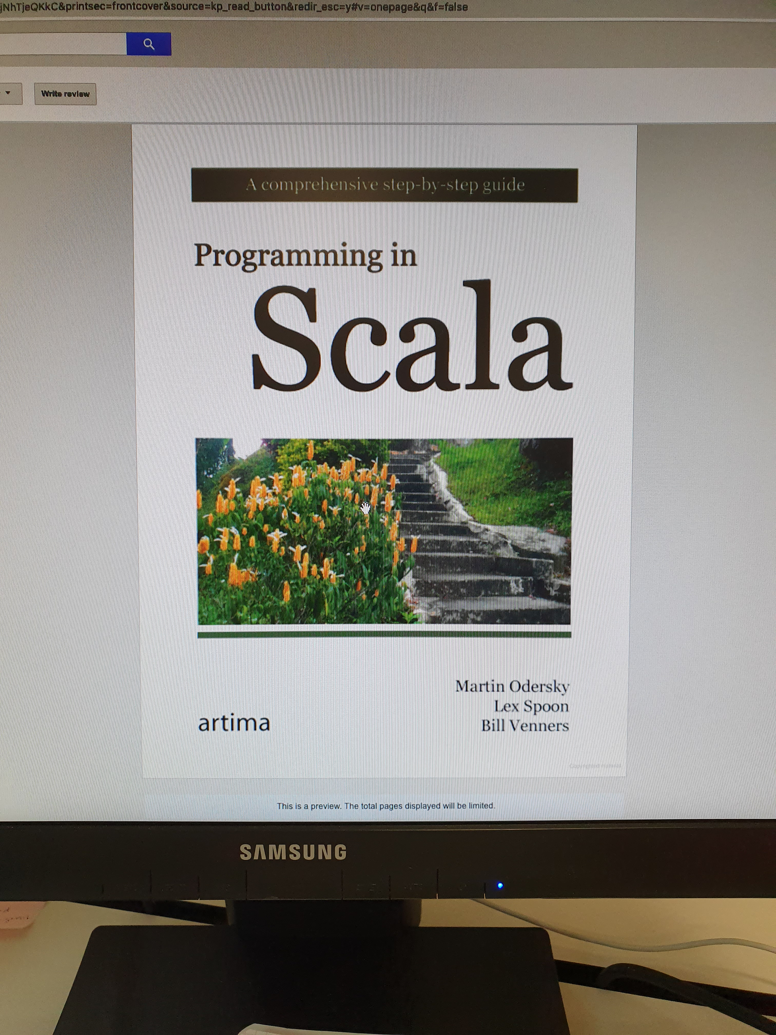
Books

Slide 27
Install Scala

