Slide 1
List (lodash implementation)

Slide 2
List
"The list is the origin of culture. It's part of the history of art and literature. What does culture want? To make infinity comprehensible. It also wants to create order." ― Umberto Eco
“The list could surely go on, and there is nothing more wonderful than a list, instrument of wondrous hypotyposis.” ― Umberto Eco, The Name of the Rose
“I love lists. Always have. when I was 14, I wrote down every dirty word I knew on file cards and placed them in alphabetical order. I have a thing about about collections, and a list is a collection with purchase. (Wired Magazine, "Step One: Make a List", October 2012)” ― Adam Savage

Slide 3
List
https://en.wikipedia.org/wiki/List_of_lists_of_lists

Slide 4
The story of the empty list
const badGetFlowers = colorOfFlower => { if(colorOfFlower === "red") { return ['Roses', 'Tulips']; } return null; }; it("imperative example with null instead of empty list", function () { const flowers = badGetFlowers('red');//will not work with 'black' var flowersThatStartsWithR = []; for(var i = 0; i < flowers.length; i++) { if(flowers[i].startsWith('R')){ flowersThatStartsWithR.push(flowers[i]); } } expect(flowersThatStartsWithR).toEqual(['Roses']); });

Slide 5
The story of the empty list - continue
const badGetFlowers = colorOfFlower => { if(colorOfFlower === "red") { return ['Roses', 'Tulips']; } return null; }; it("imperative example with null instead of empty list", function () { const flowers = badGetFlowers('black'); var flowersThatStartsWithR = []; if(flowers !== null) { for(var i = 0; i < flowers.length; i++) { if(flowers[i].startsWith('R')){ flowersThatStartsWithR.push(flowers[i]); } } } expect(flowersThatStartsWithR).toEqual([]); });

Slide 6
The story of the empty list - continue
const goodGetFlowers = colorOfFlower => { if(colorOfFlower === "red") { return ['Roses', 'Tulips']; } return []; }; it("imperative example with empty list instead of empty list", function () { const flowers = goodGetFlowers('black'); var flowersThatStartsWithR = []; for(var i = 0; i < flowers.length; i++) { if(flowers[i].startsWith('R')){ flowersThatStartsWithR.push(flowers[i]); } } expect(flowersThatStartsWithR).toEqual([]); });

Slide 7
List
Empty

Slide 8
Filter

Slide 9
By the way: Compare with imperative and functional versions of filter.
it("imperative example with empty list instead of empty list", function () { const flowers = goodGetFlowers(’red'); var flowersThatStartsWithR = []; for(var i = 0; i < flowers.length; i++) { if(flowers[i].startsWith('R')){ flowersThatStartsWithR.push(flowers[i]); } } expect(flowersThatStartsWithR).toEqual(['Roses']); }); it("functional version", function () { const flowers = goodGetFlowers('red'); const flowersThatStartsWithR = flowers.filter(flower => flower.startsWith('R')); expect(flowersThatStartsWithR).toEqual(['Roses']); });

Slide 10
Map

Slide 11
Filter && Map

Slide 12
sortBy
2
1
4
3
1
2
3
4

Slide 13
orderBy
Support for asc and desc
asc
2
1
4
3
1
2
3
4
desc
2
1
4
3
4
3
2
1

Slide 14
groupBy
1
2
1
2
3
2
2
3

Slide 15
partition
isEven
2
2
2
1
2
3
1
3
isEven

Slide 16
Size
4
1
2
3
4
0

Slide 17
Join
;
”1;2;3;4”
1
2
3
4
;
””

Slide 18
First
1
2
3
4
1
undefined (not functional ☹)

Slide 19

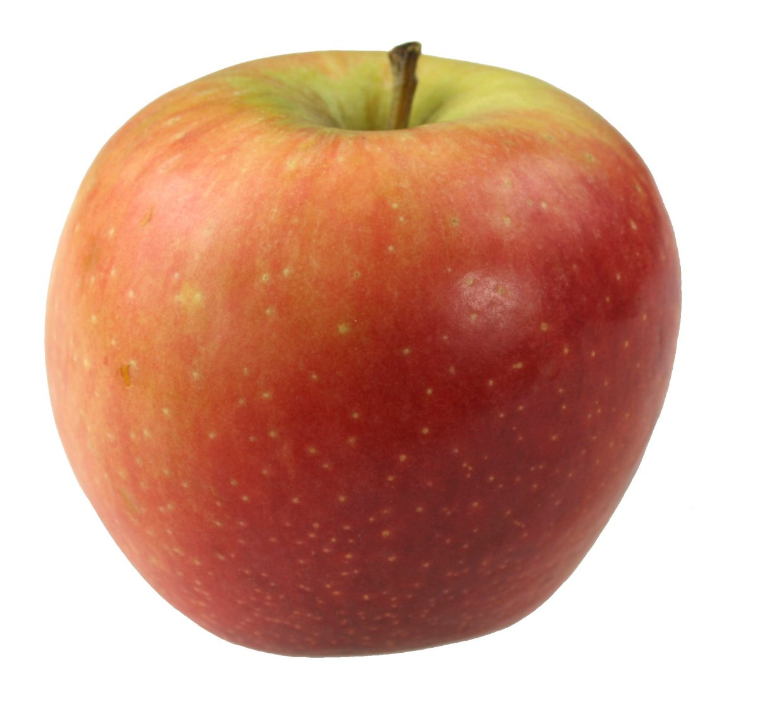
Reduce

Slide 20
Callback functions
Syntax: array.filter(callbackFunction)
const isTriangle = shape => shape === "triangle";
shapes.filter(shape => shape === "triangle")
Is the same as:
shapes.filter(shape => isTriangle(shape))
Is the same as:
shapes.filter(isTriangle)

