Slide 1
List

Slide 2
List
Empty

Slide 3
Map

Slide 4
Filter

Slide 5

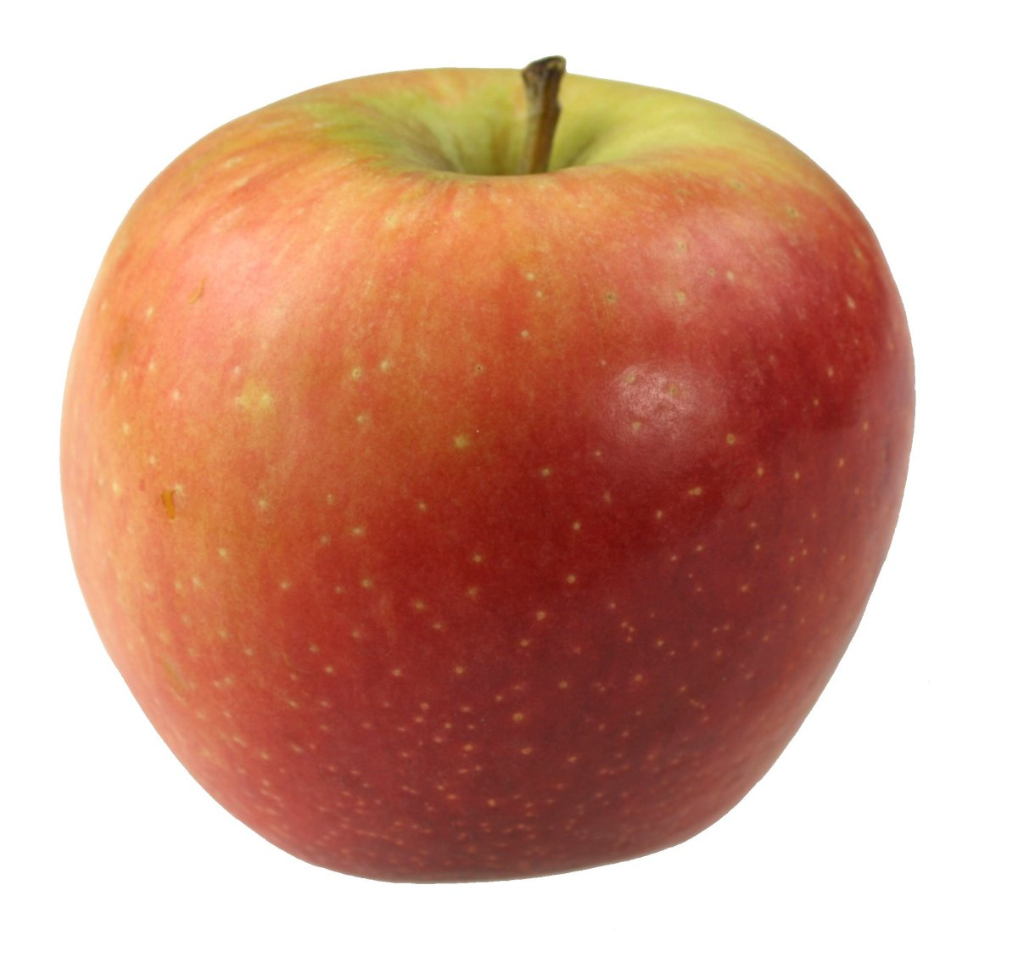
Reduce

Slide 6
Join
;
”1;2;3;4”
1
2
3
4
;
””

Slide 7
sortBy
2
1
4
3
1
2
3
4

Slide 8
orderBy
Support for asc and desc
asc
2
1
4
3
1
2
3
4
desc
2
1
4
3
4
3
2
1

Slide 9
Size
4
1
2
3
4
0

Slide 10
First
1
2
3
4
1
undefined (not functional ☹)

Slide 11
groupBy
1
2
1
2
3
2
2
3

Slide 12
partition
isEven
2
2
2
1
2
3
1
3
isEven

Slide 13
Callback functions
Syntax: array.filter(callbackFunction)
const isTriangle = shape => shape === "triangle";
shapes.filter(shape => shape === "triangle")
Is the same as:
shapes.filter(shape => isTriangle(shape))
Is the same as:
shapes.filter(isTriangle)

