Slide 1
List (lodash implementation)

Slide 2
List
"The list is the origin of culture. It's part of the history of art and literature. What does culture want? To make infinity comprehensible. It also wants to create order." ― Umberto Eco
“I love lists. Always have. when I was 14, I wrote down every dirty word I knew on file cards and placed them in alphabetical order. I have a thing about about collections, and a list is a collection with purchase. (Wired Magazine, "Step One: Make a List", October 2012)” ― Adam Savage
https://en.wikipedia.org/wiki/List_of_lists_of_lists

Slide 3
The story of the empty list
const badGetFlowers = colorOfFlower => { if(colorOfFlower === "red") { return ['Roses', 'Tulips']; } return null; }; it("imperative example with null instead of empty list", function () { const flowers = badGetFlowers('red');//will not work with 'black' var flowersThatStartsWithR = []; for(var i = 0; i < flowers.length; i++) { if(flowers[i].startsWith('R')){ flowersThatStartsWithR.push(flowers[i]); } } expect(flowersThatStartsWithR).toEqual(['Roses']); });

Slide 4
The story of the empty list - continue
const badGetFlowers = colorOfFlower => { if(colorOfFlower === "red") { return ['Roses', 'Tulips']; } return null; }; it("imperative example with null instead of empty list", function () { const flowers = badGetFlowers('black'); var flowersThatStartsWithR = []; if(flowers !== null) { for(var i = 0; i < flowers.length; i++) { if(flowers[i].startsWith('R')){ flowersThatStartsWithR.push(flowers[i]); } } } expect(flowersThatStartsWithR).toEqual([]); });

Slide 5
The story of the empty list - continue
const goodGetFlowers = colorOfFlower => { if(colorOfFlower === "red") { return ['Roses', 'Tulips']; } return []; }; it("imperative example with empty list instead of empty list", function () { const flowers = goodGetFlowers('black'); var flowersThatStartsWithR = []; for(var i = 0; i < flowers.length; i++) { if(flowers[i].startsWith('R')){ flowersThatStartsWithR.push(flowers[i]); } } expect(flowersThatStartsWithR).toEqual([]); });

Slide 6
List
Empty

Slide 7
Filter

Slide 8
By the way: Compare with imperative and functional versions of filter.
it("imperative example with empty list instead of empty list", function () { const flowers = goodGetFlowers(’red'); var flowersThatStartsWithR = []; for(var i = 0; i < flowers.length; i++) { if(flowers[i].startsWith('R')){ flowersThatStartsWithR.push(flowers[i]); } } expect(flowersThatStartsWithR).toEqual(['Roses']); }); it("functional version", function () { const flowers = goodGetFlowers('red'); const flowersThatStartsWithR = flowers.filter(flower => flower.startsWith('R')); expect(flowersThatStartsWithR).toEqual(['Roses']); });

Slide 9
Map

Slide 10
Filter && Map

Slide 11
sortBy
2
1
4
3
1
2
3
4

Slide 12
orderBy
Support for asc and desc
asc
2
1
4
3
1
2
3
4
desc
2
1
4
3
4
3
2
1

Slide 13
groupBy
1
2
1
2
3
2
2
3

Slide 14
partition
isEven
2
2
2
1
2
3
1
3
isEven

Slide 15
Size
4
1
2
3
4
0

Slide 16
Join
;
”1;2;3;4”
1
2
3
4
;
””

Slide 17
First
1
2
3
4
1
undefined (not functional ☹)

Slide 18

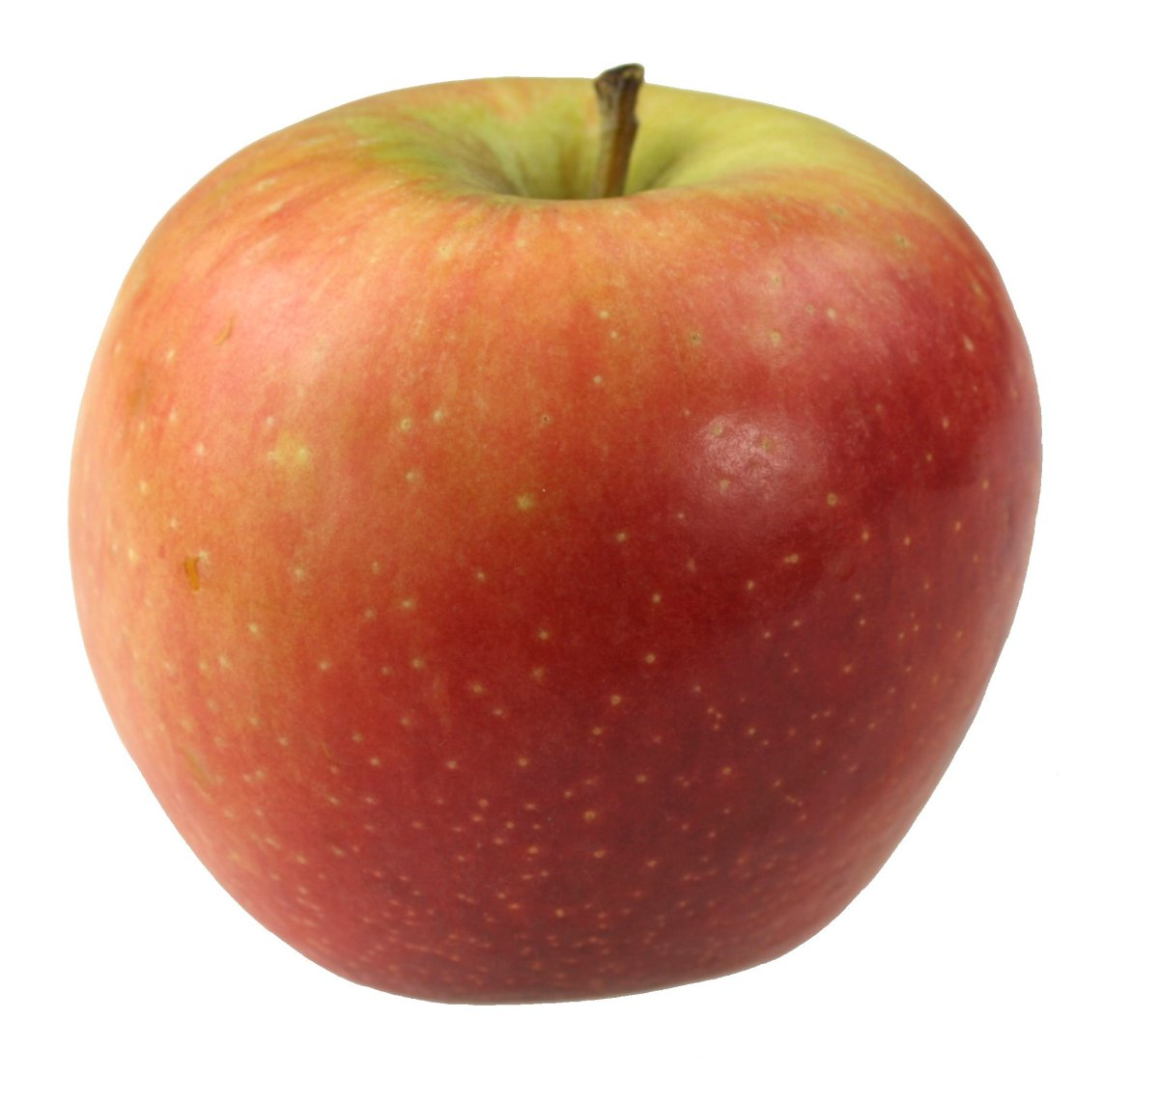
Reduce

Slide 19
Callback functions
Syntax: array.filter(callbackFunction)
const isTriangle = shape => shape === "triangle";
shapes.filter(shape => shape === "triangle")
Is the same as:
shapes.filter(shape => isTriangle(shape))
Is the same as:
shapes.filter(isTriangle)

