Slide 1
List (lodash implementation)

Slide 2
The story of the empty list
const badGetFlowers = colorOfFlower => { if(colorOfFlower === "red") { return ['Roses', 'Tulips']; } return null; }; it("imperative example with null instead of empty list", function () { const flowers = badGetFlowers('red');//will not work with 'black' var flowersThatStartsWithR = []; for(var i = 0; i < flowers.length; i++) { if(flowers[i].startsWith('R')){ flowersThatStartsWithR.push(flowers[i]); } } expect(flowersThatStartsWithR).toEqual(['Roses']); });

Slide 3
The story of the empty list - continue
const badGetFlowers = colorOfFlower => { if(colorOfFlower === "red") { return ['Roses', 'Tulips']; } return null; }; it("imperative example with null instead of empty list", function () { const flowers = badGetFlowers('black'); var flowersThatStartsWithR = []; if(flowers !== null) { for(var i = 0; i < flowers.length; i++) { if(flowers[i].startsWith('R')){ flowersThatStartsWithR.push(flowers[i]); } } } expect(flowersThatStartsWithR).toEqual([]); });

Slide 4
The story of the empty list - continue
const goodGetFlowers = colorOfFlower => { if(colorOfFlower === "red") { return ['Roses', 'Tulips']; } return []; }; it("imperative example with empty list instead of empty list", function () { const flowers = goodGetFlowers('black'); var flowersThatStartsWithR = []; for(var i = 0; i < flowers.length; i++) { if(flowers[i].startsWith('R')){ flowersThatStartsWithR.push(flowers[i]); } } expect(flowersThatStartsWithR).toEqual([]); });

Slide 5
List
Empty

Slide 6
Filter

Slide 7
By the way: Compare with imperative and functional versions of filter.
it("imperative example with empty list instead of empty list", function () { const flowers = goodGetFlowers(’red'); var flowersThatStartsWithR = []; for(var i = 0; i < flowers.length; i++) { if(flowers[i].startsWith('R')){ flowersThatStartsWithR.push(flowers[i]); } } expect(flowersThatStartsWithR).toEqual(['Roses']); }); it("functional version", function () { const flowers = goodGetFlowers('red'); const flowersThatStartsWithR = flowers.filter(flower => flower.startsWith('R')); expect(flowersThatStartsWithR).toEqual(['Roses']); });

Slide 8
Map

Slide 9
Filter && Map

Slide 10
sortBy
2
1
4
3
1
2
3
4

Slide 11
orderBy
Support for asc and desc
asc
2
1
4
3
1
2
3
4
desc
2
1
4
3
4
3
2
1

Slide 12
groupBy
1
2
1
2
3
2
2
3

Slide 13
partition
isEven
2
2
2
1
2
3
1
3
isEven

Slide 14
Size
4
1
2
3
4
0

Slide 15
Join
;
”1;2;3;4”
1
2
3
4
;
””

Slide 16
First
1
2
3
4
1
undefined (not functional ☹)

Slide 17

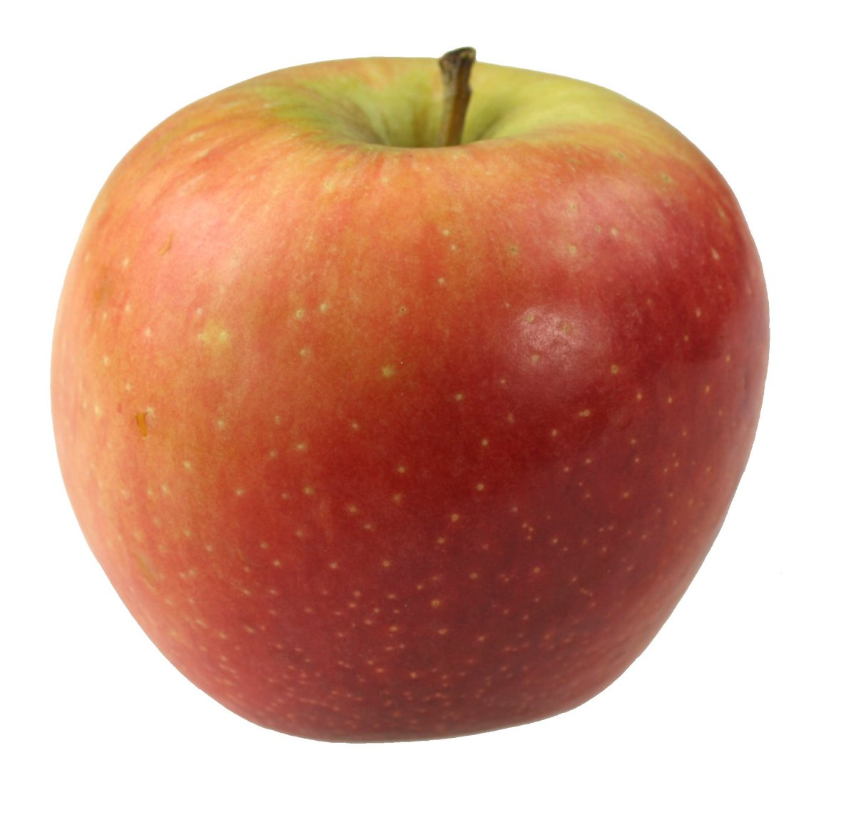
Reduce

Slide 18
Callback functions
Syntax: array.filter(callbackFunction)
const isTriangle = shape => shape === "triangle";
shapes.filter(shape => shape === "triangle")
Is the same as:
shapes.filter(shape => isTriangle(shape))
Is the same as:
shapes.filter(isTriangle)

