Slide 1
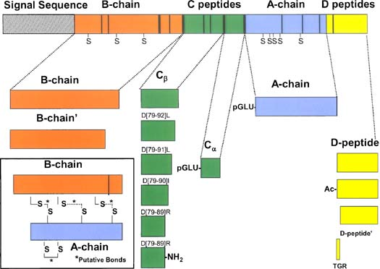
A schematic drawing of the Aplysia californica insulin prohormone showing the presence of a signaling sequence and the expressed prohormone that is processed into the bioactive peptides. The length of each section corresponds to the number of amino acids in it, and the vertical bars indicate the basic amino acids that are common proteolytic sites where the prohormone is cleaved into smaller peptides. Many of the peptides are post-translationally modified with disulfide bridges, amidation, acetylation, and pyroglutamylation (Hummon et al, 2006)

