Slide 1

Approaches to Identifying Signaling Molecules

Slide 2
Talk Outline
Introduction to protein signal sequences
Targeted search for secretory proteins
(Very) short introduction to HMMs
Secretory protein prediction pipeline
SlimeBase2 (if we have time)

Slide 3
Sub-cellular localization
Can we predict the final destination of a protein from sequence data?
Cell relies upon signal sequences to direct protein
Signal conserved to ensure correct processing
Allows us to predict location based upon conserved signal, or motif
Notes:
Can we predict the final destination of proteins? Turns out we can, because the cell relies upon signal sequences to determine where proteins should be going. Because secreted proteins use the same machinery, they must contain the same signals to be processed properly. This conservation is what allows computational methods to correctly predict protein localization based on sequence information alone.

Slide 4
Signal Motifs
Signal Peptides
Localization Signals in the Secretory Pathway
Transmembrane Domains
Mitochondrial Transit Peptide
Chloroplast Transit Peptide
Peroxisomal Peptide

Slide 5
Signal Peptides – functional and fun!
Needed for transport to the ER
  Does not determine what happens after that
  Some programs mistake this for a transmembrane domain
Characteristic N-terminal sequence
  15-40 AAs
  2-5 positively charged
  7-15 hydrophobic
  3-7 neutral (often polar) <- cleavage region
  Cleaved by signal peptidase I in ER lumen

Slide 6
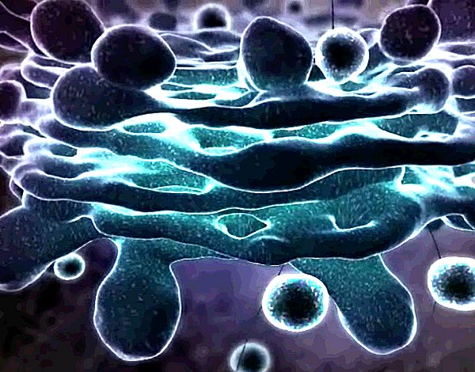
SP Localization Signals
Additional motif that can determine localization in the SP
Golgi
  No motif known, predict based on pattern of transmembrane domains
ER lumen localization motif
  K-D-E-L
  K-K-X-X <- ER transmembrane at C terminus

Slide 7
Transmembrane Domains
15-35 AA long
Mostly hydrophobic
Separated by polar connecting loops
Alternative:
  Glycosylphosphatidylinositol linkage
  G/A/S/C/D/N | X-G/A motif, followed by 15-30 hydrophobic residues

Slide 8
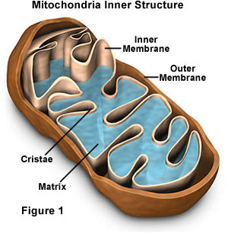
Mitochondrial Transit Peptide
N-terminus
6-80 residues
Rich in Arg, Ser, Ala, rarely negative residues
Forms amphipathic alpha helix
Usually Arg in position -2/-3 from cleavage site

Slide 9
Chloroplast Transit Peptide
Rich in Serines, no acidic residues
VRA | AAV around cleavage site
Uncharged N-terminus beginning with MA ten amino acids long
Central domain enriched in S/T, C-terminus forms amphiphillic beta-strand
Some sequences shared with proteins targeted at Mitochondria

Slide 10
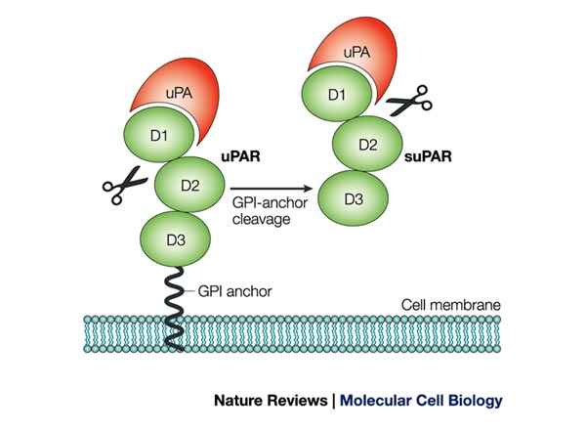
GPI Anchor
Glycolipid attached to C-termius of a mature protein during posttranslational modification in ER
Hydrophobic C-terminus is cleaved and replaced with GPI anchor
GPI-anchored proteins have signal sequence
Anchored in cell membrane and cleaved by phospholipases for controlled release

Slide 11
Myristoylation
Co-translational (or sometimese post-translational) addition of myristoyl group to N-terminus
Sequences with this modification usually have no signal peptide
Myristoylation causes protein to become anchored in cytoplasmic face of membrane

Slide 12
Signals We Don’t Check For
Peroxisomal Transit Peptide
  C-terminus signal that is not cleaved
  SKL-COOH motif necessary and sufficient for transport
Nuclear Localization Signal
  Rich in lysine and arginine
  Occur internally, not cleaved
If TargetP predicts “other” for localization, could have one of these signals

Slide 13
Signal Summary
We’re looking for secreted peptides, why do we care about these signals?
If protein has a signal peptide as well as one of these other signals, it will not be secreted!
What we want to see:
  Signal Peptide + TargetP localizing to secretory pathway + absence of everything else
Need a suite of programs to screen for all of these motifs

Slide 14
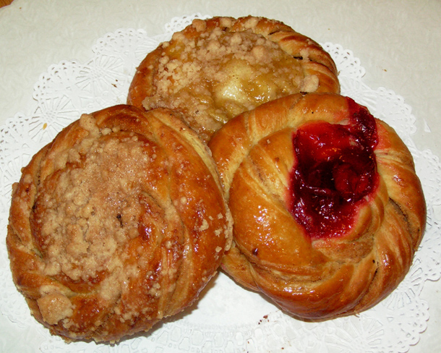
(The) Danish to the Rescue!
Center for Biological Sequence Analysis, Denmark (CBS)‏
SignalP, TargetP, THMHH, Phobius

Slide 15
An Aside on Hidden Markov Models
If you’re really interested, I have a PowerPoint that does an excellent job explaining HMMs in bioinformatics
First, what is a Markov Model?
Statistical model for describing a real-life system
Comprised of States and Transitions (with probabilities)

Slide 16
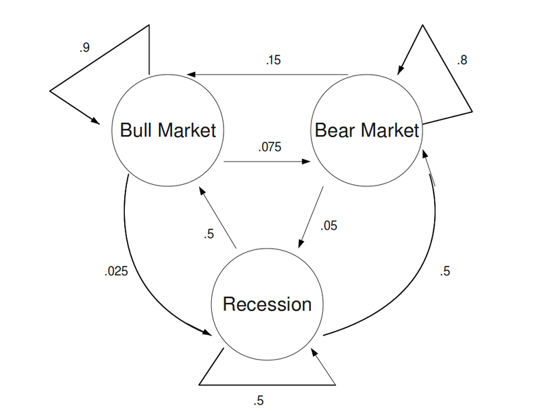
An Aside on Hidden Markov Models
First, what is a Markov Model?
States
States

Slide 17
An Aside on Hidden Markov Models
First, what is a Markov Model?
Transitions (with probabilities)
States
States

Slide 18
An Aside on Hidden Markov Models
What’s a HMM then?
It’s a Markov model where you don’t know the states!
All you know are the outputs
  In the case of the economy, it’s the health of the market
  In a strand of DNA, it’s the nucleic acids we observe
  In a protein, it’s the amino acids we observe
In a biological sequence HMM, the hidden states each have a probability (called the emission probability) of producing each of the possible bases or residues

Slide 19
EXTREMELY Generalized Method for Constructing HMMs
Build models of states and transitions from a training data set
Select the models with the maximum chance of producing your training data set
Use these models to calculate the probabilities of submitted sequences being produced by the model

Slide 20
Software – Signal Peptide Prediction
SignalP 3.0
  Hidden Markov models, NN to predict based off of N-terminus sequence
SMART
  1 Sequence at a time
  Signal peptide, as well as domains from pfam
  BLAST against domains
Signal-BLAST
  BLASTp against two curated databases, one with signal peps and one with non-signal peps
  Allows manual verification of alignment

Slide 21
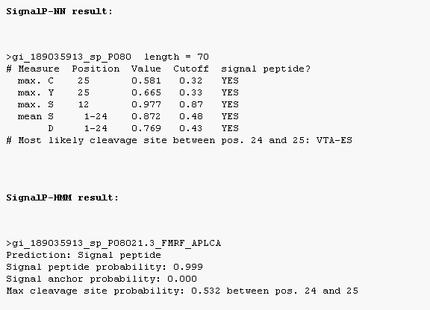
SignalP 3.0
Uses Neural Networks and HMMs to predict signal peptides
SignalP-NN: gives a S(likelihood of being in SP) and C (likelihood of being in mature protein)score to each amino acid
SignalP-HMM: gives probability of being a SP, signal anchor, or other
Use all three as metric of selection

Slide 22
General Localization Software
pTarget
  Determines localization by similarity search
  cytoplasm, endoplasmic reticulum, extracellular, Golgi, lysosomes,mitochondria, nucleus, plasma membrane, and peroxisomes
  Does not work on sequences < 26aa
  Curated sets from pfam only in certain sub-cellular compartments
TargetP
  HMM, NNs to search for N-terminus motifs of different transit peptides
  Predicts whether protein is localized to Chloroplast, Secretory Pathway, Mitochondria, or Other

Slide 23
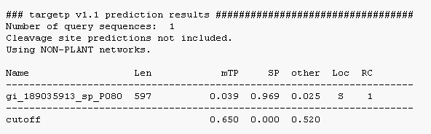
TargetP 1.1
Assigns probability for the sequence beloning to each of the sub-cellular localizations using HMMs trained on eukaryotes

Slide 24
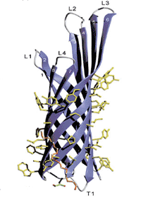
Transmembrane Prediction Software
THMHH
Phobius
TMPred
-------------------------------
TBBpred (not covered in our search)‏

Slide 25
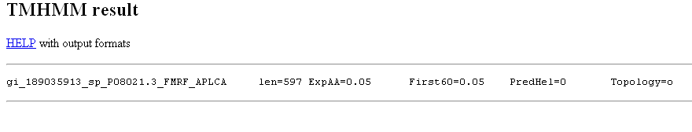
TMHMM 2.0
Also uses HMMs trained on eukaryotic data sets to do predictions
#AA expected to be in a TMD
#predicted helices
Sequence ID
#AA in first 60 residues in a TMD
Predicted protein topology

Slide 26
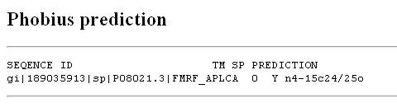
Phobius
Does simultaneous TMHMM and SP predictions to resolve conflicts in first 60AA

Slide 27
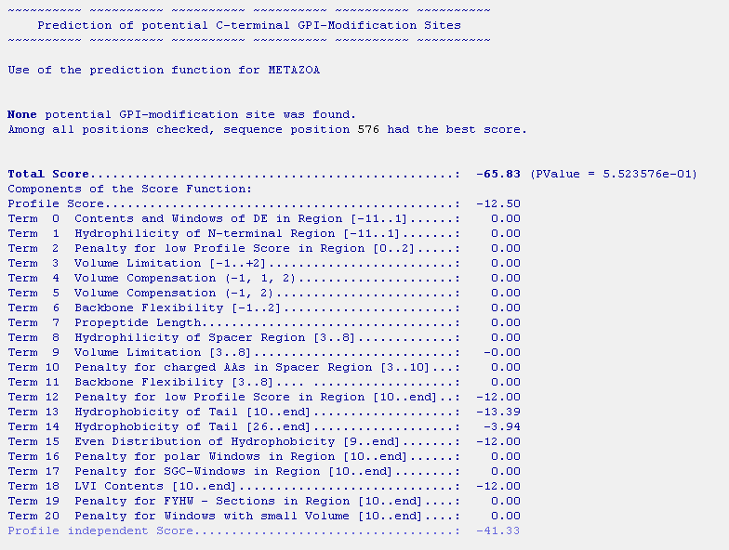
big-Pi GPI-anchor prediction

Slide 28
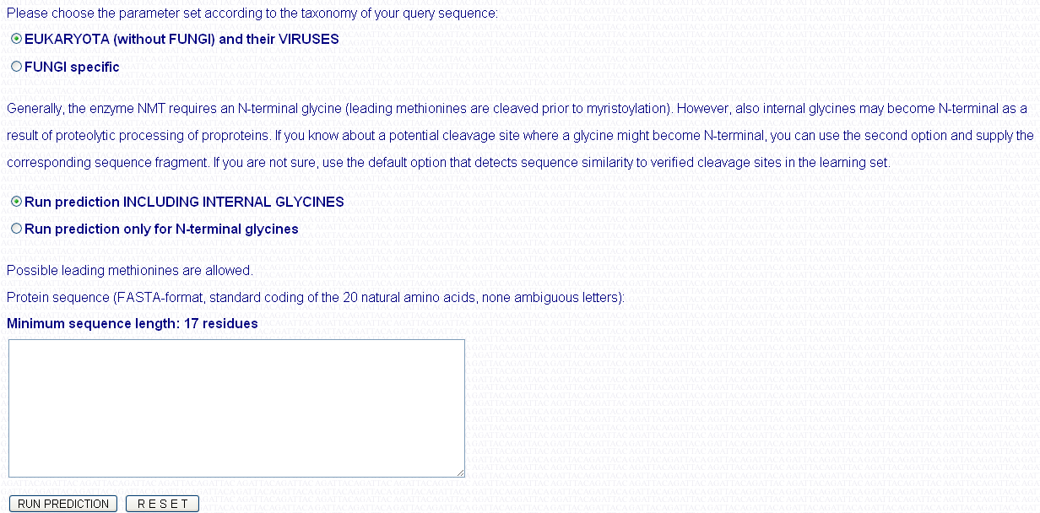
NMT Myristoylation Prediction

Slide 29
Custom Scripts
Regular expressions count number of cystines, dibasic sites
Detection of repetitive elements using a dynamic programming sliding-window algorithm

Slide 30
Prediction Workflow
Run TargetP
Run SignalP for signal peptide detection
Run SecretomeP for non-traditional secretion prediction
Run THMHH to determine transmembrane domains
Run Phobius to confirm signal/TM prediction (if necessary)‏
Run big-PI for GPI-anchor prediction
Run NMT for myristoyl anchor prediction
Run custom scripts to quantify cystines, dibasic sites, repetitive elements
Between each step, parse output and only keep sequences meeting criteria as input to the next step

Slide 31
Searching for Secretory Proteins
Two general approaches:
  Targeted search – you want to find secretory proteins like a set of known proteins
  Discovery-driven – you don’t care what you find, as long as they are secreted

Slide 32
Pseudo-computational approach/targeted search (PCA)
Download existing neuroactive proteins from public databases
  Keyword search at NCBI, SwissProt, PeptideDB for: neuropeptide, precursor, prohormone, prehormone, neuroactive
  Approximately 160,000 sequences, 30,000 non-redundant
BLASTp these sequence against protein models for a genome
Parse BLAST output to generate a candidate list of homologs
Run prediction algorithms on homologs
Run custom scripts to generate additional data
Manually screen results

Slide 33
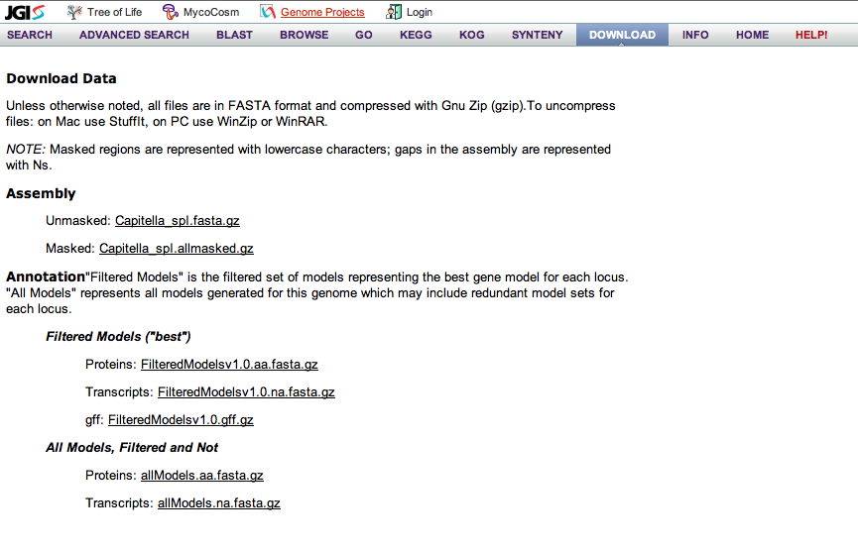
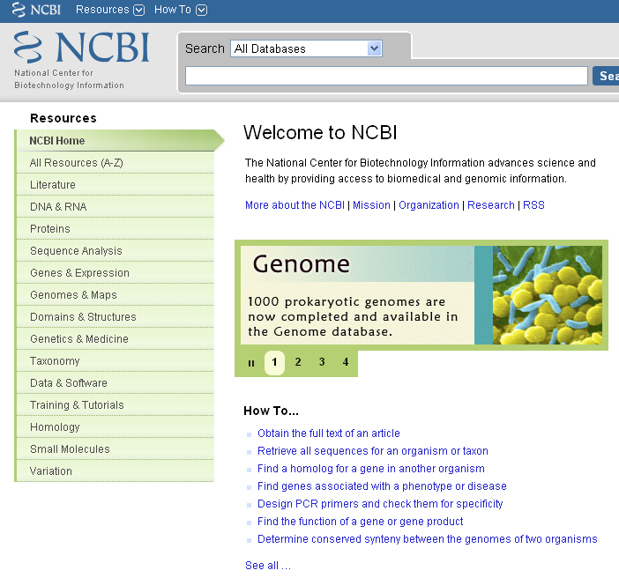
PCA Step 1: Obtaining Sequences
Two FASTA files:
Subject
Query
Protein models for your organism
30,000 protein sequences from NCBI

Slide 34
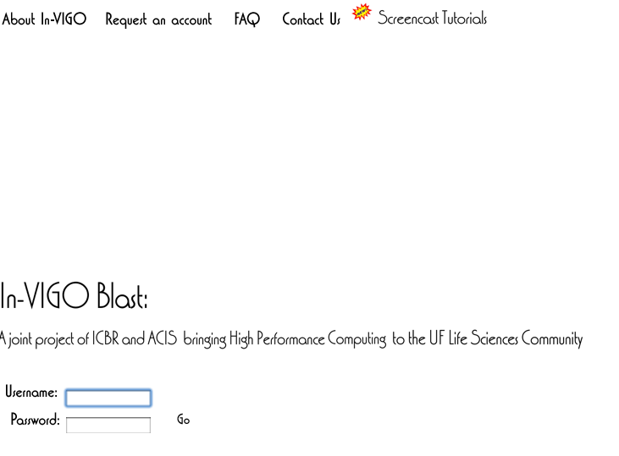
PCA Step 2: BLASTing
Use the In-VIGO BLAST interface
Interface for the high-performance computing cluster at UF in Gainesville, FL
Will allow you to BLAST a lot of sequences at once

Slide 35
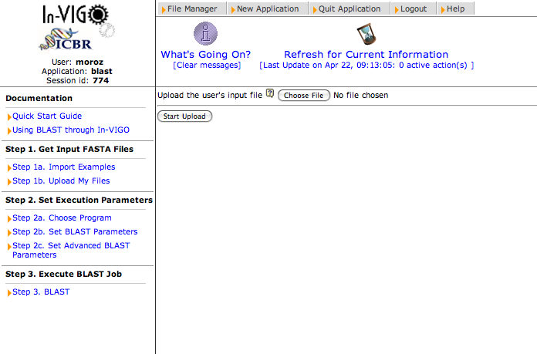
PCA Step 2: BLASTing
Upload your query file

Slide 36
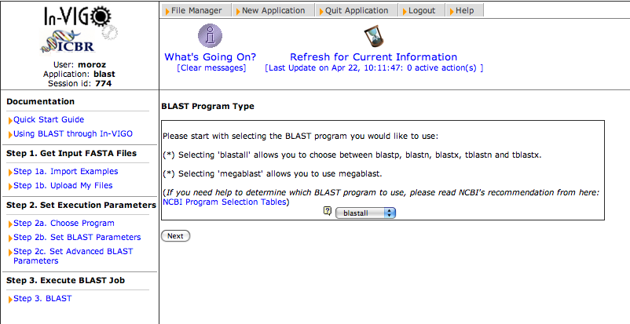
PCA Step 2: BLASTing
Select BLAST Program
Make sure blastall is selected, then hit next

Slide 37
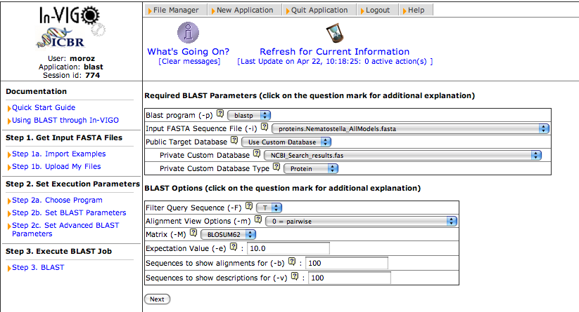
PCA Step 2: BLASTing
Select BLAST options
query file
subject file
Use custom database allows you to select an uploaded file
Enter 100 for both of these

Slide 38
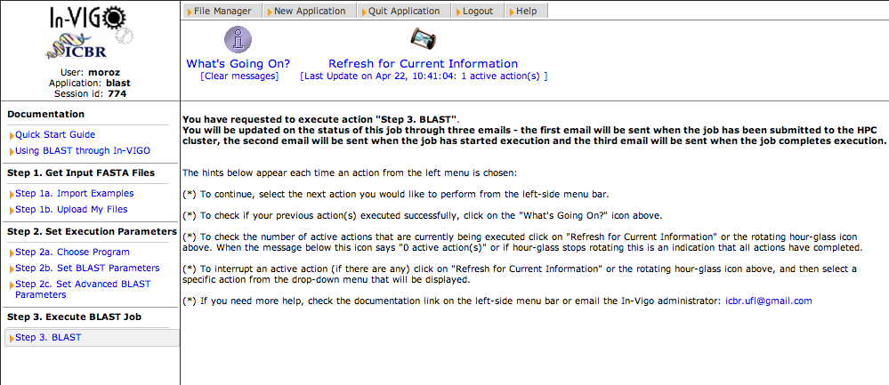
PCA Step 2: BLASTing
Execute the BLAST

Slide 39
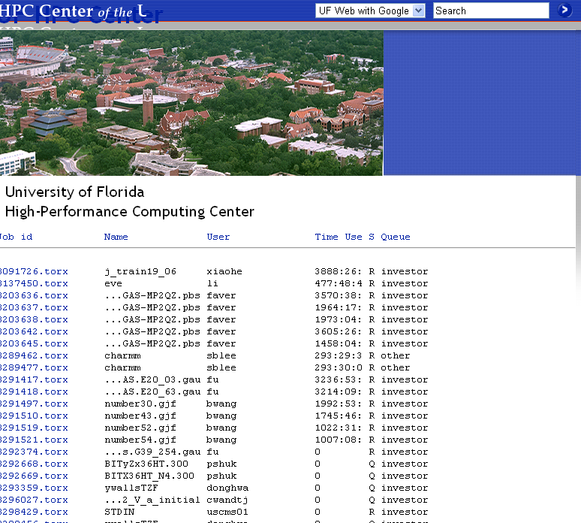
PCA Step 2: BLASTing
Your job is now submitted to the HPC queue in Gainesville
“What’s going on?” will have information about job submission, % executing, and % completed
When 100% completed, you can download your results

Slide 40
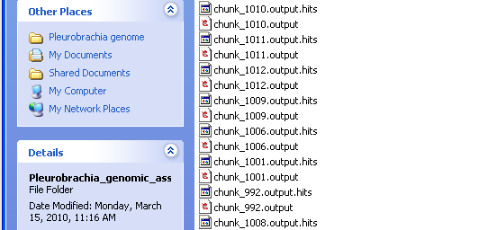
PCA Step 3: Parsing
Download BLAST output
Combine BLAST output
Create FASTA file with any sequence w/hit

Slide 41
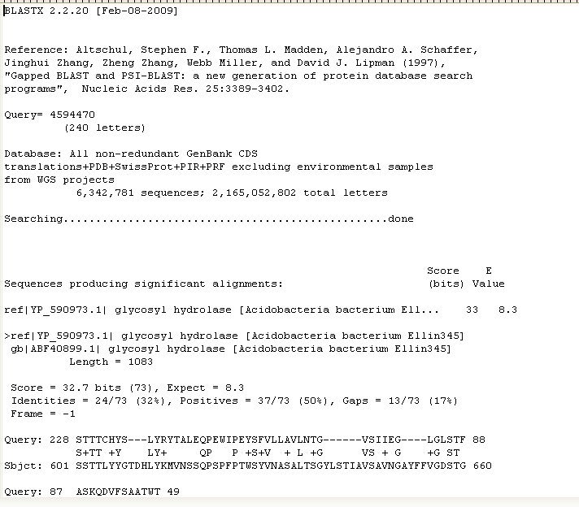
PCA Step 3: Parsing
Sample BLAST Output
X 1000

Slide 42
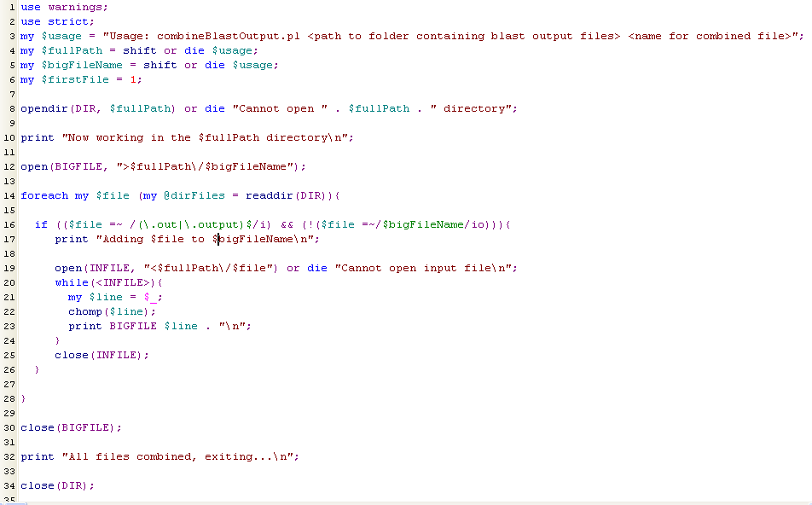
PCA Step 3: Parsing

Slide 43
PCA Step 3: Parsing
Steps for parsing sequences w/hits to neuropeptides:
  Write script to open query sequence file
  Build database of sequences indexed by IDs in memory
  Have script open BLAST output file
  Iterate over the results
  For each query sequence:
    If there is a hit with evalue < cutoff, lookup ID in the database in memory to get sequence and print to file

Slide 44
PCA Step 4: Sequence Feature Prediction
We now have a list of putative homologs to known neuropeptides (the sequences with hits)
We need to check if these sequences have the motifs necessary for secretion
Run the prediction workflow described earlier on all homologs
Annotate with Pfam domains

Slide 45
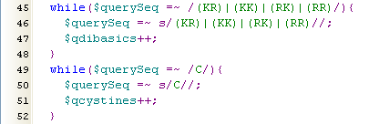
PCA Step 5: Adding additional information to predictions
Counting cystines/dibasic sites

Slide 46
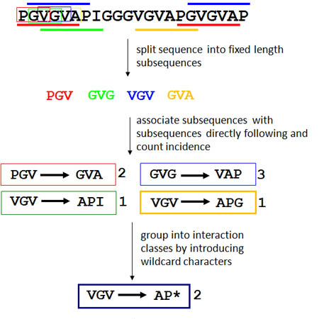
PCA Step 5: Adding additional information to predictions
Finding repetitive elements
- If an interaction class ends with the beginning of another interaction class, we can link the classes to create a longer repeat with frequency = minimum of the two frequencies

Slide 47
PCA Step 6: Manual Screening
All information is put into an excel sheet, which Leonid, Andrea, and I screen to personally validate predictions

Slide 48
Discovery-driven Searches
Perform PCA steps 4-6 on your protein set of interest!

