Slide 1
tesla bus
By Tesla Group @core2web
Notes:
<number>

Slide 2
Introduction
An idea to transform the way of commute in government buses in India . We’ve created a system to overcome problems faced by the commuters.

Slide 3
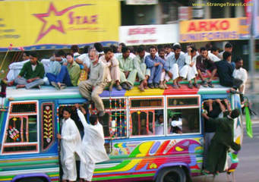
Problem : Overloaded Bus

Slide 4
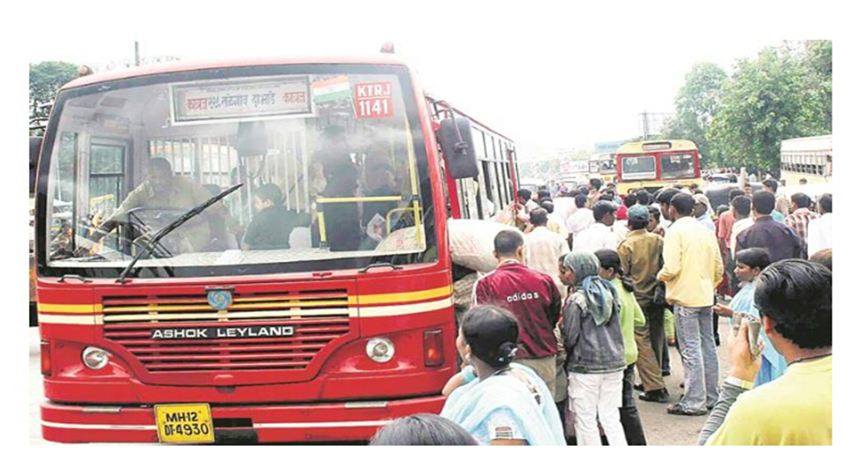
Rushed entries

Slide 5
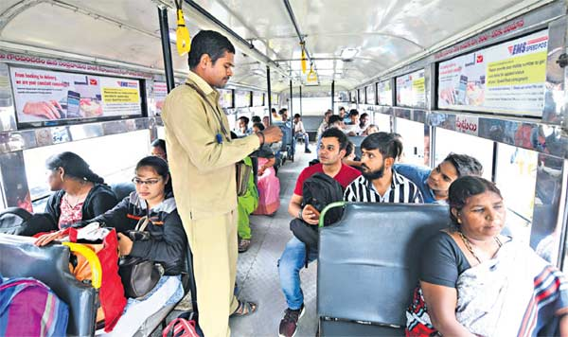
Without ticket travellers

Slide 6
Disadvantages of Old transportation buses
More crowed and there is no availability of seats
Therefore there is no guarantee for any safety and comfort.
Sometimes its dangerous for passengers.
More chances of road accidents.

Slide 7
objectives
Detects the person entered and exited .
Automatically opens and closes the entry and exit doors.
Displays the number of passenger in bus.
Detects the rain on window panels and starts the wiper to clean the glass.
Gives message of bus full if bus capacity is reached and close the gates .

Slide 8
Sensors Used
2 Infrared Sensor
3 Servo Motor
1 LED Matrix
1 Rain Drop Sensor

Slide 9
Modules
Entry gate
Exit gate
LED matrix
Glass Wiper

Slide 10
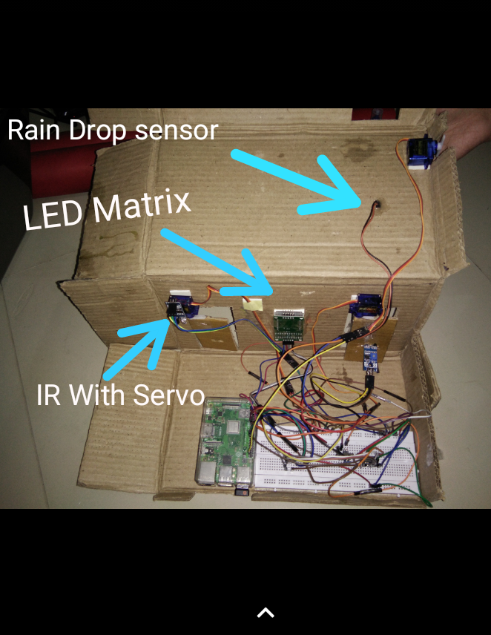
setup

Slide 11
Entry gate
If a passenger is detected at entry gate , the gate opens .
The gate remains open for specific time and then closes.
The total count of onboard passengers on bus increases according to the number of passengers entered .

Slide 12
Exit gate
If a passenger is detected at exit gate , the gate opens .
The gate remains open for specific time and then closes.
The total count of onboard passengers on bus decreases according to the number of passengers exited .

Slide 13
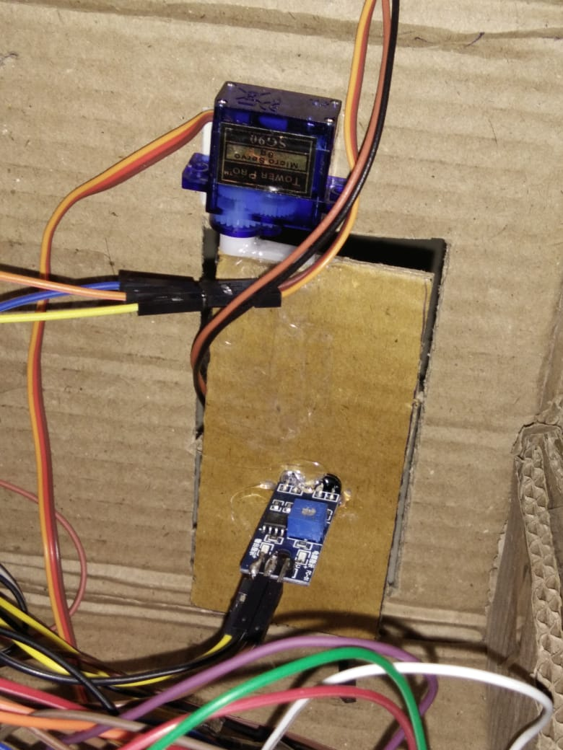
Integration of IR with servo

Slide 14
Led module
The number of passengers on board is displayed on the LED Matrix.
If the number of passengers on bus is reached to maximum seat limit , BUS FULL message is displayed on the LED Matrix .

Slide 15
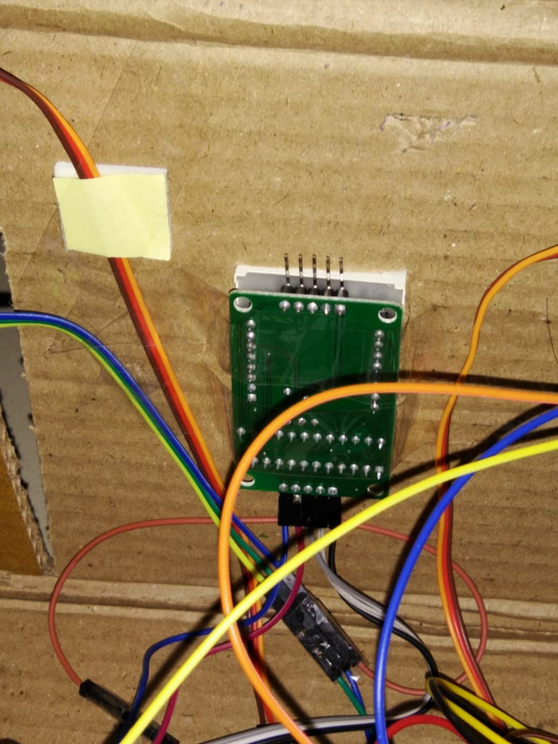
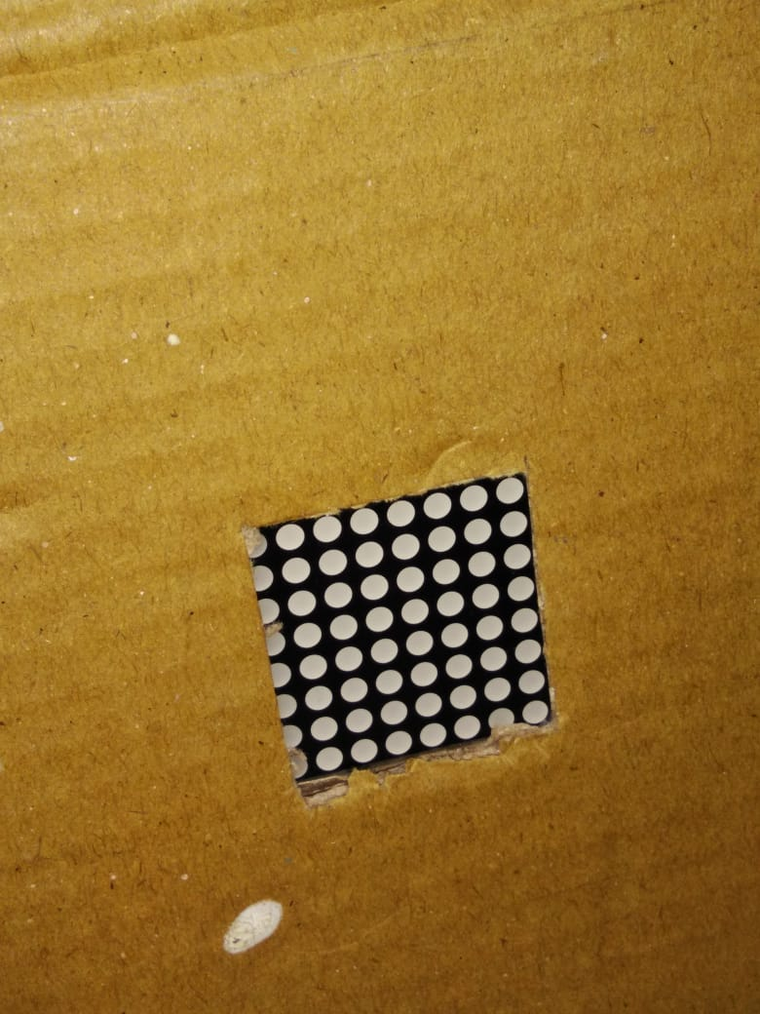
LED Matrix

Slide 16
Window wiper module
If it rains on the the rain drop sensor , the motor starts to wipe the water from the glass.
The motion of motor continues till the rain drop sensor detects rain.

Slide 17
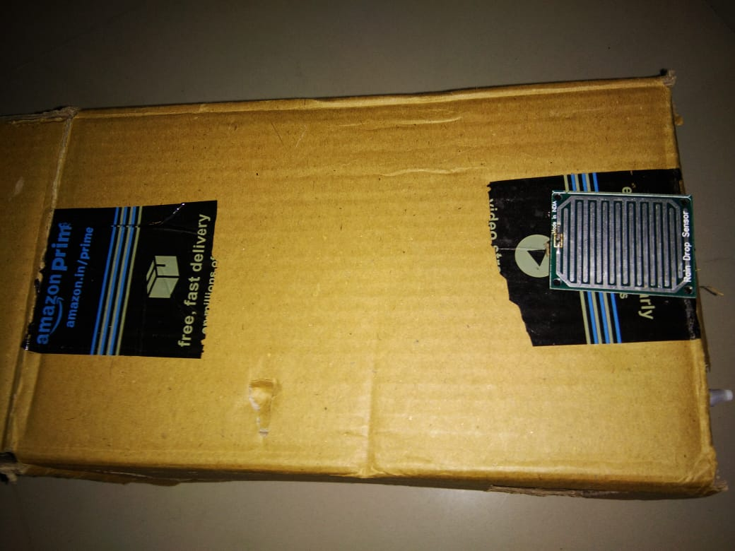
Rain drop sensor

Slide 18
Test Cases
Passengers enter continuosly.
Passenger stop at the gate.
A passenger enters and another exits at the same time.
Passenger try to enter after seat limit is reached .
Passenger try to exit from entry gate or try to enter from exit gate.

Slide 19
implementation
It can be used in government transport buses .
It can be used for School Buses.
Keeping count of on board passengers for luxury buses.
Its the Better Solution for bus transportation.

Slide 20
Thank You
.Ganesh and Krishna @Tesla Group Leaders
Pramod sir and Somesh sir
Sachin Dada and Management
Shashi sir

