Slide 1
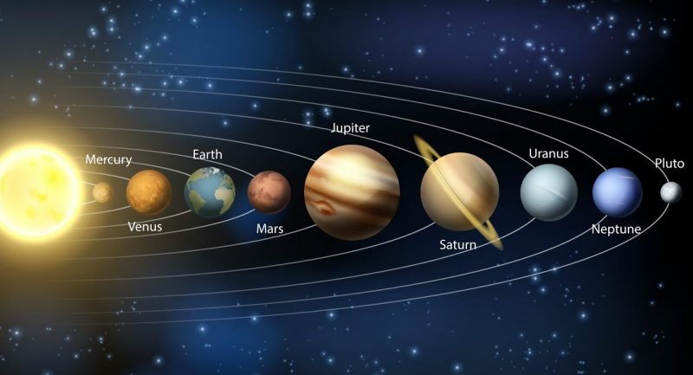
Sistema solar
Sistema solar
Sistema - Tierra - luna - Marte -
Texto falso lorem by falso lorem by falso lorem by falso lorem by falso lorem by falso lorem by falso lorem by
Tierra
Luna
Marte
Texto falso lorem by falso lorem by falso lorem by falso lorem by
Todos los izquierdos liberados ®

