Slide 1
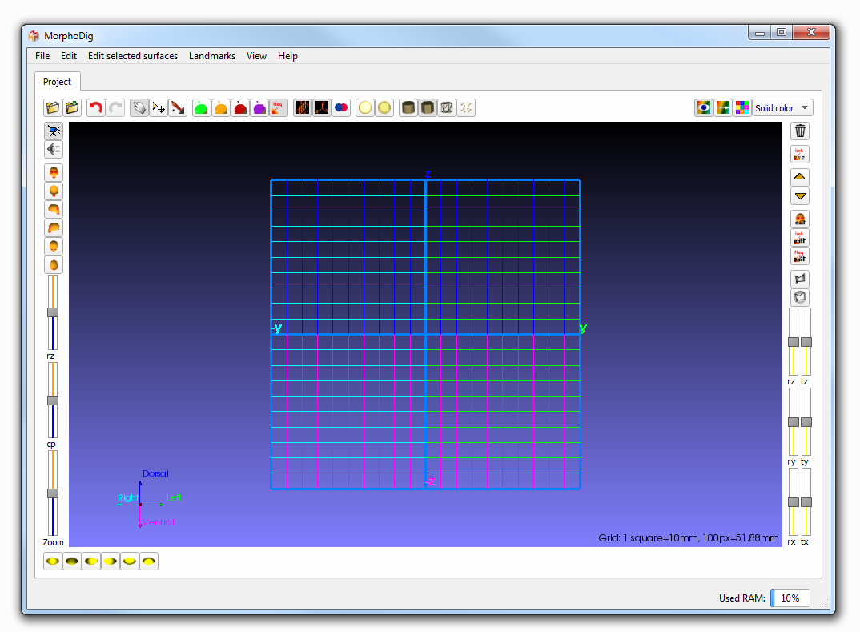
Open/save Undo redo
Interaction modes
Display controls
Array (color display) controls
Selected objects controls (unselected objects remain unchanged)
Camera controls
Light direction controls
3D window

