Slide 1

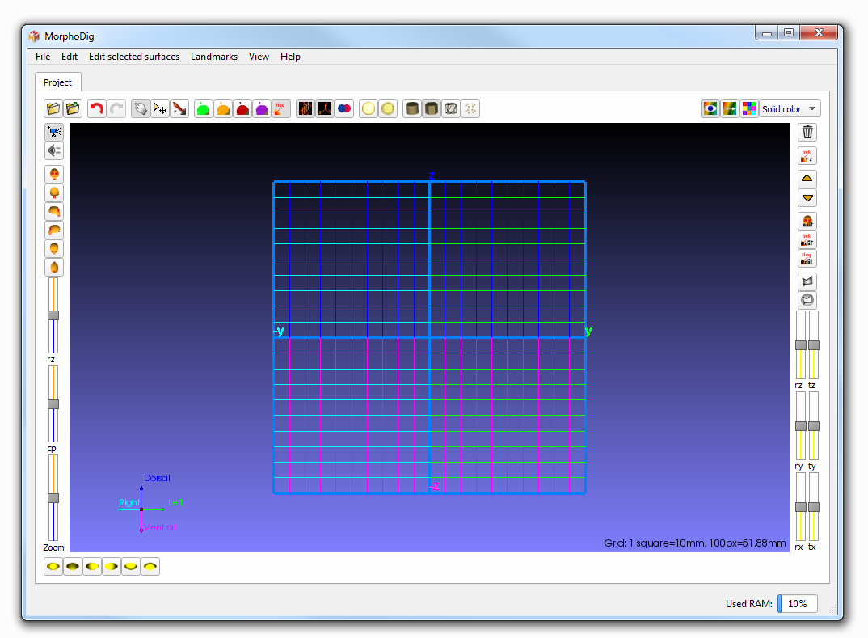
Open/save Undo redo
Interaction modes
Display controls
Drag & Drop
Array (color display) controls
Camera controls
Selected objects controls (unselected objects remain unchanged)
Light direction controls
3D window

Slide 2
Drag & Drop
(surfaces files)

