Slide 1

Creating Custom Layouts in Panels

Slide 2
What are panels?
Contrib module: https://drupal.org/project/panels
Main function
Implement a layout
Display content within that layout

Slide 3

Panels integration and support
Panels integrates with modules:
Views
Organic groups
Themes that support panels
Adaptive theme
Zen
Radix
Panels 960gs (HTML5)

Slide 4
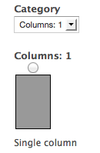
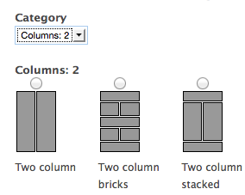
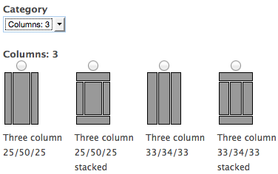
Layouts in Panels
Panels comes with a set of layouts.

Slide 5
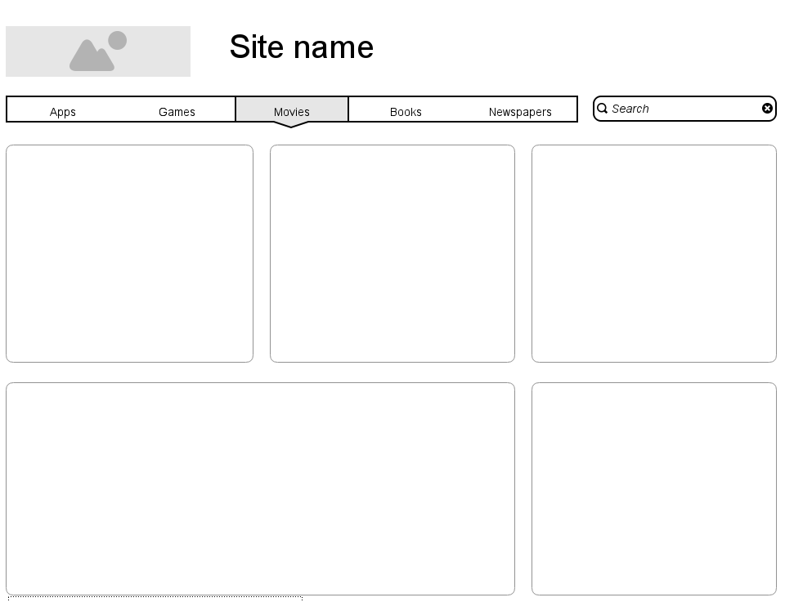
Adding a custom layout
You get homepage layout design like:

Slide 6
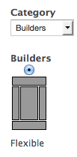
Layouts in Panels
Custom layout builder

Slide 7
Adding a custom layout
Issues with the flexible layout builder
Interface is clunky
Performance heavy
Buggy (personal experience)
Unclean HTML output
Responsive design

Slide 8

Creating a panel custom layout

Slide 9

Creating a panel custom layout

Slide 10
Creating a panel custom layout
Step 1
Download and enable panels
Step 2
Let Drupal know the location of the custom layout.
Module
Theme

Slide 11
Creating custom panel layouts
Step 3
In your custom theme’s .info add to the bottom
; Panels layouts. You can place multiple layouts under the "layouts" folder. plugins[panels][layouts] = layouts

Slide 12
Creating a panel custom layout
Step 4
Copy layout folder to your custom theme directory
Copy from panels module:
/sites/all/modules/panels/plugins/layouts/twocol
To your theme:
/sites/all/themes/custom_theme/layouts/customlayout

Slide 13
Creating a panel custom layout
Step 5
Rename all the files in the customlayout folder to the same as your layout folder.
customlayout.png - a screenshot of the layout
customlayout.css - a stylesheet for the layout
customlayout.inc – defines all the files and specifies regions
panels_customlayout.tpl.php - the template file for the layout.

Slide 14
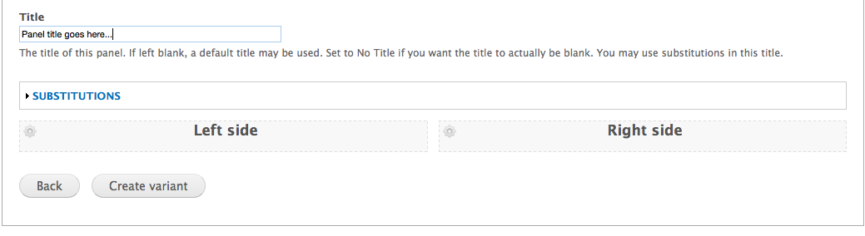
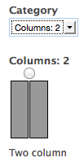
Creating a panel custom layout
Configuring .inc file
<?php
// Plugin definition
$plugin = array(
'title' => t('Two column'),
'category' => t('Columns: 2'),
'icon' => 'twocol.png',
'theme' => ’twocol',
'css' => 'twocol.css',
'regions' => array(
'left' => t('Left side'),
'right' => t('Right side')
),
);

Slide 15
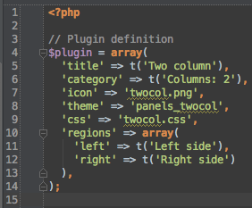
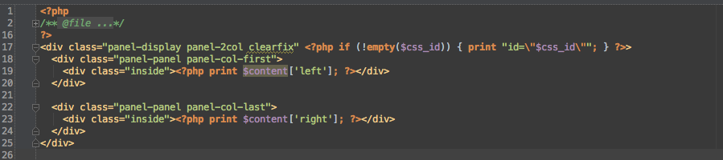
Creating a panel custom layout
Amending the template file

Slide 16
Creating a panel custom layout
Last steps…
Amend CSS files to match design
Clear cache
Resources on Panels
DrupalCon Sydney 2013 Build better websites with Panels: https://www.youtube.com/watch?v=p-9paDzHOt8
Video Tuts for Panels and Page panager

