Slide 1



Every LoB rebuilds
the same delivery stack.
OCM is the shared standard. Each LoB still ships — but on the same model.
Open Component Model — open source, NeoNephos Foundation. Stewarded by SAP.

Slide 2
Compliance and sovereignty are given.
Our strategic position is a choice.
WHY NOW
ECOSYSTEM VELOCITY IS REAL
THE WINDOW IS CLOSING
DISINVESTMENT HAS A COST
OCM-shaped abstractions are landing in adjacent OSS projects. NeoNephos is operationalizing. The peer ecosystem (Gardener, Kyma, OpenControlPlane, Konfidence, Hyperspace, RBSC, CSI) shares the primitive.
Adoption is consolidating. NeoNephos governance, CRA enforcement, sovereign-cloud market formation — the rails are being laid now. Late entrants pay migration cost; early stewards keep optionality.
Walking away costs more than staying. Each LoB that builds its own retrofit pays the cost OCM was supposed to amortize. Competitors who keep investing get the standard built around their preferences. SAP doesn't.

Slide 3
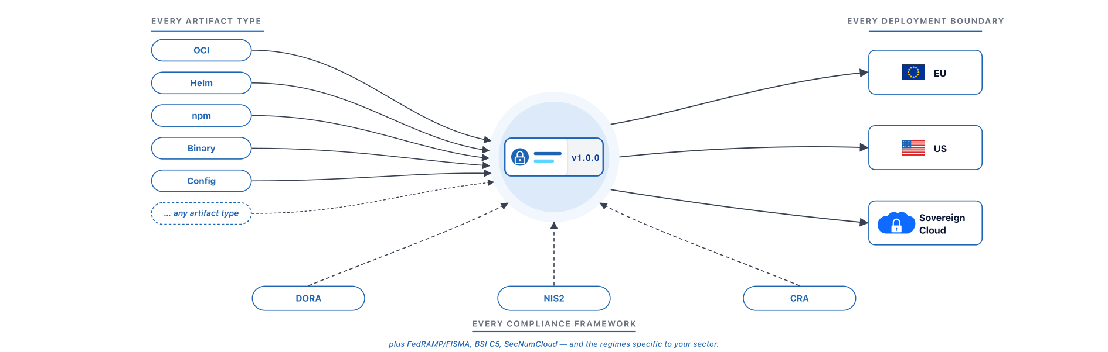
Meet OCM. One identity, every boundary.
THE ANSWER

Slide 4
SBOM lists. SBOD delivers.
THE SHIFT
▪ An SBOM tells you what's in your software. It was built for inventory.
▪ A Software Bill of Delivery (SBOD) tells you what you delivered, how to verify, transport, and operate it. It was built for delivery.
▪ The SBOD contains the SBOM. OCM doesn't replace your SBOM tooling — it gives the SBOM an envelope that's compliance-native, signed once, and travels intact across any boundary.
▪ SBOD is the category SAP led the definition of — now standardised through NeoNephos governance.

Slide 5
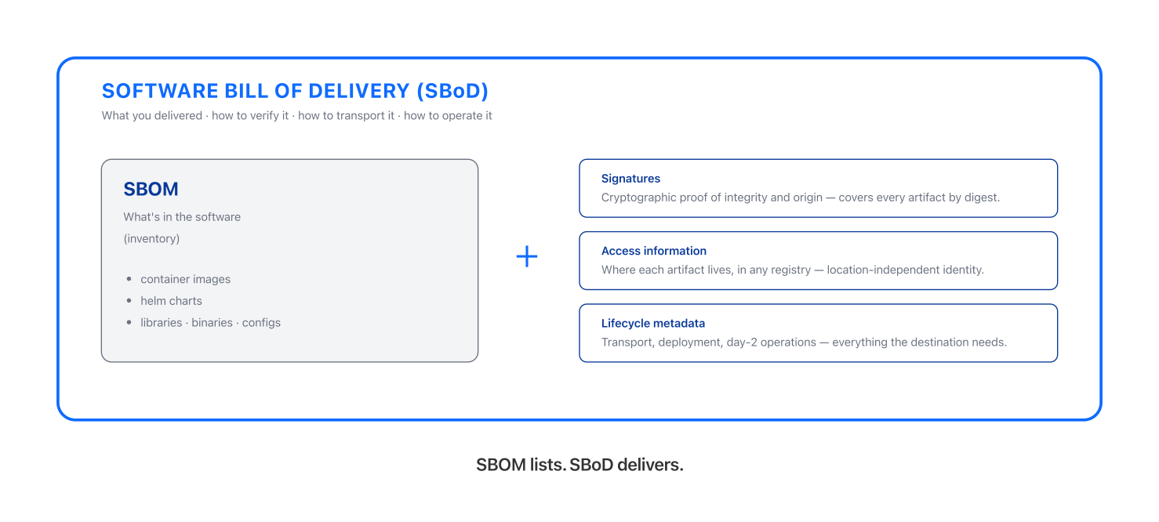
An envelope, not a list.
THE SHIFT — SBOM INSIDE SBOD

Slide 6
OCM doesn't replace your tools. It gives them an envelope to compose around.
HOW OCM COMPOSES
SIGNING
TRANSPORT
COMPLIANCE
Keyless (Sigstore) or key-based (your PKI) signs one artifact at a time. OCM gives them the complete SBOD to sign — one signature covers every artifact in the delivery, by digest.
S3, OCI and Helm registries — each stores artifacts differently. OCM transports a signed envelope of artifacts across any boundary: registry to registry, registry to air-gapped archive. The signature travels intact.
Trivy, Grype, your SBOM tools — each scans in isolation. OCM (via Open Delivery Gear) correlates every finding by component identity. Compliance is a system output, not a quarterly project.

Slide 7
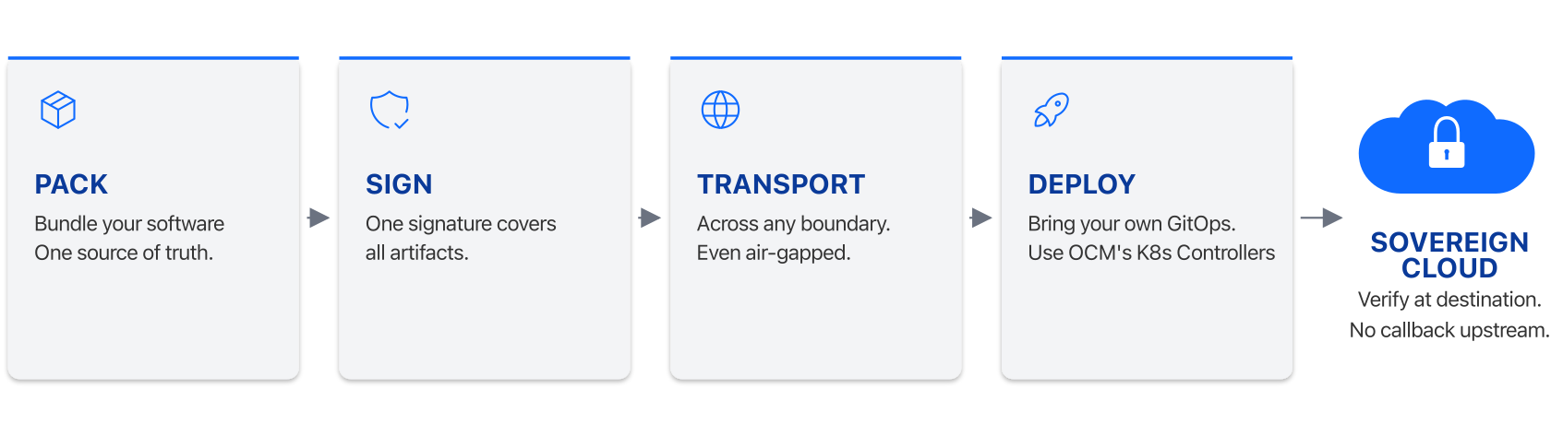
Pack · Sign · Transport · Deploy
OCM IN ONE PICTURE

Slide 8
Trust, but verify.
SOVEREIGN-READY
▪ Identity is location-independent. A component carries its name regardless where it lives.
▪ Signatures are location-independent. Sign once at source, verify at all hops up to the destination. No callback upstream.
▪ Day-2 ops happen inside the boundary. Subscribe to a component and pull upgrades when needed. Again, no callback upstream.
▪ On transfer into a sovereign environment, a component can carry every artifact it needs along with it. Completely self-contained.

Slide 9
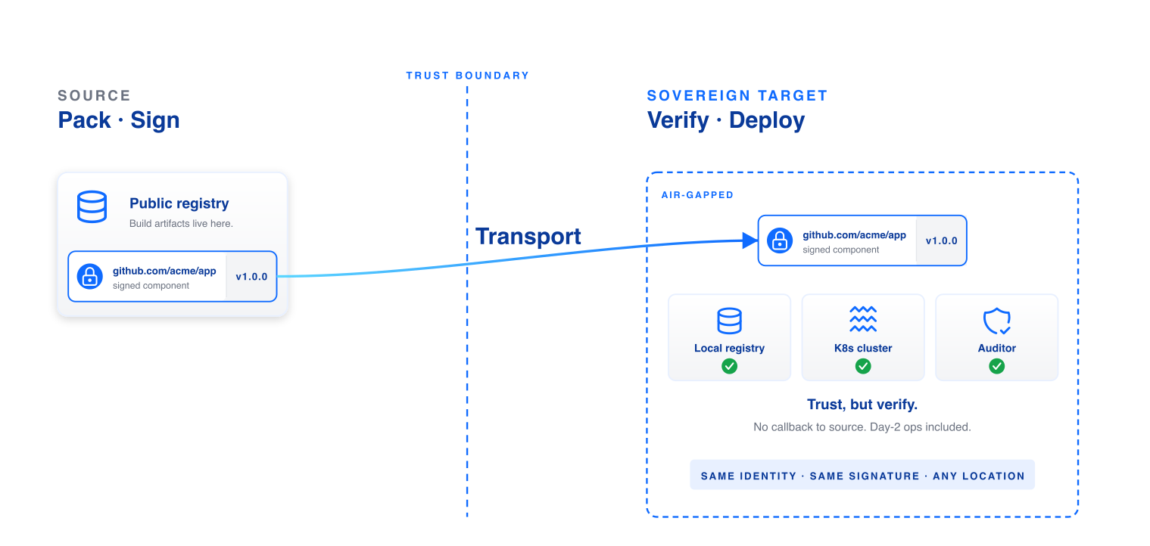
Trust travels with the component.
SOVEREIGN-READY — AIR-GAP

Slide 10
Compliance as a system property —
not a quarterly retrofit.
SCAN — COMPLIANCE-NATIVE WITH OPEN DELIVERY GEAR
▪ Open Delivery Gear (ODG) is the OCM compliance automation engine.
▪ The Compliance Dashboard is your entry point: every component, every finding in one view.
▪ Continuous scans run asynchronously — even after release.
▪ Findings get rescored against contextual risk. Your team only patches what actually matters.
▪ Every compliance signal correlates by component identity. Auditors get evidence, not spreadsheets.

Slide 11






Six outcomes from one shared primitive.
WHAT OCM UNLOCKS FOR SAP
Faster sovereign delivery
Compliance leverage across LoBs
Integration after acquisition
Pack once, ship everywhere.
Sovereign Cloud for all products.
Report from one shared primitive —
ODG correlates all findings.
Let's be efficient:
Delivery schemes converge on one mechanism.
Cross-LoB security correlation
One source of truth
Ecosystem stewardship
Blast radius is one query —
answered via the OCM coordinate system.
One signed descriptor per delivery.
Rebuild any landscape easily.
SAP investment compounds with
the open-peer ecosystem.

Slide 12





Peer in the open ecosystem.
WHERE OCM IS SHIPPING — OPEN ECOSYSTEM
Gardener
Kyma
OpenControlPlane
Konfidence
Aligned with
NeoNephos

Slide 13
Backbone of internal SAP delivery.
WHERE OCM IS SHIPPING — SAP
▪ Hyperspace — hosts the internal Dev Portal, lifecycle processes, and delivery of SAP products.
▪ Release-Based Shipment Channel (RBSC) — SAP delivery infrastructure for customer shipments.
▪ Common Service Infrastructure (CSI) — the largest internal-services footprint shared across SAP.
▪ Steampunk — SAP BTP PaaS for ABAP Development.
▪ Greenhouse — Cloud operations platform designed to streamline the management of distributed infrastructure.

Slide 14
Sponsor. Scale. Standardize.
Sponsor — Allocate engineering capacity to OCM stewardship in your LoB.
Scale — Pack one regulated component delivery as an OCM component this quarter.
Standardize — Bring your LoB into the OCM steering conversation — SAP Slack #sap-tech-ocm.

Slide 15
Quick reference for the acronyms used in this deck.
APPENDIX — ABBREVIATIONS
BSI C5 — Bundesamt für Sicherheit in der Informationstechnik — Cloud Computing Compliance Criteria Catalogue.
BTP — SAP Business Technology Platform.
CRA — Cyber Resilience Act — EU regulation on cybersecurity for products with digital elements.
DORA — Digital Operational Resilience Act — EU regulation for ICT risk in financial services.
FedRAMP — Federal Risk and Authorization Management Program — US standardised cloud security assessment.
FISMA — Federal Information Security Modernization Act — US federal information security mandate.
Grype — Open-source vulnerability scanner for container images and filesystems (Anchore).
Helm — Package manager for Kubernetes; reference artifact type for OCM.
LoB — Line of Business — SAP organisational unit owning a product portfolio.
NeoNephos — European foundation for sovereign cloud open-source projects, hosted under the Linux Foundation.
NIS2 — Network and Information Security Directive 2 — EU baseline for cybersecurity of essential entities.
OCI — Open Container Initiative — open standards for container image format and distribution.
OCM — Open Component Model — vendor-neutral specification for signed, transportable software components.
ODG — Open Delivery Gear — OCM-native compliance automation engine and dashboard.
OSS — Open Source Software.
PKI — Public Key Infrastructure — framework for managing certificates and signing keys.
SBOD — Software Bill of Delivery — the OCM component descriptor, signed and traceable. Containing all artifacts and metadata for delivery and deployment.
SBOM — Software Bill of Materials — inventory of components and dependencies inside a software artifact.
SecNumCloud — French cloud security qualification scheme operated by ANSSI.
Sigstore — Open-source project for keyless software signing using OIDC identities.
SPDX — Software Package Data Exchange — ISO/IEC 5962 standard format for SBOM data.
SWID — Software Identification Tags — ISO/IEC 19770-2 standard for software inventory.
Trivy — Open-source security scanner for containers, IaC, and code (Aqua Security).

Slide 16
Logos and trademarks belong to their respective owners.
TRADEMARK & LICENSE NOTICES (1/2)
▪ SAP, SAP NS2 — trademarks of SAP SE / SAP National Security Services. Editorial use only; no endorsement implied. sap.com · sapns2.com
▪ BWI — trademark of BWI GmbH (Bundeswehr-IT). Editorial use of the Wikimedia public-domain wordmark; verify against BWI press conditions before external publication. bwi.de
▪ Gardener, Platform Mesh, NeoNephos Foundation — Linux Foundation Europe artwork; usage governed by the Linux Foundation trademark usage guidelines (linuxfoundation.org/legal/trademark-usage). gardener.cloud · platform-mesh.io · neonephos.org
▪ Konfidence — SAP-supported open project; logo from konfidence.cloud. Editorial use only; verify with the Konfidence project before external publication. konfidence.cloud
▪ OpenControlPlane — open-source project at open-control-plane.io. Editorial use only; verify with the project before external publication. open-control-plane.io

Slide 17
Third-party trademarks named for technical reference.
TRADEMARK & LICENSE NOTICES (2/2)
▪ Kyma — SAP-originated open-source project at kyma-project.io. Editorial use only. kyma-project.io
▪ Hyperspace, RBSC, CSI, Greenhouse, Steampunk — internal SAP delivery infrastructure named for context; not third-party marks.
▪ Trivy, Grype, Sigstore, Helm, OCI, Kubernetes, kro, Flux, Argo CD — third-party trademarks named for technical reference; ownership remains with their respective projects and organisations.

