Slide 1



Your supply chain has
blind spots.
Three minutes from now, you'll know what they are.
Open Component Model — open source, NeoNephos Foundation.

Slide 2
Sovereignty is no longer optional
WHY NOW
SOVEREIGNTY PRESSURE
REGULATION TIGHTENING
SUPPLY-CHAIN ATTACKS ARE REAL
Wherever the law puts the boundary — by jurisdiction, sector, or air-gap — software must be deliverable, verifiable, and operable inside it.
EU DORA · NIS2 · CRA. Provable supply-chain control, not best effort.
SolarWinds. xz. log4shell. Signatures must survive the journey, or compliance is theatre.

Slide 3
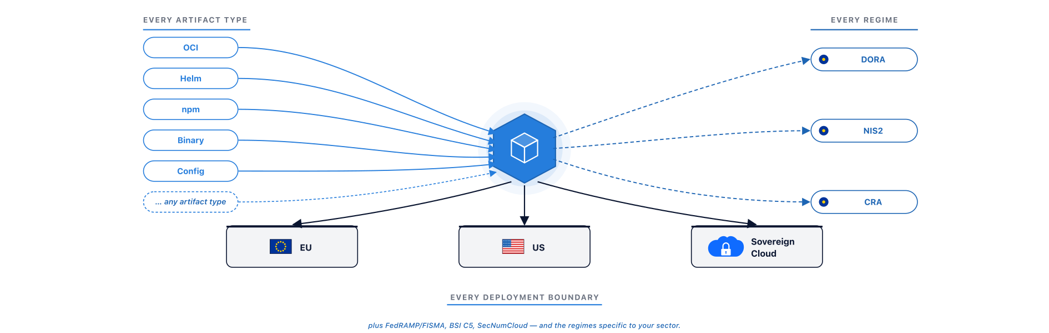
Meet OCM. One identity, every boundary.
THE ANSWER

Slide 4
SBOM lists. SBoD delivers.
THE SHIFT
▪ An SBOM tells you what's in your software. It was built for inventory.
▪ A Software Bill of Delivery (SBoD) tells you what you delivered, how to verify it, how to transport it, and how to operate it. It was built for delivery.
▪ The SBoD contains the SBOM. OCM doesn't replace your SBOM tooling — it gives the SBOM an envelope that's compliance-native, signed once, and travels intact across any boundary.

Slide 5
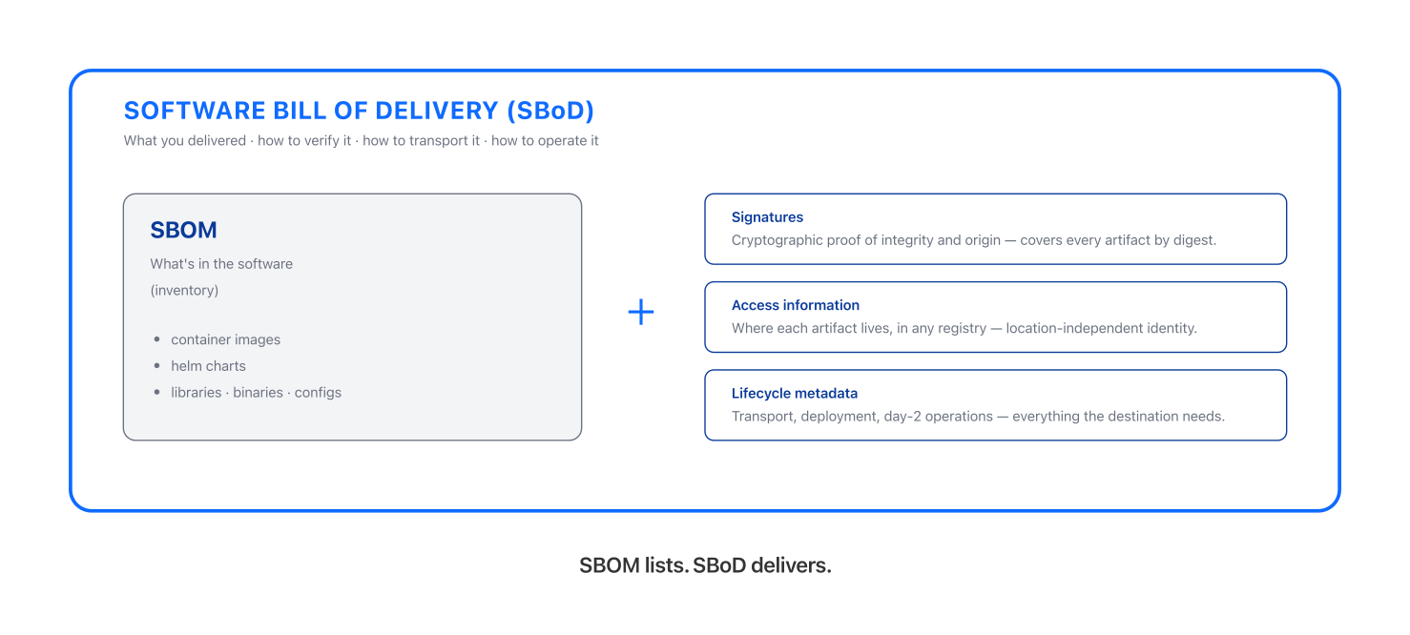
An envelope, not a list.
THE SHIFT — SBOM INSIDE SBoD

Slide 6
OCM doesn't replace your tools. It gives them an envelope to compose around.
HOW OCM COMPOSES
SIGNING
TRANSPORT
COMPLIANCE
Keyless (Sigstore) or key-based (your PKI) signs one artifact at a time. OCM gives them the complete SBoD to sign — one signature covers every artifact in the delivery, by digest.
Helm registries, S3, OCI — each moves artifacts. OCM moves a signed envelope across any boundary: registry to registry, registry to air-gapped archive. The signature travels intact.
Trivy, Grype, your SBOM tools — each scans in isolation. OCM (via Open Delivery Gear) correlates every finding by component identity. Compliance is a system output, not a quarterly project.

Slide 7
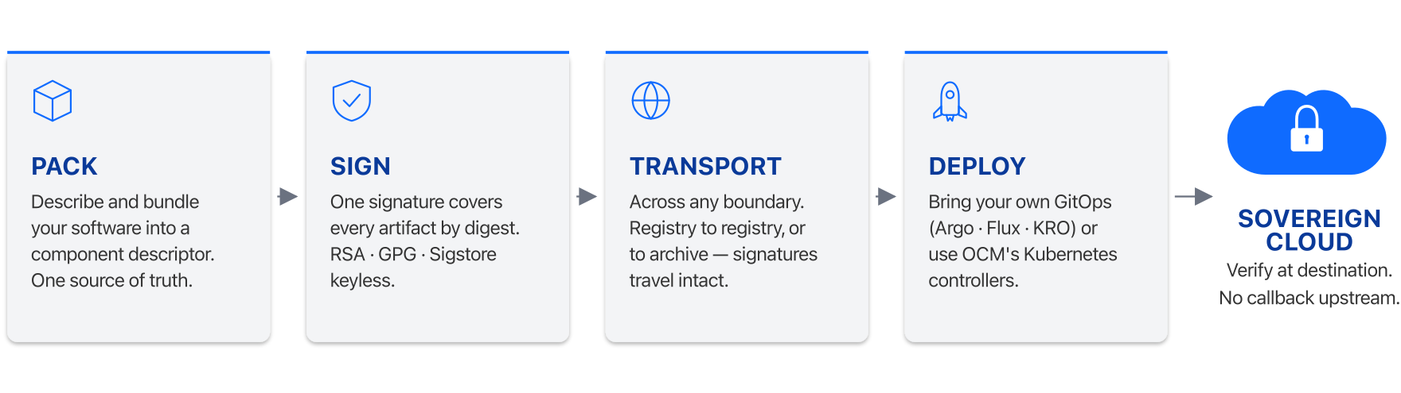
Pack · Sign · Transport · Deploy
OCM IN ONE PICTURE

Slide 8
Trust, but verify.
SOVEREIGN-READY
▪ Identity is location-independent. A component carries its name regardless of which registry it lives in.
▪ Signatures are location-independent. Sign once at source; verify at the destination, or at any hop in between, with no callback upstream.
▪ Day-2 ops happen inside the boundary. Subscribe to the component and pull upgrades on your schedule, scale across regions, all without reaching back upstream.
▪ On transfer into a sovereign environment, a component can carry every artifact it needs along with it. The destination needs nothing more.

Slide 9
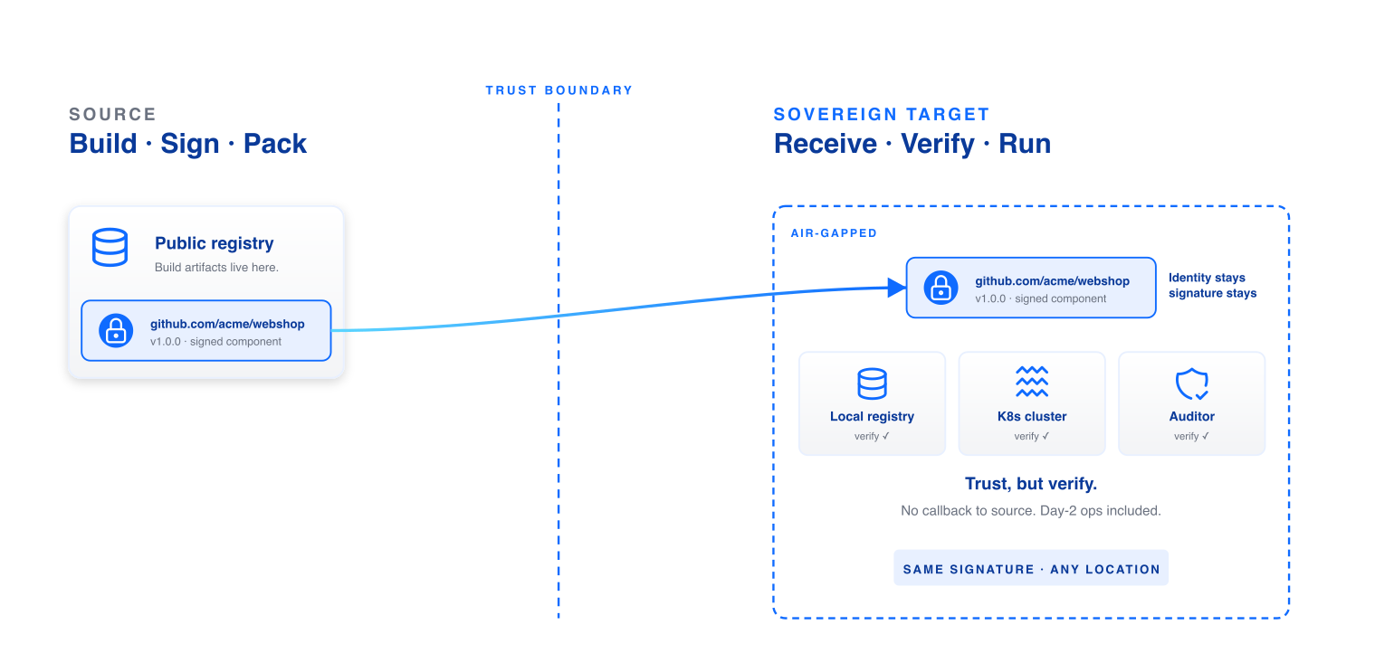
Trust travels with the component.
SOVEREIGN-READY — AIR-GAP

Slide 10
Compliance as a system property —
not a quarterly retrofit.
SCAN — COMPLIANCE-NATIVE WITH OPEN DELIVERY GEAR
▪ Open Delivery Gear (ODG) is the OCM compliance automation engine.
▪ The Compliance Dashboard is your entry point: every component, every finding, every signature in one view.
▪ Continuous scans run asynchronously — even after release.
▪ Findings get rescored against contextual risk, so your team patches what actually matters.
▪ Every compliance signal correlates by component identity. Auditors get evidence, not spreadsheets.

Slide 11






One model unlocks all of this.
WHAT OCM UNLOCKS
Code signing across stacks
Air-gapped delivery
Kubernetes-native deployment
Sign once at source; verify everywhere, with no per-stack tooling.
Walk a complete component across an air gap; verify at destination.
OCM controllers deploy components directly into clusters.
Asynchronous security scans
One source of truth
Automated compliance reporting
Continuous scanning, even after release; findings tied to component identity.
Rebuild any landscape from a single signed descriptor.
Reports composed from SBoD metadata — no spreadsheet drift.

Slide 12




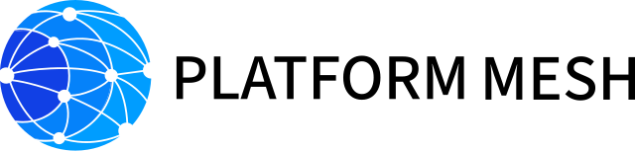
Aligned with NeoNephos.
TRUSTED IN PRODUCTION
ADOPTED BY ENTERPRISES SHIPPING INTO REGULATED ENVIRONMENTS
BUILT INTO THE OPEN-SOURCE ECOSYSTEM
An open standard, neutrally governed — your stack stays portable, your dependencies stay yours.

Slide 13
Start delivering with confidence.
Try it — ocm.software
Build with us — github.com/open-component-model
Talk to us — community channels on the website

