Slide 1



Every LoB rebuilds
the same delivery stack.
OCM is the shared standard. Each LoB still ships — but on the same model.
Open Component Model — open source, NeoNephos Foundation. Stewarded by SAP.

Slide 2
Compliance and sovereignty are given. The strategic position is not.
WHY NOW — INTERNAL
ECOSYSTEM VELOCITY IS REAL
THE WINDOW IS CLOSING
DISINVESTMENT HAS A COST
OCM-shaped abstractions are landing in adjacent OSS projects. NeoNephos is operationalizing. The peer ecosystem (Gardener, Kyma, Konfidence, OCP, Hyperspace, RBSC, CSI) shares the primitive.
Adoption is consolidating. NeoNephos governance, CRA enforcement, sovereign-cloud market formation — the rails are being laid now. Late entrants pay migration cost; early stewards keep optionality.
Walking away costs more than staying. Each LoB that builds its own retrofit pays the cost OCM was supposed to amortize. Competitors who keep investing get the standard built around their preferences. SAP doesn't.

Slide 3
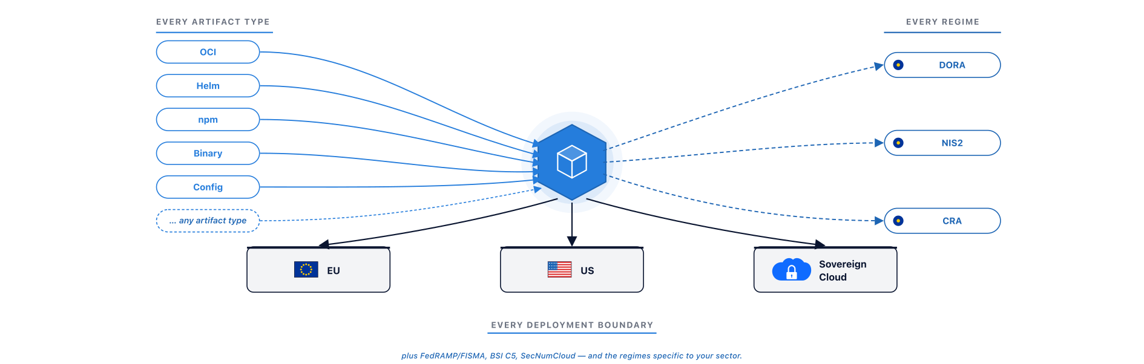
Meet OCM. One identity, every boundary.
THE ANSWER

Slide 4
SBOM lists. SBoD delivers.
THE SHIFT
▪ An SBOM tells you what's in your software. It was built for inventory.
▪ A Software Bill of Delivery (SBoD) tells you what you delivered, how to verify it, how to transport it, and how to operate it. It was built for delivery.
▪ The SBoD contains the SBOM. OCM doesn't replace your SBOM tooling — it gives the SBOM an envelope that's compliance-native, signed once, and travels intact across any boundary.
▪ SBoD is the category SAP led the definition of — now standardised through NeoNephos governance.

Slide 5
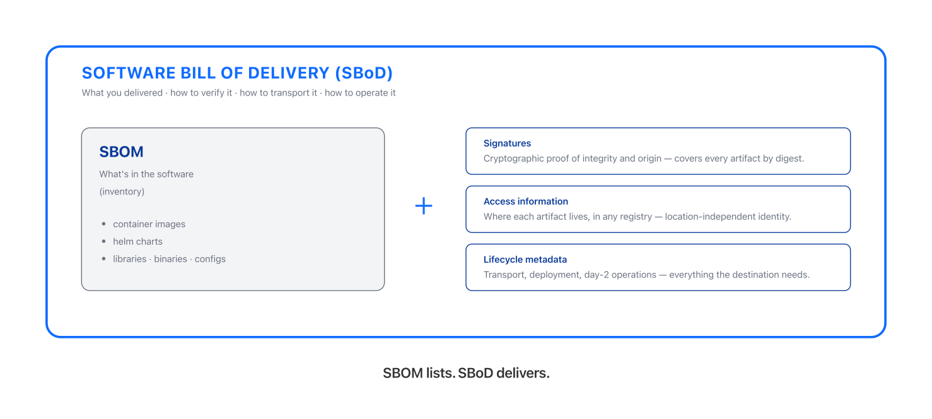
An envelope, not a list.
THE SHIFT — SBOM INSIDE SBoD

Slide 6
OCM doesn't replace your tools. It gives them an envelope to compose around.
HOW OCM COMPOSES
SIGNING
TRANSPORT
COMPLIANCE
Keyless (Sigstore) or key-based (your PKI) signs one artifact at a time. OCM gives them the complete SBoD to sign — one signature covers every artifact in the delivery, by digest.
Helm registries, S3, OCI — each moves artifacts. OCM moves a signed envelope across any boundary: registry to registry, registry to air-gapped archive. The signature travels intact.
Trivy, Grype, your SBOM tools — each scans in isolation. OCM (via Open Delivery Gear) correlates every finding by component identity. Compliance is a system output, not a quarterly project.

Slide 7
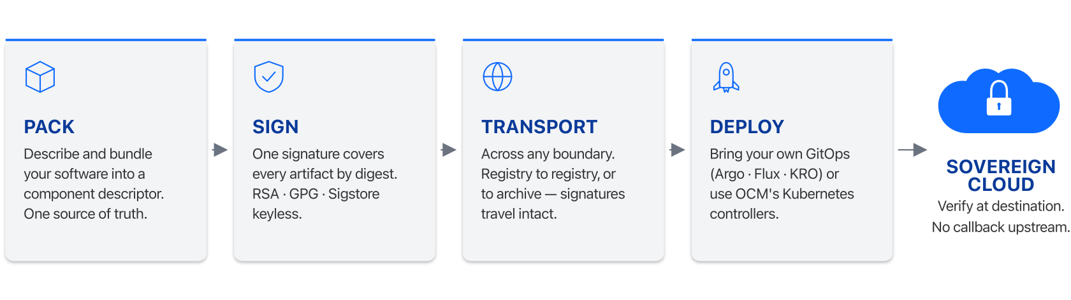
Pack · Sign · Transport · Deploy
OCM IN ONE PICTURE

Slide 8
Trust, but verify.
SOVEREIGN-READY
▪ Identity is location-independent. A component carries its name regardless of which registry it lives in.
▪ Signatures are location-independent. Sign once at source; verify at the destination, or at any hop in between, with no callback upstream.
▪ Day-2 ops happen inside the boundary. Subscribe to the component and pull upgrades on your schedule, scale across regions, all without reaching back upstream.
▪ On transfer into a sovereign environment, a component can carry every artifact it needs along with it. The destination needs nothing more.

Slide 9
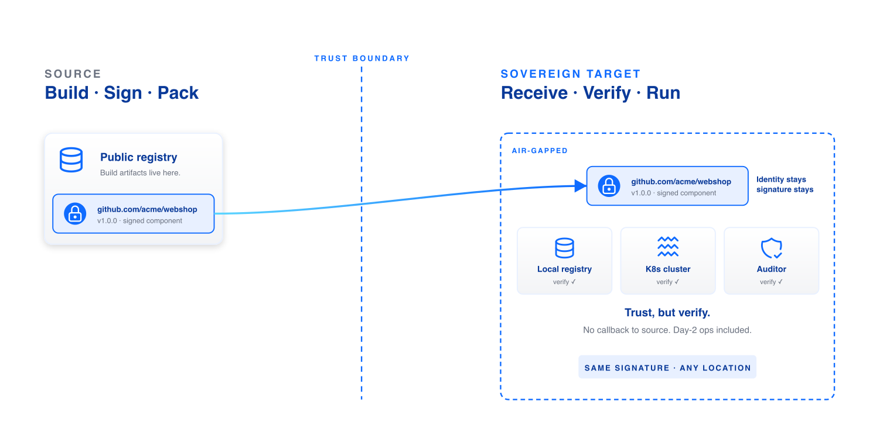
Trust travels with the component.
SOVEREIGN-READY — AIR-GAP

Slide 10
Compliance as a system property —
not a quarterly retrofit.
SCAN — COMPLIANCE-NATIVE WITH OPEN DELIVERY GEAR
▪ Open Delivery Gear (ODG) is the OCM compliance automation engine.
▪ The Compliance Dashboard is your entry point: every component, every finding, every signature in one view.
▪ Continuous scans run asynchronously — even after release.
▪ Findings get rescored against contextual risk, so your team patches what actually matters.
▪ Every compliance signal correlates by component identity. Auditors get evidence, not spreadsheets.
▪ Every SAP LoB gets compliance correlation by component identity, without each LoB building its own retrofit.

Slide 11






Six outcomes from one shared primitive.
WHAT OCM UNLOCKS FOR SAP
Faster sovereign delivery
Compliance leverage across LoBs
Integration after acquisition
Pack a complete component once. From source into a regulated sovereign environment — every operator, every region, every air-gap.
Each LoB gets DORA-aligned reporting from one shared primitive — not built N times.
Acquired teams' signing schemes converge on one mechanism. The retire-list shrinks every quarter.
Cross-LoB security correlation
One source of truth
Ecosystem stewardship
An incident's blast radius is one query — “which deployments contain OCM component X?” — across every LoB on OCM.
One signed descriptor per delivery. Rebuild any landscape. Audit prep is composition, not archaeology.
SAP investment in OCM compounds with the open-peer ecosystem (Gardener, Konfidence, OCP, NeoNephos).

Slide 12
Peer in the open ecosystem.
WHERE OCM IS SHIPPING — OPEN ECOSYSTEM
▪ Gardener — Kubernetes-as-a-service, open ecosystem.
▪ Kyma — SAP-originated open-source Kubernetes-based runtime.
▪ Konfidence — a development and delivery framework (SAP-originated, now open source).
▪ Open Control Plane (OCP) — a platform that lets you create and manage Kubernetes-based ControlPlanes for your teams.
▪ And forthcoming: every NeoNephos foundation project as it lands.

Slide 13
Backbone of internal SAP delivery.
WHERE OCM IS SHIPPING — INTERNAL SAP
▪ Hyperspace — hosts the internal Dev Portal, lifecycle processes, and the shipment / delivery of SAP products. Direct OCM consumer.
▪ Release-Based Shipment Channel (RBSC) — internal SAP delivery infrastructure converging on OCM.
▪ Common Service Infrastructure (CSI) — the largest internal-services footprint shared across SAP.
▪ Greenhouse — a cloud operations platform that streamlines management of large-scale, distributed infrastructure.
▪ Steampunk — internal name for SAP BTP ABAP Environment (PaaS within SAP BTP); large user of OCM and ODG.
Stewardship is leverage. Disinvestment forfeits it. The window for shaping the open standard for regulated delivery is closing — what compounds for SAP today migrates elsewhere if we step back.

Slide 14
Sponsor. Scale. Standardize.
Sponsor — Allocate engineering capacity to OCM stewardship in your LoB.
Scale — Pack one regulated component delivery as an OCM component this quarter.
Standardize — Bring your LoB into the OCM steering conversation — SAP Slack #sap-tech-ocm.

