Slide 1
The Curious Case of Convexity Confusion
Project Zero Post By: Ivan Fratric
Report By: Hui Zhou & Nicole Morris

Slide 2
An Open Source graphics library
https://en.wikipedia.org/wiki/Skia_Graphics_Engine

Slide 3
Sponsored/managed by Google
Used by:
Chrome
Firefox
Android
And more…
https://en.wikipedia.org/wiki/Skia_Graphics_Engine

Slide 4
Exploiting ?
Creating a buffer overflow while drawing shapes
2 key details
Classify concave as convex
Make it non y- monotone
https://en.wikipedia.org/wiki/Skia_Graphics_Engine

Slide 5
“geometry for exploit writers”
What you need to know in order to exploit skia’s code

Slide 6
Geometry Background
Convex
Concave
Lines between points are all inside the polygon
At least one line between points is outside the polygon

Slide 7
More Geometry Background
X-Monotone
Y-Monotone
Every vertical line intersects at most 2x
Every horizontal line intersects at most 2x

Slide 8
More Geometry Background
Monotone
Not Monotone

Slide 9
IMPORTANT DETAIL:
CONVEX SHAPES MUST BE BOTH X- & Y- MONOTONE
X-MONOTONE
Y-MONOTONE

Slide 10
Exploiting
Classify concave as convex
=
concave
convex
https://en.wikipedia.org/wiki/Skia_Graphics_Engine

Slide 11
Classification checks
Check the direction of turns in the path
Confirm monotonicity
https://en.wikipedia.org/wiki/Skia_Graphics_Engine

Slide 12
Classification Check 1: check the direction of turns in the path
Convex
Concave
Always same turn directions (all right or all left turns)
Mix of turn directions (some right, some left)
L
L
L
L
L
L

Slide 13
Classification Check 1: check the direction of turns in the path
Convex
Concave
Always same turn directions (all right or all left turns)
Mix of turn directions (some right, some left)
R
R
R
L
R
R
R
R

Slide 14
Tricking check 1…
Classification checks
Make the concavity tiny
If x-y < ~3.74e-23, COMPLETELY ignore it.
R
R
Concave
R
tiny = ignored
Classified as convex
L
R
R
R
R
R
https://en.wikipedia.org/wiki/Skia_Graphics_Engine

Slide 15
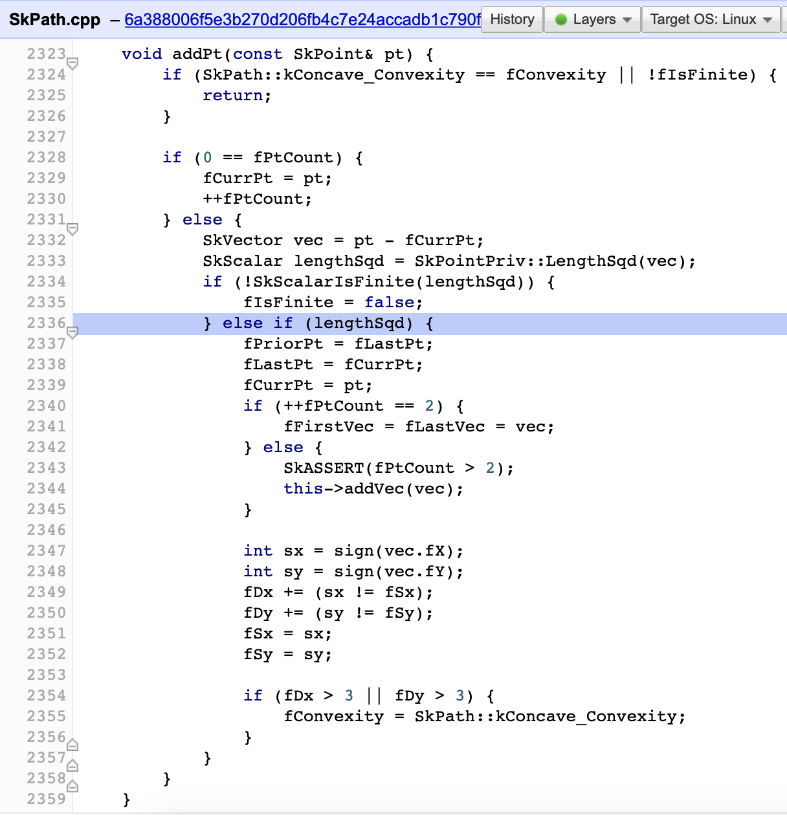

Slide 16
Classification checks
Check the direction of turns in the path
Confirm monotonicity
We only have to trick check 2 if x-y > ~3.74e-23
https://en.wikipedia.org/wiki/Skia_Graphics_Engine

Slide 17
NOT SAFE
Now we have a concave shape acting like a convex shape
will now use
convex functions
to draw a
concave shape
https://en.wikipedia.org/wiki/Skia_Graphics_Engine

Slide 18
Exploiting
Make it non y- monotone
Non Y-monotone
X- & y-
monotone
https://en.wikipedia.org/wiki/Skia_Graphics_Engine

Slide 19
Exploiting ?
Creating a buffer overflow while drawing shapes
Causing the
Buffer overflow
https://en.wikipedia.org/wiki/Skia_Graphics_Engine

