Slide 1

Silence the stigma, not the conversation

Slide 2
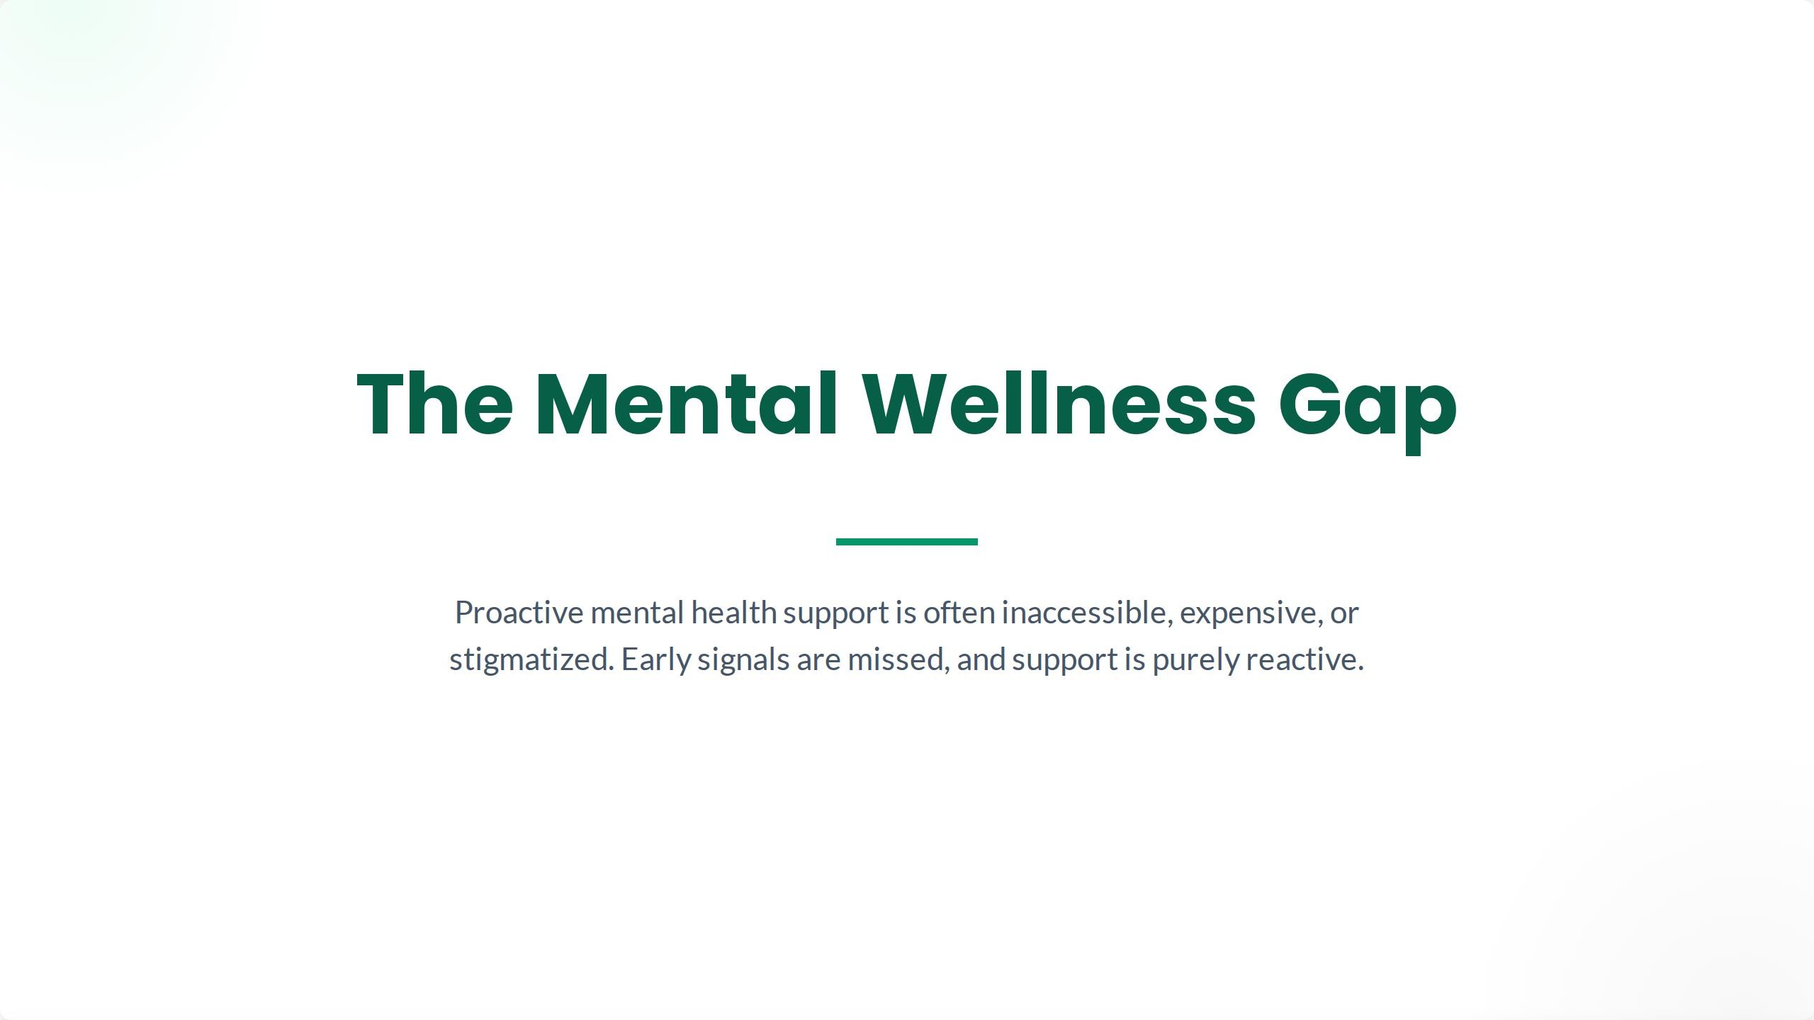

Slide 3
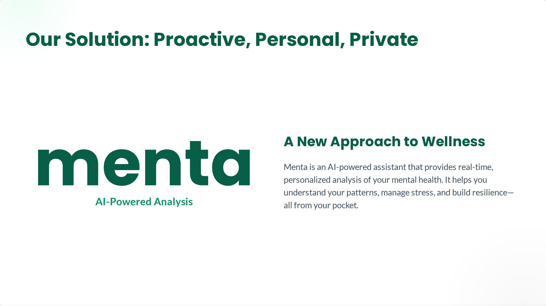
Menta provides real-time, personalized analysis of your mental health. It helps you understand your patterns, manage stress, and build resilience—all at your own comfort.

Slide 4
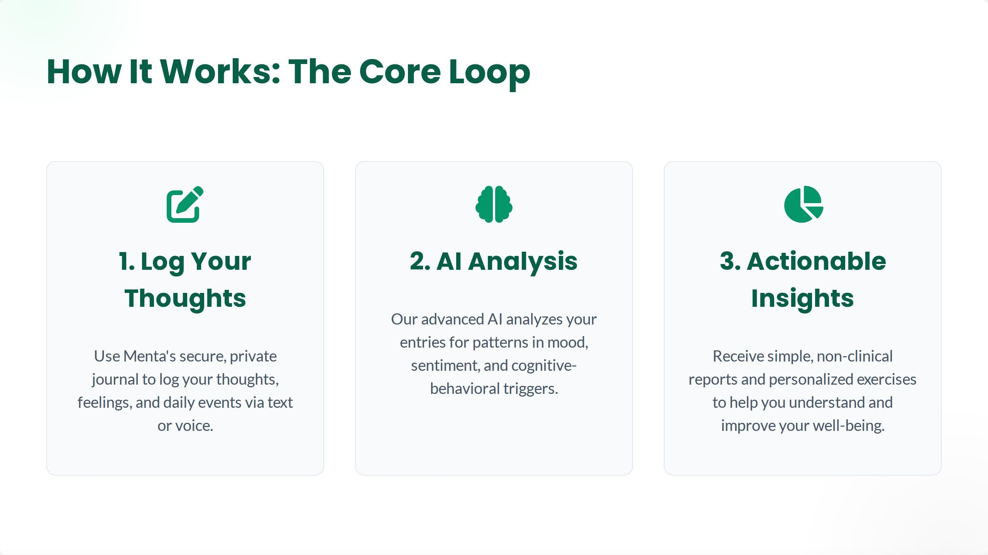

Slide 5
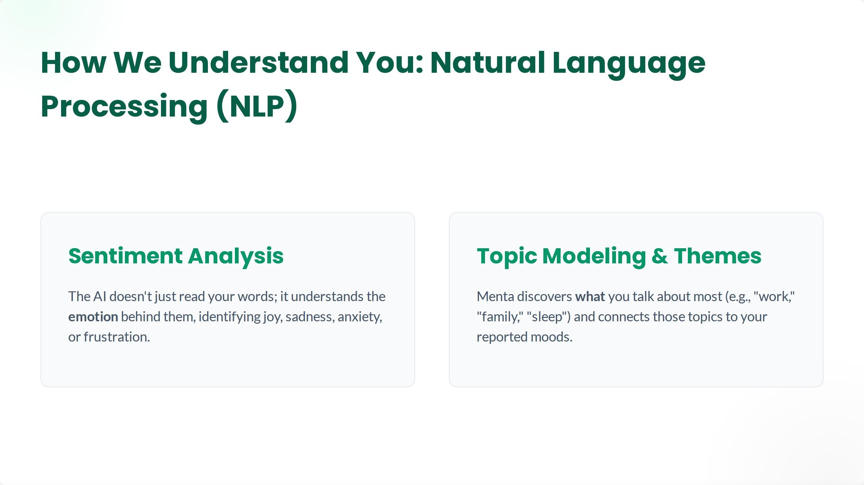

Slide 6
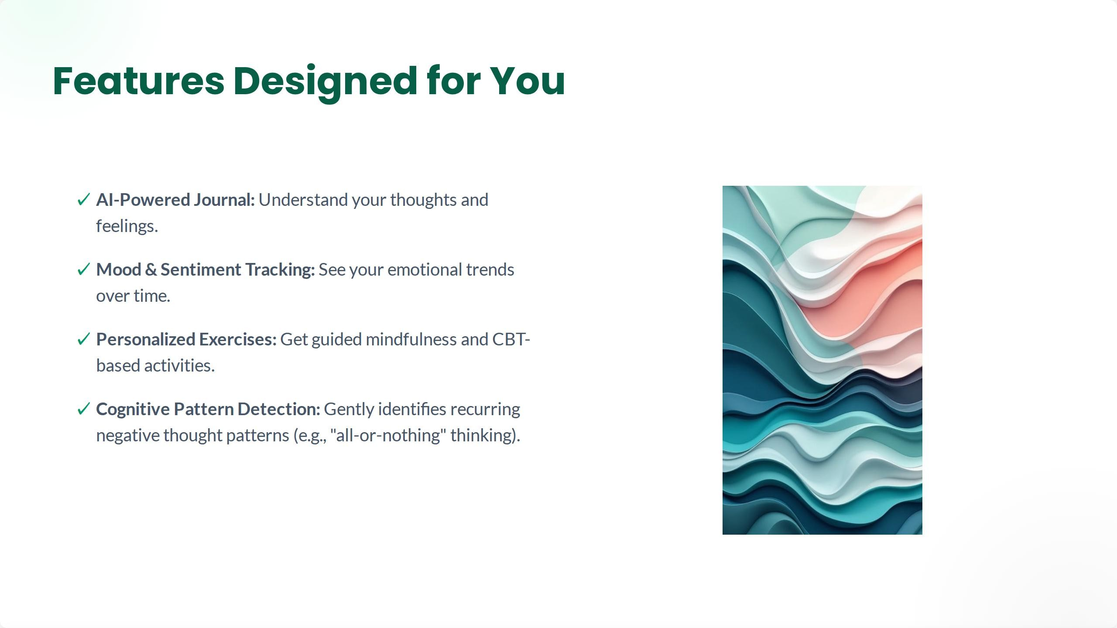

Slide 7
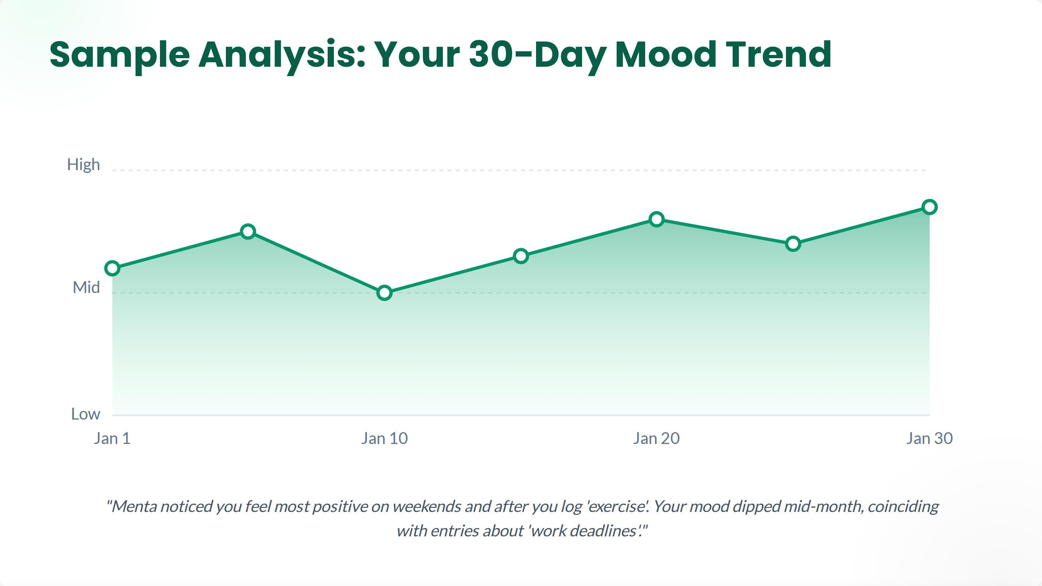

Slide 8
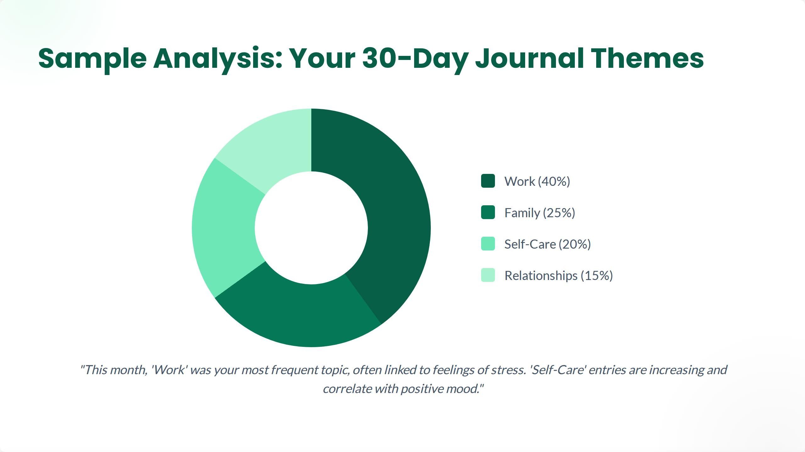

Slide 9


Slide 10
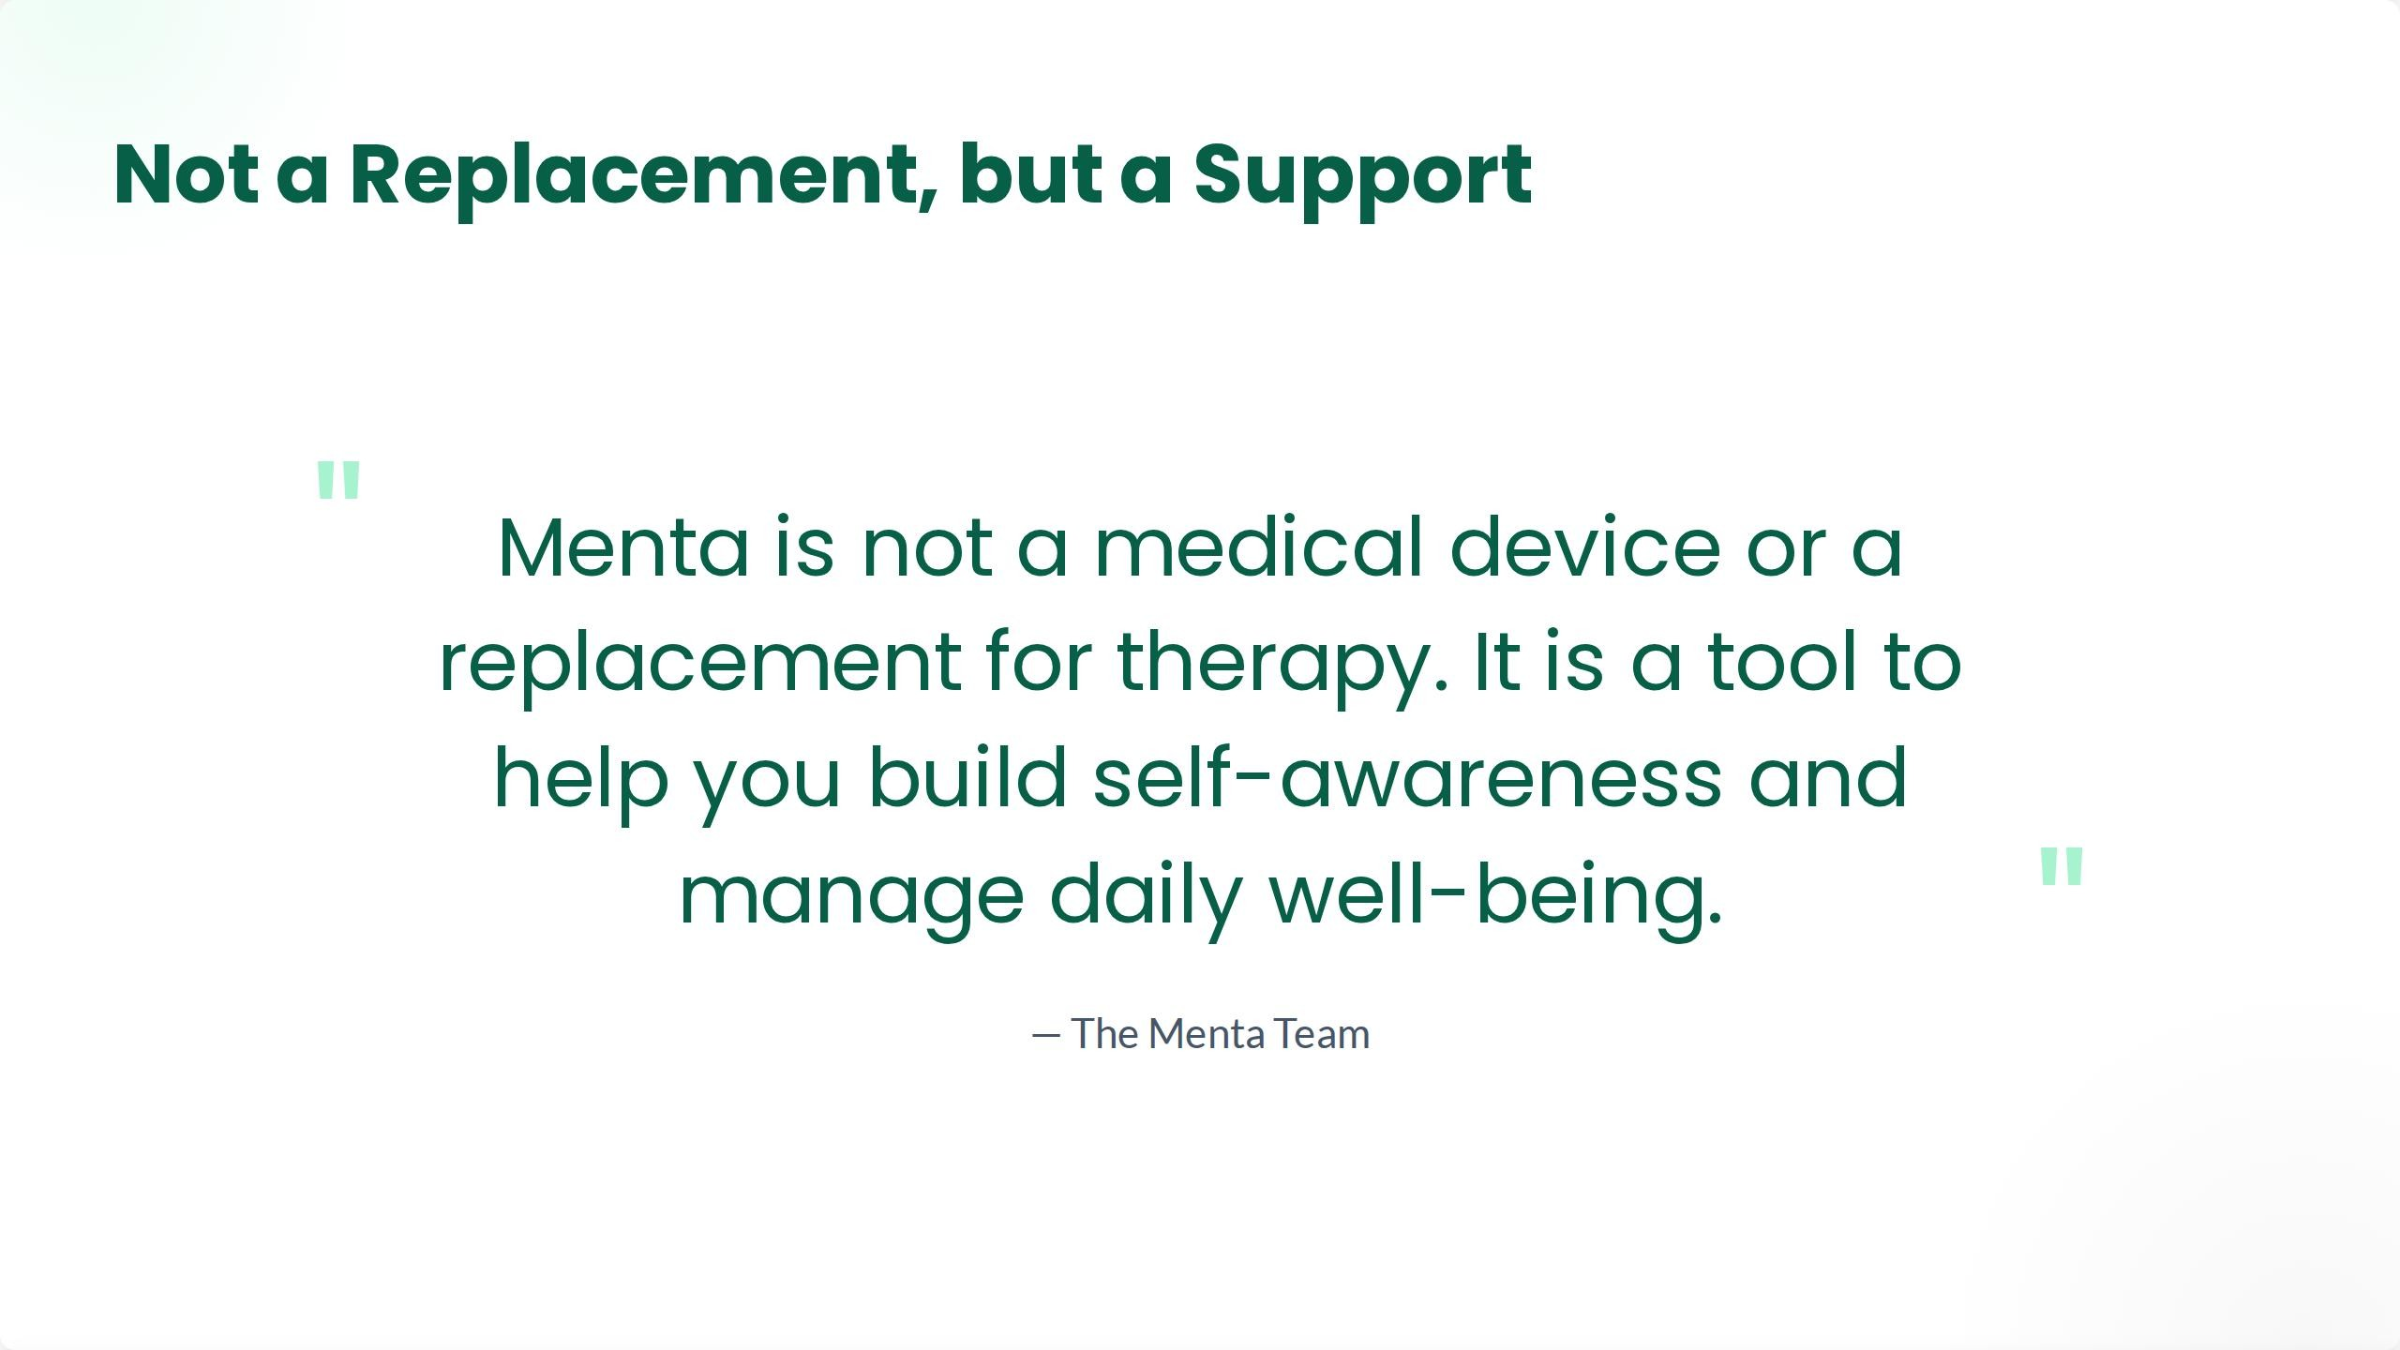

Slide 11


Slide 12


