Slide 1
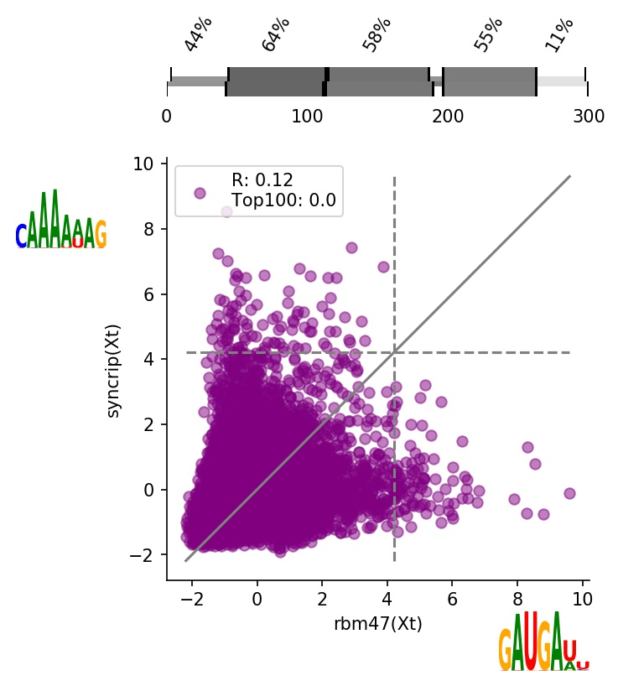
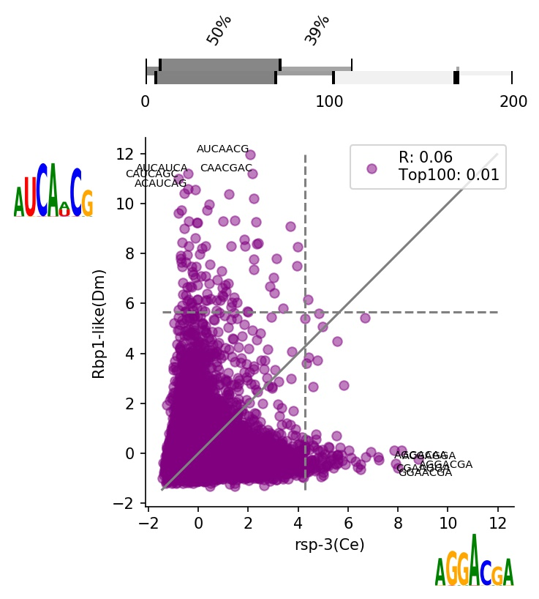
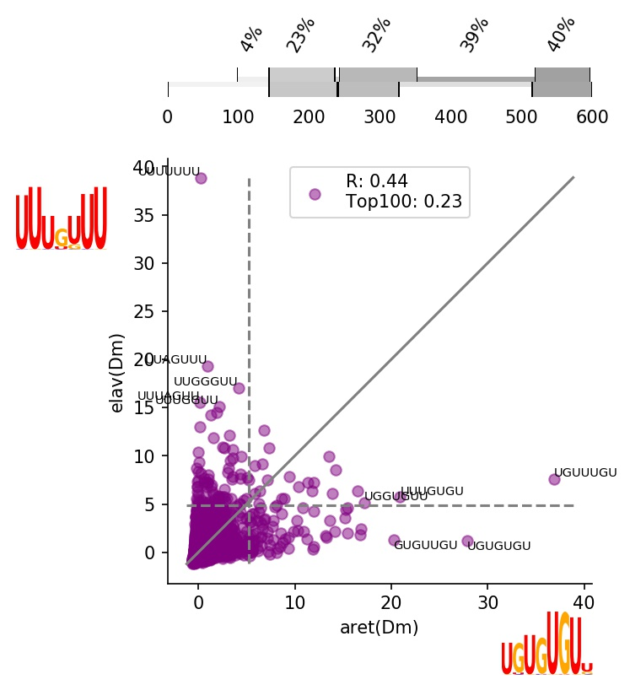
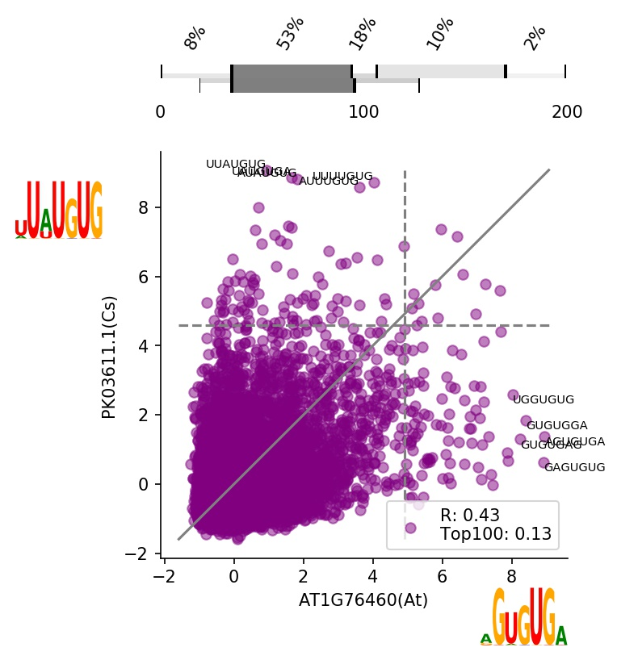
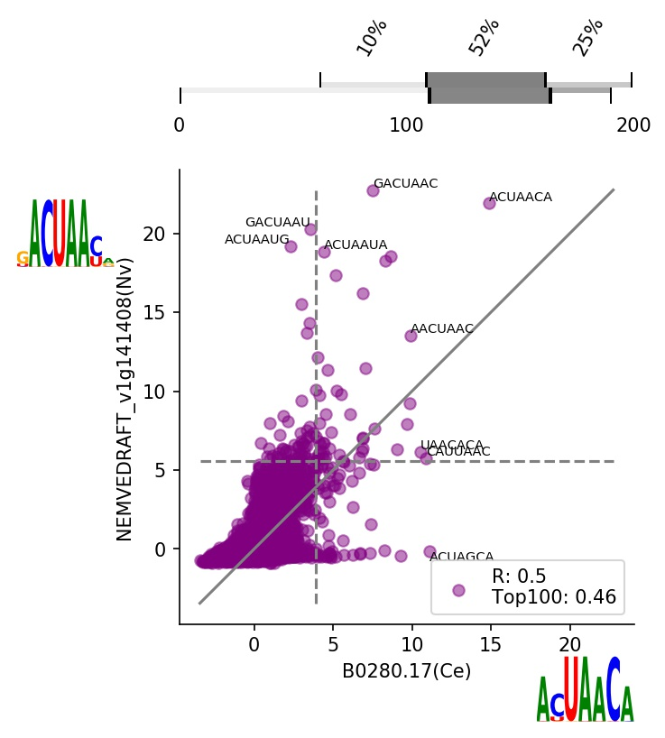
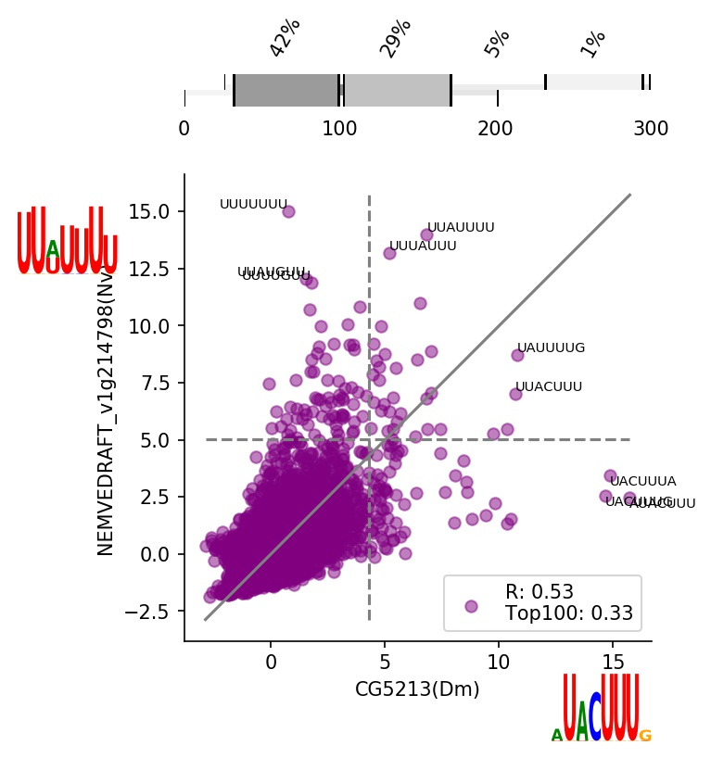
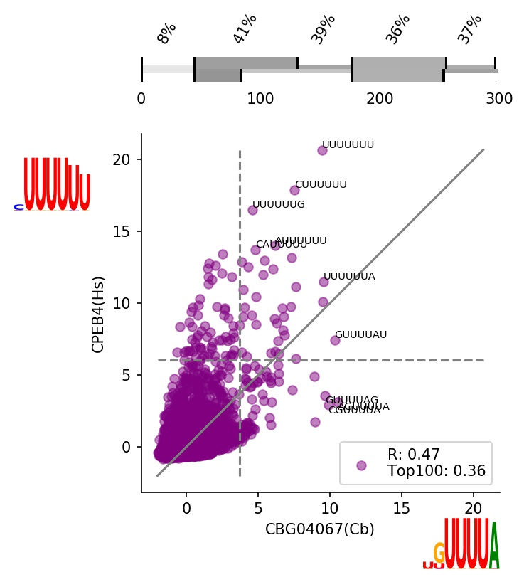
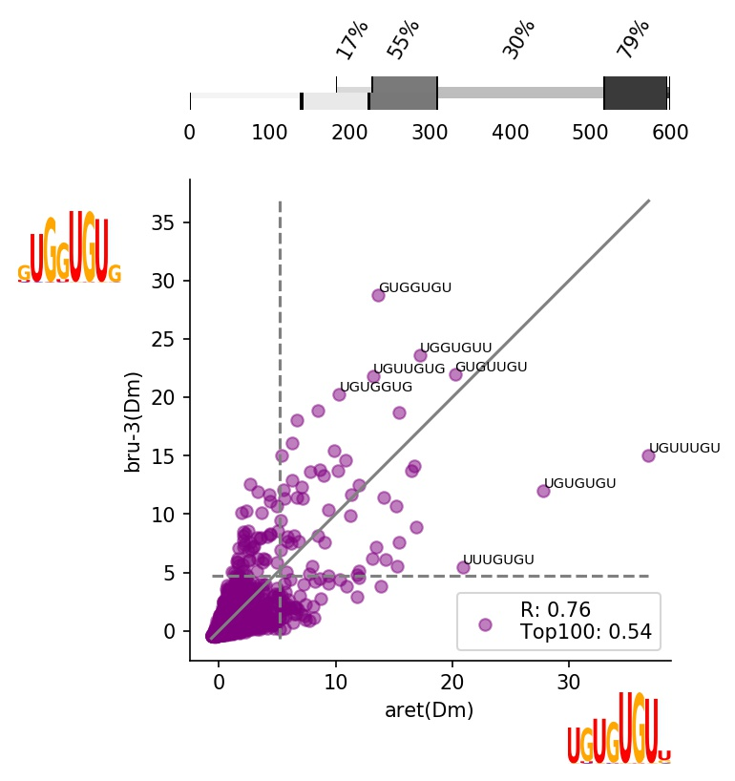
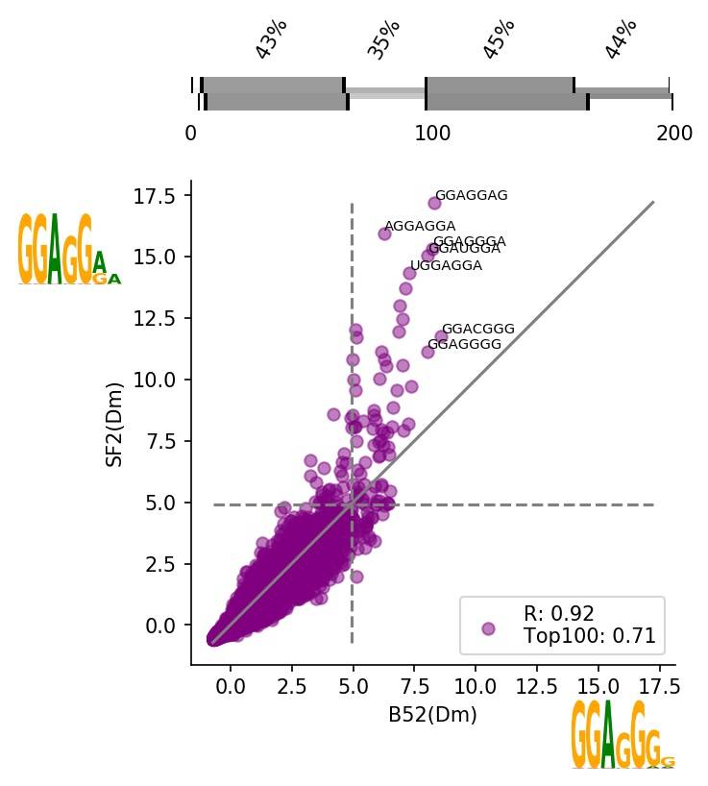
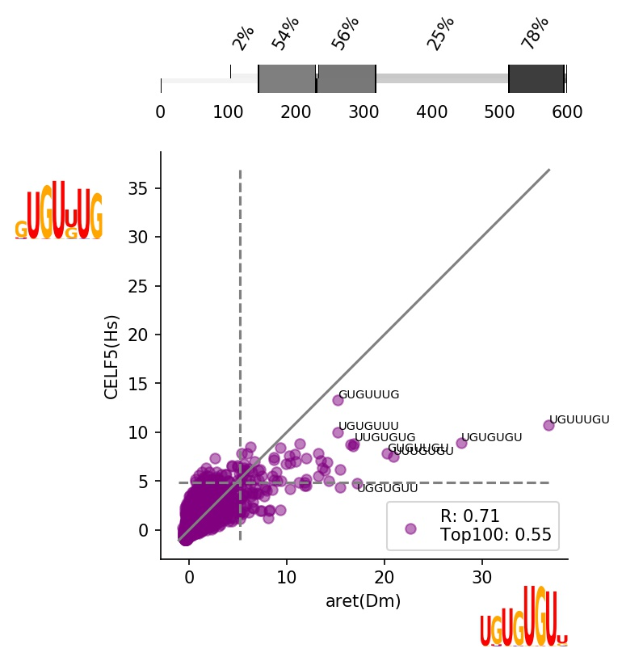
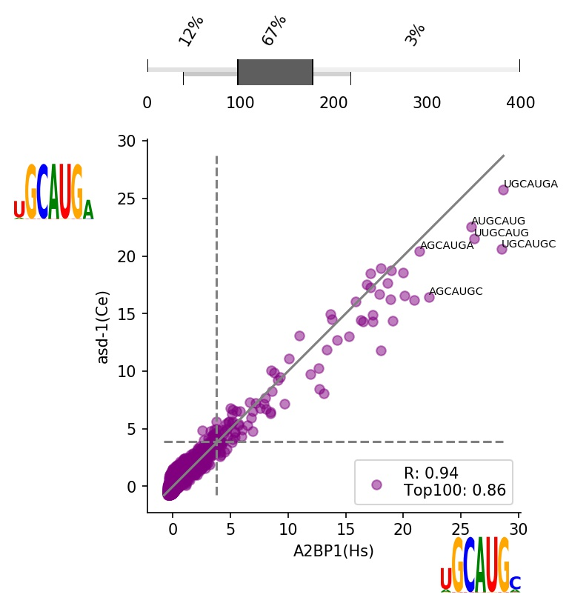
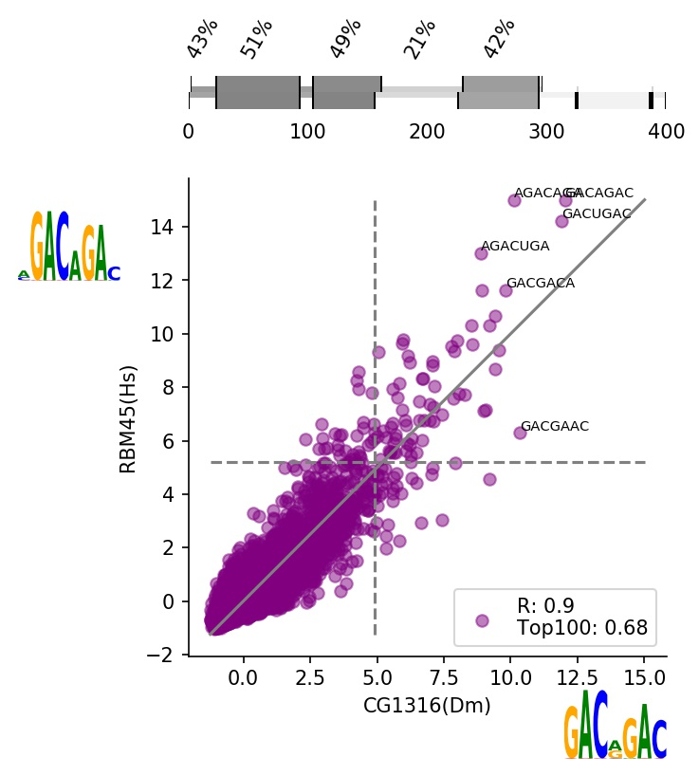
Changes within domain
Domain loss/gain
Distinct binding
No k-mers shared in top 100
Each profile has distinct enrichment
Modest specialization
Some k-mers in top 100 shared but not in top 10
Each profile has distinct enrichment
Weak specialization
Some top 100 k-mers shared with some in top 10
Profiles form acute triangle
Transitioning specificity
Top 10 k-mers are in both
Profiles form acute triangle
Some k-mers in top100 are unique for one or both
Intensified binding
Profiles correlate, top 10 for both the same
One profile has higher max values than the other
Conservation
Profiles align on diagonal

