Slide 1
Project #1 Presentation
By: Antonio Peavy, Christina Wuerz, Edel Farah, and Tomeka Morrison

Slide 2
Project Summary
To determine the access to healthcare to various income levels within Dallas County and examine if the economic level determined access to a health care facility

Slide 3
Building Blocks

Slide 4
Data Sources
Source | Usage | Access
Census Data | To identify the zip codes and income levels of the zip codes within Dallas County | https://www.kaggle.com/census/census-bureau-usa
Medicare Data | To determine which hospitals were registered within Dallas County | https://www.dallasopendata.com/
Google Maps API | To locate the Urgent Care facilities within Dallas Country | https://cloud.google.com/maps-platform/

Slide 5
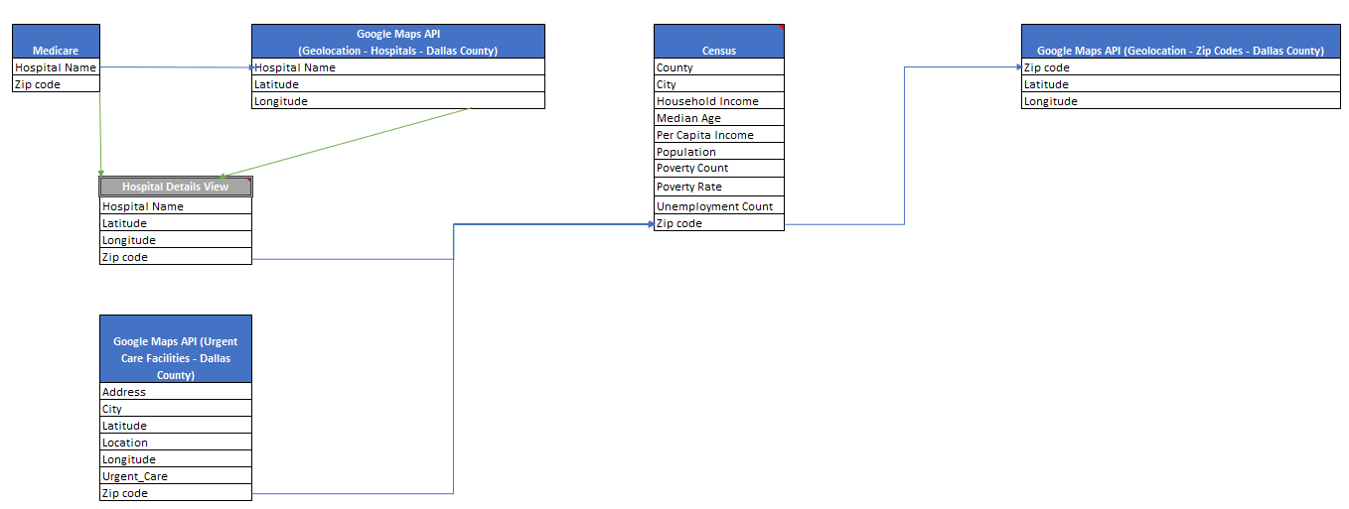
Data Model

Slide 6
Python Libraries
Library | Usage
Requests | To fetch the geolocation coordinates for the zip codes, Hospitals, and Urgent Care clinics in Dallas county from maps.googleapis
Pandas | To import the Dallas Census data, Hospital data, and Urgent Care data and parse/convert them into a data frame To identify and scrub dirty data that came from the data sources To merge the data together to create the data model that was previously shown
Gmaps | To generate the maps for hospital, urgent care, and poverty concentration data
Numpy | To create the Y-axis for the charts
Matplotlib.pyplot | To generate the charts and graphs

Slide 7
Analysis

Slide 8
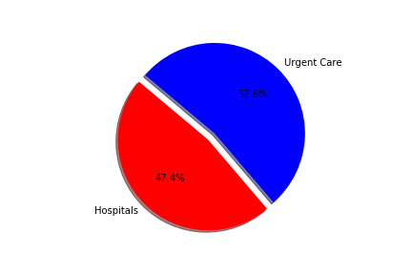
The Percentage of Hospitals vs Urgent Cares

Slide 9
Where are the hospitals concentrated?

Slide 10
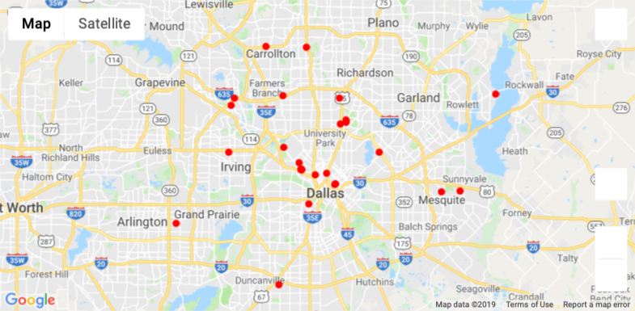
Hospital Concentration (based on 86 Zip codes)

Slide 11
Where are the Urgent Care Clinics concentrated?

Slide 12
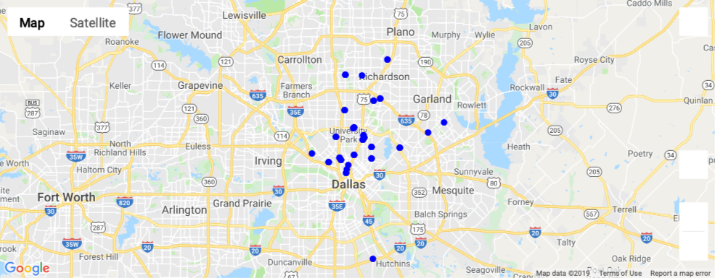
Urgent Care Clinic Concentration

Slide 13
Where are the impoverished areas concentrated?

Slide 14
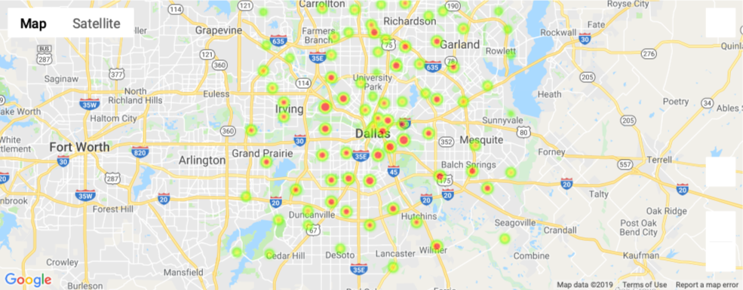
Poverty Concentration Heat Map

Slide 15
Breakdown of Facilities by Income

Slide 16
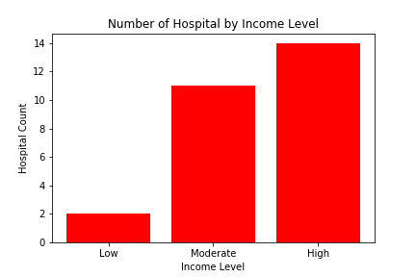
Hospital Concentration by Income in Dallas County

Slide 17
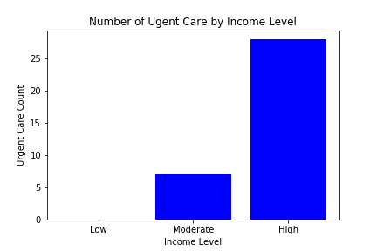
Urgent Care Concentration by Income in Dallas County

Slide 18
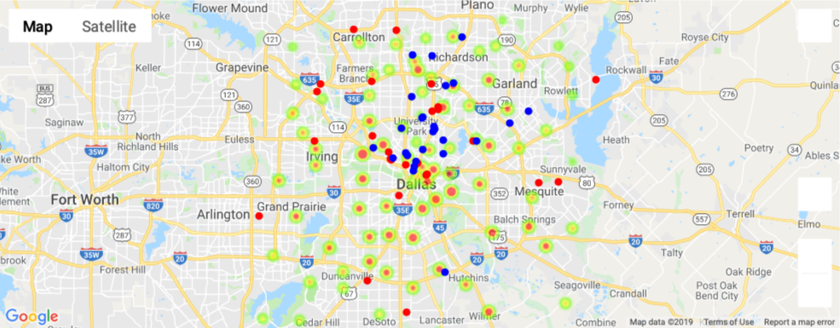
All Layers

Slide 19
Conclusion
Although the number of Urgent Cares and Hospitals were nearly equal, we did notice that higher income locations have more access to healthcare then lower income

