Slide 1
P+O Approach for a New Problem Setting
Preliminary results on alloy production problem (a covering LP used in our NeurIPS submission) are bad
One possible reason is that we cannot use MSE as warm-start in this new setting

Slide 2
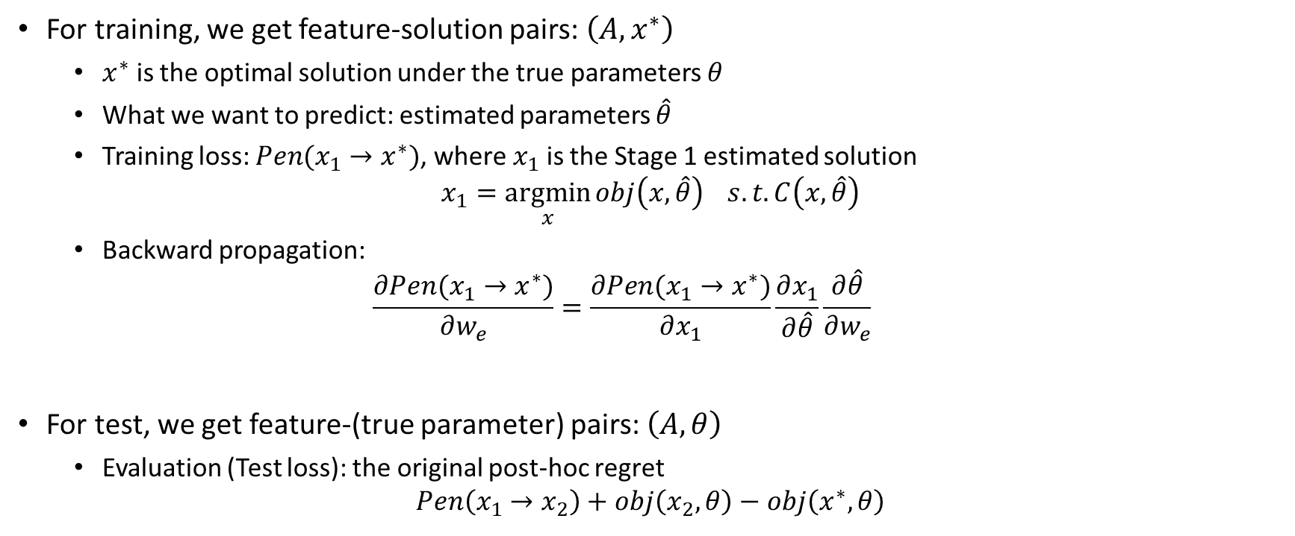
New Problem Setting
For training, we get feature-solution pairs: $\left(A, x^{∗}\right)$
  $x^{∗}$ is the optimal solution under the true parameters $θ$
  What we want to predict: estimated parameters $\hat{θ}$
  Training loss: $Pen(x_{1}→x^{∗})$, where $x_{1}$ is the Stage 1 estimated solution
$$x_{1}=\underset{x}{argmin}{obj\left(x,\hat{θ}\right) } s.t.C\left(x,\hat{θ}\right)$$
  Backward propagation:
  $$\frac{∂Pen(x_{1}→x^{∗})}{∂w_{e}}=\frac{∂Pen(x_{1}→x^{∗})}{∂x_{1}}\frac{∂x_{1}}{∂\hat{θ}}\frac{∂\hat{θ}}{∂w_{e}}$$
For test, we get feature-(true parameter) pairs: $\left(A,θ\right)$
  Evaluation (Test loss): the original post-hoc regret
$$Pen\left(x_{1}→x_{2}\right)+obj\left(x_{2},θ\right)−obj\left(x^{∗},θ\right)$$
Notes:
For training, we not only get A and x*, but also get the true objective values: add the obj values into the training loss
why this may be better: now the training loss is really the upper bound of the test loss

Slide 3
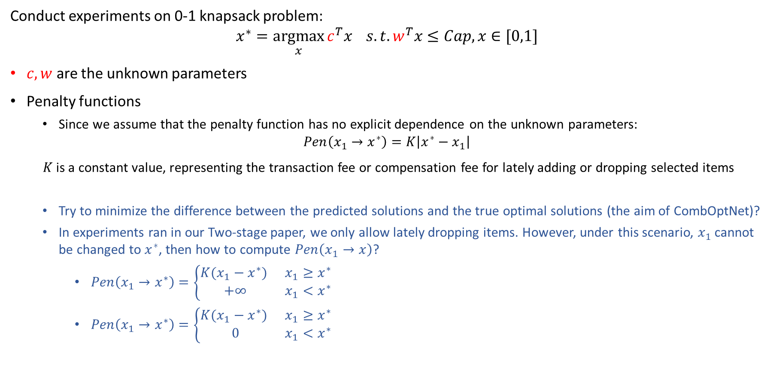
Preliminary Experiment Results
Conduct experiments on 0-1 knapsack problem:
$$x^{∗}=\underset{x}{argmax}{c^{T}x } s.t.w^{T}x≤Cap, x∈[0,1]$$
$c,w$ are the unknown parameters
Penalty functions
  Since we assume that the penalty function has no explicit dependence on the unknown parameters:
$$Pen\left(x_{1}→x^{∗}\right)=K\left|x^{∗}−x_{1}\right|$$
$K$ is a constant value, representing the transaction fee or compensation fee for lately adding or dropping selected items
  Try to minimize the difference between the predicted solutions and the true optimal solutions (the aim of CombOptNet)?
  In experiments ran in our Two-stage paper, we only allow lately dropping items. However, under this scenario, $x_{1}$ cannot be changed to $x^{∗}$, then how to compute $Pen\left(x_{1}→x\right)$?
    $Pen\left(x_{1}→x^{∗}\right)=\left\{\begin{matrix}K(x_{1}−x^{∗}) & x_{1}≥x^{∗} \\ +∞ & x_{1}<x^{∗}\end{matrix}\right.$
    $Pen\left(x_{1}→x^{∗}\right)=\left\{\begin{matrix}K(x_{1}−x^{∗}) & x_{1}≥x^{∗} \\ 0 & x_{1}<x^{∗}\end{matrix}\right.$

Slide 4
Preliminary Experiment Results
Since the true parameters are unknown when training, we cannot use MSE as warm-start now
Use the same dataset (4096 features per parameter) as our Two-stage paper, 10 simulations, each simulation contains 700 training instances and 300 test instances
Similar performance when Cap=100 and 150?
Try to minimize the difference between the predicted solutions and the true optimal solutions (the aim of CombOptNet)
Much better performance when Cap=200 and 250?
Packing IP ➔ when cap is large enough, tends to select all items
Proposed:
Much shorter training time

