Slide 1



Binary model-wide measures
Курс “Машинное обучение”
Лабораторная работа
Харитонов Е.А., М16-524
Вариант 1-09
2017

Slide 2
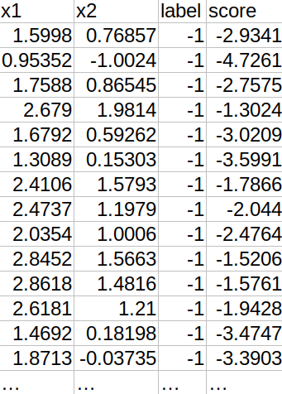
Исходные данные
Source data – binary classified (positive and negative classes) set of entities, described by two parameters x1 and x2.
Sample size – 350 (50 positive, 300 negative)
Representation – entities can be interpreted as points on Cartesian coordinate plane with axes x1 and x2 for ease.
Figure 1. Piece of sample data

Slide 3
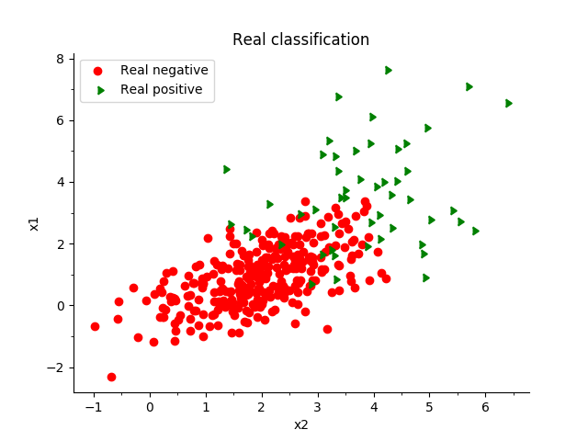

Исходные данные
Figure 1. Visualization of source data set as points on the coordinate plane with real classification
Figure 2. Visualization of source data set as points on the coordinate plane classified by proposed classifier

Slide 4
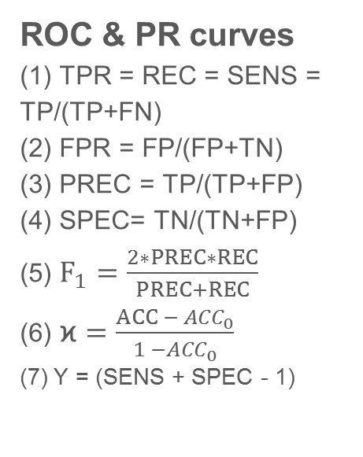

Используемые методы и формулы
ROC & PR curves
(1) TPR = REC = SENS = TP/(TP+FN)
(2) FPR = FP/(FP+TN)
(3) PREC = TP/(TP+FP)
(4) SPEC= TN/(TN+FP)
(5) $F_{1}=\frac{2∗PREC∗REC}{PREC+REC}$
(6) $\text{ϰ}=\frac{ACC − {ACC}_{0}}{1 −{ACC}_{0}}$
(7) Y = (SENS + SPEC - 1)
where
TP – True Positives count,
FN – False Negatives count,
FP – False Positives count,
TPR – True Positive Rate,
SENS – Sensitivity,
SPEC – Specificity,
FPR – False Positive Rate,
PREC – Precision,
REC – Recall
$F_{1}$ – F-score value for β = 1,
$\text{ϰ}$ – Cohen’s kappa,
Y – Youden’s index.

Slide 5
Используемые методы и формулы
ROC (receiver operating characteristic) curve of classifier h is a graphical plot of its sensitivity (true positive rate) against the 1-specificity (false positive rate) at various thresholds b ∈ ℝ
PR (Precision-Recall) curve of classifier h is a graphical plot of its precision (PREC) against RECALL (REC) at various thresholds b ∈ ℝ
AUC (Area Under Curve) - the probability that a classifier will rank a randomly chosen positive instance higher than a randomly chosen negative one

Slide 6
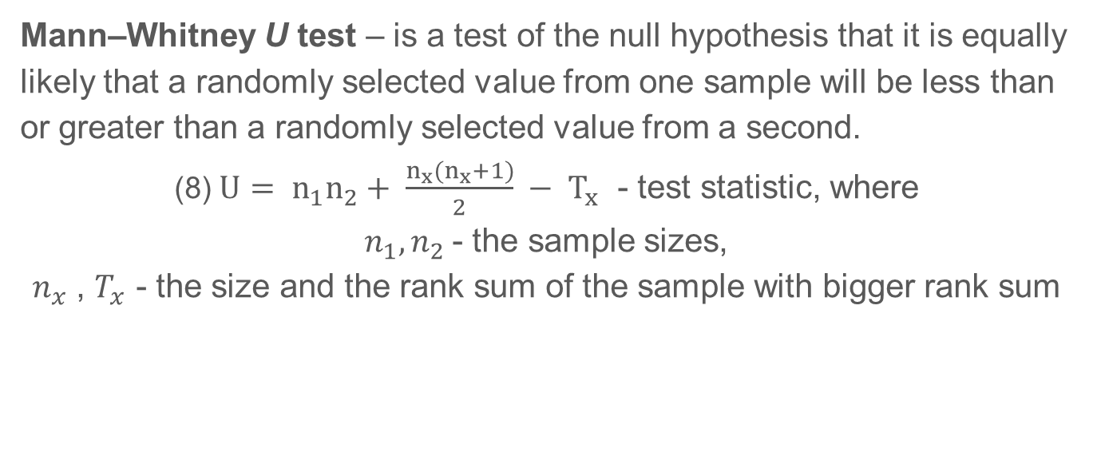
Используемые методы и формулы
Mann–Whitney U test – is a test of the null hypothesis that it is equally likely that a randomly selected value from one sample will be less than or greater than a randomly selected value from a second.
(8) $U= n_{1}n_{2}+ \frac{n_{x}(n_{x}+1)}{2} − T_{x}$ - test statistic, where
$n_{1},n_{2}$- the sample sizes,
$n_{x}$ , $T_{x}$ - the size and the rank sum of the sample with bigger rank sum

Slide 7
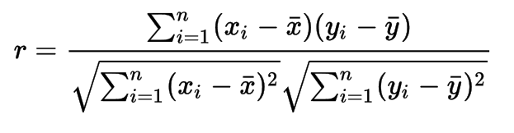

Используемые методы и формулы
Correlation coefficient is a number that quantifies a type of correlation and dependence, meaning statistical relationships between two or more values in fundamental statistics.
(9)
where:
n - the sample size,
$x_{i},y_{i}$ are the single samples indexed with I,
$\overline{x},\overline{y}$ are the sample mean

Slide 8
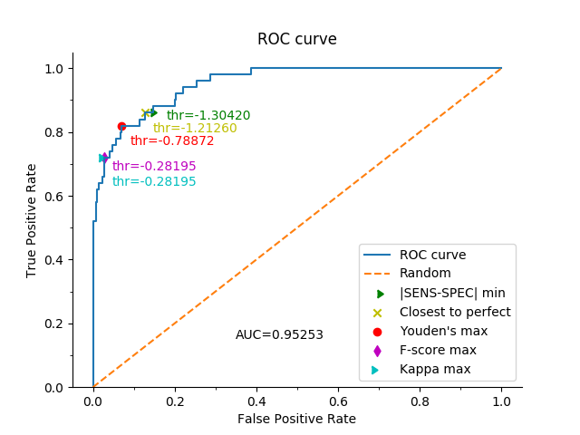
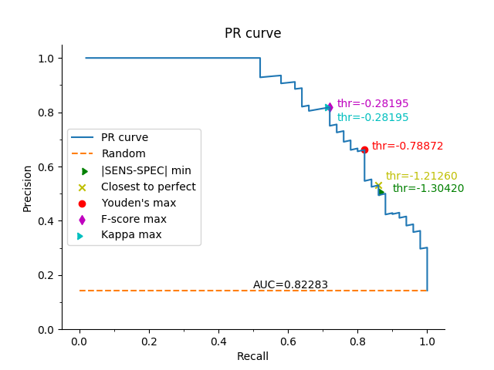
Результаты исследований
Figure 3. ROC curve of the classifier family with AUC value and optimal threshold values (thr) obtained by different methods
Figure 4. PR curve of the classifier family with AUC value and optimal threshold values (thr) obtained by different methods

Slide 9
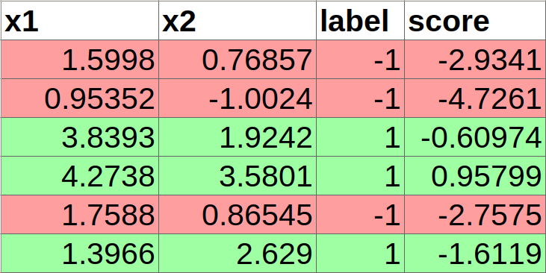
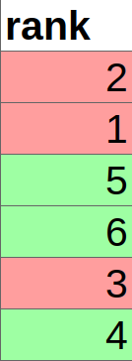
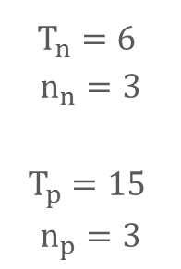

Результаты исследований
Mann–Whitney U test
H0: scores of the positive sample is the same as scores of the negative sample
H1: scores of the positive sample is greater than scores of the negative sample
$U_{emp}$ = 94
$U_{cr}$ = 557 (p = 0.01)
$U_{emp}$ < ${ U}_{cr}$ H0 is rejected
p-value = 2.52 * ${10}^{−12}$
$$T_{n}=6$$
$$n_{n}=3$$
$$T_{p}=15$$
$$n_{p}=3$$
Figure 5. Simple example of Mann-Whitney’s sums of ranks calculation

Slide 10
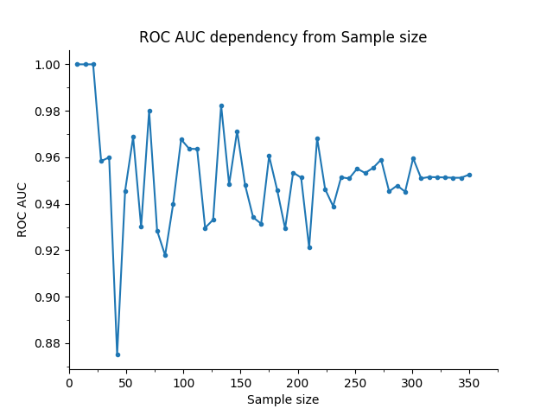
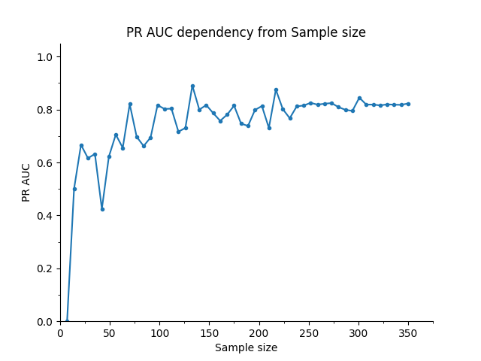
Результаты исследований
Figure 6. ROC curve AUC dependency from the Sample size plot
Figure 7. PR curve AUC dependency from the Sample size plot

Slide 11
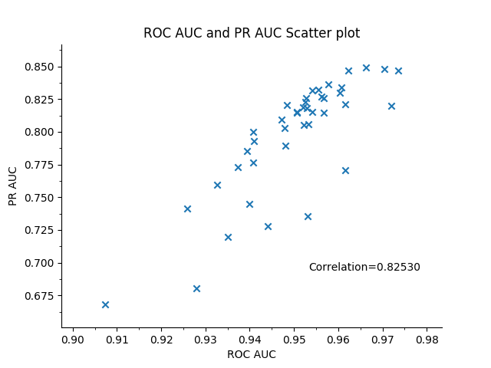
Результаты исследований
Linear correlation between ROC AUC and PR AUC values with different sample sizes is strong enough (if samples with little sample sizes are ignored). On different random samples selection it varies in range [0.60; 0.95]
Figure 8. Scatter plot of ROC AUC and PR AUC with correlation coefficient value

Slide 12
Выводы
ROC and PR curves can help to decide which classifier is more appropriate. Classifier h1 is better than classifier h2 if it’s curve is closer to the ideal.
PR curve is more informative when dealing with “needle-in-haystack” type problems or problems where the positive class is more important than the negative class.
AUC of both curves can help to compare curves not relaying on their visualization. The closer AUC value to 1.0 the better is classifier.

