Slide 1


Linear Algebra & Vector Geometry
Image Processing
Final Project Presentation

Slide 2

Fall 2022
Math 201
Linear Algebra & Vector Geometry
Team Members:
1- Adham Saad 202100163
2- Mahmoud Elshahed 202100678
3- Mohamed Morshedy 202100372

Slide 3
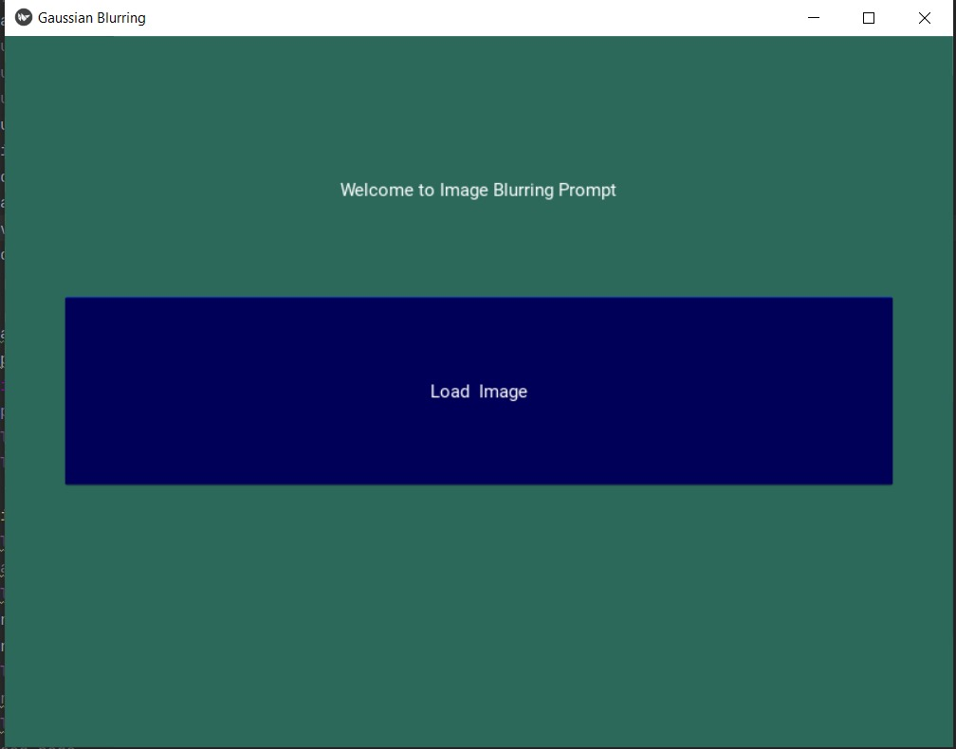

Main Window

Slide 4
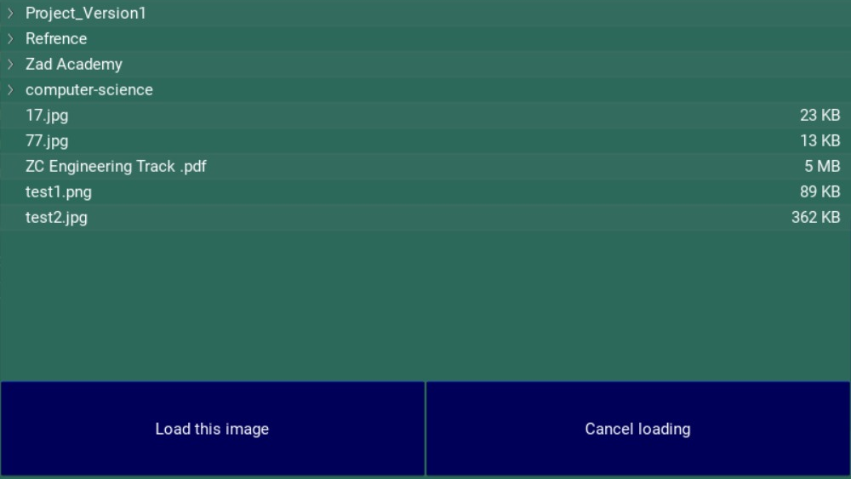
Image Location

Slide 5
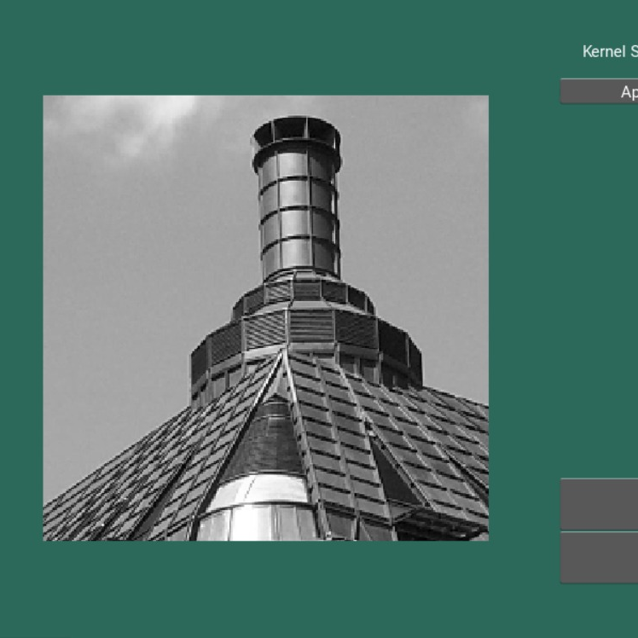
Image before blurring

Slide 6



Slide 7
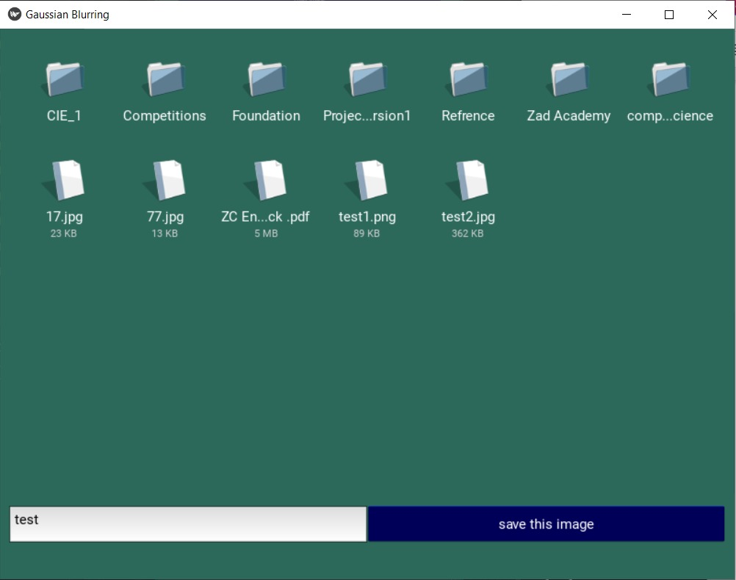
Save Window

Slide 8
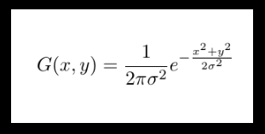

Slide 9

Thank you

