Slide 1
FY10 NTHMP
Budget Overview
Jenifer Rhoades
January 27, 2010

Slide 2
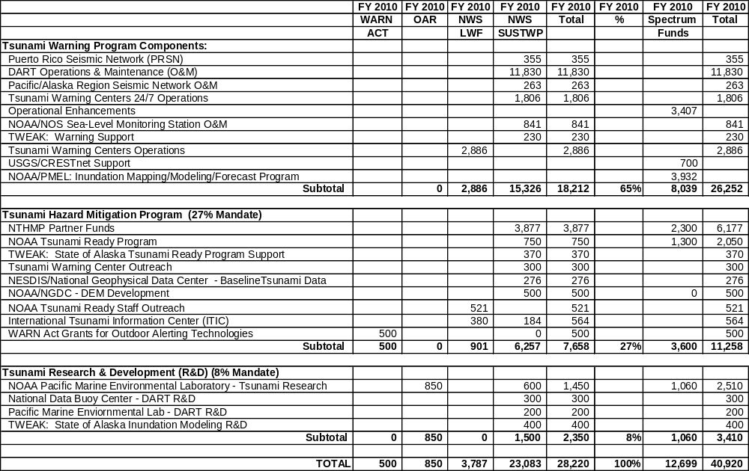
FY10 NOAA Tsunami Program Budget

Slide 3
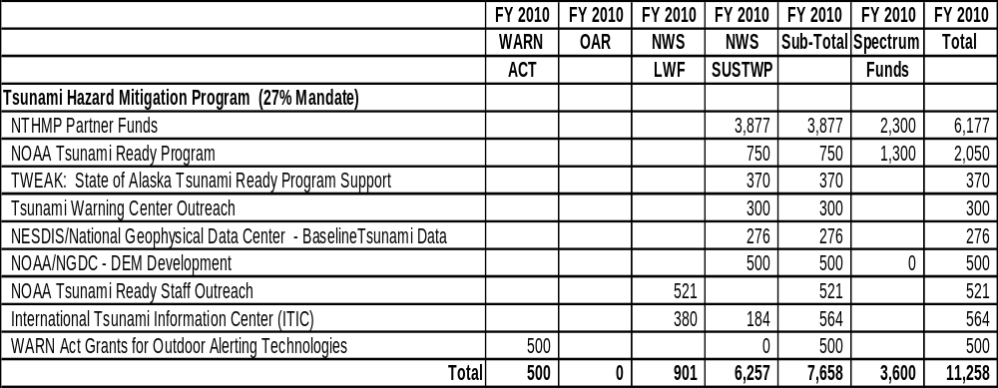
FY10 NTHMP Budget

Slide 4
NTHMP FY10 Grants Process for New Proposals
Call for New Proposals (Due November 15, 2009)
  For New Proposals Only
  3-Year Funding Request
  Annual Project Plan and Budget
  Tied to NTHMP Performance Metrics
  Partners should request funding levels for activities they can reasonably accomplish
NTHMP-CC Review of New Proposals
  Completed January 1, 2010
  Comments sent to Applicant

Slide 5
NTHMP FY10 Grants Process
Guidance for Formal Applications for New Proposal
  Distributed to NTHMP Partners - January 12, 2010
  Follow Guidance
  Applications Due February 17, 2010 through NOAA Grants On-line
NOAA Subject Matter Expert Review of Applications (30 Days)
  Using procedures outlined in Appendix B of the ROP
Dept. of Commerce Legal Review (14 Days)
Negotiation Period – if required (10 Days)
Award Processing – Working toward June 30, 2010
  Notification of Grant Award (NOAA AGO)
  Acceptance of Grant Award (Partner)

Slide 6
NTHMP Grants Process (cont.)
Continuing Grants for FY09-12 Awards (Ref. NTHMP Rules of Procedure)
  No need to submit grant applications through process mentioned above
  Continuation of Funding (FY10) influenced by Sub-Committee Reviews of Semi-Annual Progress Reports (submitted in August 2009 and February 2010) for FY08 and FY09 Grant Awards
  Sub-Committee Review Reports will be provided to NTHMP Grant Review Panel; the Review Panel will make recommendations to NOAA on funding amounts for FY10
  NTHMP Program Administrator will notify each grant awardee of Review Panel recommendation and negotiate FY10 funding award and project plan as necessary
Post-Award FY10 Grant Process (Partner)
  Routine Financial Reporting (Due to Grants On-Line)
  Provide Semi-Annual progress reports to the NTHMP Administrator through Grants On-Line
  Provide Annual Report of accomplishments to the NTHMP-CC at the next Annual NTHMP Meeting
    Demonstrate how accomplishment supported NTHMP performance measures and milestones
    Coordinated in advance with relevant subcommittees

