Slide 1
COURSE PROJECT · MULTI-AGENT REINFORCEMENT LEARNING
Emergent Coordination in 2v2 Pong
Four independent PPO agents · one shared team reward · no communication, no role assignment, no opponent observations
A1 + A2 (blue, left) vs B1 + B2 (red, right)
Results: 3 seeds, 1M steps per 2v2 run · 60-episode deterministic eval · report/report.md
Notes:
Open with the question, then play the footage. Frame: can teammates coordinate with only local state, teammate state, and a shared win/lose signal? Li et al. 2025 supplies the framing: non-stationarity and credit assignment.

Slide 2
THE EXPERIMENT
Coordination without communication
8-dim observations
own paddle y/vy, ball x/y/vx/vy, teammate y/vy — opponents excluded by design
Shared team reward
+1 / -1 per point, identical signal to both teammates
3 actions per paddle
stay / up / down, applied simultaneously every step
Overlapping vertical ranges — nobody owns a region
Independent PPO ×4
separate 64×64 actor-critic MLPs, CPU-only; no shared critic, no parameter sharing
Notes:
Stress the design constraint: excluding opponent observations is deliberate — it keeps the research question about local+teammate coordination. The overlap band is where both teammates can roam; no fixed regions are assigned.

Slide 3
PROTOCOL
Small enough to run, honest enough to trust
4
3
1M
60
independent PPO learners
seeds per condition
steps per 2v2 run
eval episodes × 3 opponents
64×64 actor-critic MLPs, one per paddle, CPU
fresh initialization every run — no warm starts
1v1 sanity baseline at 300k; all runs logged per iteration
deterministic greedy play vs self, scripted tracker, random
Every number in this deck comes from committed checkpoints, logs, and eval records — reproducible from the repo.
Source: results/models/, results/logs/, results/eval_*.json (marl-pong repo)
Notes:
If asked about MLflow/SB3 deviations: custom PPO was TASK.md option (b); CSV logs replace MLflow; both documented in report section 2.

Slide 4
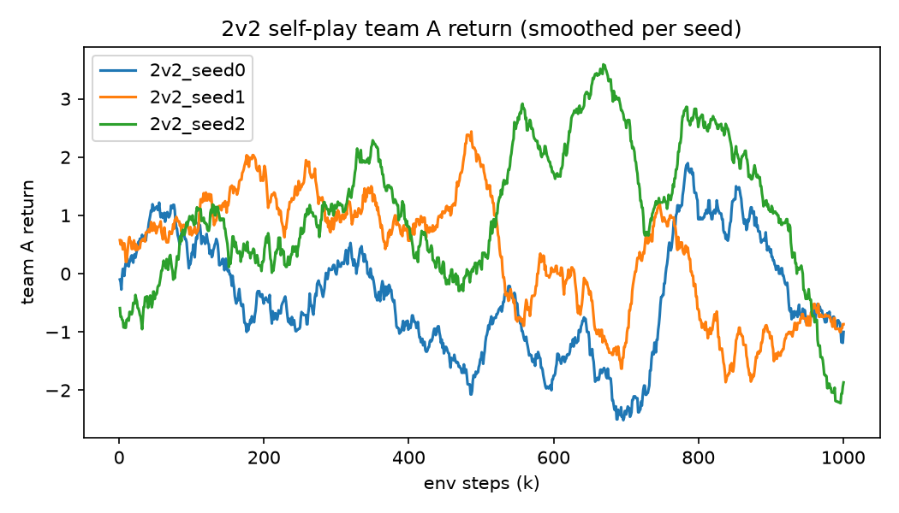
FINDING 1 · NON-STATIONARITY
Learning is a wave, not a trend
Oscillation, not convergence
Dominance swings in ~300k-step waves — each team's improvement is the other's environment change
All three seeds decline together after ~800k steps
Which team leads at 1M is a coin flip: seed 1 → A, seeds 0/2 → B
“The opponent is the environment.”
Self-play team A return, smoothed — one curve per seed
Source: results/logs/2v2_seed{0,1,2}_1M.csv — per-iteration returns, 51-iter rolling mean
Notes:
This is the non-stationarity challenge from Li et al. demonstrated, not just cited. Nobody converged; the optimization target keeps moving. Present the decline at the end honestly: an arms race, not undertraining.

Slide 5
FINDING 2 · SKILL CALIBRATION
Beats random, loses to a hand-written tracker
±0.27
seed spread on the 0.68 win rate vs random — real skill, fragile across seeds
A scripted ball tracker wins ~99% against every trained team. PPO-learned play is qualitatively behind hand-written defense at this budget.
Source: results/summary.md — 3 seeds, 60 greedy episodes per run per opponent
Notes:
Calibrated honesty: PPO learned something real (0.68 vs random) but far from scripted-perfect. The spread matters: one seed wins ~90%, another ~50%. Do not oversell.

Slide 6
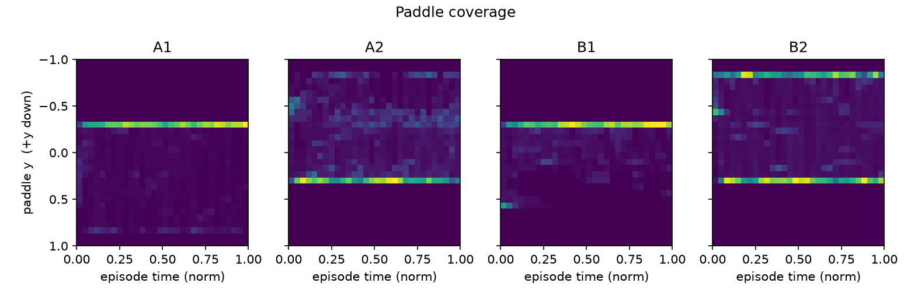
FINDING 3 · COORDINATION EVIDENCE
Positional roles emerge — nobody assigned them
Paddle y-position over normalized episode time, seed 0: each paddle holds a home band plus chase excursions
A1 anchors mid-upper, A2 mid-lower with excursions to the top wall — the mirror structure appears on team B. No communication, no role assignment.
Source: results/traj_2v2_seed0_1M.npz — 20 greedy self-play episodes
Notes:
This is the centerpiece: the actual research question answered visually. Structure is unambiguous in the heatmaps. Seeds 1 and 2 show different partitions — the deck's next slides quantify that.

Slide 7
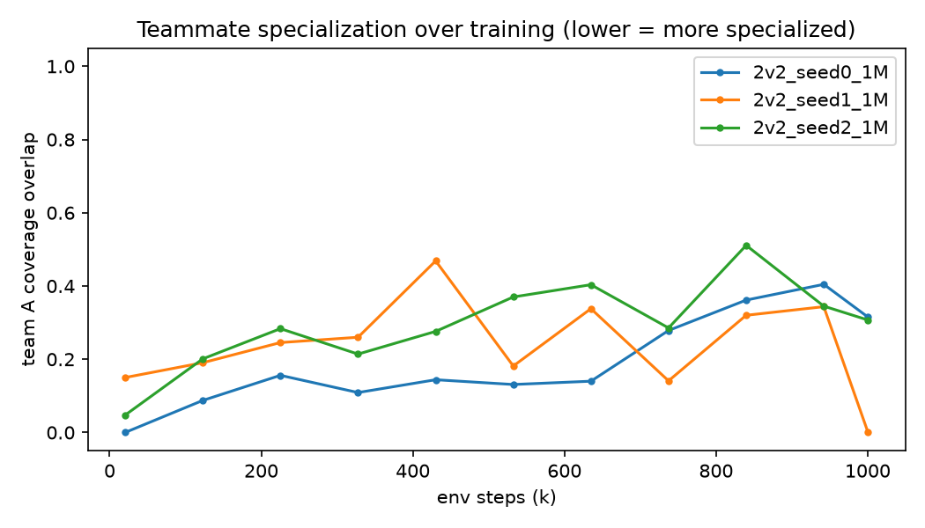
FINDING 3 · CONTINUED
Specialization is real — and not what we predicted
0.01
coverage overlap in seed 1 — a near-disjoint band partition, and the strongest team (0.67 win rate)
Overlap rises over training in all seeds — early policies barely move; later ones chase hard
So complementary roles mean distinct anchors with shared pursuit, not disjoint coverage
n = 3: the specialization-success link is suggestive, not causal
Teammate coverage overlap at checkpoints (lower = more specialized)
Source: overlap sweep over iter_*.pt checkpoints, 4 short greedy probes each
Notes:
The metric went the 'wrong' way and that is the interesting part: rising overlap reflects vigorous shared chasing on top of stable home bands. Presenting this honestly beats pretending it trended down.

Slide 8
FINDING 4 · CREDIT ASSIGNMENT
Which team dominates is a seed lottery
Asymmetry entrenches
Shared reward cannot attribute a point to a paddle
Whichever team stumbles into a better joint equilibrium early keeps it
Same setup, same budget — opposite winners. That variance is the credit-assignment caveat made visible
Source: results/eval_2v2_seed{0,1,2}_1M.json — self-play, 60 episodes each
Notes:
This explains the footage: the recorded clip shows blue winning 4-1, but across 60 episodes red wins that seed 0.58-0.37. One match is anecdote; the table is the finding. Seed 1 is where blue genuinely dominates.

Slide 9
THE VERDICT
Partial yes.
Complementary positional roles emerge without communication or role assignment — but coordination is a seed lottery, it does not grow monotonically, and win rate alone would have overstated it. Beating random requires zero coordination; the heatmaps are the evidence.
Emerges
Varies
Correlates
distinct home bands in every seed, from identical rewards and local views
coverage overlap spans 0.01 - 0.28 across seeds at eval
the best-partitioned seed is also the strongest team (0.67 win rate)
Notes:
Say the verdict sentence exactly like this, then stop. This is the slide to linger on.

Slide 10
LIMITATIONS & NEXT STEPS
What this evidence cannot yet claim
3 seeds
the specialization-success correlation needs more runs to be more than suggestive
Unswept overlap
paddle overlap stayed at its 0.4 default — the frozen-before-training sweep was never run
No frozen-opponent run
skill improvement and opponent drift remain entangled — the one experiment that would disentangle them
Repo: marl-pong — checkpoints, logs, eval records, analysis code, and report/report.md are all committed
Notes:
Close on future work: frozen-opponent condition first, then more seeds. Offer the repo for anyone who wants to rerun the eval.

