Slide 1


WSR
(Weekly Status Report)
(29/01/2024 - 04/02/2024)
Internal

Slide 2

Agenda
Executive Summary
Service Delivery –Dashboard (With SLA Status)
Change Request Tracker
Other Support Activity/Issues
Defects Tracker
Application Availability Trend
Utilization Trend
Issue & RCA
Feedback Tracker
VAPT Observations /Action items / open items / support required
GPI Ticket Tracker Sheet and Pending Task Sheet - Link
Internal

Slide 3
Executive Summary (05 Feb 2024 – 11 Feb 2024)
Name Figures
Tickets - E-Saarthi/Hawker/GPI Website (Resolved/ Logged) | 01
Tickets Tracker(MT) (Resolved/ Logged) | 0
Tickets Tracker(Mirror) (Resolved/ Logged) | 10/10
Utilization Status
Active Mirror Users | 1038
Active MT Users | 322
Active CodNxt Users | 1
Active E-Saarthi Users(Promoters) | Total: 1223 Active:102 Inactive:1121
Active E-Saarthi Users(Hawkers) | Total :1552 , Active 827 Inactive: 725
Internal

Slide 4
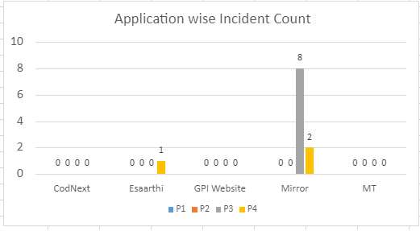
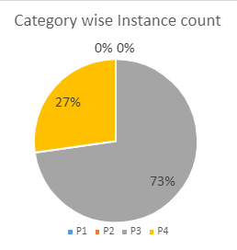
Service Delivery Dashboard (05 Feb 2024 – 11 Feb 2024)
Internal

Slide 5
Service Delivery Dashboard (05 Feb 2024 – 11 Feb 2024)
Priority | CodNext | Esaarthi | GPI Website | Mirror | MT | Total | Resolved Within SLA
P1 | 0 | 0 | 0 | 0 | 0 | 0 | Yes
P2 | 0 | 0 | 0 | 0 | 0 | 0 | Yes
P3 | 0 | 0 | 0 | 8 | 0 | 8 | Yes
P4 | 0 | 1 | 0 | 2 | 0 | 3 | Yes
 | 0 | 1 | 0 | 10 | 0 | 11
Internal

Slide 6
Change Request ​Tracker (Mirror and SFA MT)
SN | User Story | Application | Priority | Task | Status | UAT Date | Prod Date | Remarks
1. | SFA Modern Trade - Change request brief | MT (Modern Trade) |  |  | CR not approved from GPI. | Not Decided | Not Decided
2. | Mirror - Change request brief | Mirror | P1 P3 P6 P5 | Primary sales report Integration API integrations for Masters (SKU, WD etc.) from ERP on daily basis SFA MT Application data auto flow to MT WDs Candy sales in KG (new filter to be added in reports) | WIP WIP Not started WIP |  |  | API for ERP Team is Completed, and report work is pending.
<number>
Internal

Slide 7
Change Request ​
SN | User Story | Application | Priority | Task | Status | UAT Date | Prod Date | Remarks
 |  |  | P4 P2 P7 | GPI State, State, Zone mapping to be added in all reports. Admin access for opening the respective window in advance to tackle public holidays. Direct view of sales instead of every time downloading an excel. | Done Not Started Not Started | 05/02/2024 | Pending | We have successfully deployed in UAT. We will deploy In production After approval of GPI.
<number>
Internal

Slide 8
Change Request Tracker (​GPI Website work upload)
SN | User Story | Application (URL) | Priority | Task | Status | Reported by | Reported date | Remarks
1 | International Page |  |  | Revamp the page according to the domestic business as per discussion with Sukirti and Archna Bhasin. Revamp “State of the Art manufacturing” section. | Done | Sukirti |  | Frontend development has been started as per design approval.
2 | Current and New Website Update |  |  | Update on the page our ESG commitment. | Done | Sukirti | 29/01/24
<number>
Internal

Slide 9
Change Request Tracker (​GPI Website work upload)
SN | User Story | Application (URL) | Priority | Task | Status | Reported by | Reported date | Remarks
3 | Our Leader Page |  |  | Textual changes | Done | Sukirti | 29/01/24
4 | Our culture |  |  | Change Header Image | Done | Sukirti | 29/01/24
5 | International Business |  |  | Image update in cigarette brand. State of the art manufacturing section | Done | Sukirti | 31/01/24
6 | Leaf division |  |  | Update headings and content. | Done | Sukirti | 31/01/24
<number>
Internal

Slide 10
Change Request Tracker (​GPI Website work upload)
SN | User Story | Application (URL) | Priority | Task | Status | Reported by | Reported date | Remarks
7 | International and domestic Business responsive |  |  | Working on page responsive. | WIP | Sukirti |  | As per design revamp, so it’s not done yet, in cigarette brand page for both.
<number>
Internal

Slide 11
Other Support Activity/Issues
SN | User Story | Application | Priority | Task | Status | UAT Date | Prod Date | Remarks
<number>
Internal

Slide 12
Defect Tracker (Change request)
Internal
<number>

Slide 13
App Trends
​ | MT​​ |  | Mirror​​ |  | Esaarthi​​ |  | Hawker​​
DATE​​ | No. of Users ​ Login​​ | No. of ​Transaction​​s | No. of Users​ Login​​ | ​ No. of ​ Transaction​​ | No. of Users ​ Login​​ | Outlet / productive sell​ | No. of Users ​ Login​​ | Productive sell​
05-02-2024 | MT LOGIN | transaction_MT | ss_login | - | 31 | 954/10957 | 2 | 2140
04-02-2024 | MT LOGIN | transaction_MT | ss_login | - | 34 | 976/14480 | 0 | 0
03-02-2024 | MT LOGIN | transaction_MT | ss_login | - | 33 | 944/11888 | 96 | 85960
02-02-2024 | MT LOGIN | transaction_MT | ss_login | - | 34 | 980/12455 | 0 | 0
01-02-2024 | MT LOGIN | transaction_MT | ss_login | - | 36 | 1013/11577 | 0 | 380
31-01-2024 | MT LOGIN | transaction_MT | ss_login | - | 32 | 883/11036 | 0 | 0
30-01-2024 | MT LOGIN | transaction_MT | ss_login | - | 0 | 0 | 0 | 0
Internal

Slide 14
Application Utilization Trend
Application availability is 100%, No outage reported during this period
Internal
<number>

Slide 15
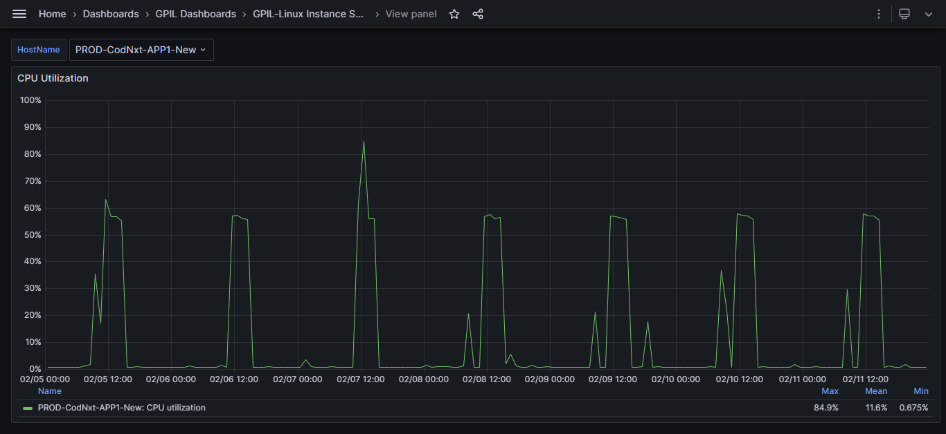
CPU Utilization Trend & Server Alerts – Prod CodNxt APP
Internal
<number>

Slide 16
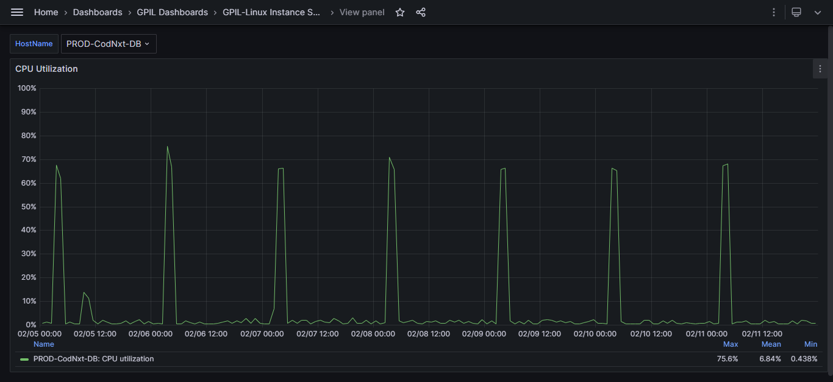
CPU Utilization Trend & Server Alerts – Prod CodNxt DB
Internal

Slide 17
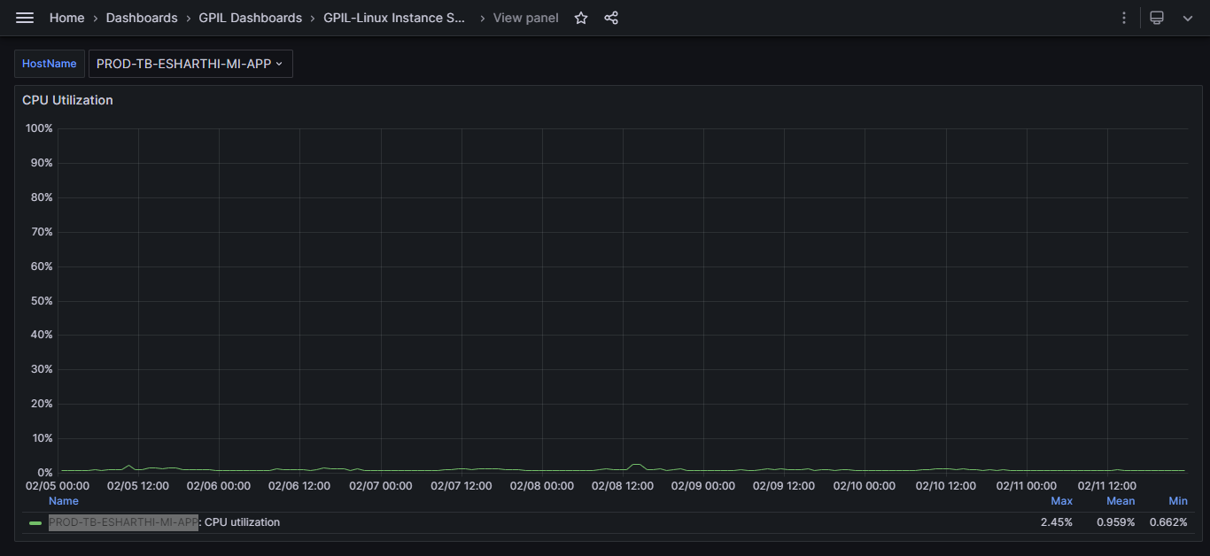
CPU Utilization Trend & Server Alerts – Prod Esaarthi APP
Internal

Slide 18
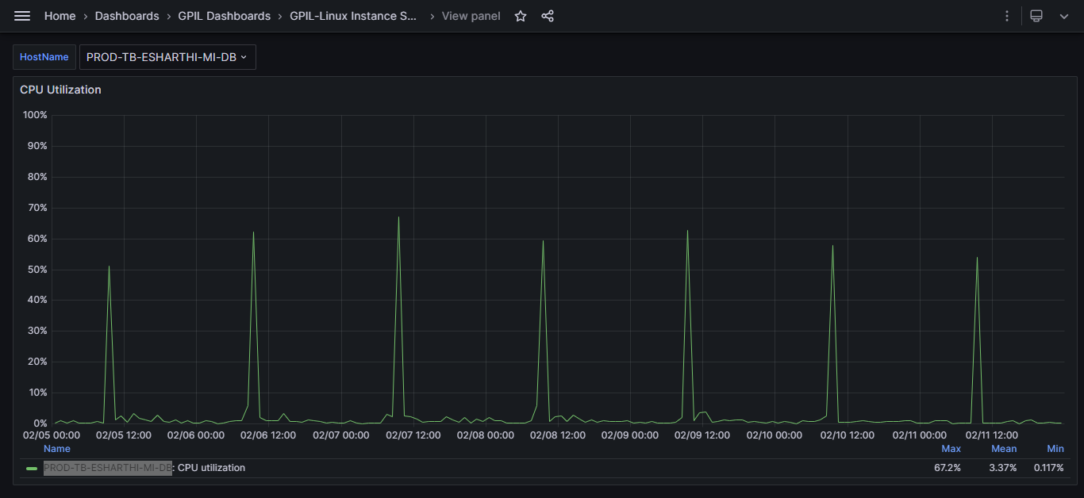
CPU Utilization Trend & Server Alerts – Prod E-Saarthi DB
Internal
<number>

Slide 19
Issues & RCA
No RCA found this Week.
Internal

Slide 20
Feedback tracker
Internal

Slide 21
VAPT Observations
SN | Web/APP | Observation | Risk/Impact | URL/IP | Status | Expected Closing Date | Remarks
1 | Modern Trade App | Python Unsupported Version Detection | The remote host is running unsupported versions of Python, indicating a lack of vendor support and leaving the system vulnerable to potential security threats due to the absence of future security patches.. | 10.250.8.214 | WIP | Not Decided | We have successfully deployed the python upgrade version on our local server and it's working fine same code we have deployed to the UAT server but on UAT we got CORS issue since last week and we are working on it. Note: We have to schedule a call with Wipro Team and discus further on that issue then we will decide the closing date.
<number>
Internal

Slide 22
VAPT Observations
SN | Web/APP | Observation | Risk/Impact | URL/IP | Status | Expected Closing Date | Remarks
2 | Secondary Sales Application MySQL | SSL Medium Strength Cipher Suites Supported (SWEET32) | The remote host utilizes SSL ciphers with medium strength encryption, defined as key lengths between 64 and 112 bits or the use of the 3DES encryption suite. | 10.250.1.189 | WIP | Not Decided | I have set the TLS version, but it's not working because the port is running with nohup cmd. That way, I need more time to understand why it's not working. Reason: SSL Support Protocol Assigned into Apache Conf file Following are the command SSL
<number>
Internal

Slide 23
VAPT Observations
SN | Web/APP | Observation | Risk/Impact | URL/IP | Status | Expected Closing Date | Remarks
 |  |  |  |  |  |  | Support Protocol –ALL TLSv1.0 which is we have already configured into Apache file httpd.conf but with local IP Address all protocol reflecting but with the domain name its working fine and both IPD address and Domian name route through the same httpd.conf file and port
<number>
Internal

Slide 24
VAPT Observations
SN | Web/APP | Observation | Risk/Impact | URL/IP | Status | Expected Closing Date | Remarks
3 | Secondary Sales Application MySQL | SSL RC4 Cipher Suites Supported (Bar Mitzvah) | The remote host's support for RC4 in its cipher suites poses a security risk due to flaws in the generation of pseudo-random streams, allowing potential plaintext derivation by attackers with access to large amounts of ciphertext, particularly in scenarios like repeated encryption of HTTP cookies. | 10.250.1.189 | WIP | Not Decided | I have set the TLS version, but it's not working because the port is running with nohup cmd. That way, I need more time to understand why it's not working. Reason: SSL Support Protocol Assigned into Apache Conf file Following are the command SSL
<number>
Internal

Slide 25
VAPT Observations
SN | Web/APP | Observation | Risk/Impact | URL/IP | Status | Expected Closing Date | Remarks
 |  |  |  |  |  |  | Support Protocol –ALL TLSv1.0 which is we have already configured into Apache file httpd.conf but with local IP Address all protocol reflecting but with the domain name its working fine and both IPD address and Domian name route through the same httpd.conf file and port
<number>
Internal

Slide 26
VAPT Observations
SN | Web/APP | Observation | Risk/Impact | URL/IP | Status | Expected Closing Date | Remarks
4 | Secondary Sales Application MySQL | TLS Version 1.0 and 1.1 Protocol Detection | The remote service allows encrypted connections using potentially insecure TLS 1.0 and 1.1 protocols, known for cryptographic flaws. Best practices recommend upgrading to TLS 1.2 or higher due to enhanced security features, and compliance standards like PCI DSS mandate disabling TLS 1.0 by specific deadlines to mitigate vulnerabilities. | 10.250.1.189 | WIP | Not Decided | I have set the TLS version, but it's not working because the port is running with nohup cmd. That way, I need more time to understand why it's not working. Reason: SSL Support Protocol Assigned into Apache Conf file Following are the command SSL
<number>
Internal

Slide 27
VAPT Observations
SN | Web/APP | Observation | Risk/Impact | URL/IP | Status | Expected Closing Date | Remarks
 |  |  |  |  |  |  | Support Protocol –ALL TLSv1.0 which is we have already configured into Apache file httpd.conf but with local IP Address all protocol reflecting but with the domain name its working fine and both IPD address and Domian name route through the same httpd.conf file and port Note: We need a meeting with VAPT team to understandf the exact problem
<number>
Internal

Slide 28
VAPT Observations
SN | Web/APP | Observation | Risk/Impact | URL/IP | Status | Expected Closing Date | Remarks
107 | E-Saarthi Prod | TLS Version 1.0 & 1.1 Protocol Détection | The remote service accepts connections encrypted using TLS 1.0. TLS 1.0 has a number of cryptographic design flaws. Modern implementations of TLS 1.0 mitigate these problems, but newer versions of TLS like 1.2 and 1.3 are designed against these flaws and should be used whenever possible. | 13.127.178.2 | Done |  | Pending approval from client side.
<number>
Internal

Slide 29
Action items / open items / support required
Sr No | Description | Owner | Status | Remarks
1 | E-Saarthi Os Upgrade Production | Triazine | Completed | Scope Point already shared on the Email with login credentials
2 | CodNxt- Upgrade | Triazine | Completed | Scope Point already shared on the Email with login credentials
3 | CodNxt Setup on UAT https://10.0.2.83:8443/ | Triazine | Completed | Already shared on the Email with login credentials
4 | E-Saarthi PHP Upgrade E-Saarthi on UAT https://10.0.2.83/login | Triazine | completed | Already shared on the Email with login credentials
<number>
Internal

Slide 30
GPI Ticket Tracker Sheet and Pending Task Sheet - Link
Ticket Tracker Sheet Link : Ticket Tracker.xlsx
GPI pending Task Sheet : GPI_Pending_Task_Sheet.xlsx
<number>
Internal

