Slide 1
SAR Change Detection
2003 the original bitemporal algorithm (DTU) (Conradsen, Nielsen, Skriver, Schou)
  Multilook, full quad pol observations
  likelihood ratio (LR) hypothesis testing
  Verified with EMISAR aerial data
  Software Matlab

Slide 2
2016 multitemporal algorithm introduced
  series of statistically independent LR tests to subsequences to determine times of change
  (later) complete characterization of the block diagonal case (important for Sentinel-1)
  (later) application to satellite imagery (RadarSat-2 time series, comparison of Python and MatLab)

Slide 3
After 2018 Series of papers (and tutorials) on applications with Google Earth Engine
  Site monitoring
  Adaptive temporal filtering
  Forest extent monitoring (in preparation)

Slide 4
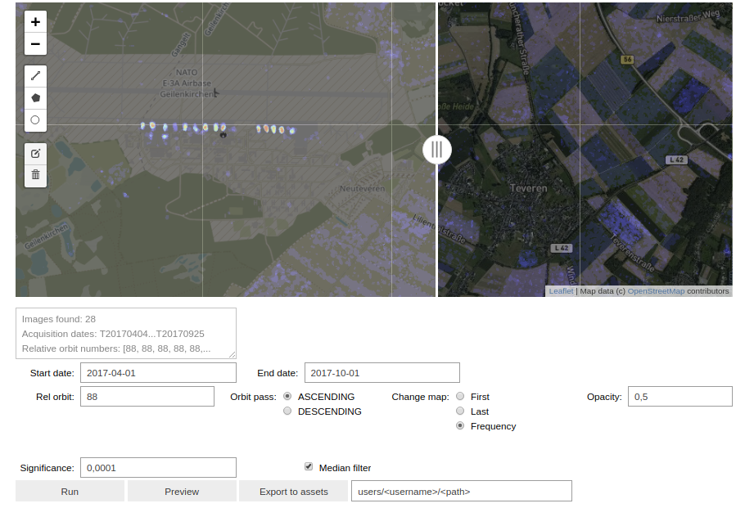
Nato Airbase

Slide 5
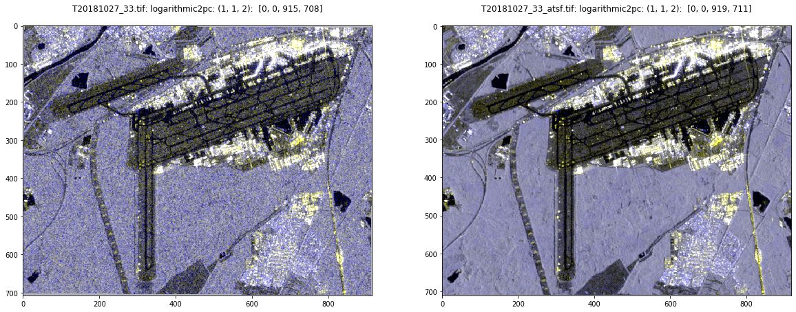
Adaptive Temporal Filtering

Slide 6
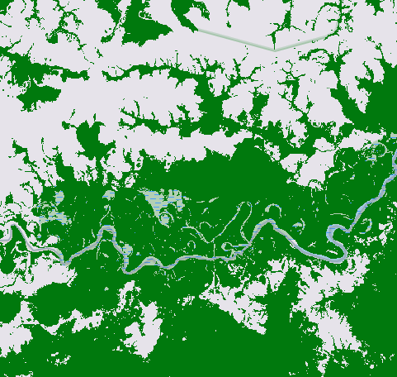
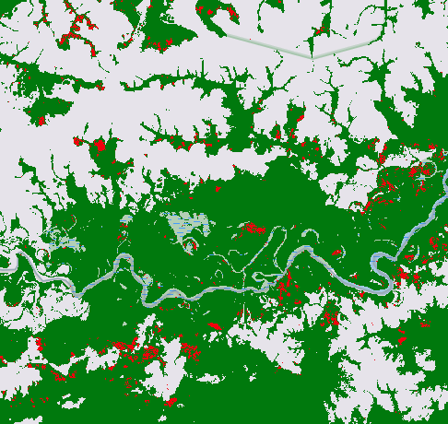
Forest Mapping

