Slide 1
ENVI/IDL Programming for Statistical Image Analysis
ZFL 2013
Mort Canty
Forschungszentrum Jülich
m.canty@fz-juelich.de

Slide 2
Literature
The ENVI/IDL Online Documentation, Exelis Inc.
IDL Programming Techniques (2nd Edition)
David W. Fanning, Fanning Software Consulting 2000
ISBN 0-9662383-2-X
Practical IDL Programming
L. E. Gumley (2nd Ed.)
Morgan Kaufmann 2003
ISBN 1558607005
Modern IDL, A guide to IDL Programming
M. Galloy 2011
Image Analysis, Classification and Change Detection in
Remote Sensing, with algorithms for ENVI/IDL (2nd Ed.)
M. J. Canty
Taylor and Francis 2010

Slide 3
Internet
http://www.exelisvis.com/docs/
comp.lang.idl-pvwave
http://dfanning.com
http://michaelgalloy.com/
http://ms-image-analysis.appspot.com/static/homepage/index.html
http://fwenvi-idl.blogspot.com

Slide 4
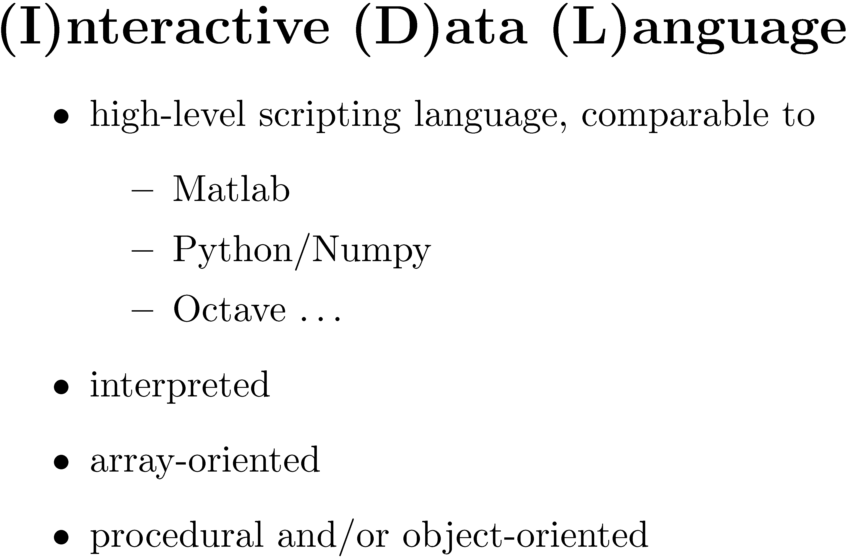

Slide 5
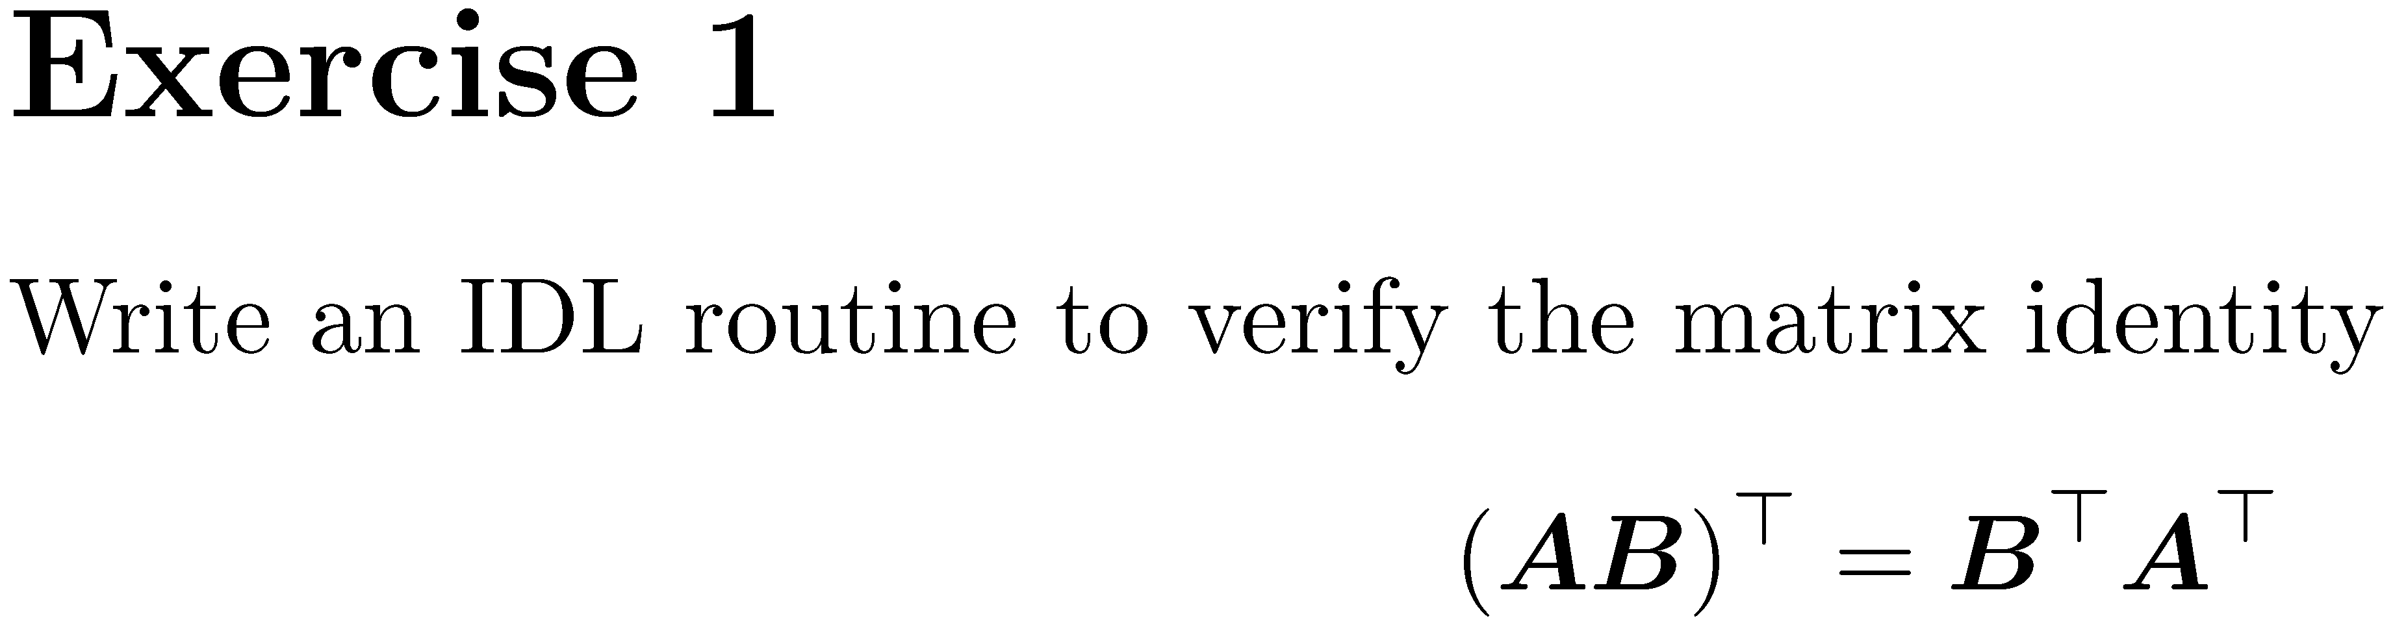

Slide 6
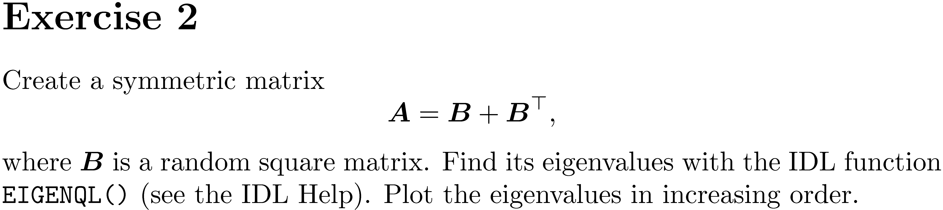

Slide 7
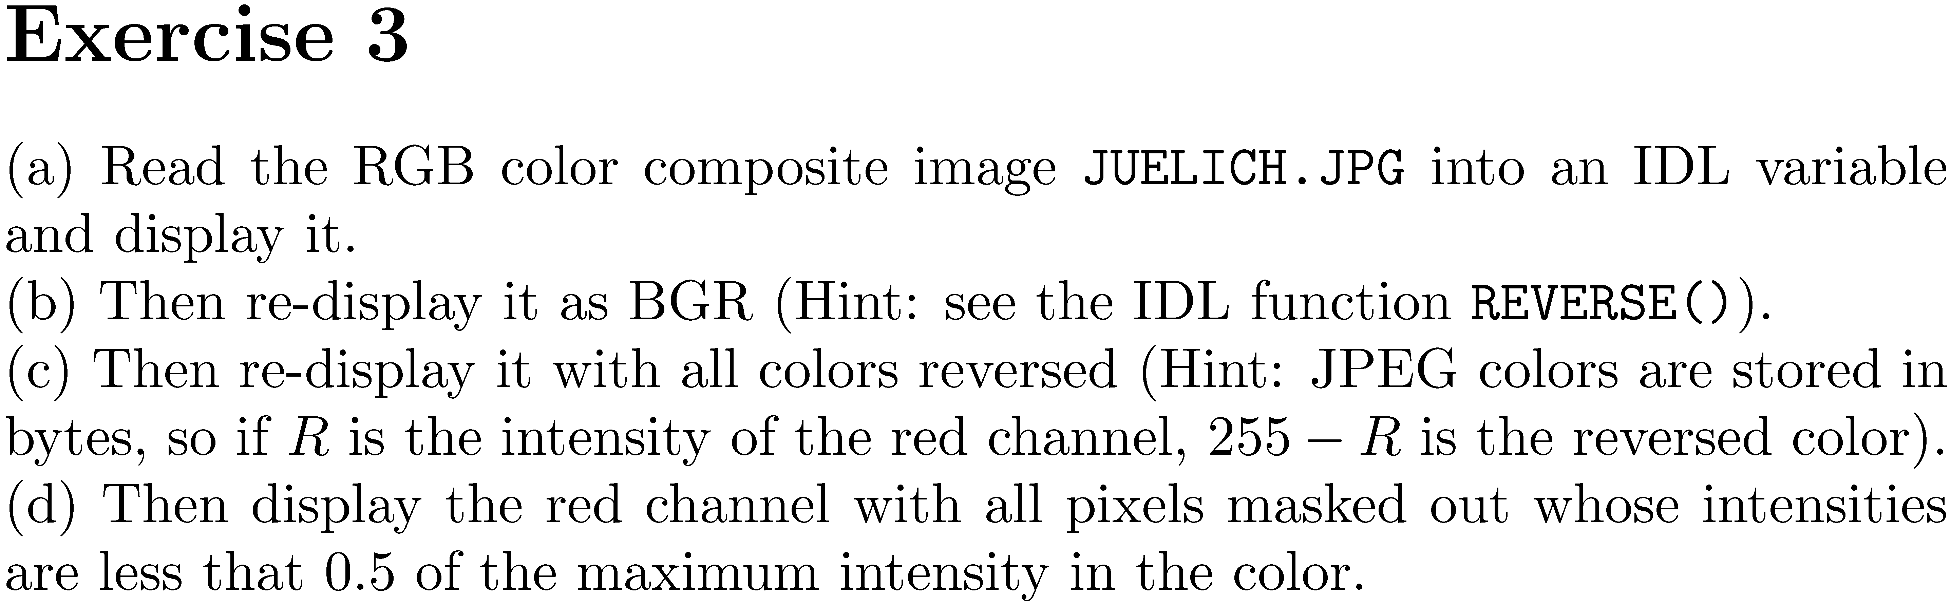

Slide 8
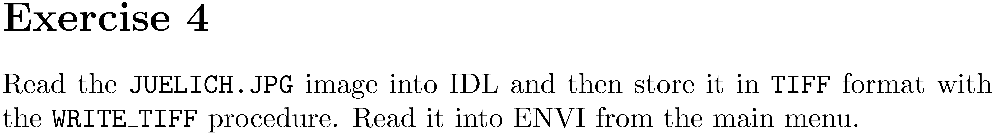

Slide 13
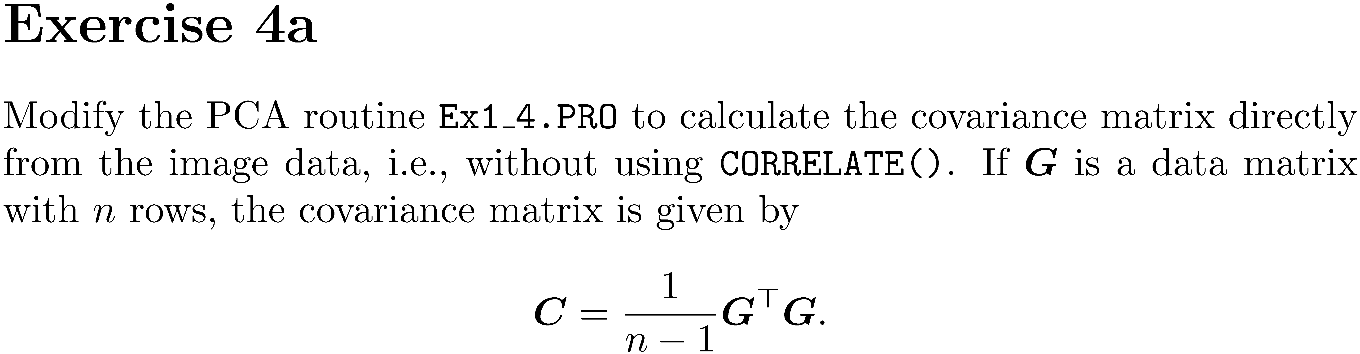

Slide 14
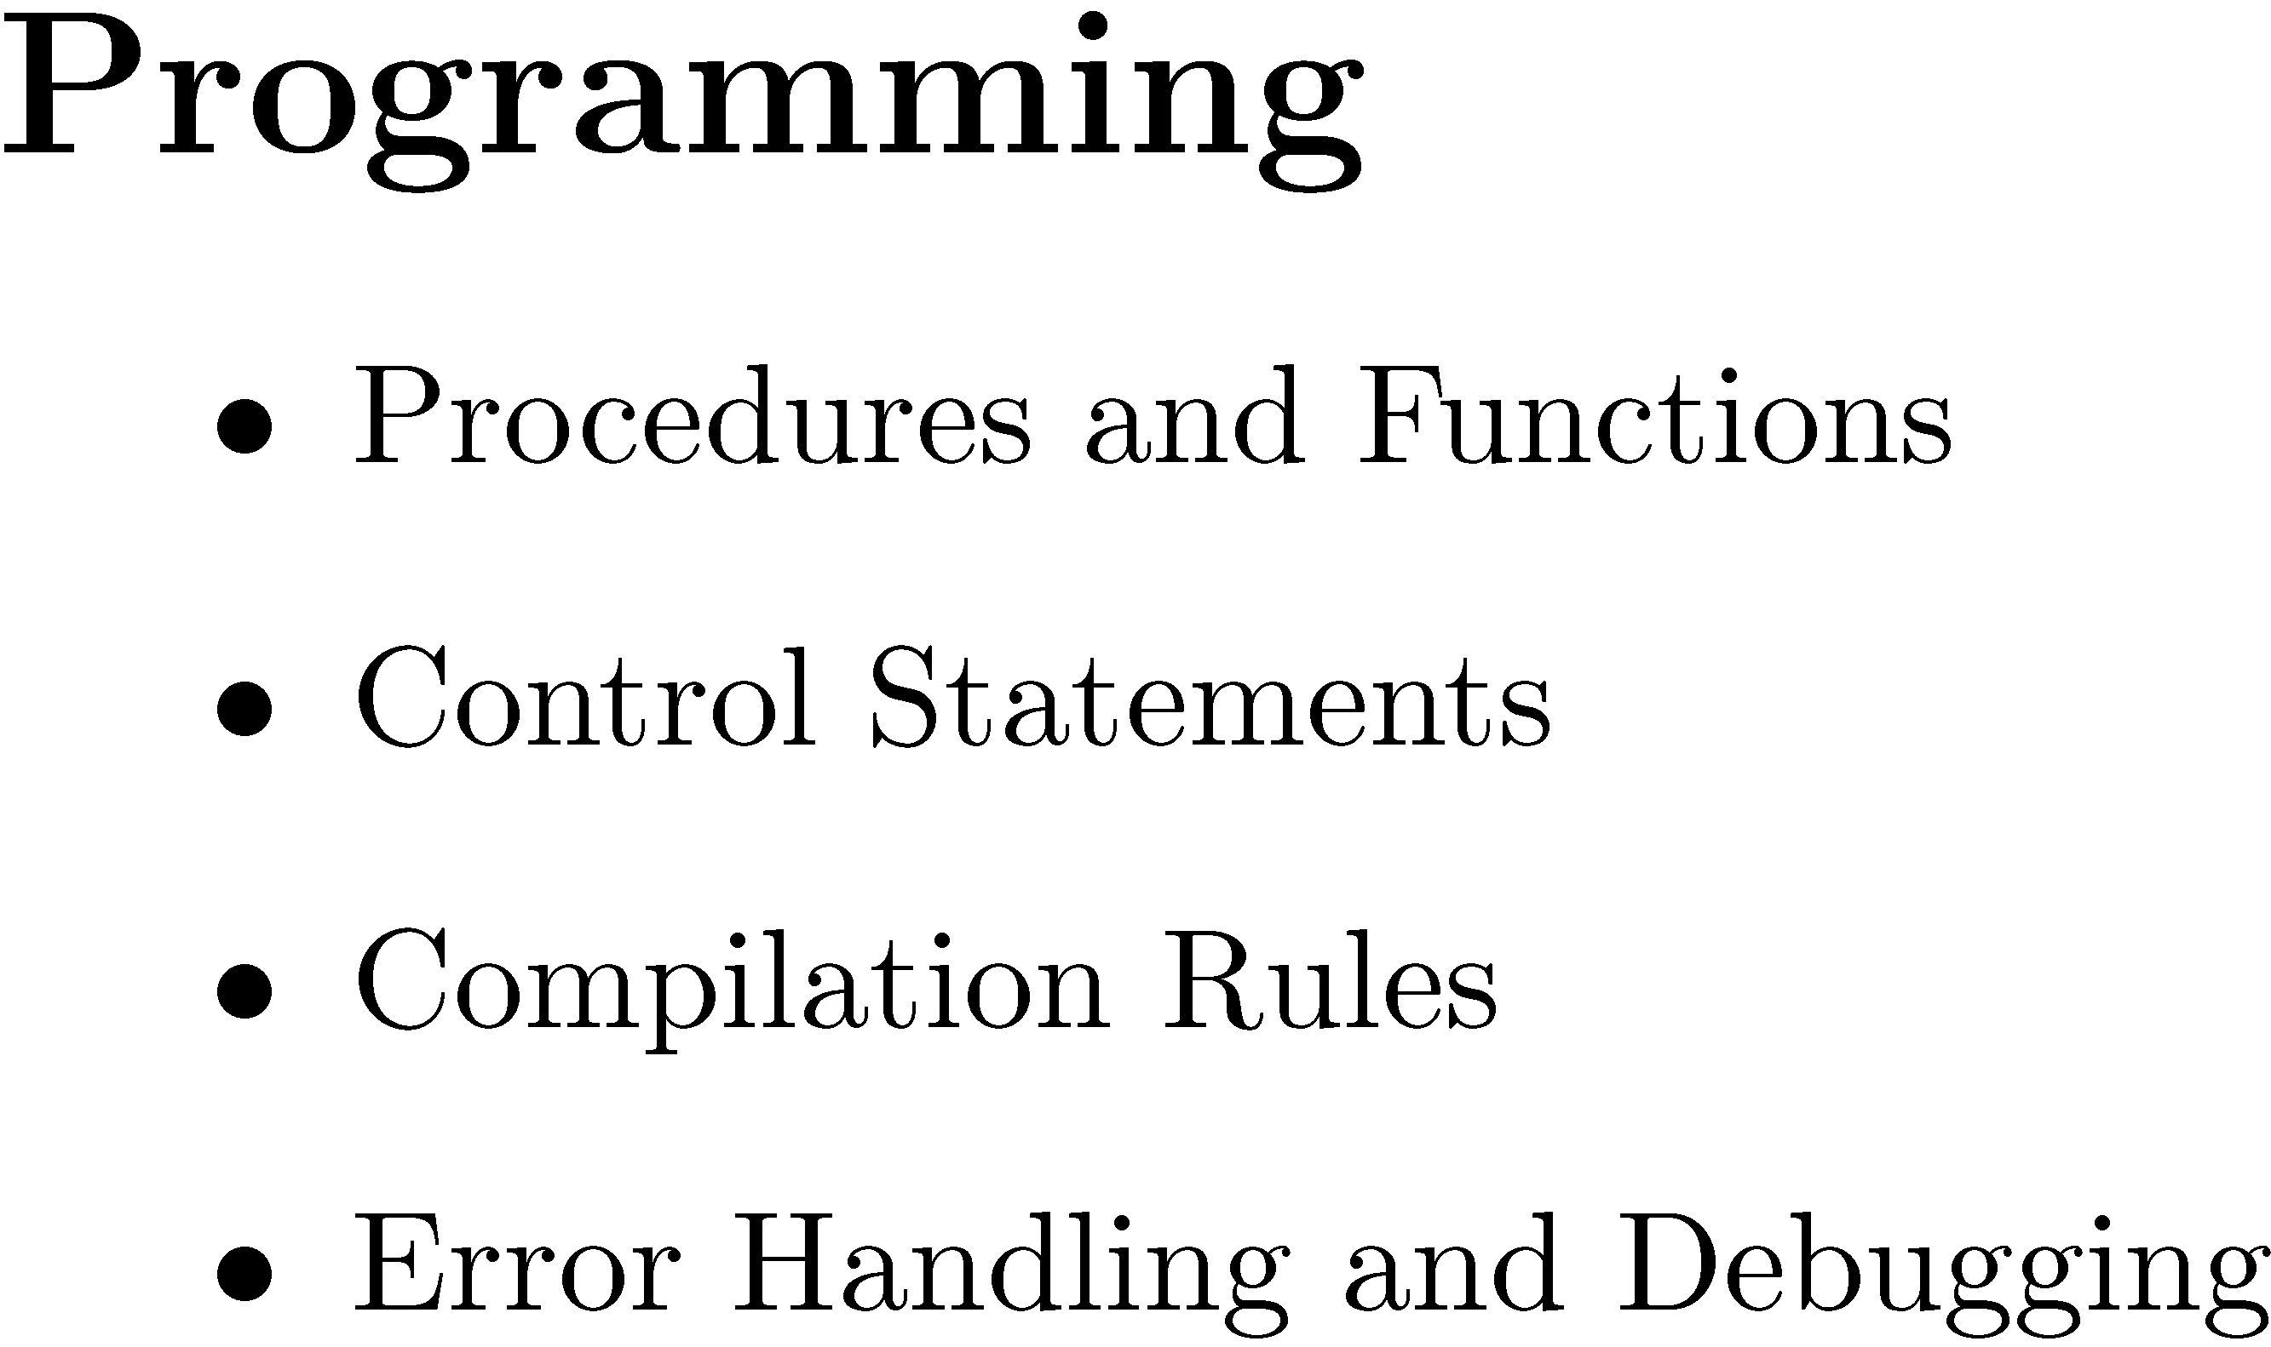

Slide 15
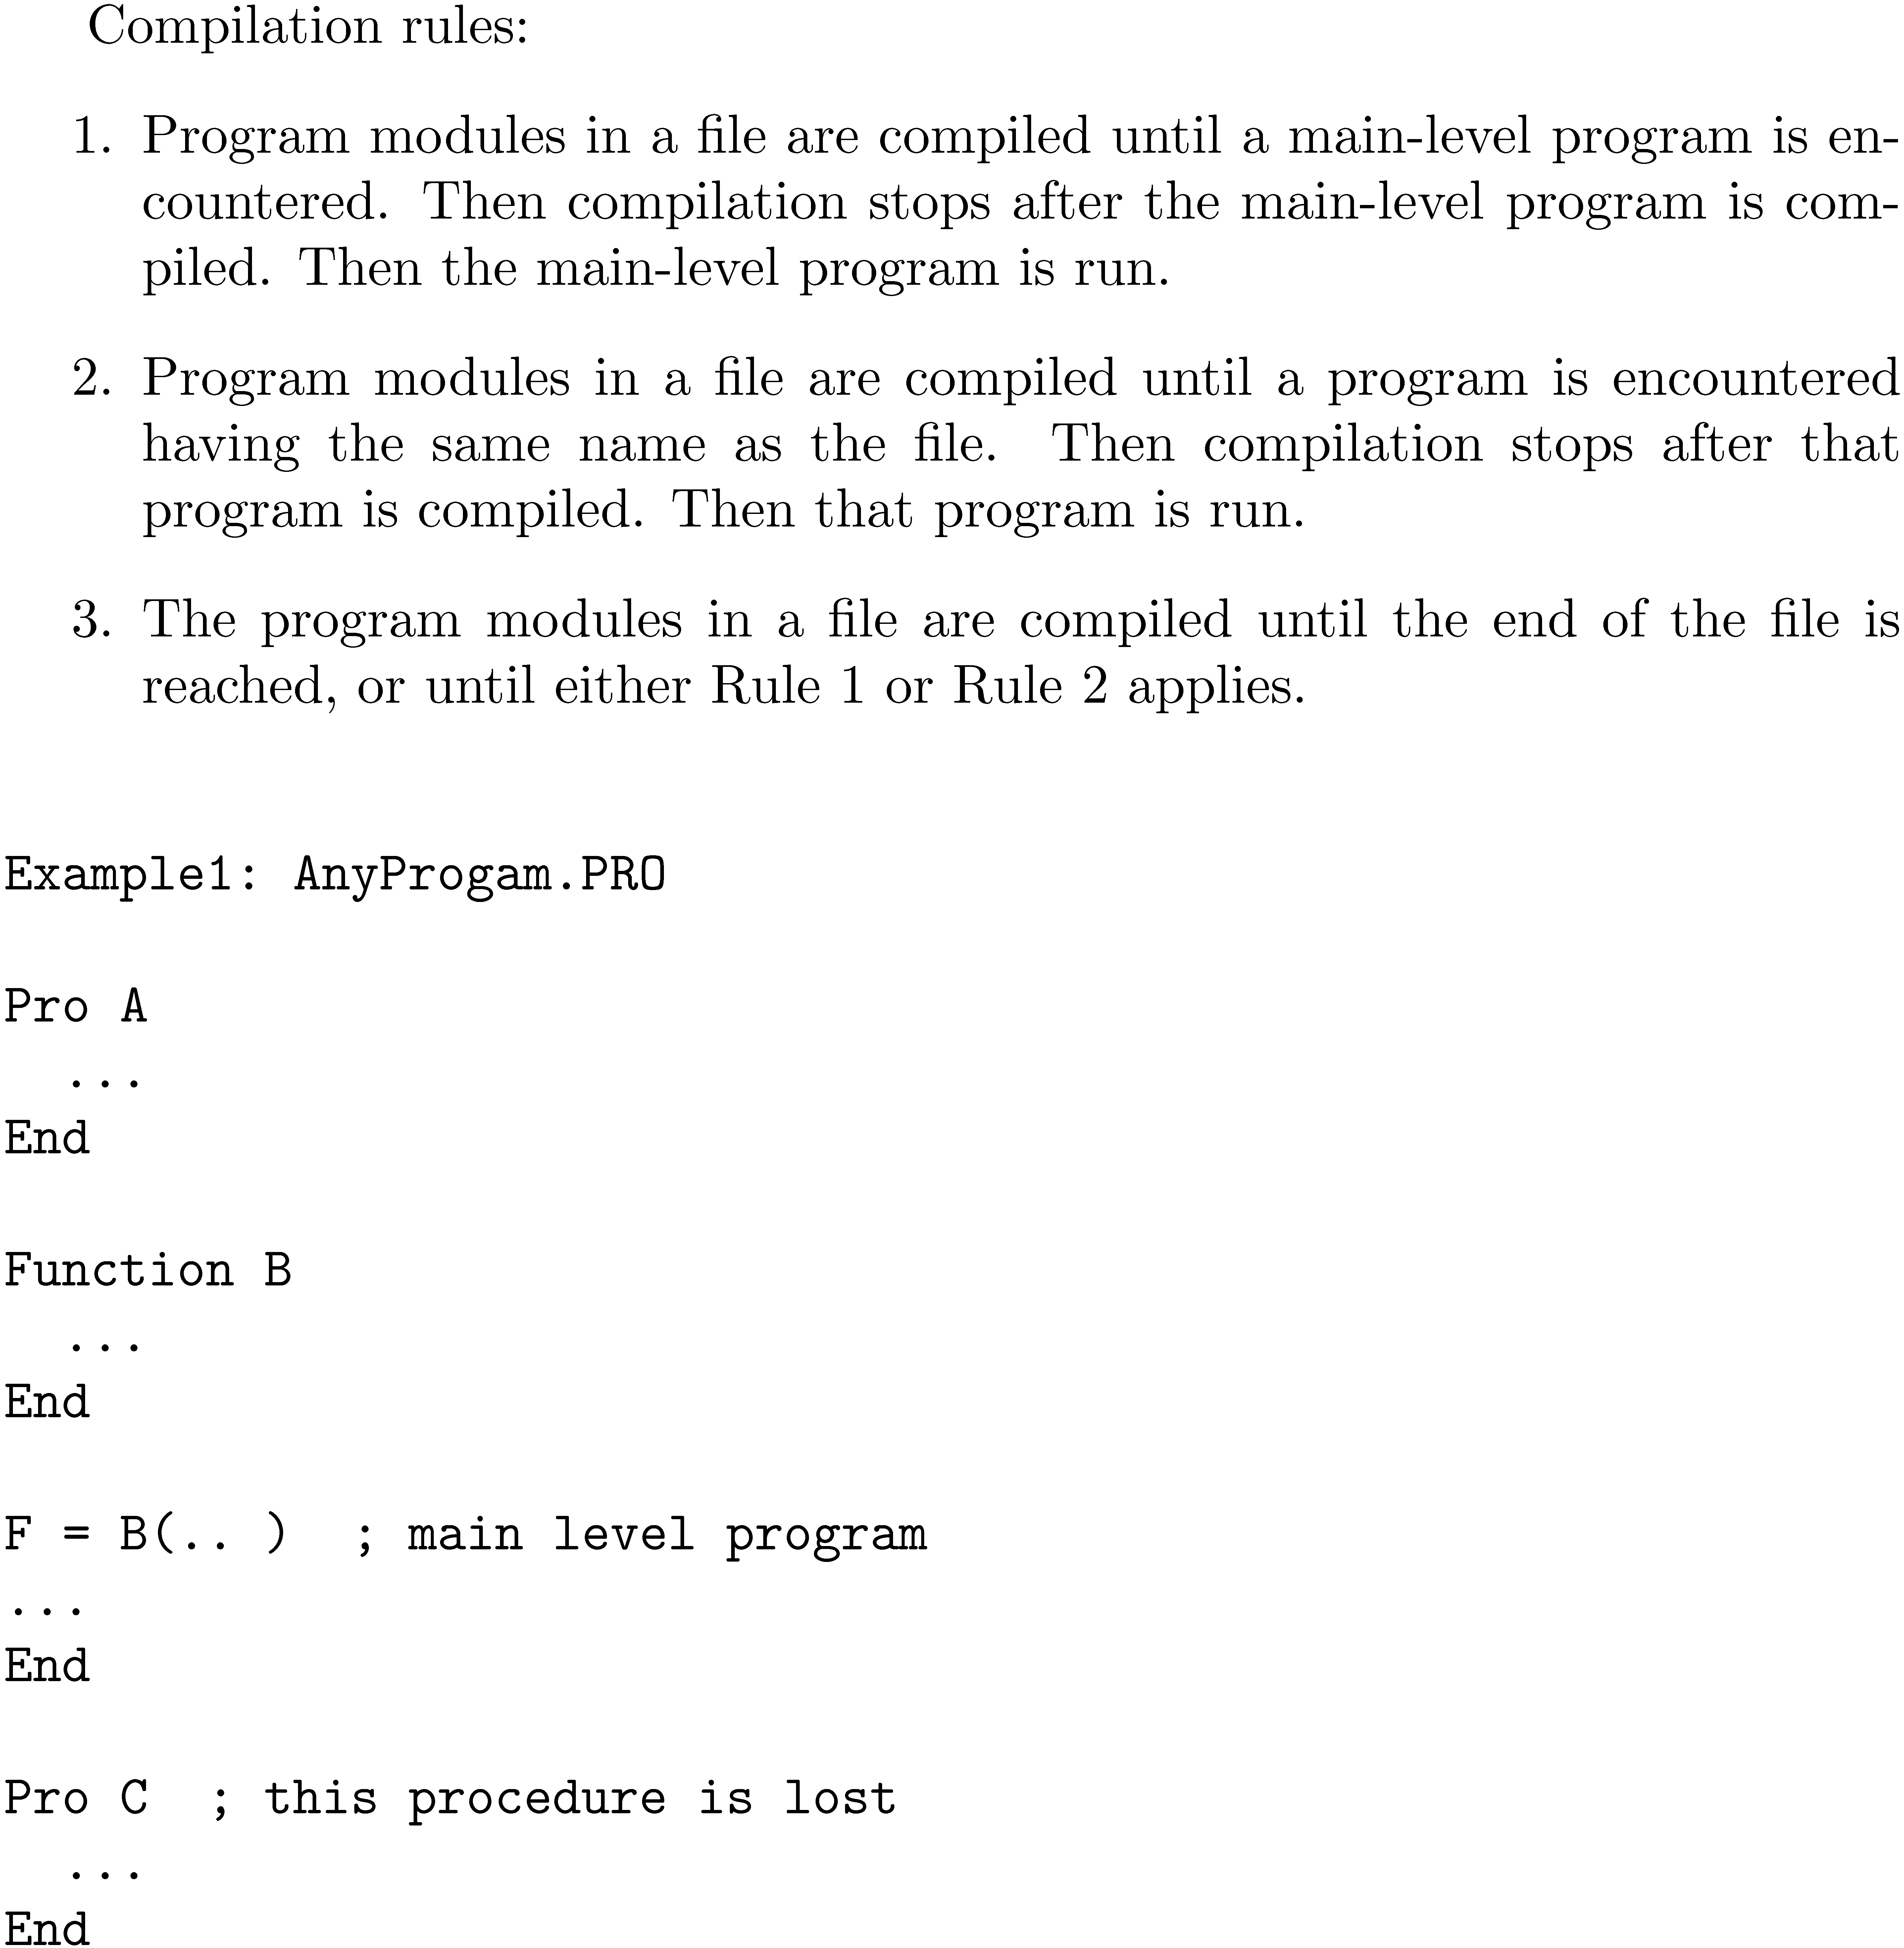

Slide 16
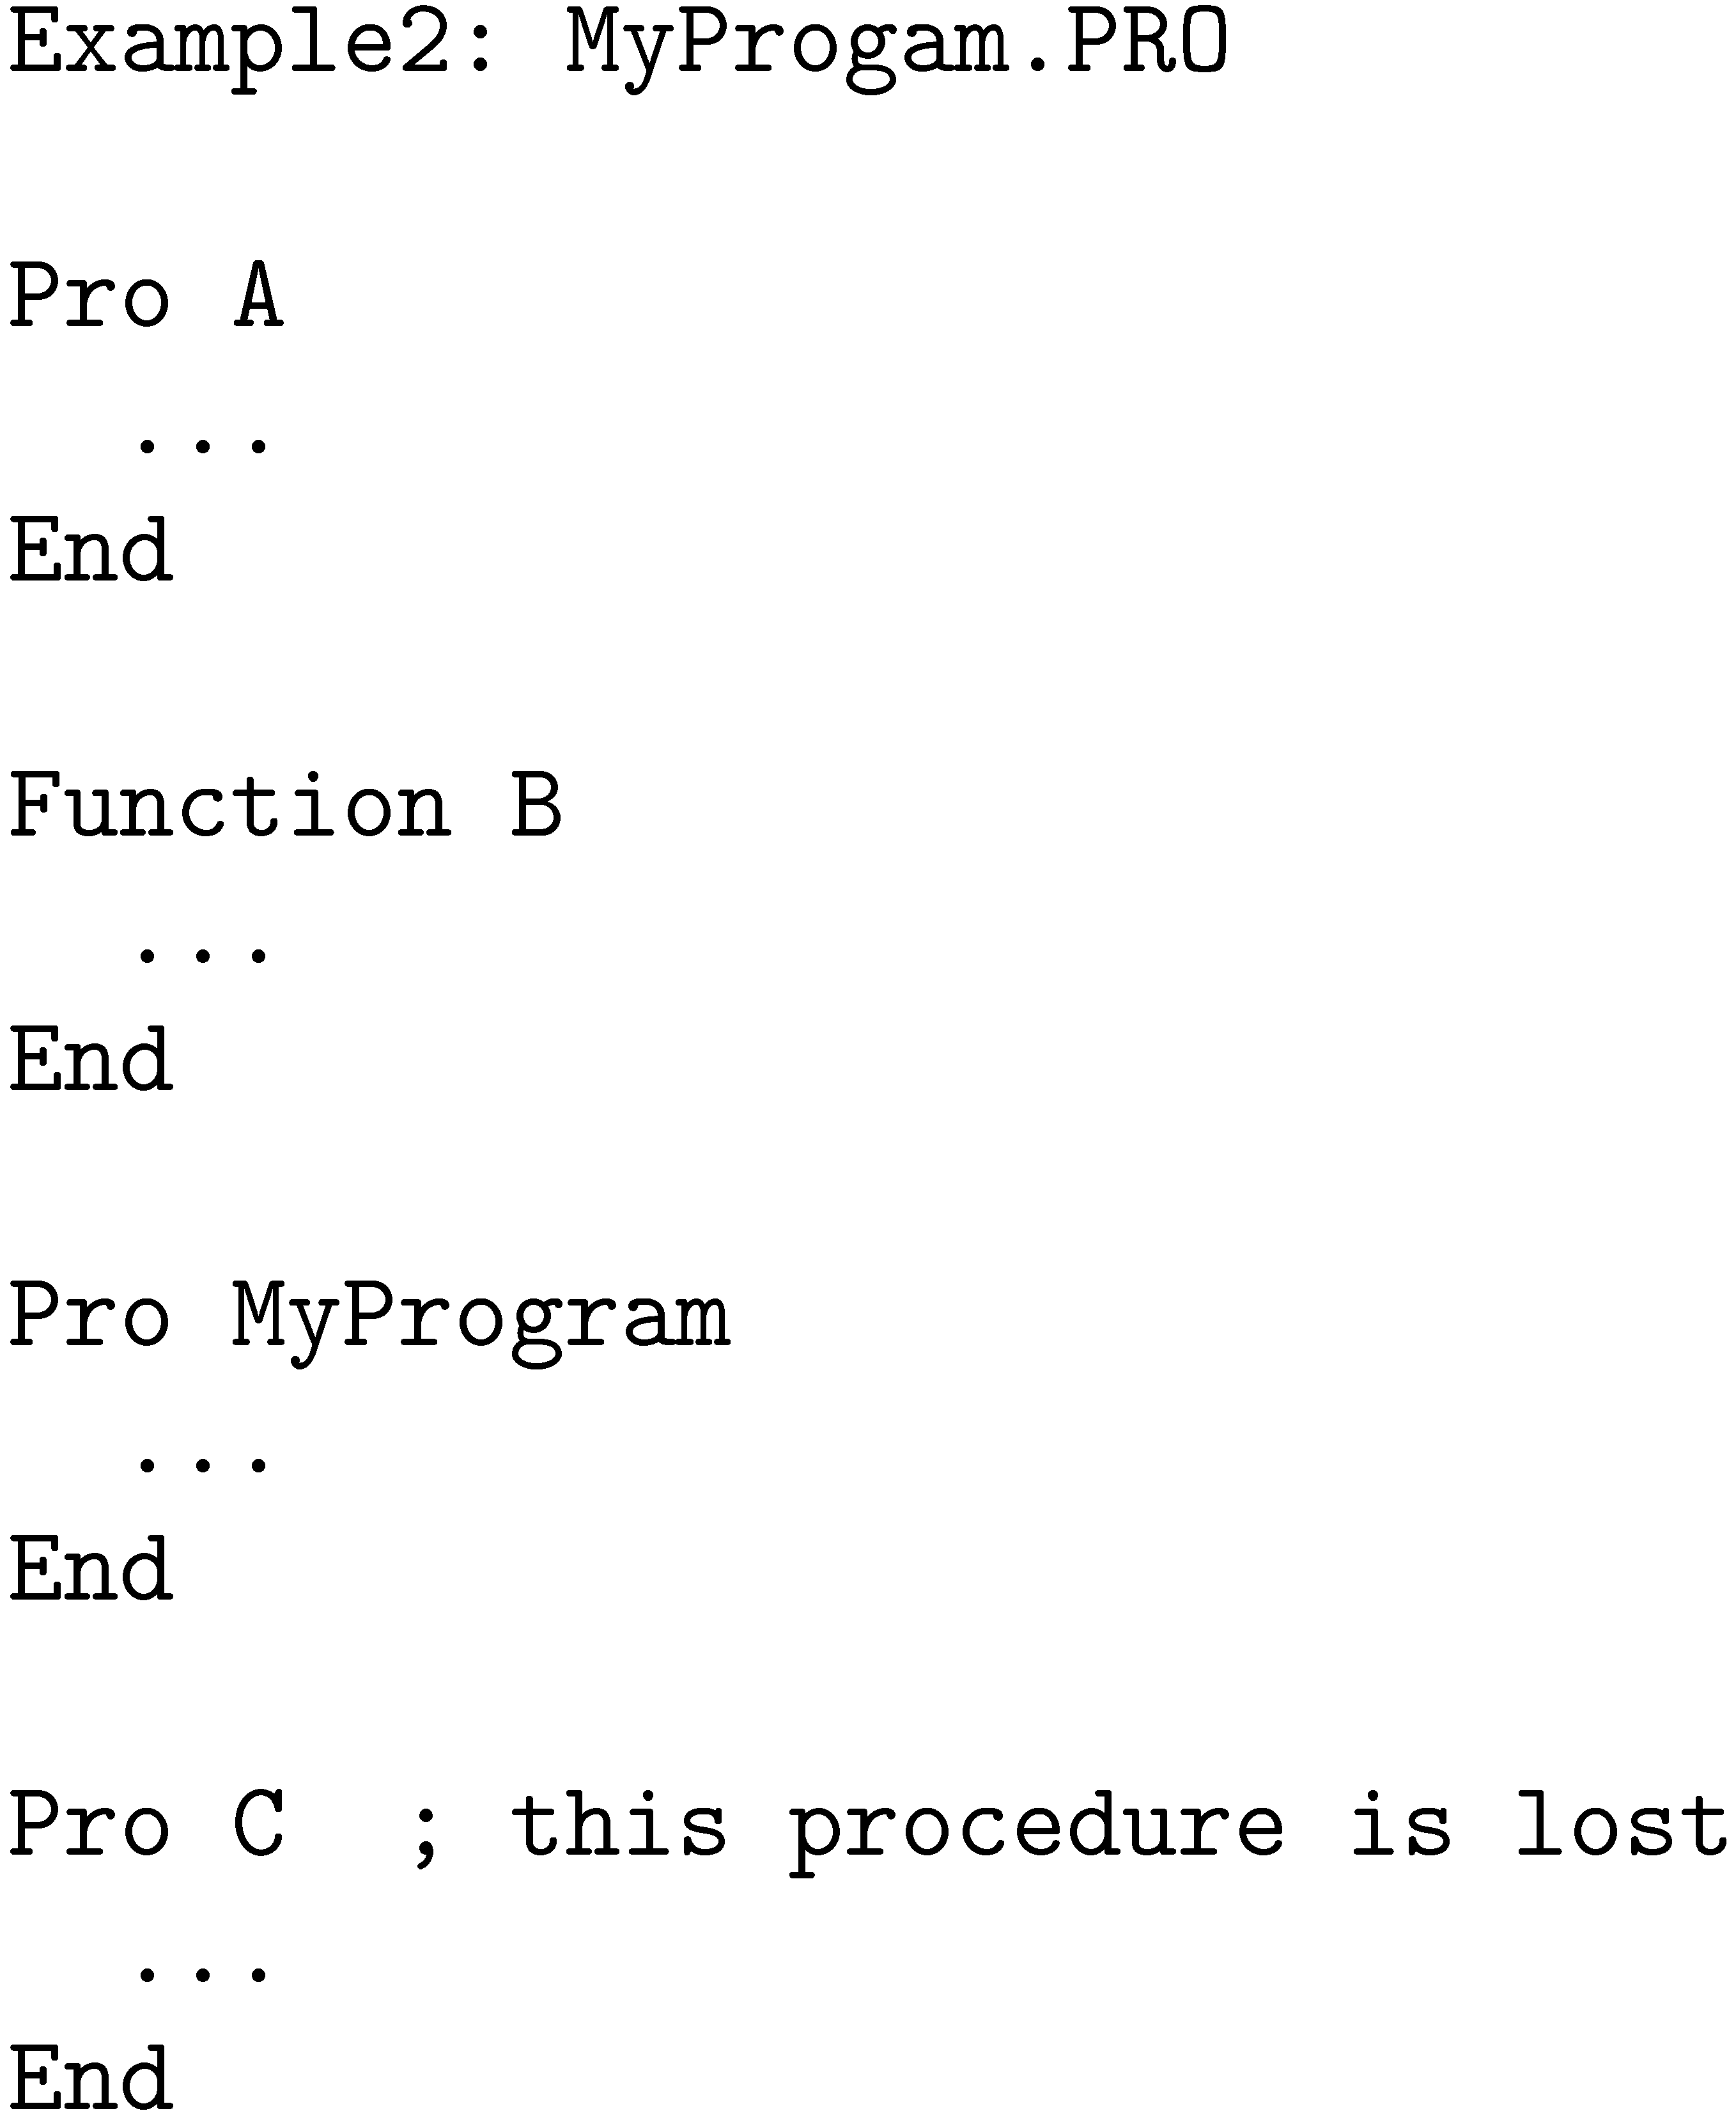

Slide 17
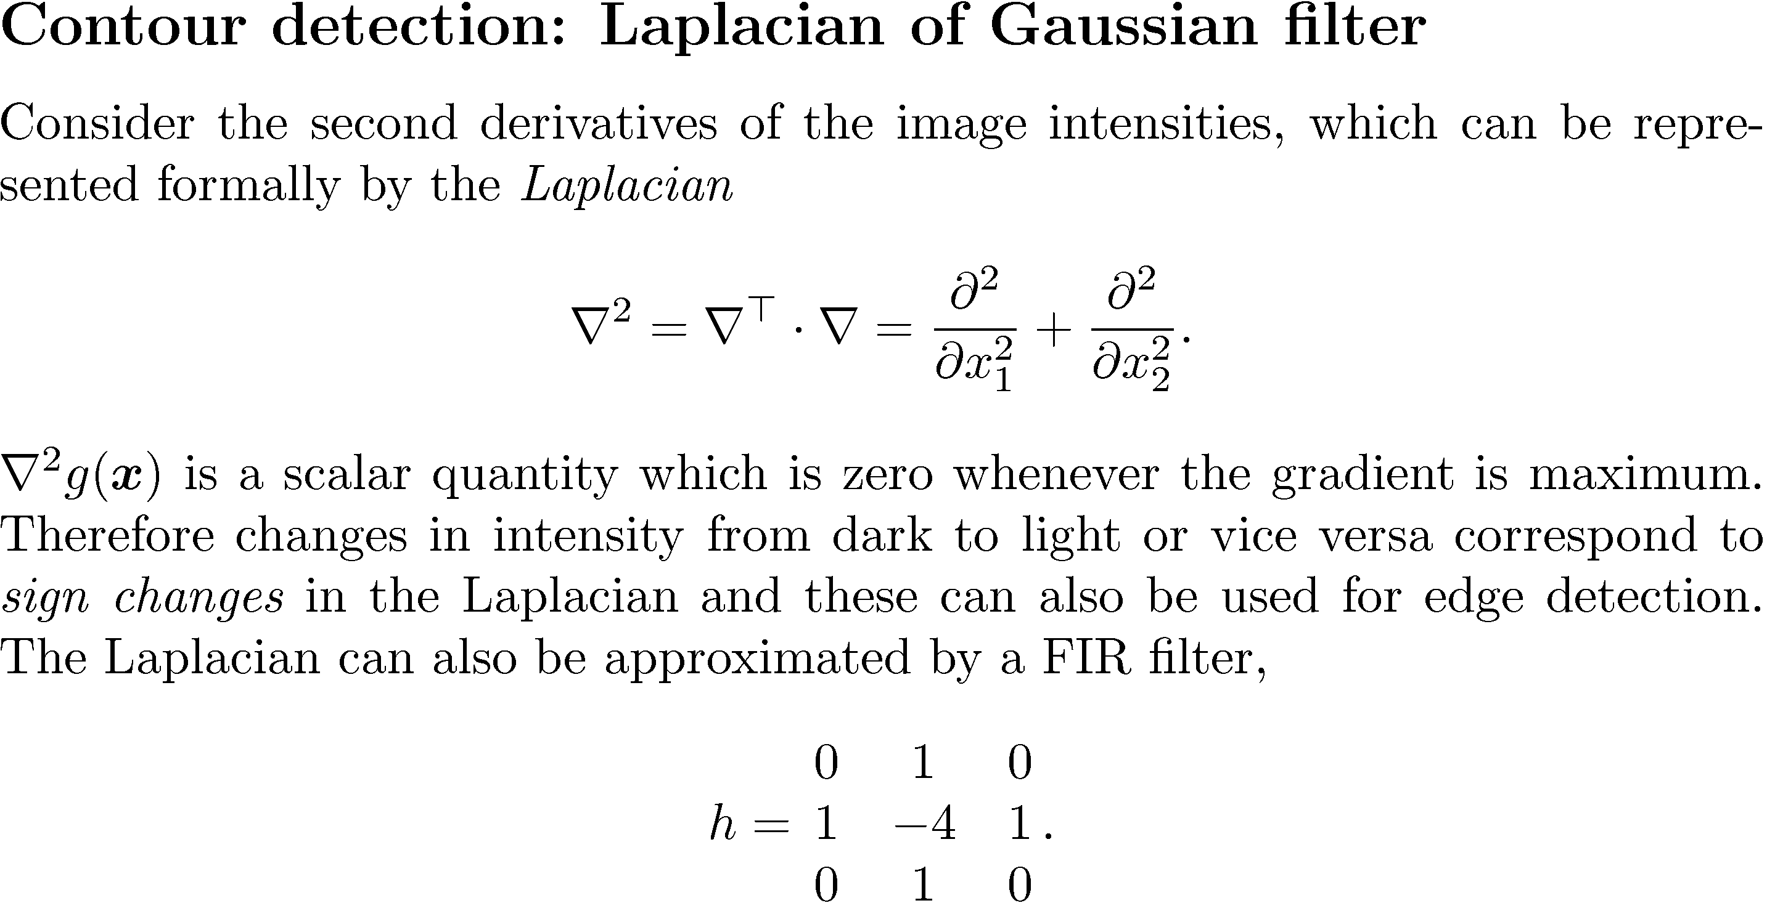

Slide 18
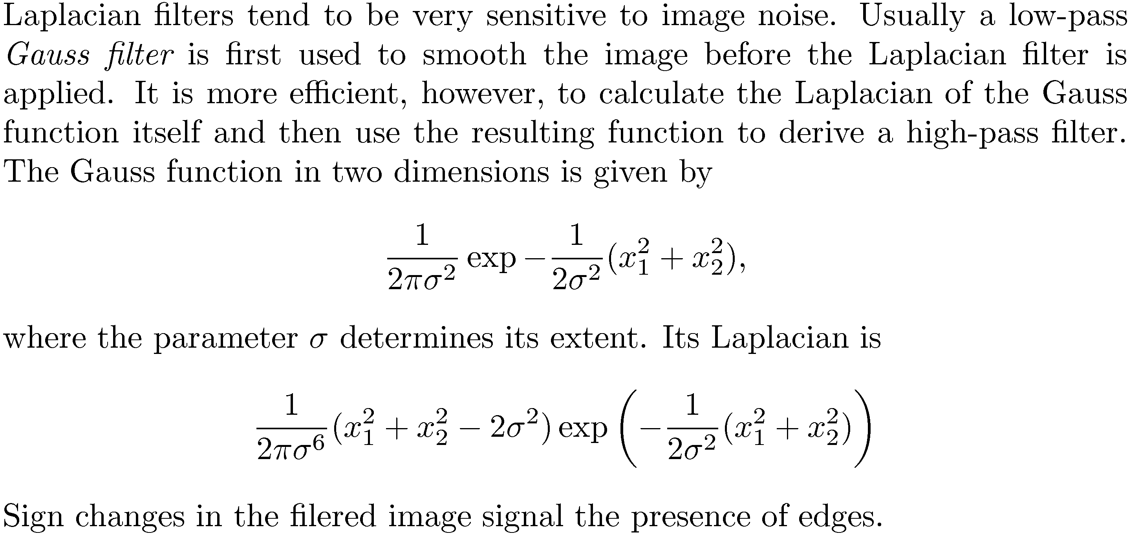

Slide 19
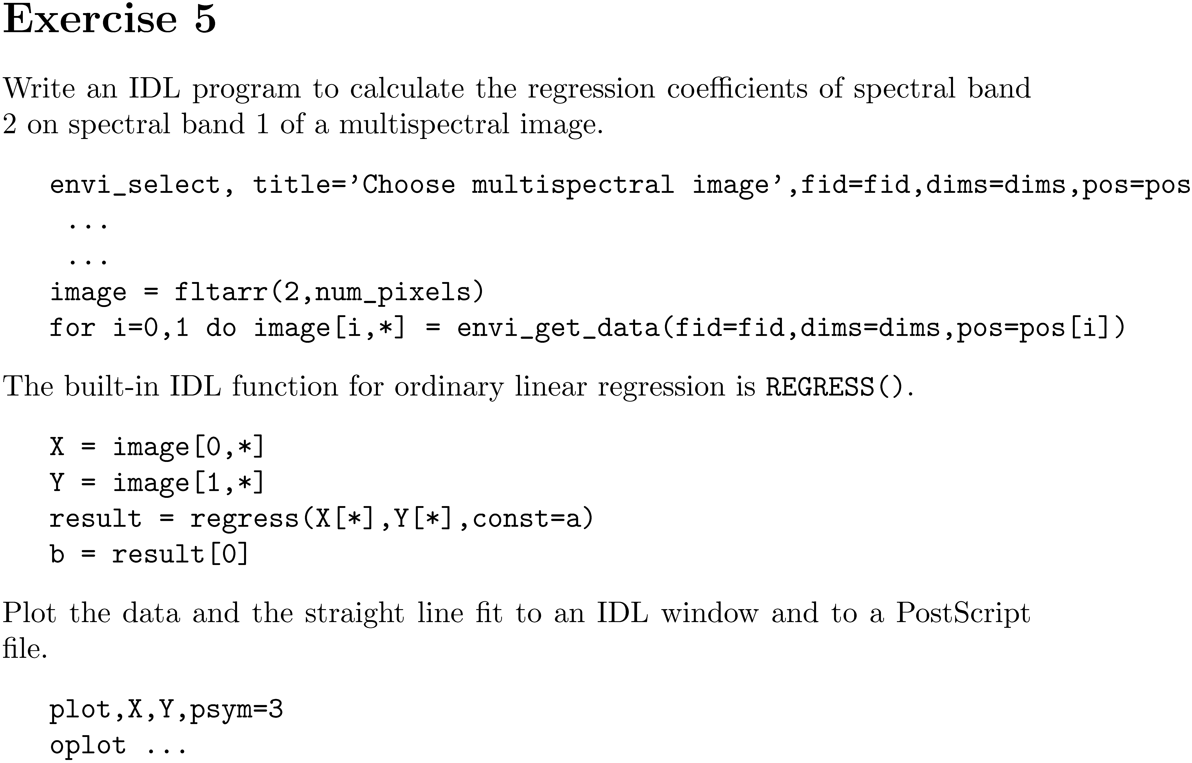

Slide 20
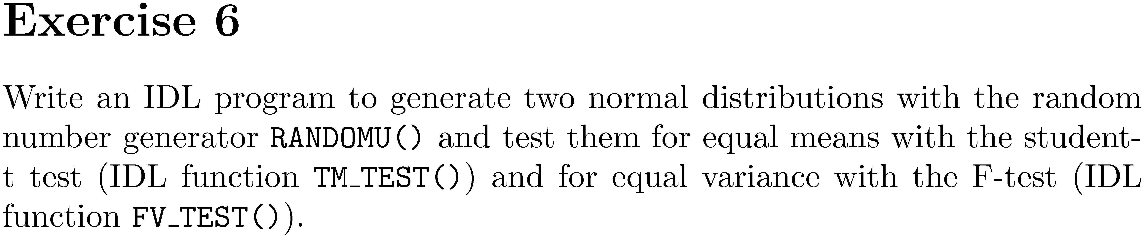

Slide 21
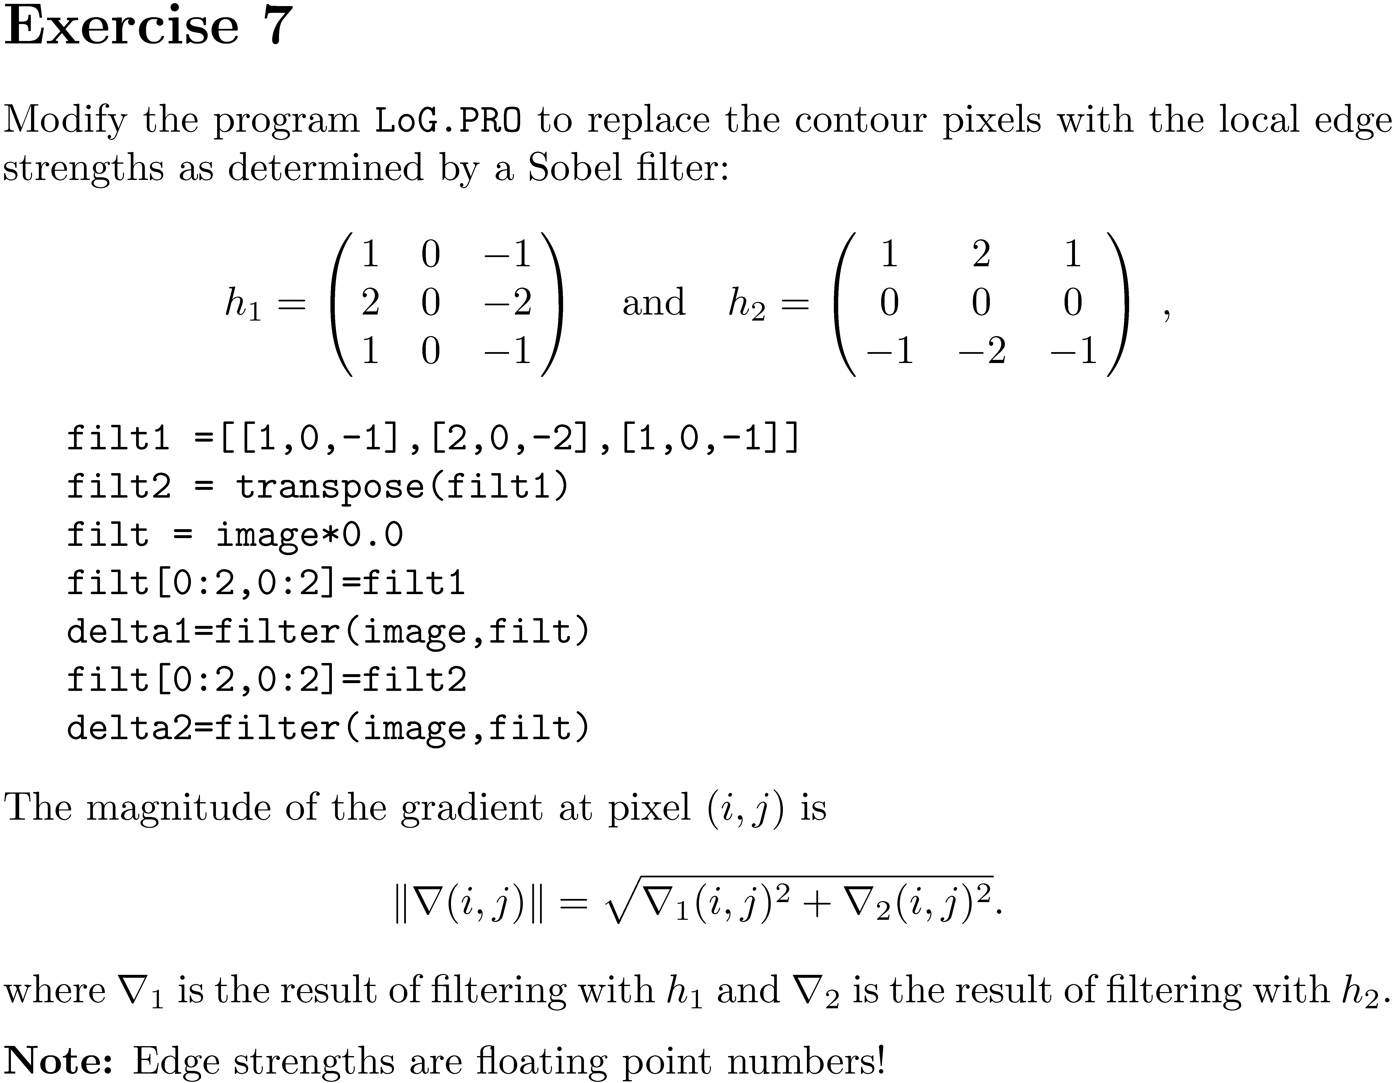

Slide 22
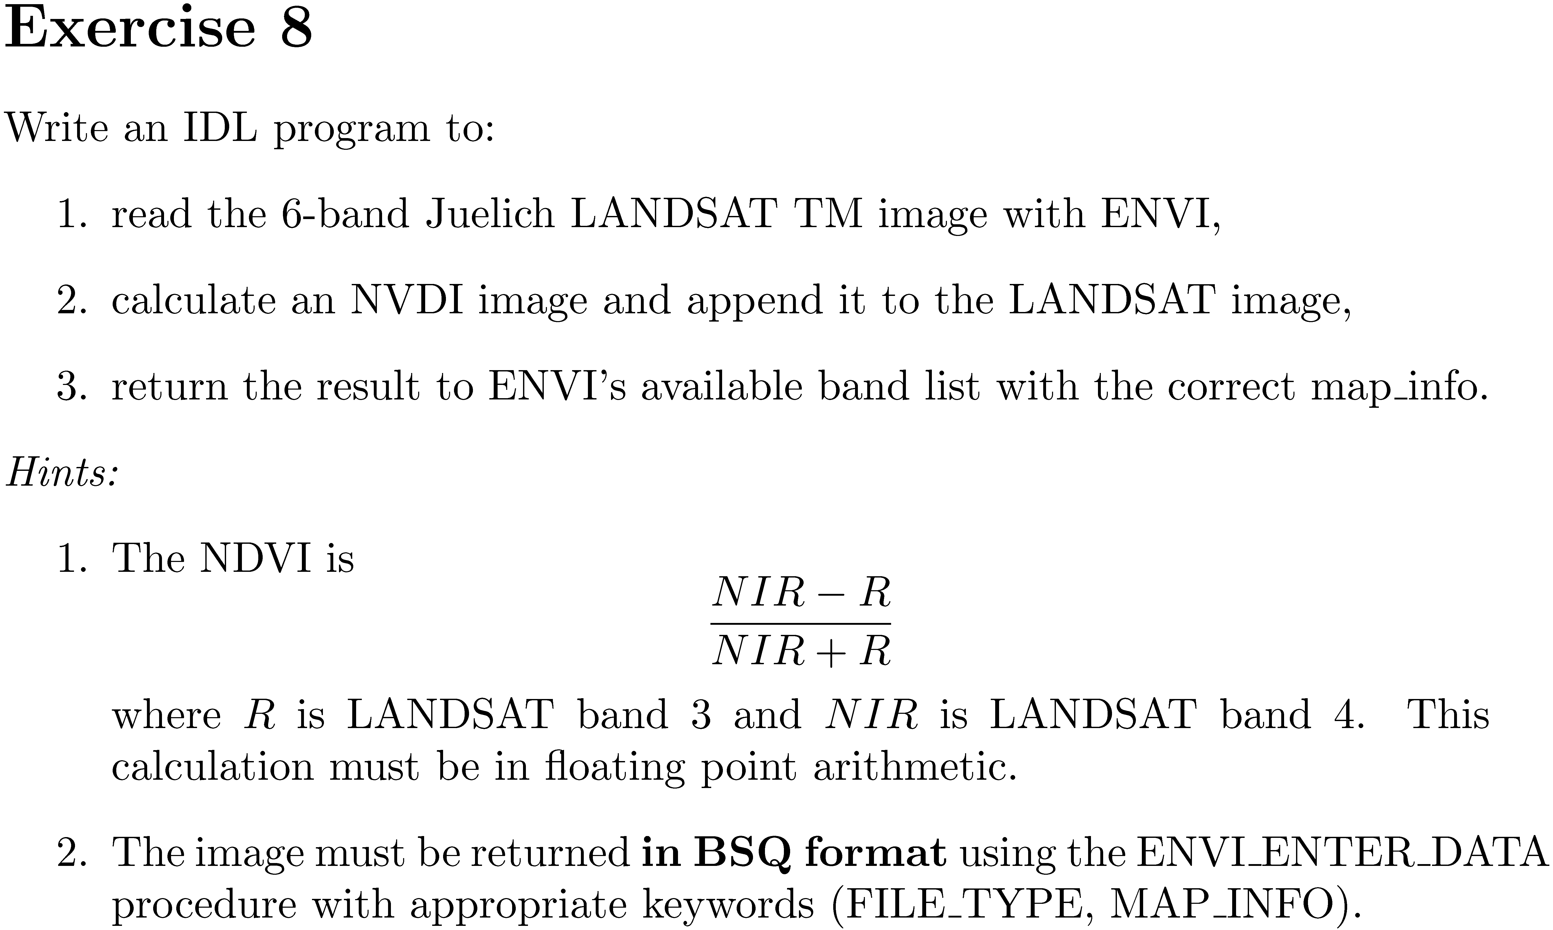

Slide 23
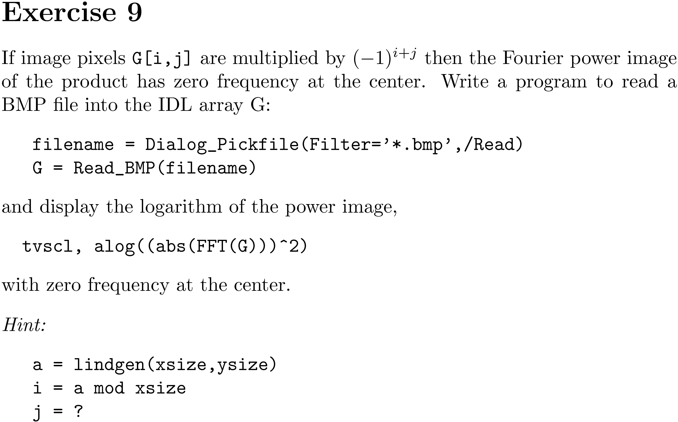

Slide 24
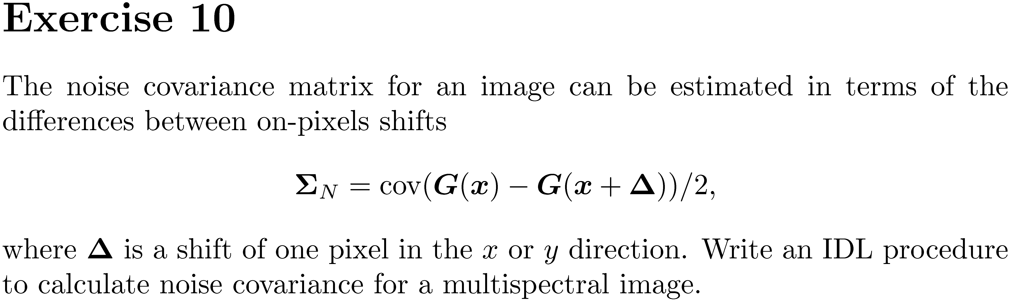

Slide 25
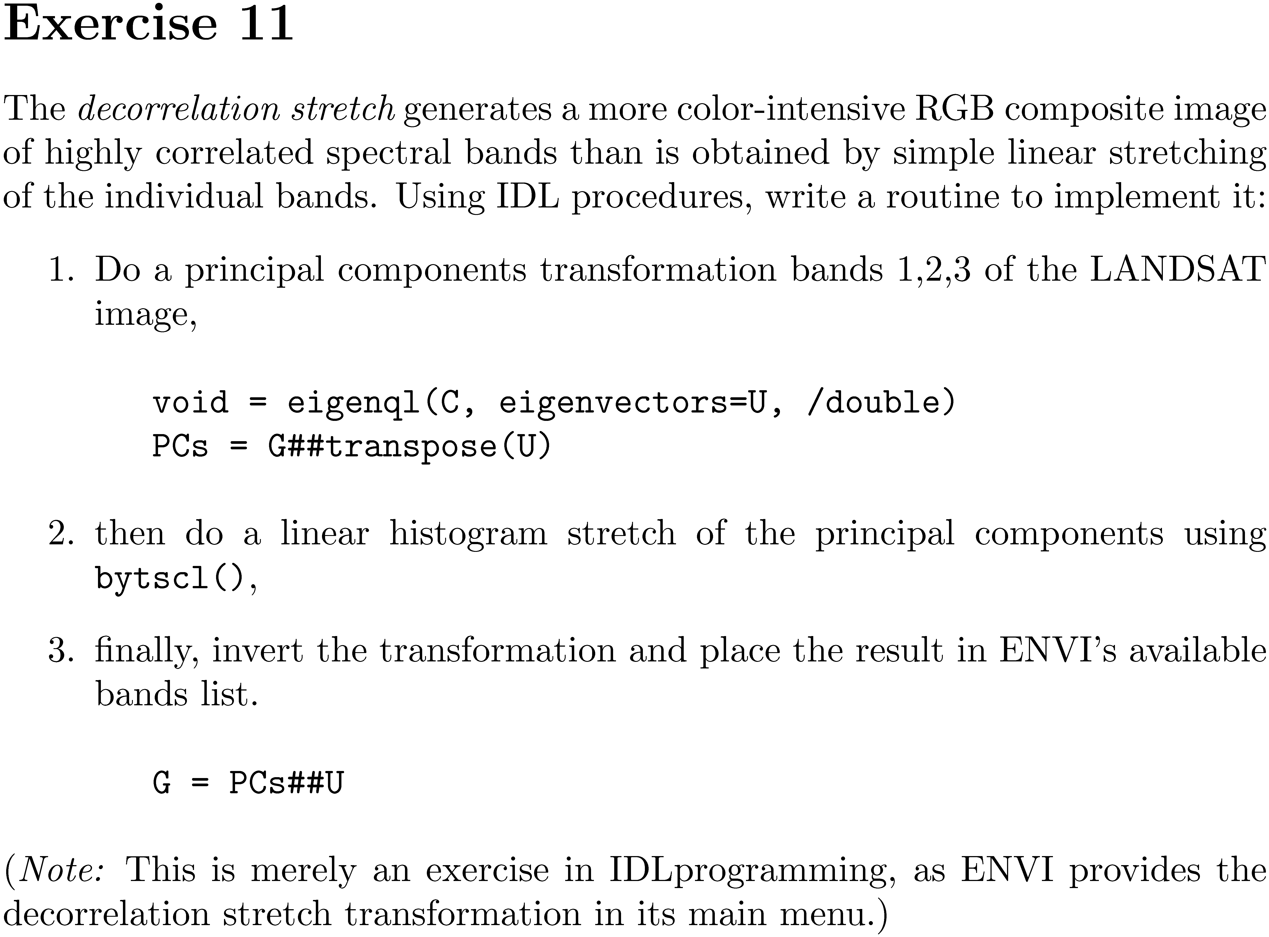

Slide 26
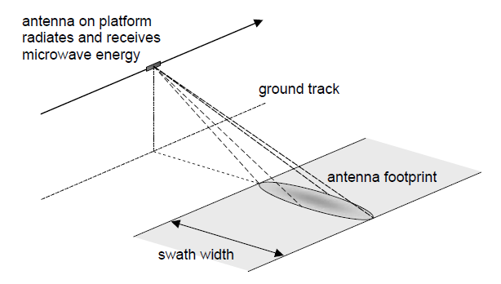
SAR Imagery

Slide 27
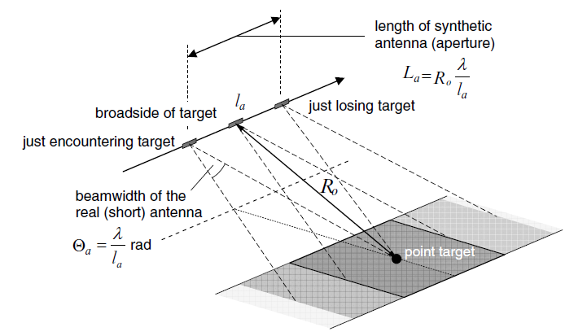

Slide 28
