Slide 1
Iran Renewable System Analysis
Group A | February 5th, 2026
Data Science for Energy System Modelling
Notes:
Harry - Slides 4-8
Rebecca - 9-14
Siqe - 15-21
Mori - 22 - end

Slide 2
Outline
1 | Introduction
2 | Model Inputs
3 | Results
4 | Sensitivity Analysis
5 | Limitations
Group A | Iran RES Grid Modelling | DSESM | 5th Feb 2026

Slide 3
Introduction
Group A | February 5th, 2026
Data Science for Energy System Modelling

Slide 4
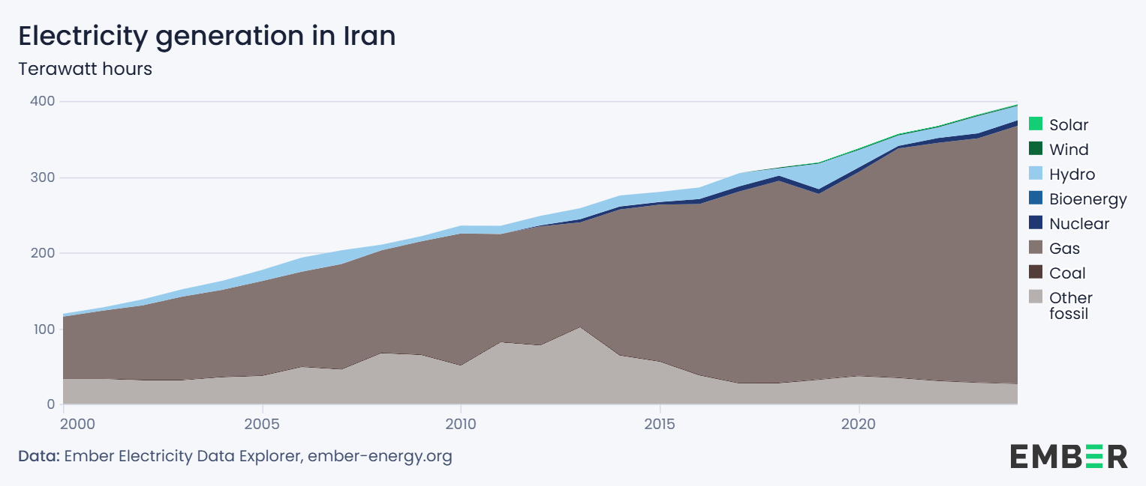
Context - Current State of Electricity System in Iran
0.2% (2023)
0.3% (2023)
2.1% (2022)
<0.1% (2023)
1.9% (2020)
86.6% (2023)
0.2% (2023)
7% (2023)
(Oil)
Fact Sources: (IR Gas Production, 2024), (IR Oil Production, 2023)
Notes:
Other Fossil = Oil
Electricity mix is attributed to large production of gas & oil in Iran
World’s 3rd largest producer, accounting for 7% of global gas supply
Additionally accounted for 4.4% of global oil supply in 2023

Slide 5
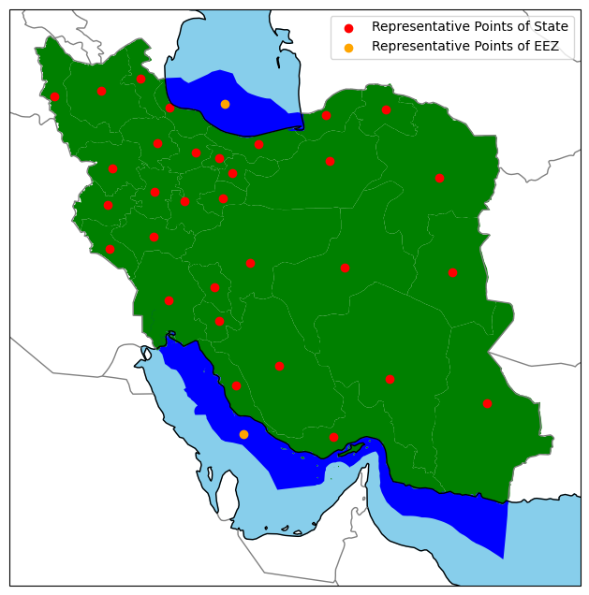
Context - Model Considerations
Area: 1.648 million km²
(vs. Germany: 0.357 million km²)
Population (2024): ~85,961,000
(vs. Germany ~83,600,000)
System costs sourced from various currency years
Cost projection year: 2025
Discount Rate: 7%
31 States + 2 exclusive economic zones (EEZ)
1 Bus per state/EEZ
Buses set at regional representative point
Sources: (Bundesamt, 2024), (Statistical Center of Iran, 2024)
Tehran
Group A | Iran RES Grid Modelling | DSESM | 5th Feb 2026
Notes:
Shapes of regions based on provided geojson
Mention No. of states and EEZs
4.6 times the area of Germany
Roughly the same population as DE
Population used to aggregate available national load data
2023 population data used as region-specific data was the most accurate

Slide 6
Model Inputs
Group A | February 5th, 2026
Data Science for Energy System Modelling

Slide 7
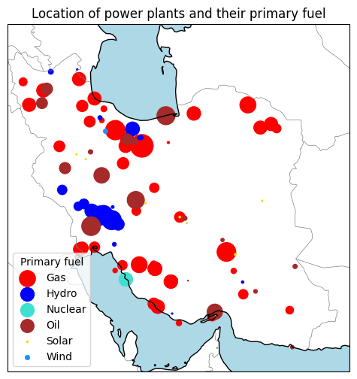
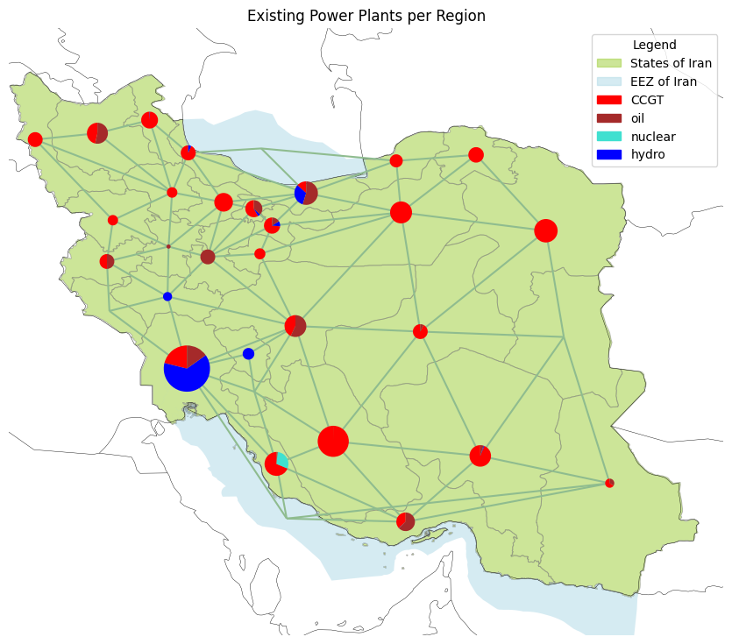
Inputs - Power Plant Capacities
Tehran
Khuzistan
Zagros
Regional Aggregation
RES Exclusion
Links between neighbor regions
Group A | Iran RES Grid Modelling | DSESM | 5th Feb 2026
Notes:
Based on the provided powerplant data from the dataset
powerplant mix is dominated by gas; large concentration of generators around Tehran, ports & bordering nations
Minimal existing Solar or Wind; makes exclusion for RES modelling quite accurate to actual situation
Hydro is also concentrated along the Zagros mountain range which runs from northwest to southeast
Powerplants were aggregated by technology and region with geometry reset to the regional representative point
Examining the regional electricity mix in the aggregated model;
colour indicated the regional share, size indicates the comparable regional generation
most of the east is almost purely powered by gas
oil takes a comparable share to gas in the central north & south
Hydro dominates Khuzistan; the highest generating region
Some Smaller regions neighbouring the Zagros mountains run completely on hydro

Slide 8
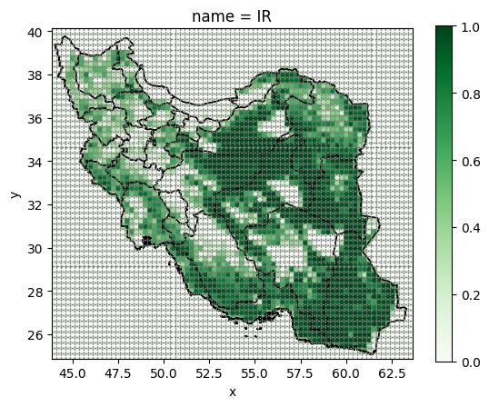
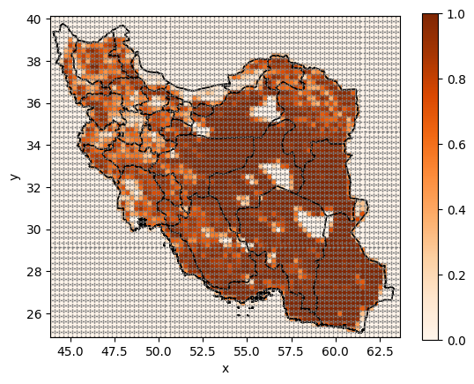
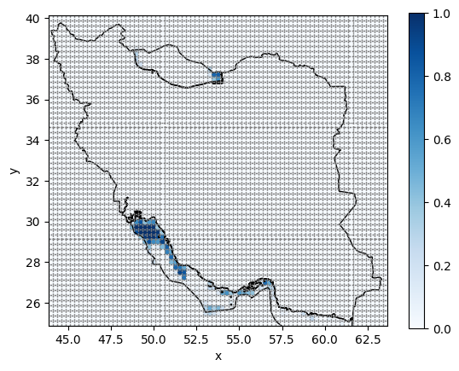
Inputs - Land Eligibility Analysis
E.A. = 73.33%
E.A. = 77.41%
E.A. = 14.96%
onwind
solar
offwind
Considered criteria:
Elevation data
Distance from airports, major roads, built up areas
Exclusion of world protected areas
Exclusive Economic Zones (for wind offshore)
Land classification
Group A | Iran RES Grid Modelling | DSESM | 5th Feb 2026
Notes:
Solar & wind have quite similar land area eligibility; solar being slightly higher
3 excluded regions in east/right hand-side are world protected areas
Main Differentiation is the zagros mountain region in the central west/left-hand side; where large areas exceed the 2000m elevation constraint; additionally the northern coast is quite mountainous

Slide 9
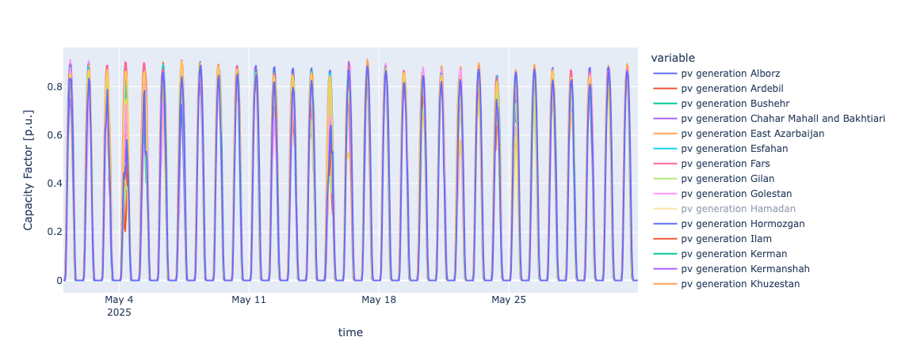
Inputs - RES Time Series (PV - May - 2025)
Group A | Iran RES Grid Modelling | DSESM | 5th Feb 2026
Notes:
CF of up to 0.9 for all the regions
Stable for month (summer)
chosen arbitrarily

Slide 10
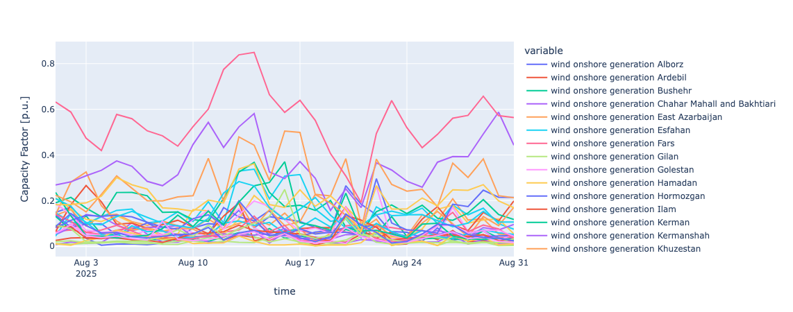
Inputs - RES Time Series (Wind onshore - August 2025)
South Khorasan
Semnan
Razavi Khorasan
Group A | Iran RES Grid Modelling | DSESM | 5th Feb 2026
Notes:
High volatility

Slide 11
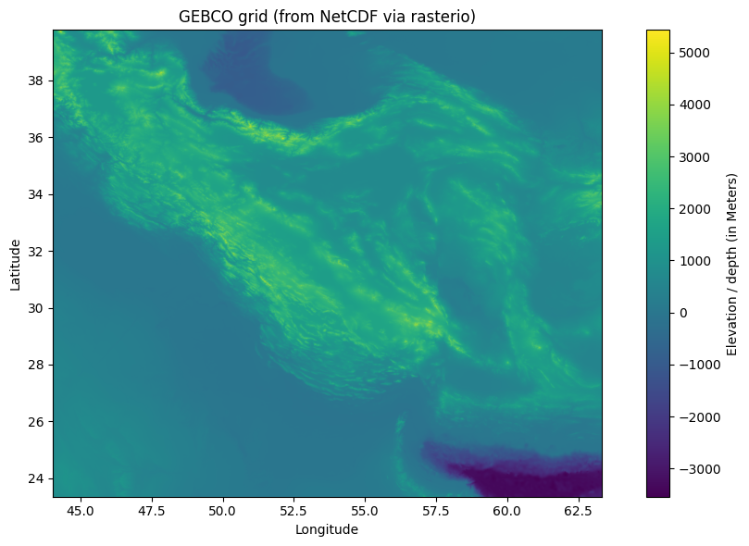
Inputs - Elevation Data
Razavi Khorasan
Semnan
South Khorasan
Group A | Iran RES Grid Modelling | DSESM | 5th Feb 2026
Notes:
High

Slide 12
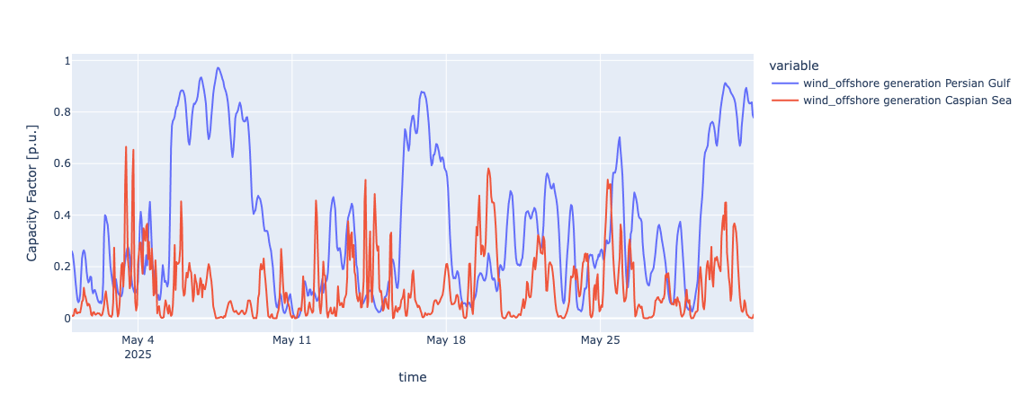
Inputs - RES Time Series (Wind offshore - May 2025)
Group A | Iran RES Grid Modelling | DSESM | 5th Feb 2026

Slide 13
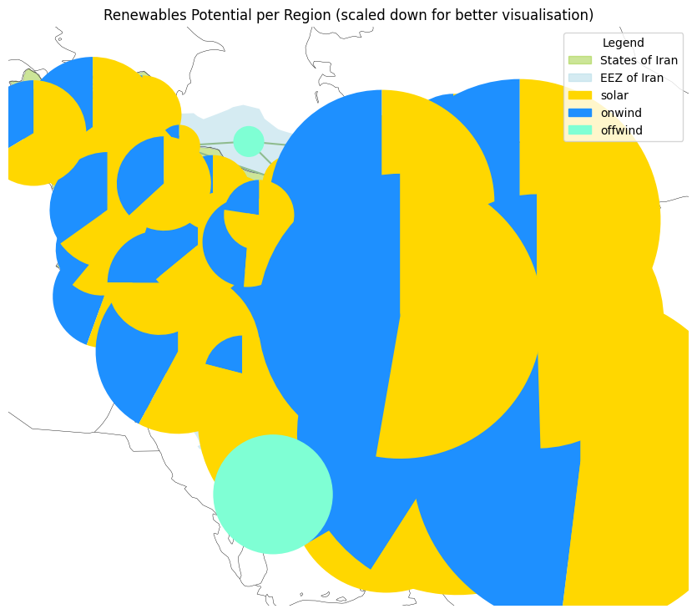
Inputs - RES Available Capacity (same scale of existing power plants)
The potentials are in the same scale as the previous plot, showing existing power plants!
Group A | Iran RES Grid Modelling | DSESM | 5th Feb 2026
Notes:
Is this for given hour? or max potential at any time?

Slide 14
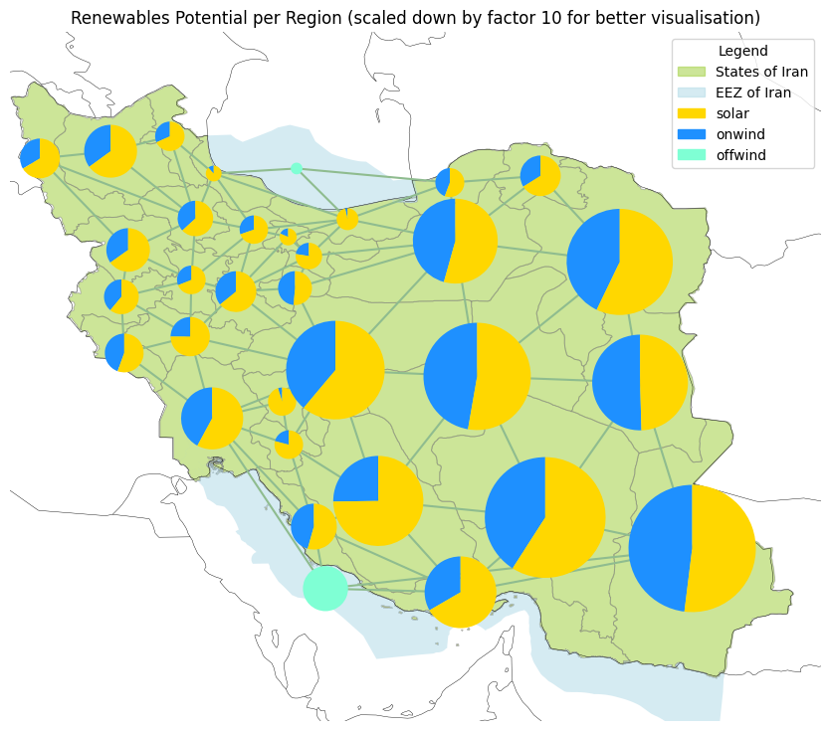
Inputs - RES Available Capacity (scaled down by factor 10)
Caspian Sea
Base: Land Eligibility Analysis and 2025 weather
High Potential of Solar and Wind Capacities, especially in the center and east
Sistan and Baluchestan:
Solar: ~380 GW
Wind onshore: ~350 GW
Kerman:
Solar: ~390 GW
Wind onshore: ~270 GW
Mazandaran:
Solar: ~21 GW
Wind onshore: ~0.8 GW
Persian Gulf:
Wind offshore: ~92 GW
Caspian Sea:
Wind offshore: ~6 GW
Mazandaran
Kerman
Persian Gulf
Sistan and Baluchestan
Group A | Iran RES Grid Modelling | DSESM | 5th Feb 2026

Slide 15
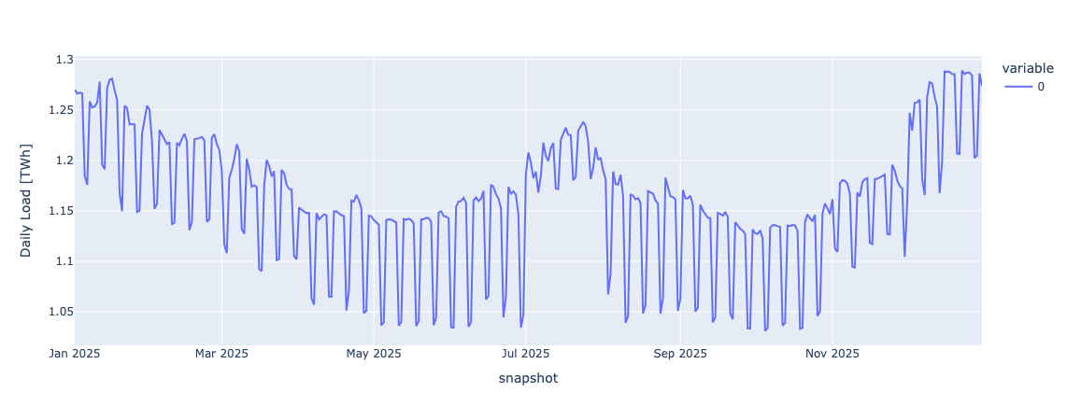
Inputs - Load Time Series
Group A | Iran RES Grid Modelling | DSESM | 5th Feb 2026
Notes:
Definition: National electricity demand profile (daily, 2025 weather-year snapshots), used as temporal load shape for the optimisation. Interpretation: “Seasonality + short-term fluctuations drive storage and dispatch needs.

Slide 16
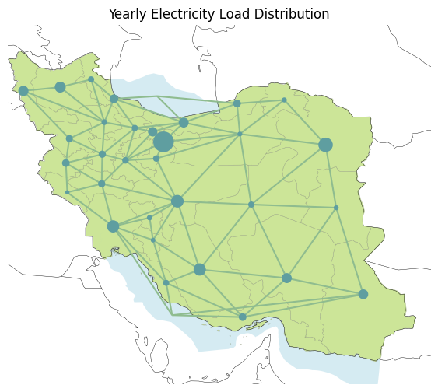
Inputs - Regional Load Distribution
Load time series (from 2013 projected to 2030)
Electricity demand of ~424 TWh/a
Assumption: Distributed to regions, based on population
Load per Region ranges between:
Tehran: ~71 TWh/a
…
Sistan and Baluchestan: ~16 TWh/a
…
Ilam: ~3 TWh/a
Tehran
Ilam
Sistan and Baluchestan
Group A | Iran RES Grid Modelling | DSESM | 5th Feb 2026

Slide 17
Model Results
Group A | February 5th, 2026
Data Science for Energy System Modelling

Slide 18
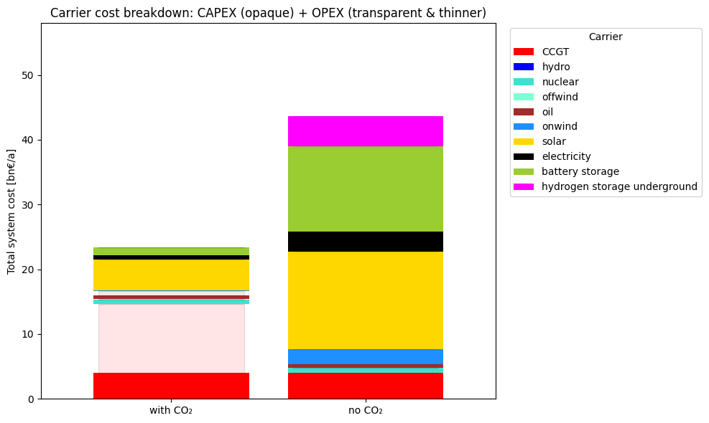
Results - Total System Costs
43.7 bn€/a
20.3 bn€/a
4.73
(Grid Cost)
13.17
23.4 bn€/a
High opex of CCGT in base case (with CO2)
Existing Capacities (CCGT, Oil, Nuclear) always built, but no dispatch of CCGT and Oil in “No CO2”
Higher RE capacities require more grid investment, and also more storages
onshore wind technology only required with CO2 Limitations
1.31
3.11
0.63
4.71
15.02
10.54 (CCGT Opex)
2.36
4.07
4.07
Group A | Iran RES Grid Modelling | DSESM | 5th Feb 2026

Slide 19
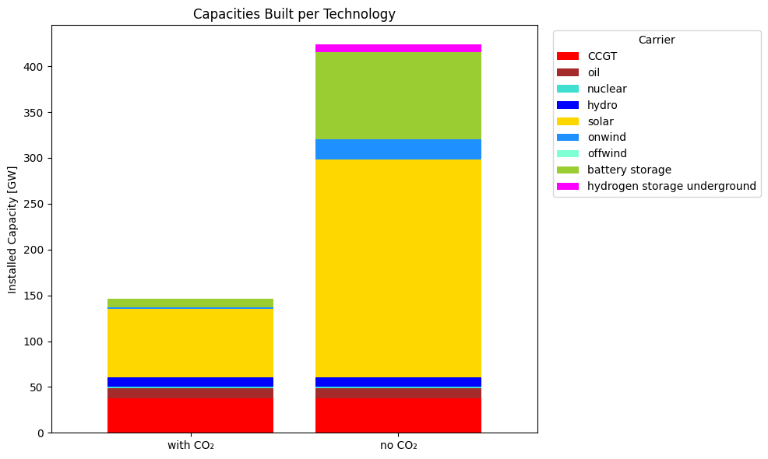
Results - Optimal Generation Capacity
423.7 GW
7.9
95.1
22
Existing power plants (CCGT, oil, nuclear and hydro) are the same in both cases
No dispatch of oil, and CCGT in “no CO2” case, therefore more renewable capacities, mostly solar and wind onshore
As renewable capacity increases, there is more need for Storage (Battery and Hydrogen)
146.4 GW
9.8
238
1.1
74.6
10.7
10.7
1
1
11.3
11.3
37.7
37.7
Group A | Iran RES Grid Modelling | DSESM | 5th Feb 2026

Slide 20
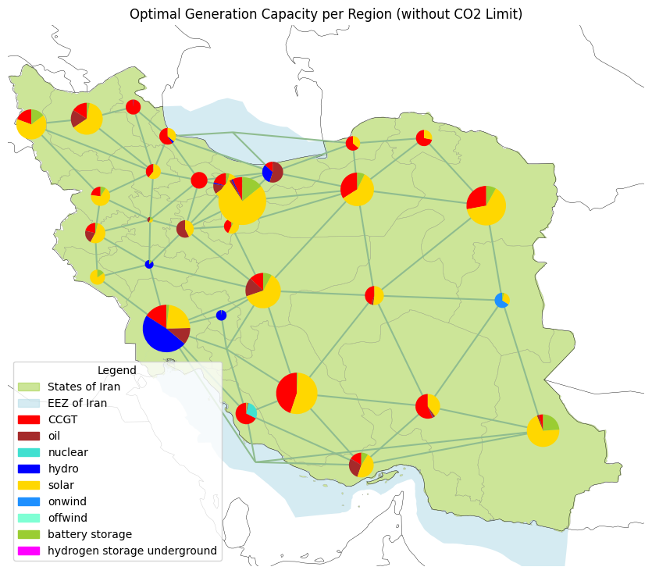
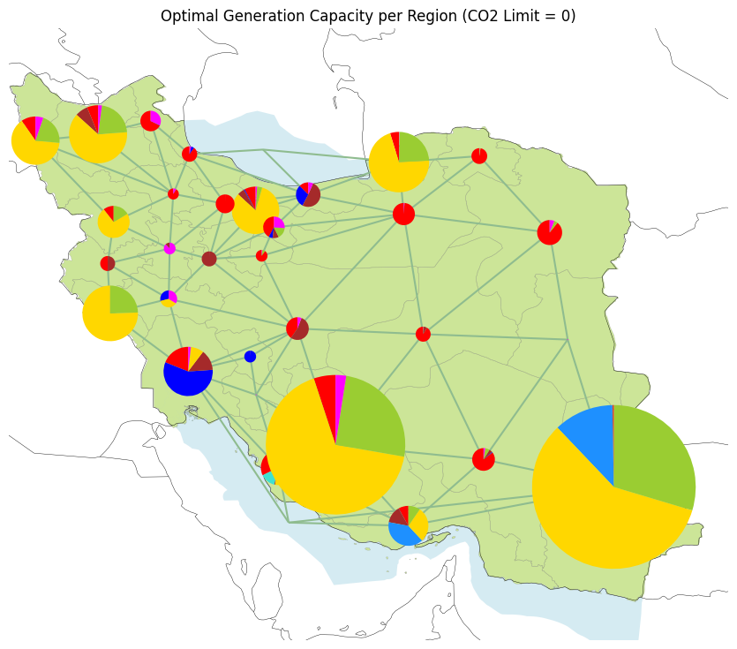
Results - Optimal Generation Capacity per Region
Group A | Iran RES Grid Modelling | DSESM | 5th Feb 2026
Notes:
Highest Generation in south vs load in north

Slide 21
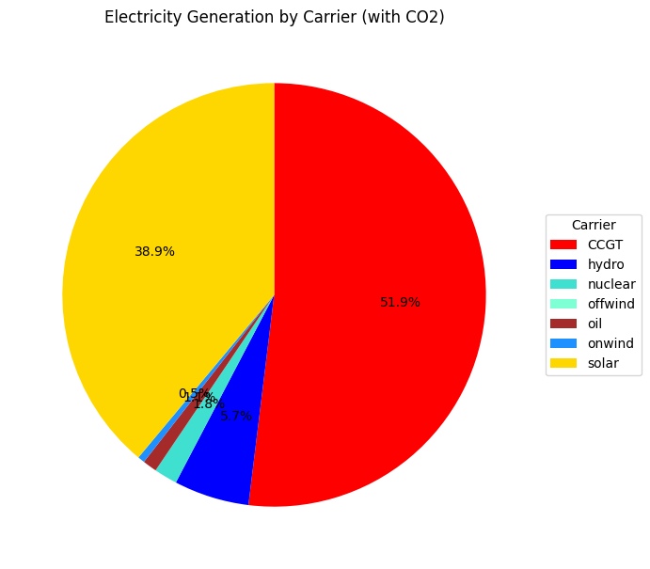
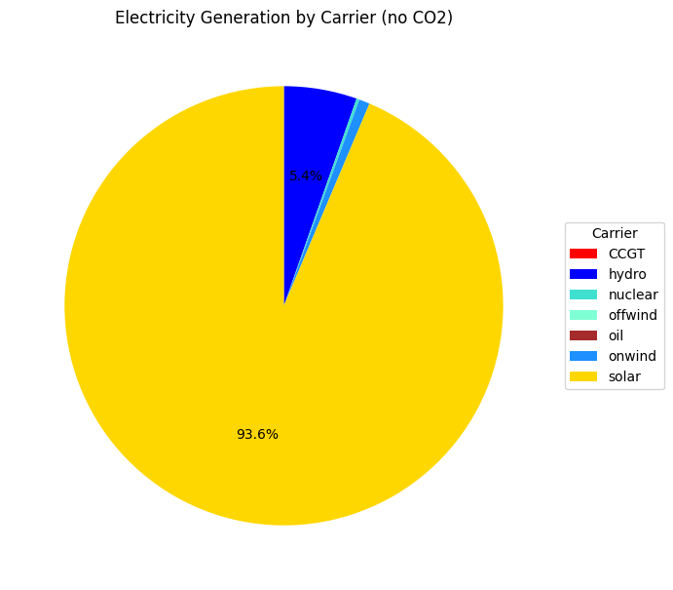
Results - Electricity Mix
0.2%
1 TWh
5.4%
24 TWh
0.8%
3.5 TWh
38.9%
166 TWh
51.9%
221 TWh
0.5%
2.3 TWh
1.8%
7.6 TWh
93.6%
423 TWh
1.1%
4.6 TWh
5.7%
24 TWh
~426 TWh
~452 TWh
More generation than load mostly because of the losses in Storages
Group A | Iran RES Grid Modelling | DSESM | 5th Feb 2026
Notes:
Slight increase in Power Generation (more than load)
Due to storage Losses

Slide 22
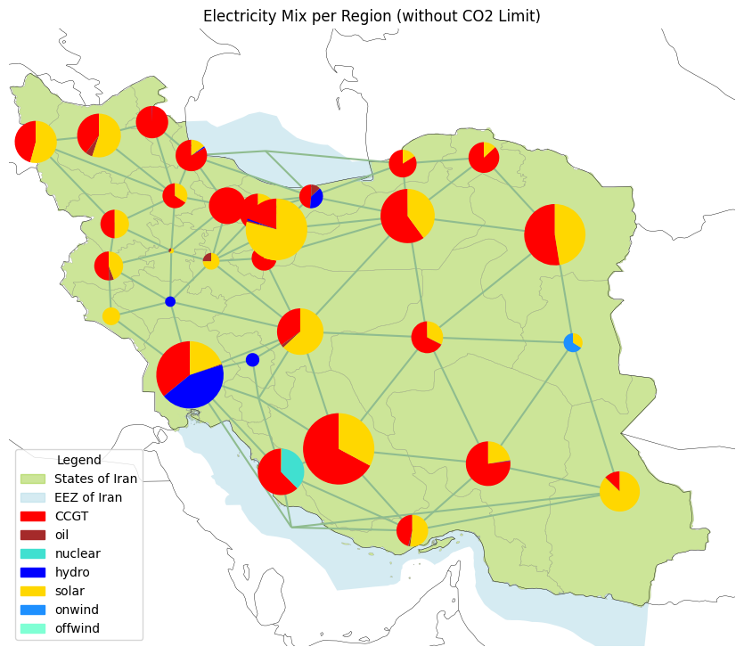
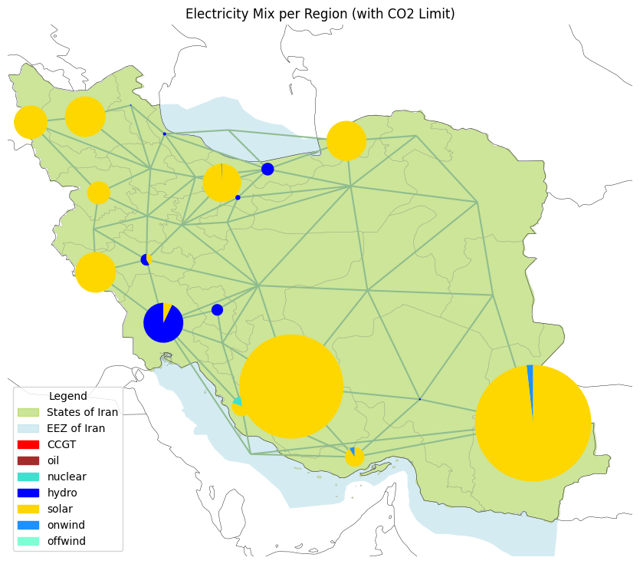
Results - Electricity Generation Mix per Region
Group A | Iran RES Grid Modelling | DSESM | 5th Feb 2026
Notes:
Slight increase in Power Generation (more than load)
Due to storage Losses

Slide 23
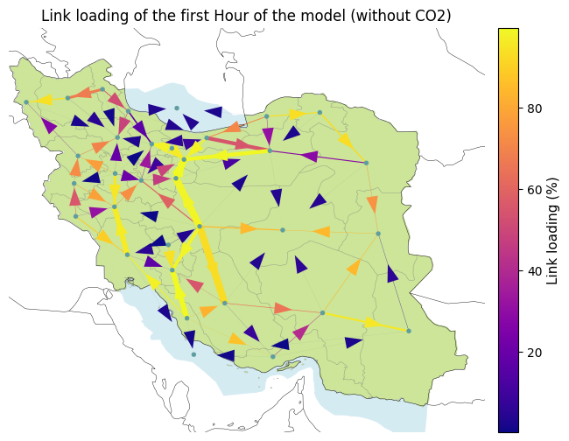
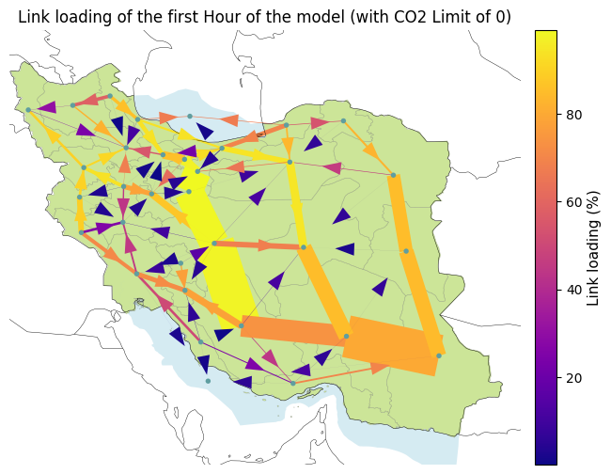
Results - Power Flow
Group A | Iran RES Grid Modelling | DSESM | 5th Feb 2026
Notes:
In no CO2 scenario, we require higher capacity lines to send generation from south to load in the north. High transmission loading in Persian gulf to transport inside the country
Limitation of one bus per region model shows higher link loading compared to real-life

Slide 24
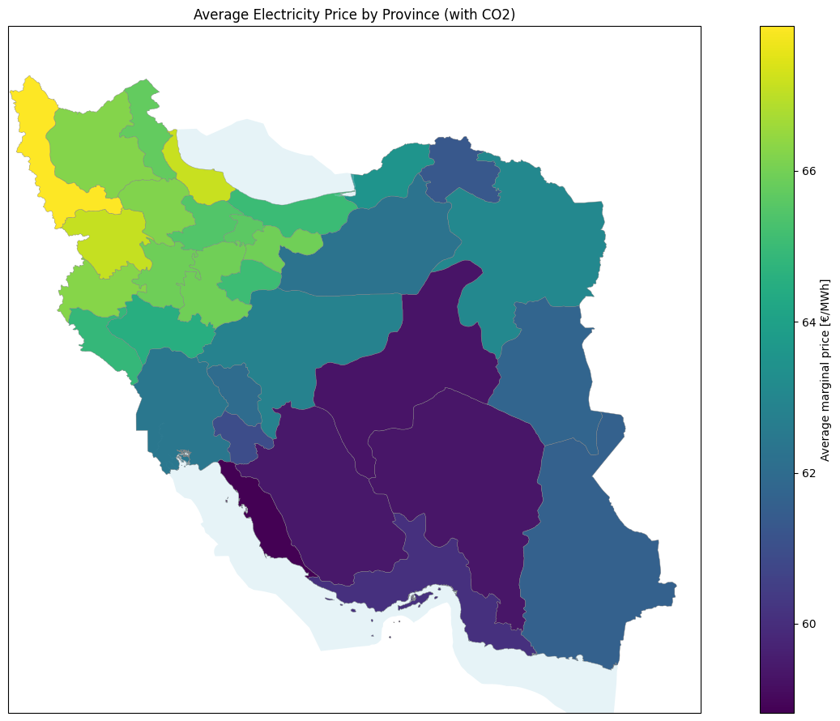
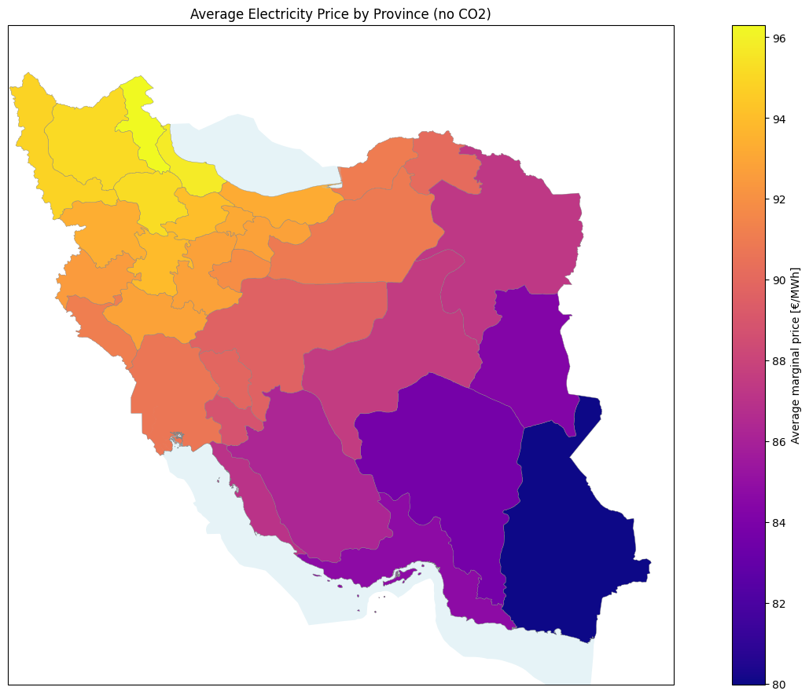
Results - Average Price per Region
Average Marginal Price [€/MWh]
Average Marginal Price [€/MWh]
Group A | Iran RES Grid Modelling | DSESM | 5th Feb 2026

Slide 25
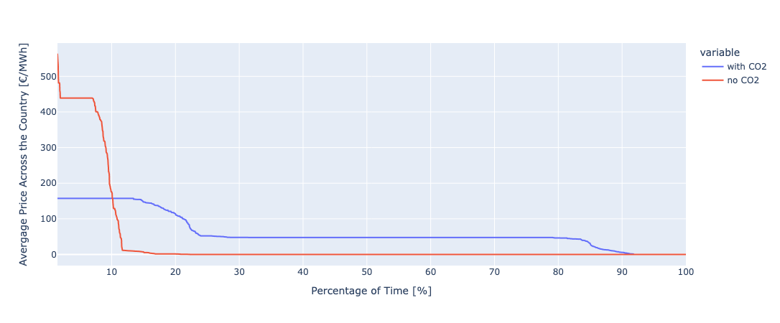
Results - Prices
Price Duration Curve
Note: the top 1.5% percent are removed for better visualization (see archive for more detail)
Group A | Iran RES Grid Modelling | DSESM | 5th Feb 2026

Slide 26
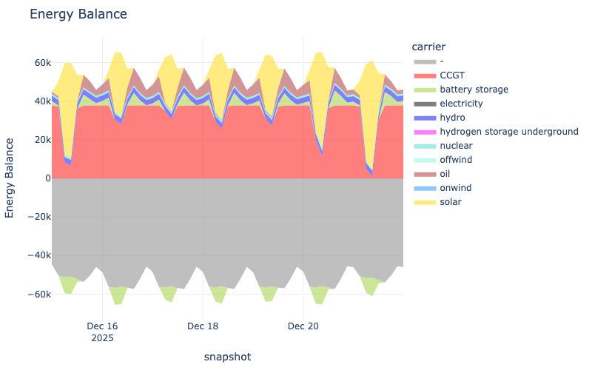
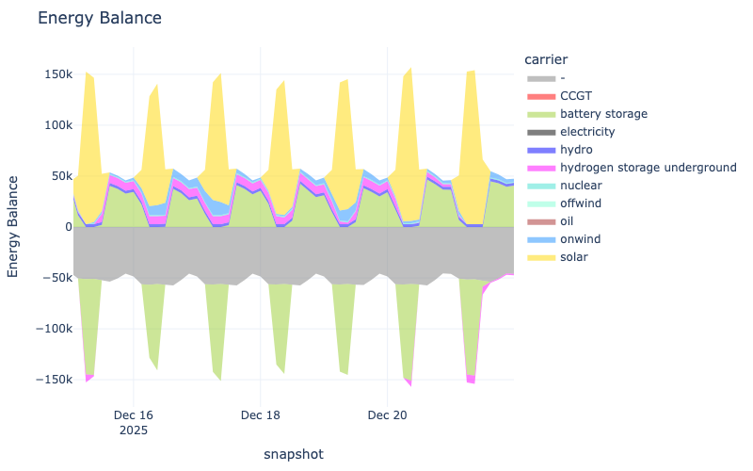
Results - Energy Balance
with CO2
no CO2
Power [MW]
Power [MW]
Group A | Iran RES Grid Modelling | DSESM | 5th Feb 2026
Notes:
CO2 case, gas and battery to fill load, charge during solar peak
no CO2 case, use H2 generated in peak generation season for high load season
December is most challenging week to provide from RES sources

Slide 27
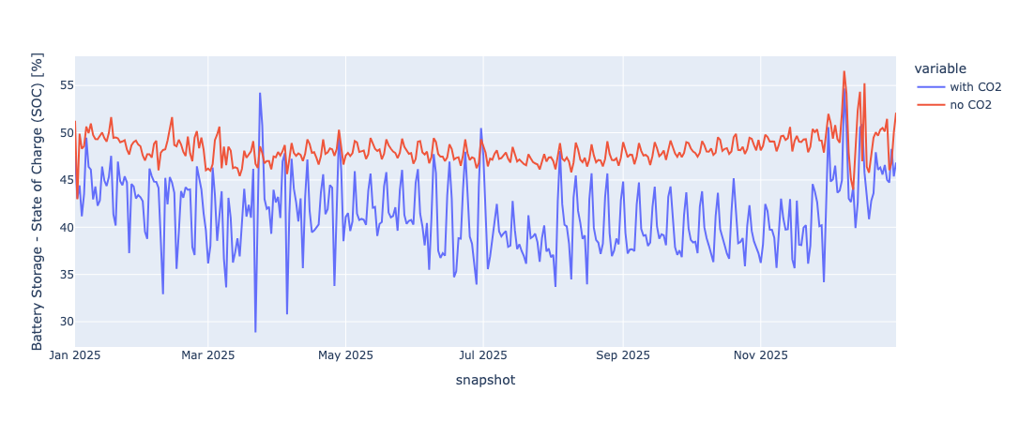
Results - Storages
Battery Storage - SOC (Daily Mean)
100% SOC: 55.3 GWh (with CO2) vs. 562.9 GWh (no CO2)
Group A | Iran RES Grid Modelling | DSESM | 5th Feb 2026

Slide 28
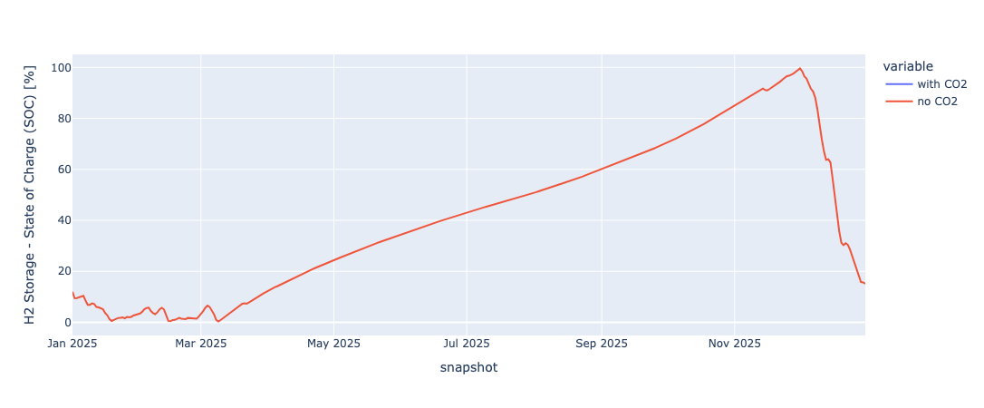
Results - Storages
Hydrogen Storage Underground - SOC (Daily Mean)
100% SOC: 5328.6 GWh (no CO2)
Group A | Iran RES Grid Modelling | DSESM | 5th Feb 2026

Slide 29
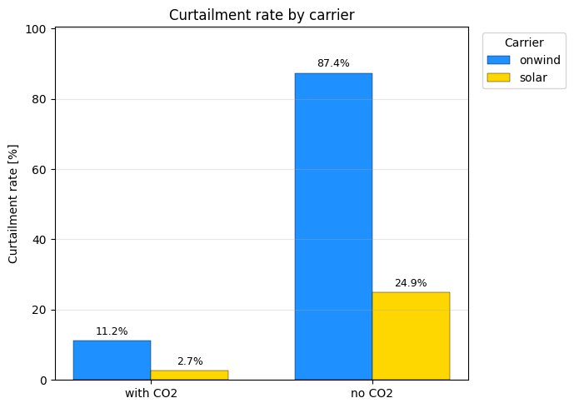
Results - Rate of Curtailment
Group A | Iran RES Grid Modelling | DSESM | 5th Feb 2026

Slide 30
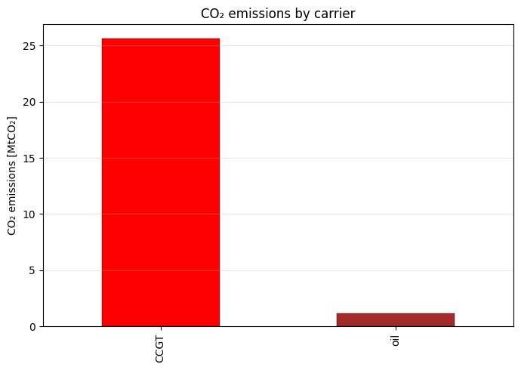
Results - CO2 Shadow Prices
with CO2 Case:
no CO2 Case:
Total emissions: 0.0 tCO2
Carbon shadow price: 15,389.3 €/tCO2
→ Allowing 1 extra tonne of CO2 would reduce total system cost by ~15,000 €
25.6
1.1
Group A | Iran RES Grid Modelling | DSESM | 5th Feb 2026

Slide 31
Sensitivity Analysis
Group A | February 5th, 2026
Data Science for Energy System Modelling

Slide 32
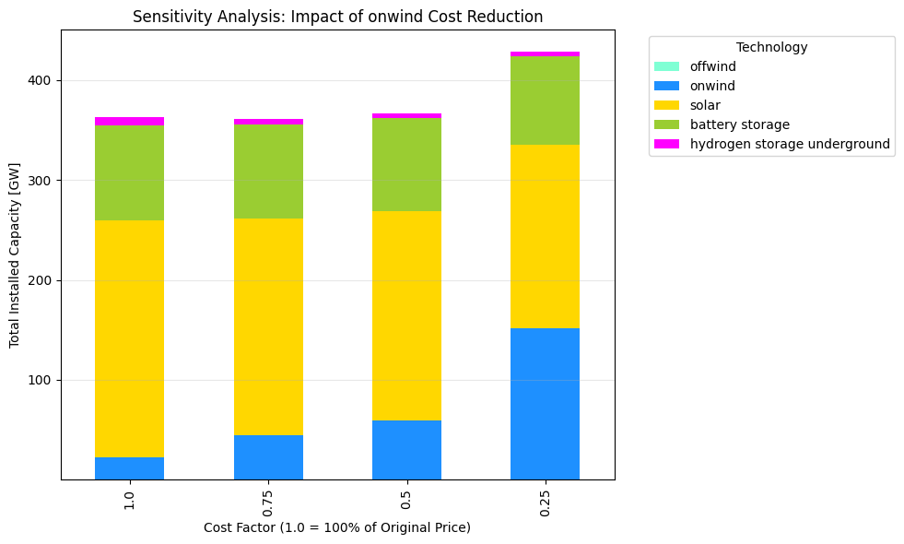
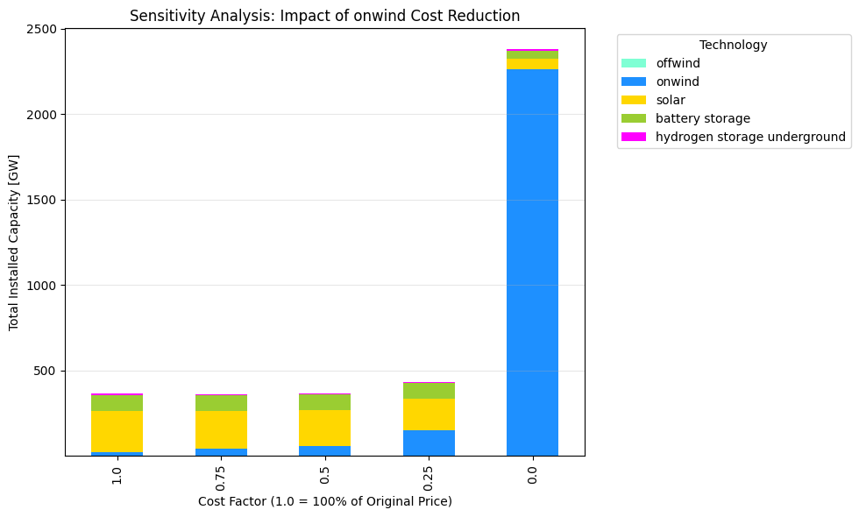
Sensitivity Analysis - Variation of Onshore Wind Capital Cost
5.0
88
7.9
5.7
5.1
93
95
94
Lower onwind capex
→ onwind will replace solar & the need for storages become less, because the cheaper onwind makes curtailment more cost efficient than storages
184
15 GW
44 GW
210
64 GW
238
217
2260 GW
152
44
59
22
Group A | Iran RES Grid Modelling | DSESM | 5th Feb 2026

Slide 33
Limitations
Group A | February 5th, 2026
Data Science for Energy System Modelling

Slide 34
Model Limitations
Data availability: load data (2013); Power plant data (2017); Population data (2024)
Population distributed load; industry consumption not considered
One bus per region & EEZ
Energy import/export not considered
2025 costs forecasted from multiple currency years at fixed discount rate
One cost per technology (sub-type cost difference not considered)
Storage technologies limited to H2 & BESS
3h time resolution
Dispatchable technology ramping constraints not considered
Global fuel prices may overestimate costs for Iran (oil/gas producer)
Group A | Iran RES Grid Modelling | DSESM | 5th Feb 2026
Notes:
nuclear only used for some hours then shut-down; ramping constraints ignored
global fuel prices for Iran; prices would be cheaper as Iran is a prime gas and oil producer

Slide 35
Improvement Potential
Update load data to 2025
Allocate regional load by GDP instead of population
Update existing power plant data (Global Energy Monitor)
Use grid-based network instead of one bus per region
Include imports and exports with neighboring countries
Further subdivide EEZ regions (beyond Caspian & Persian Gulf)
Ensure consistent currency year for costs
Differentiate gas, oil, and nuclear technologies
Extend storage technologies beyond batteries and hydrogen tanks
Increase temporal resolution from 3-hourly to hourly
Add technology-specific ramping constraints and costs
Consider domestic extraction costs and export opportunity costs
Group A | Iran RES Grid Modelling | DSESM | 5th Feb 2026
Notes:
nuclear only used for some hours then shut-down; ramping constraints ignored
global fuel prices for Iran; prices would be cheaper as Iran is a prime gas and oil producer

Slide 36
Thanks. Any Question?
Group A | February 5th, 2026
Data Science for Energy System Modelling

Slide 37
External Dataset References
(Bundesamt, 2024)
“Bevölkerung Im Jahr 2024 Um 100 000 Menschen Gewachsen.” Statistisches Bundesamt, 2025, www.destatis.de/DE/Presse/Pressemitteilungen/2025/01/PD25_030_124.html. Accessed 02 Feb. 2026.
(Statistical Center of Iran, 2024)
iranopendata.org/en/dataset/iod-06124-estimated-population-iran-province-2024/. Accessed 02 Feb. 2026.
(Ember Energy, 2025)
“Iran.” Ember, 10 Apr. 2025, ember-energy.org/countries-and-regions/iran/. Accessed 02 Feb. 2026.
(IR Gas Production, 2024)
Kgi-Admin. “Iran Natural Gas Production: Data and Insights.” Offshore Technology, 11 July 2024, www.offshore-technology.com/data-insights/iran-natural-gas-production/. Accessed 02 Feb. 2026.
(IR Oil Production, 2023)
LLC, Globalen. “Iran Percent of World Oil Production - Data, Chart.” TheGlobalEconomy.Com, www.theglobaleconomy.com/Iran/oil_production_share/. Accessed 02 Feb. 2026.
The model can be found in git repository: Link

Slide 38
Archive
The model can be found in git repository: Link
Group A | February 5th, 2026
Data Science for Energy System Modelling

Slide 39
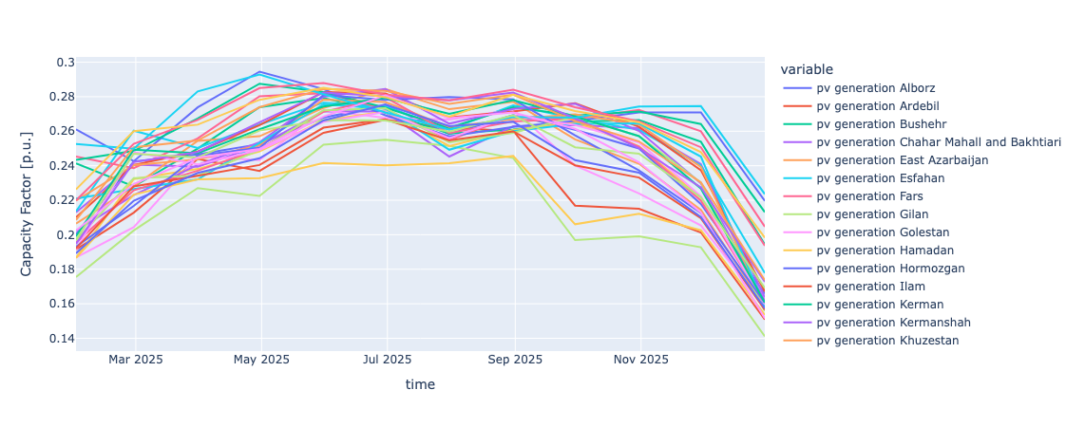
Inputs - RES Time Series (PV - Monthly Average)
Group A | Iran RES Grid Modelling | DSESM | 5th Feb 2026

Slide 40
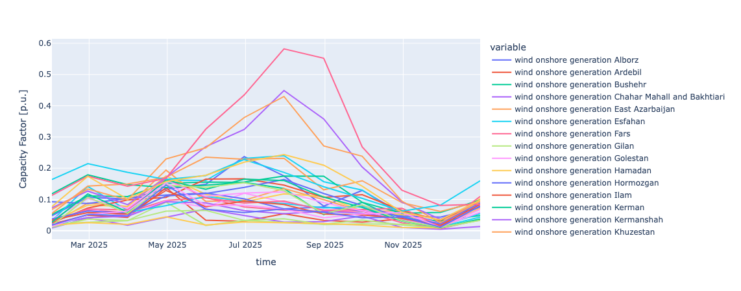
Inputs - RES Time Series (Wind onshore - Monthly Average)
South Khorasan
Razavi Khorasan
Semnan
Group A | Iran RES Grid Modelling | DSESM | 5th Feb 2026

Slide 41
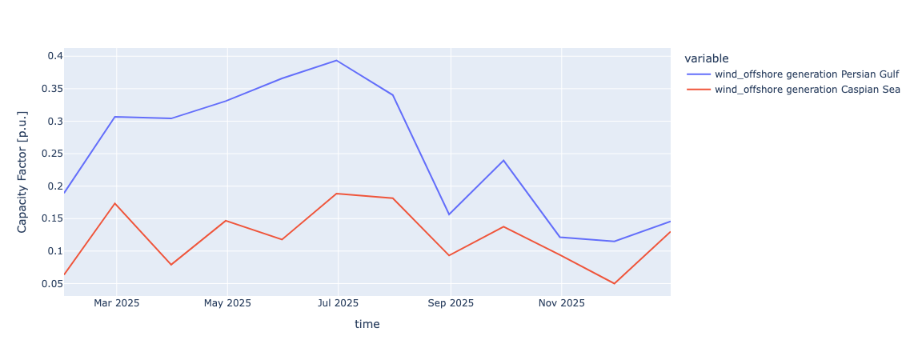
Inputs - RES Time Series (Wind offshore - Monthly Average)
Group A | Iran RES Grid Modelling | DSESM | 5th Feb 2026

Slide 42
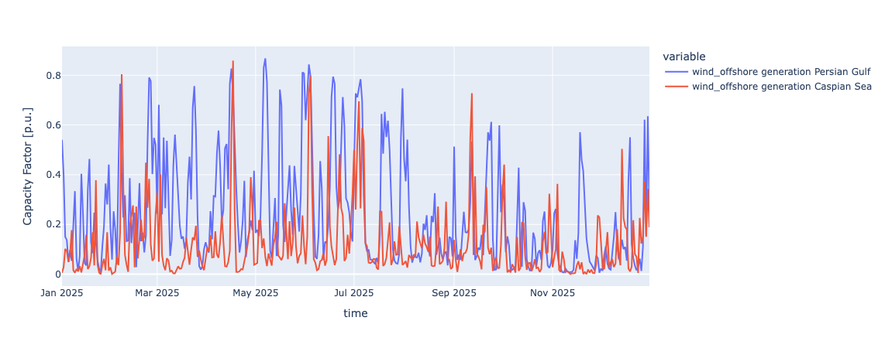
Inputs - RES Time Series (Wind offshore - Daily Average)
Group A | Iran RES Grid Modelling | DSESM | 5th Feb 2026

Slide 43
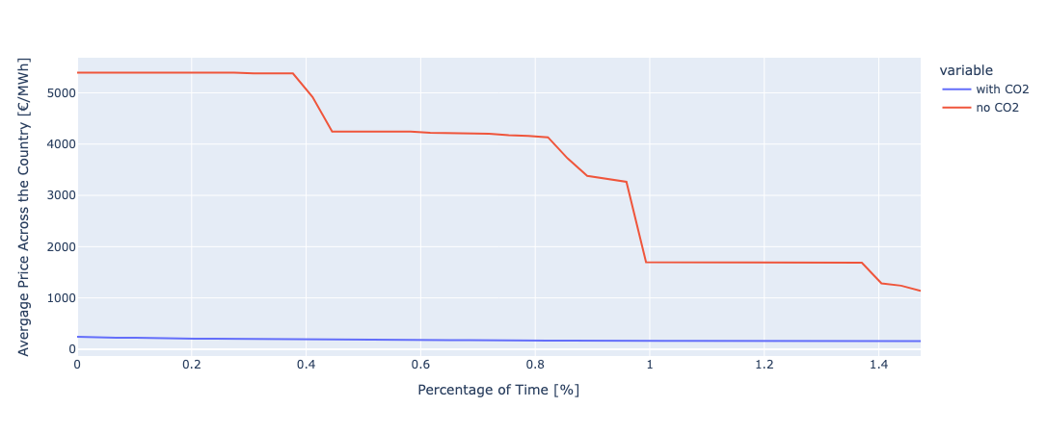
Results - Prices
Price Duration Curve (Top 1.5%)
Group A | Iran RES Grid Modelling | DSESM | 5th Feb 2026

Slide 44
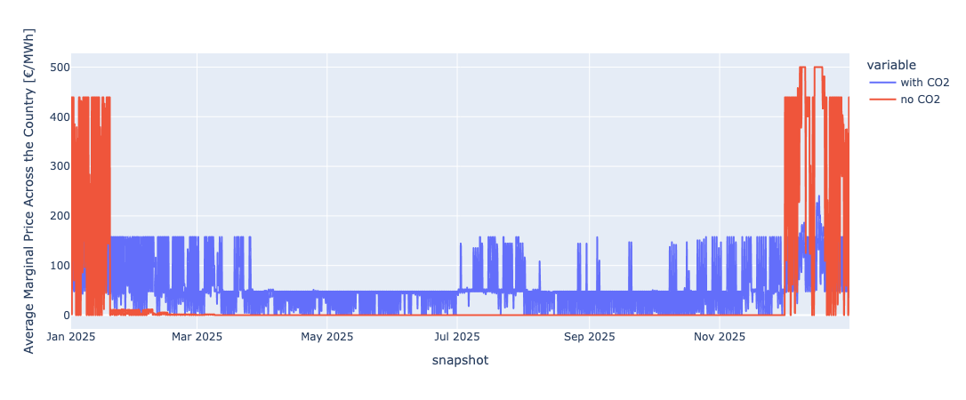
Results - Prices
Average Marginal Price Time Series
Note: Values greater than 500 €/MWh are clipped at 500/MWh for better visualization
Group A | Iran RES Grid Modelling | DSESM | 5th Feb 2026

Slide 45
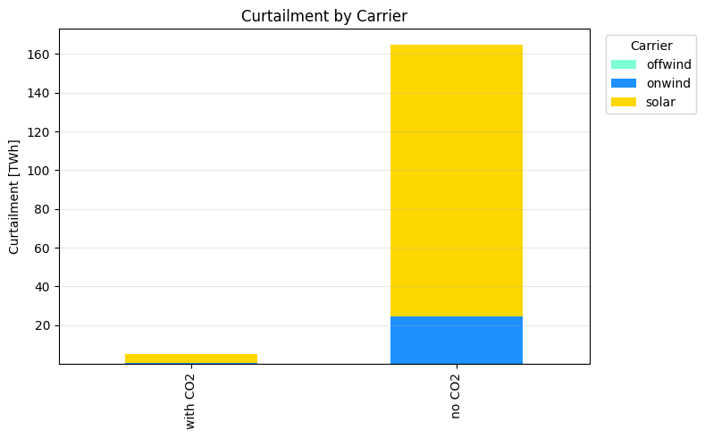
Results - Curtailed Energy
140.2
4.6
24.5
0.3
Group A | Iran RES Grid Modelling | DSESM | 5th Feb 2026

Slide 46
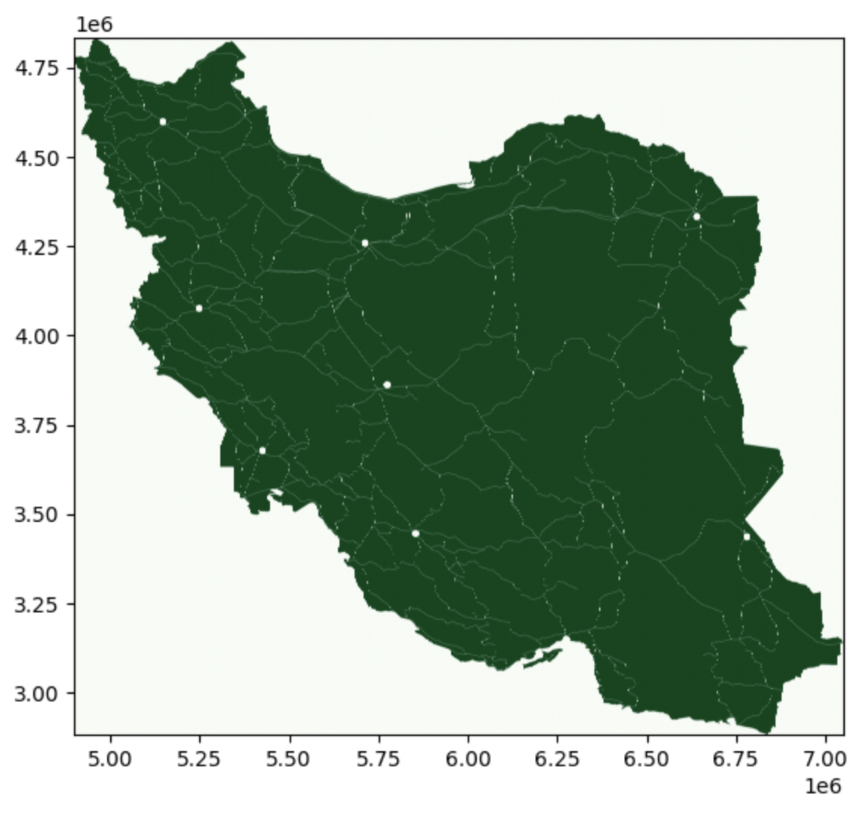
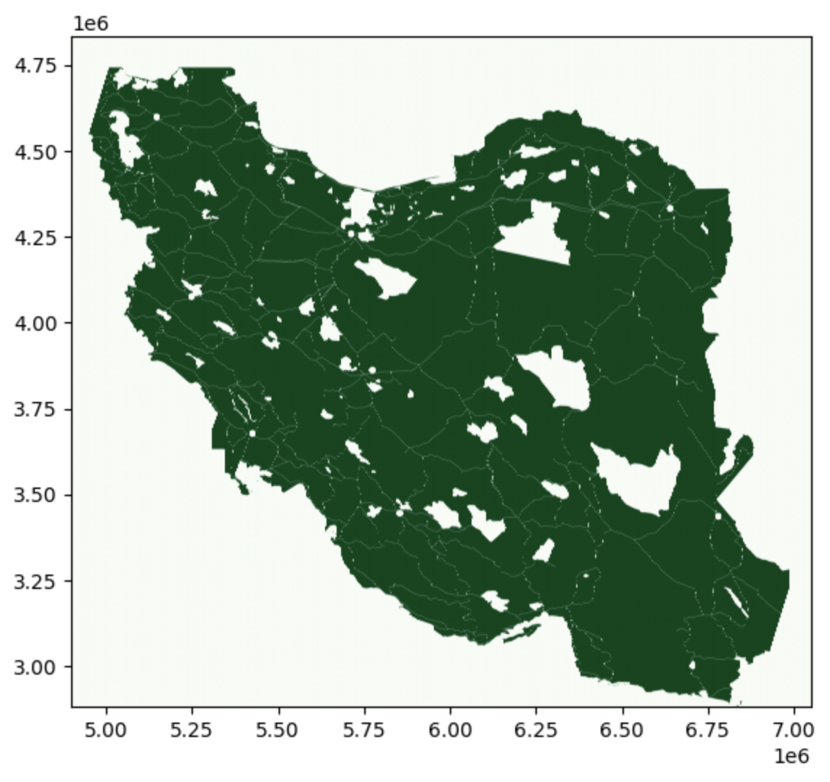
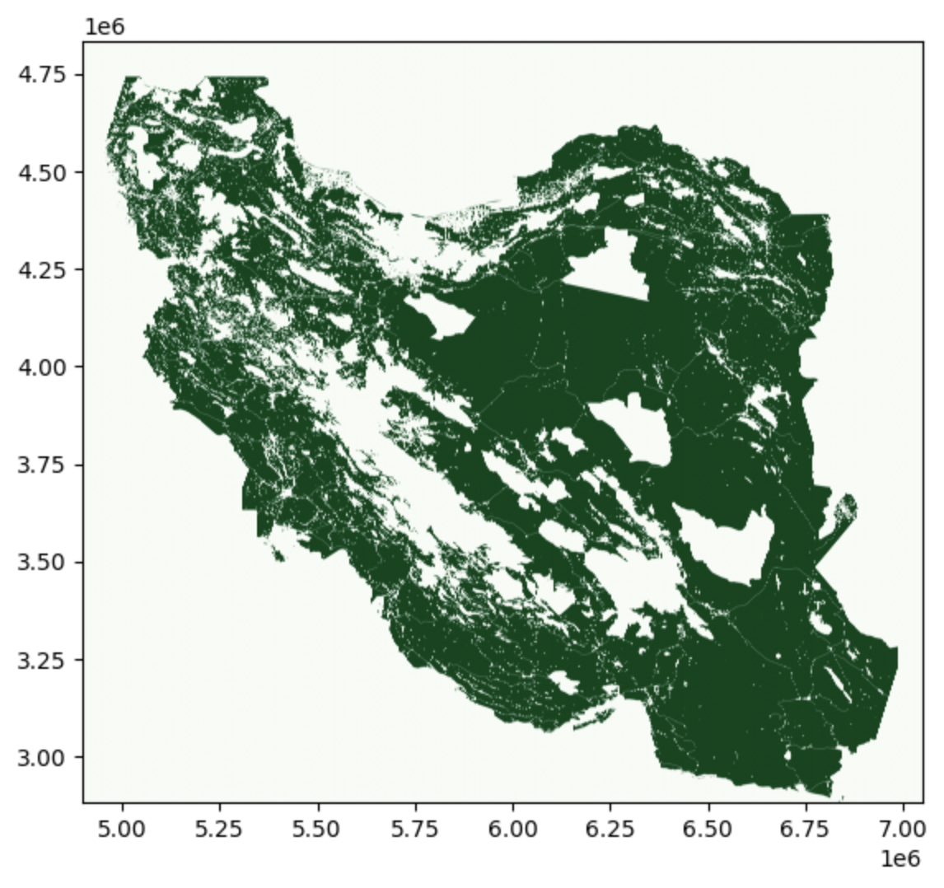
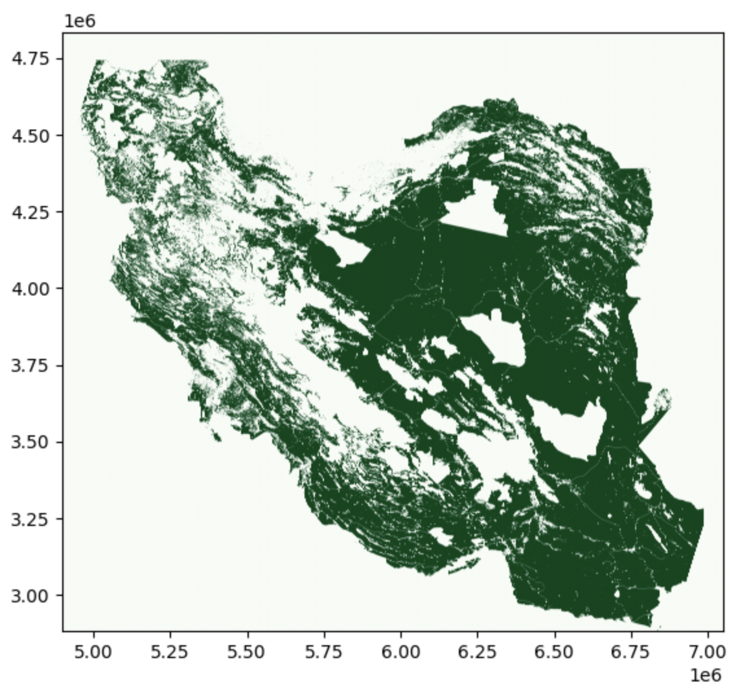
Inputs - Land Eligibility Analysis - Wind Onshore
Exclusion of airports (10 km distance)
& Roads (300 m distance)
Exclusion of World protected area
Exclusion of more than 2000 m Elevation
& built up areas (1 km distance)
Considering the land classification
EXCLUDE: codes 100: Moss & Lichen, 90: Wetlands, 200: Open sea, 80: water bodies, 70: snow & ice, 111, 112, 113, 114, 115, 116: closed forrest
INCLUDE: codes 60: Bare / sparse vegetation, 20: Shrubs, 30: Herbaceous vegetation
Group A | Iran RES Grid Modelling | DSESM | 5th Feb 2026

Slide 47
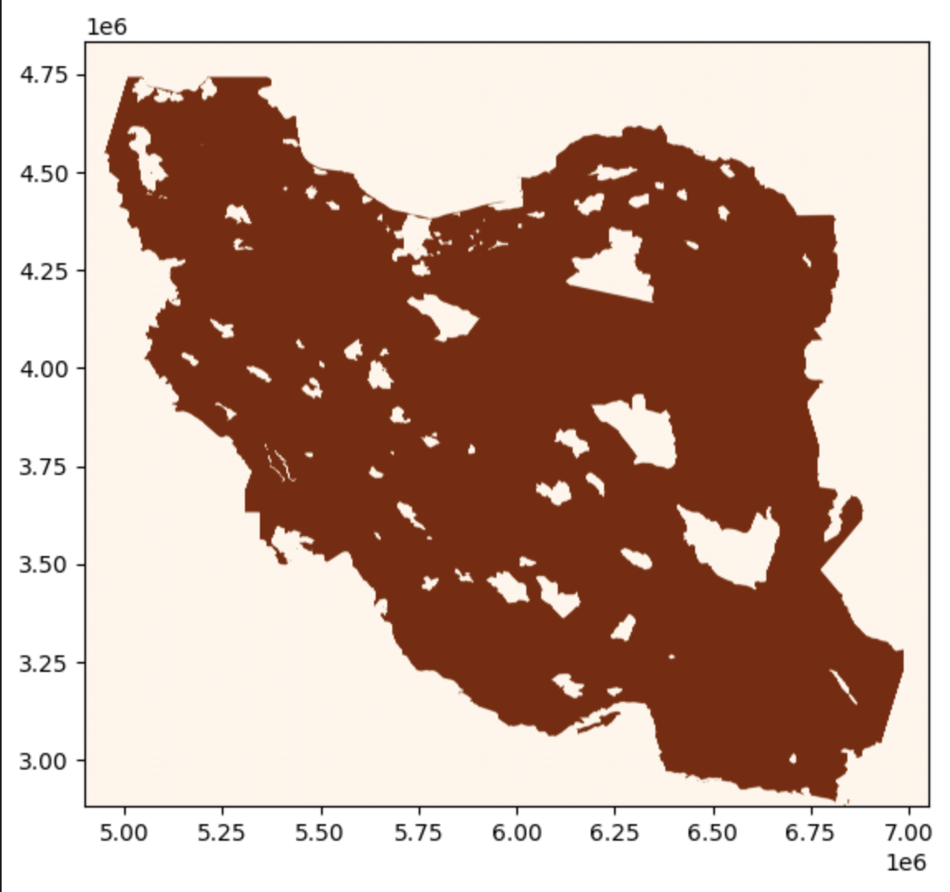
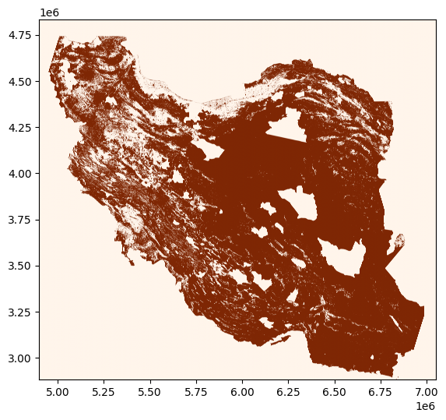
Inputs - Land Eligibility Analysis - PV
Exclusion of World Protected Areas
Considering the Land Classification
EXCLUDE: codes 100: Moss & Lichen, 90: Wetlands, 200: Open sea, 80: water bodies, 70: snow & ice, 111, 112, 113, 114, 115, 116: closed forrest
INCLUDE: rooftop in Built up areas (50), and utility in Shrubs (20), Herbaceous vegetation (30), Bare / sparse vegetation (60)
Group A | Iran RES Grid Modelling | DSESM | 5th Feb 2026

Slide 48
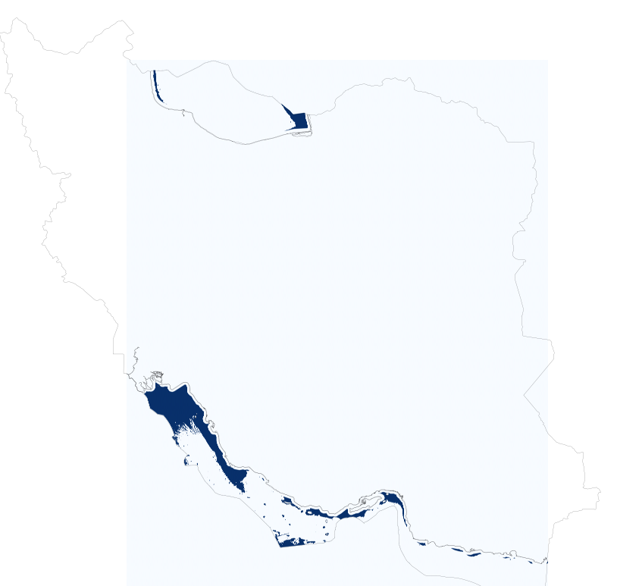

Inputs - Land Eligibility Analysis - Wind Offshore
Exclusion of World Protected Areas
& distance to shore (10 km)
Water depth (inclusion up to 50 m)
Group A | Iran RES Grid Modelling | DSESM | 5th Feb 2026

