Slide 1
CI/CD
System Architecture
Application Architecture
GitHub
Repo
Azure App
Service
UI
React⁺⁺⁺⁺
React Route
API
JS/TS⁺
Express⁺⁺
SQL⁺⁺⁺
push feature
auto deploy
main
d=dev
Azure Static Web App
Service
UI
branch for release
push
bugfix
auto deploy
Azure App
Service
UI Test
Puppeteer
API Test
Axios
release
u=uat
API
promote
p=prod
Azure Postgres
SQL
DB
Node.js
Node.js⁺
Alternative cloud solution: * AWS Elastic Beanstalk
**RDS for PostgreSQL
Alternative Node FW: ++ Nest.js (instead of Express)
++++ Next.js (on top of React)
Alternative API solution: + Java
++ Spring Boot
+++ JPA + Liquibase

Slide 2
UI
API
DB

Slide 3
The old way
The new way
The better way
Team lead
Team lead
Team lead
4: Approve feture Checkout branch
Run build incl tests
Review code
Approve PR
1: Request feature Provide explanation
DevEnv
DevEnv
DevEnv
GitHub
GitHub
GitHub
DevEnv
DevEnv
Variation: Team lead creates new failing tests
Code should pass the tests Variation: New feature requires new libraries or other extension of environment which should also be managed by git
Variation:
Discussion about PR Variation:
Require changes to PR
2: Implement feature
Create branch
Edit file contents
Run build incl tests
Commit changed files
Push commited files
Create PR
3: Deliver feature Report readiness
Developer
GenAI
GenAI

Slide 4
Team lead
GenAI
DevEnv
GitHub
I call the APIs
AI calls the APIs
AI controls the computer
GenAI
GitHub
Team lead
GenAI
Team lead
Agent
DevEnv
GitHub
DevEnv

Slide 5
My App
Prompt
GenAI
API request
Prompt
API request
Ext API
API response

Slide 6
Benefits
It’s not reported ready until it works
Hallucinations (e.g. using non existing libraries) eliminated by running the tests, just like a developer would
Minimal overhead for team lead
Not using ChatGpt like a parrot on your shoulder

Slide 7
The “Snake Oil thing” – Hype-driven development
Waterfall
Agile
SOA
Microservices
RDBMS
BigData
NoSQL
?
Crypto/Blockchain
Classical AI
GenAI
Prompt engineering

Slide 8
Good Cases, Bad Cases
Good
Draft method requiring trial and error
Troubleshoot error in unknown context
Complex search/replace pattern.
Create a new feature.
Draft a pen test preparation
Bad
Coding to Analysis rate low
Complicated detailed calculations
Lots of implicit context
Complex & precise UI

Slide 9
Good cases
Drafting a method which would require googling + trial and error Example: write PL/SQL stored procedure which repeatedly checks if a table contains a row with a certan value for a certain column, and throws an error if it has not happened after a fixed amount of time
Trouble shooting an error in unknown context Example: Game written in Python using PyGame library starts up but does render the page, despite everything looking fine.
Performing complex search replace patterns. Example: Adding error handling around similar, but different, method calls that occur in many different files.
Creating a new feature. Example: build entire React/Note application this way.

Slide 10
And that was just coding
Good
Charge your muscle car
Learn Spanish
Summarize literature survey

Slide 11
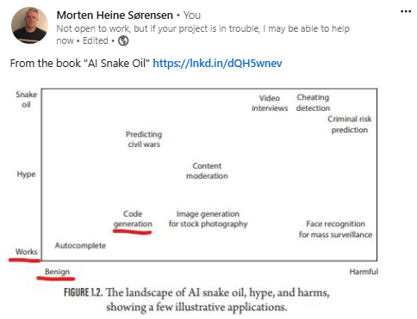

Slide 12
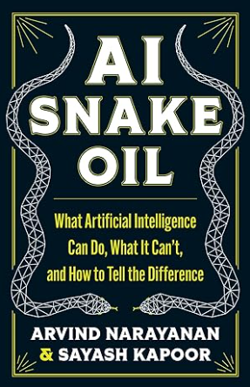
Issues
Hallucinations, inaccurate answers
Errors in training material
Genuine hallucinations
Less of an issue when you TEST
Don’t complain about it happening
Compare the amount to developers
Service may not be available
Multiple ChatGPT, Claude, Amazon Bedrock
Service may become more expensive
Company losing money
Service very energy intensive
Service entails poor working conditions outside US/Europe
Crackpot applications/gold rush syndrome

Slide 13
How come next word prediction can do this?
Massive Scale of Training Data
Learning Patterns, Grammar, and Context
Self-Attention and Contextual Depth
Implicit Knowledge Representation
Fine-Tuning for Specific Tasks
Multi-Layered Understanding of Language Nuance
Generalization and Adaptation

Slide 14
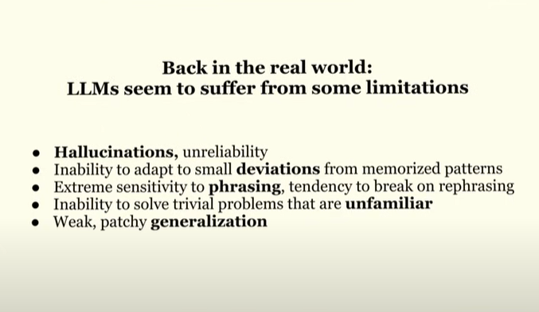
Deviations: special caseing

