Slide 1

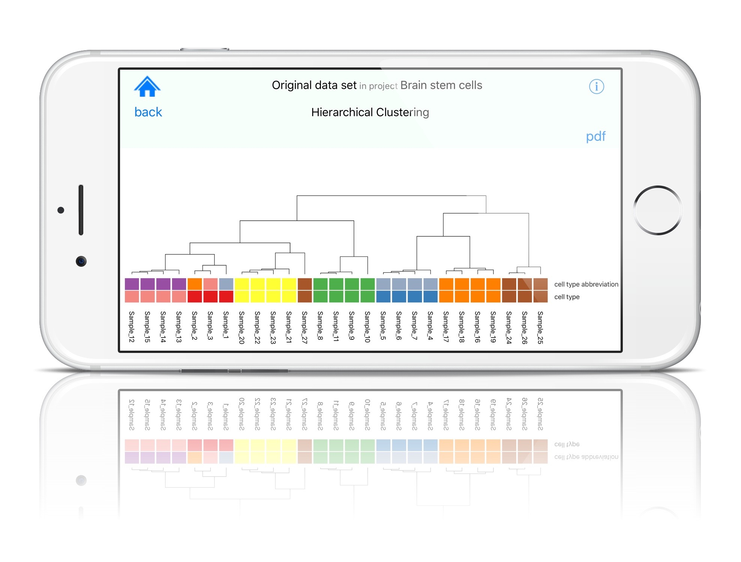
Mobile Data Analysis
Morten Krogh
Amberbio
www.amberbio.com

Slide 2
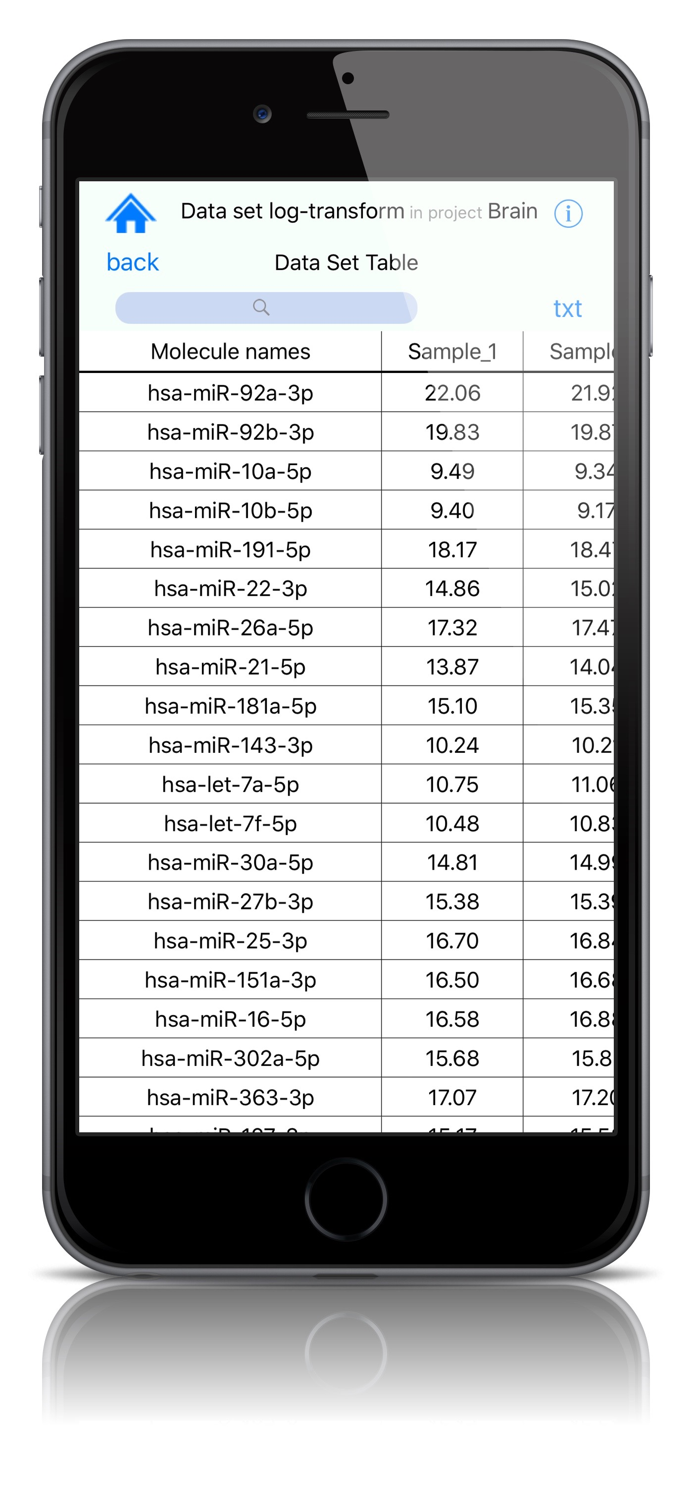
Amberbio
Vision about Data
Almost all data will be on personal devices (smart phones).

Slide 3
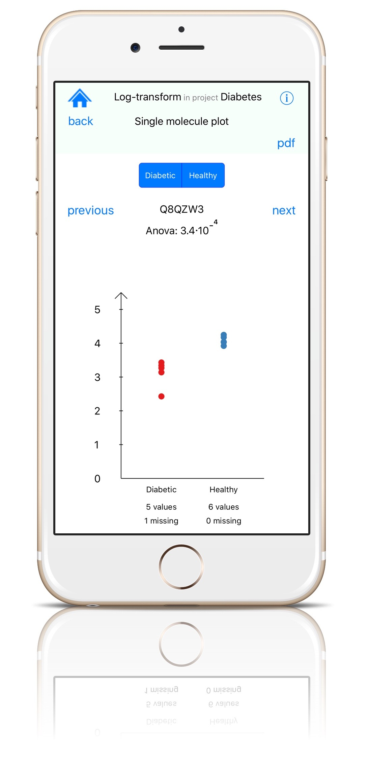
Amberbio
The phone can
Store data
Analyze data
Visualize data

Slide 4
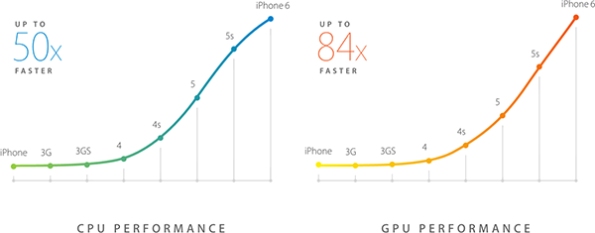
Amberbio

Slide 5
Amberbio
Geekbench 3 benchmark test
iMac (27-inch Retina) 4354
Mac Pro (Mid 2010) 2503
Iphone 6s 2498
MacBook Pro (13-inch Late 2011) 2437
iPhone 5 707

Slide 6
Amberbio
Lots of memory by historical standards
Main memory
Up to 4GB phones
OnePlus 2
Samsung galaxy S6

Slide 7
Amberbio
Lots of storage
128 GB onboard storage
256GB ??
Expandable micro SD card 256 GB ??

Slide 8
Amberbio
How big is a data set?
It depends
Big data
Wikiepedia:
A few dozen terabytes
to
petabytes of data.
Mobile data analysis is impossible!

Slide 9
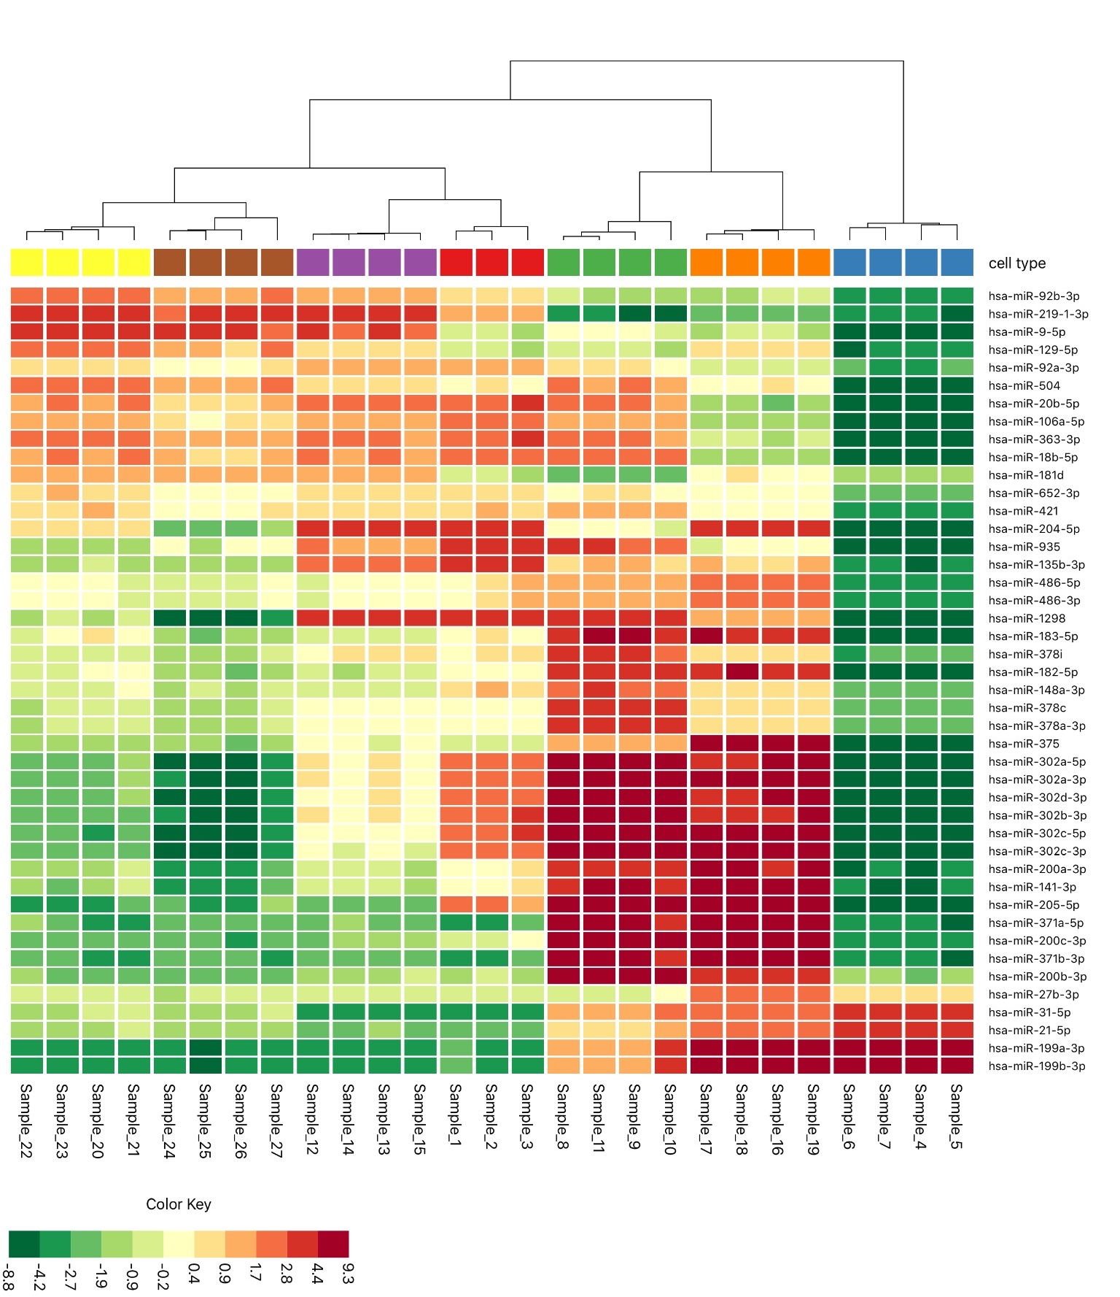
Amberbio
Microarray gene expression data set
100 samples
30,000 genes
3,000,000 values
8 bytes per value
24 MB of memory needed
Easy for a smart phone.

Slide 10
Amberbio
Lifetime of a data set
Raw data from machine
Gigabytes of data
Preprocessing
Biologically interesting data
Megabytes of data
Mobile analysis!

Slide 11
Amberbio
Advantages of mobile analysis
Always available
Easy to look up information
Easy to test hypothesis
Show data to collaborators
Mobile apps are easy to use
Presentations
Meetings
Easy to install from app stores
Easy to play around with the data
Visualization is analysis

Slide 12
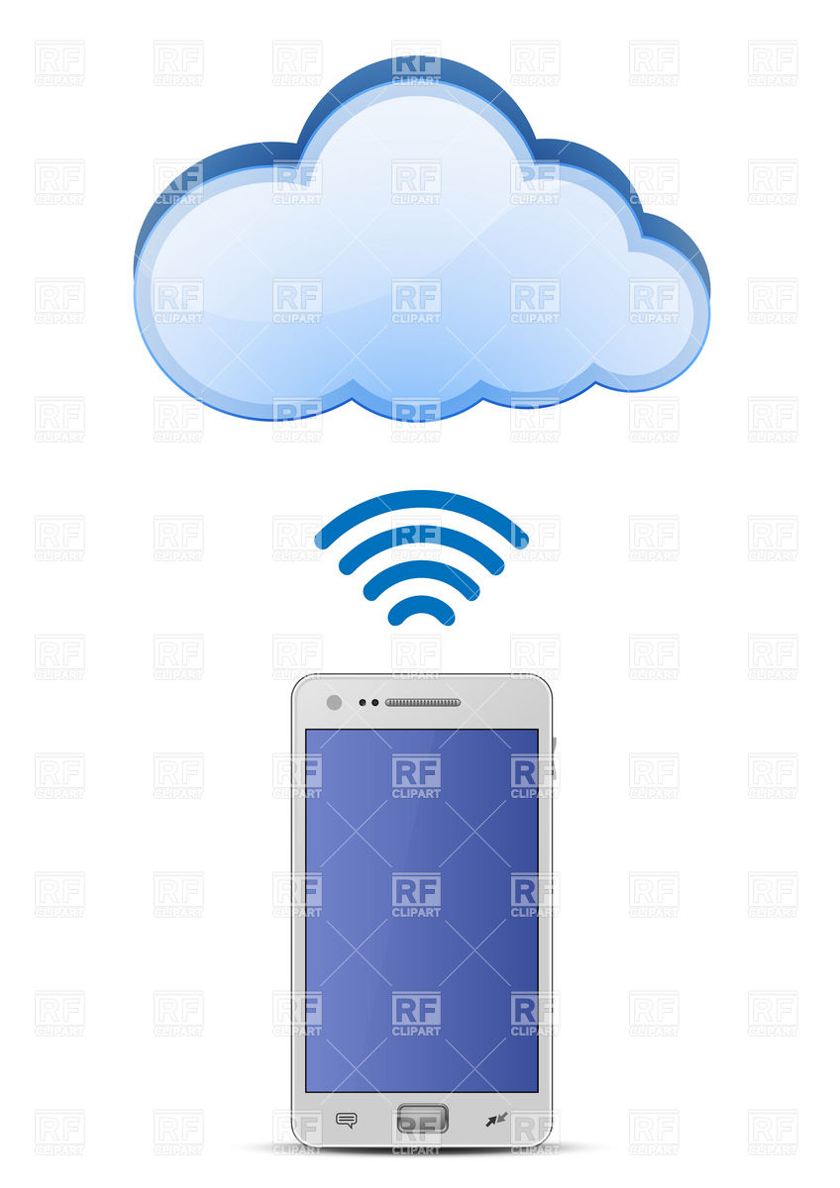
Amberbio
Data repositories
Public or private
Easy to analyze other people's data
Repositories should have APIs for downloading data
Example:
http://www.repository.se/get-data/2378237623/xml

