Slide 1
New figures for 1 revision in COMMMED

Slide 2
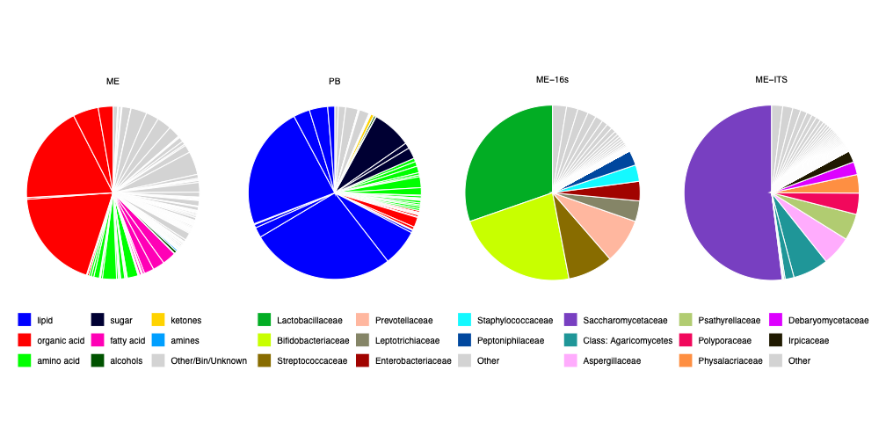
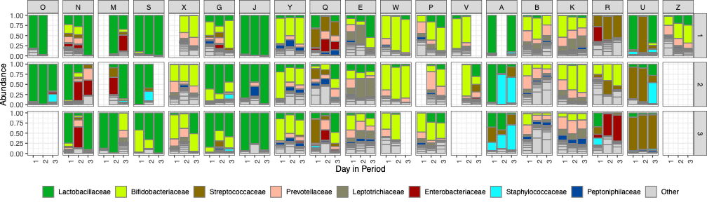
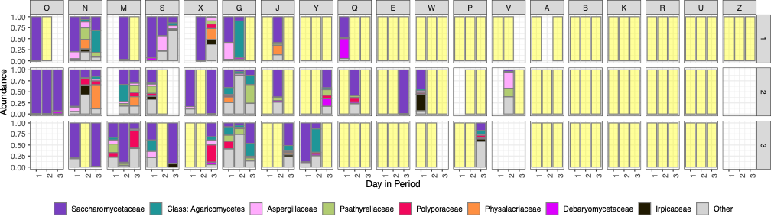
A
B
C
Notes:
Figure 2 Characterization of menstrual effluent on metabolomics (ME-NMR, n = 18 women / 110 samples), peripheral blood metabolomics (PB-NMR, , n = 18 women / 43 samples), menstrual effluent bacteria (ME-16S, n = 19 women / 149 samples) and fungi (ME-ITS, n = 19 women / 149 samples). A: Composition of ME metabolome, PB metabolome, ME bacteria and ME fungome, respectively.
B: Individual sample wise bacterial (16s) composition as relative abundance of the eight dominating families per women (horizontal facets) per cycle (vertical facets) across the first three days (x-axis). Women are horizontally sorted according to the overall abundance of the dominating family Lactobacillaceae.
C: Individual sample wise fungal (ITS) composition as relative abundance of the eight dominating families per women (horizontal facets) per cycle (vertical facets) across the first three days (x-axis). Women are horizontally sorted according to the overall abundance of the dominating family Saccharomycetaceae. Yellow fill-color indicates samples with no fungal PCR product detected. Blank in B and C refers to absence of samples.

Slide 3
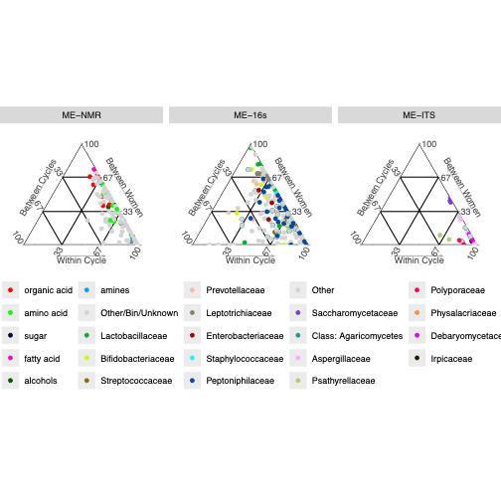
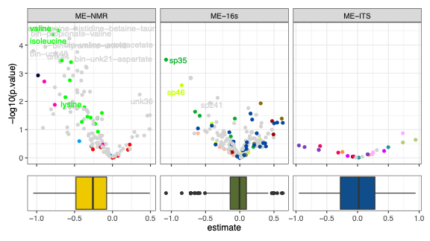
A
B
C
Notes:
Figure 3: Characterization of impact of women, cycle and cycle day. A: Individual feature variance split between women and between menstrual cycle. B Volcano plots of difference between menstruation cycle day 1 to 2 (day 2 and 3 did not differ significant) for menstrual effluent on metabolomics (ME-NMR, n = 18 women / 110 samples), menstrual effluent bacteria (ME-16S, n = 19 women / 149 samples) and fungi (ME-ITS, n = 19 women / 149 samples). C: Distribution of effect size of day 1 vs day 2.

Slide 4
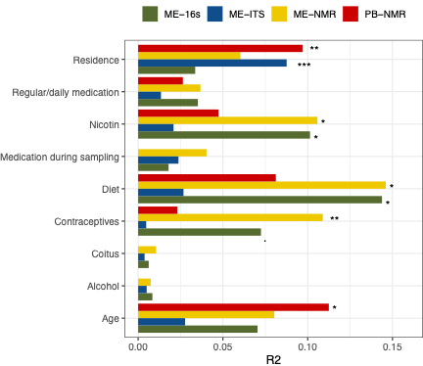
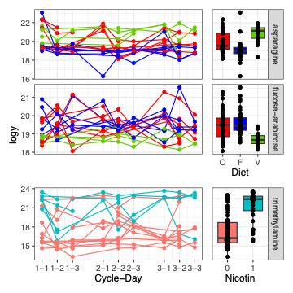
A
B
Notes:
Figure 4 A: Demographic imprint on overall variation within menstrual effluent metabolomics (ME-NMR, n = 18 women / 110 samples), peripheral blood metabolomics (PB-NMR, , n = 18 women / 43 samples), menstrual effluent bacteria (ME-16S, n = 19 women / 149 samples) and fungi (ME-ITS, n = 19 women / 149 samples). * Indicate inference from nested mixed models. B: Example of two (fdr < 0.01 significant) diet-related metabolites and one metabolite relating to nicotine usage.

Slide 5
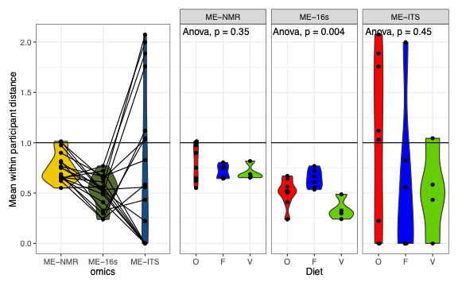
A
B
Notes:
Figure 5: Characterization of person-centric longitudinal stability of menstrual effluent components. A: Multivariate stability measure within each woman for ME metabolomics
(ME-NMR, n = 18 women / 110 samples, yellow), ME bacteria (ME-16S, n = 18 women / 141 samples, green) and fungi (ME-ITS, n = 18 women / 141 samples, blue). A value of 1 means that within person variance is equal to mean variation, values <1 indicates within-person stability. B: Variance stability in reference to dietary habits of metabolomics, bacteria and fungi respectively (F=flexitarian, O=omnivore, V=vegetarian).

Slide 6
Notes:
Multivariate figure are removed to be in supplement.

Slide 7
Old figures from first submission

Slide 8
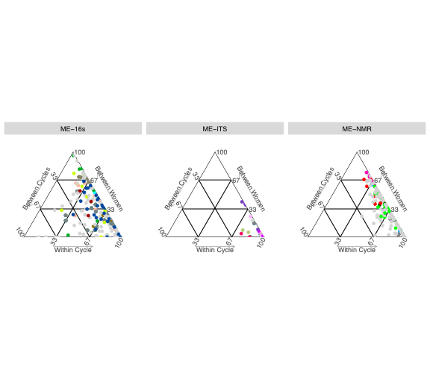
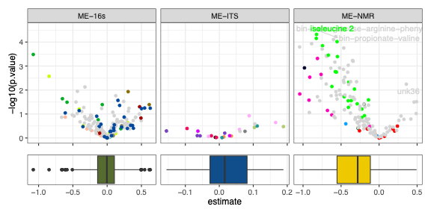
A
B
C
Notes:
Figure 2 Characterization of menstrual effluent on metabolomics (ME-NMR), peripheral blood metabolomics (PB-NMR), menstrual effluent bacteria (ME-16S) and fungi (ME-ITS). A: Composition of ME metabolome, PB metabolome, ME bacteria and ME fungome, respectively. B: Individual feature variance split between women, between menstrual cycle. C: Volcano plots of difference between menstruation cycle day 1 to 2 (day 2 and 3 did not differ significant in neither metabolome nor microbiome) for bacteria composition, fungome and metabolome respectively.

Slide 9
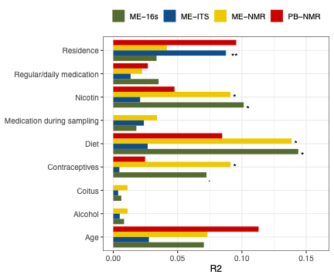
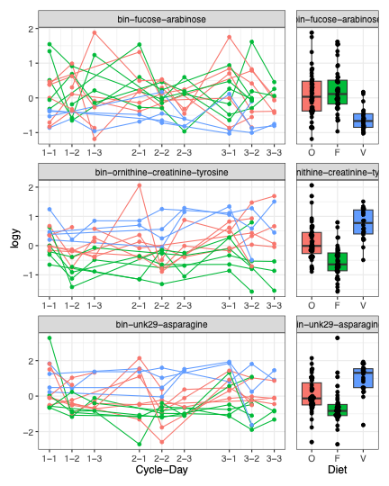
A
B
Notes:
Figure 3 A: Demographic imprint on overall variation within menstrual effluent metabolomics (ME-NMR), bacteria (16s) and fungi (ITS). * Indicate inference from nested mixed models. B: Example of two (fdr < 0.01 significant) diet-related and one metabolite relating to nicotine usage.

Slide 10
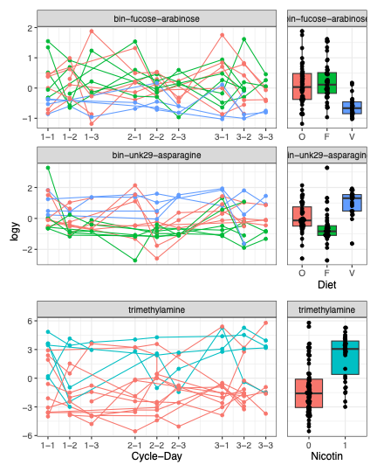
A
B

Slide 11
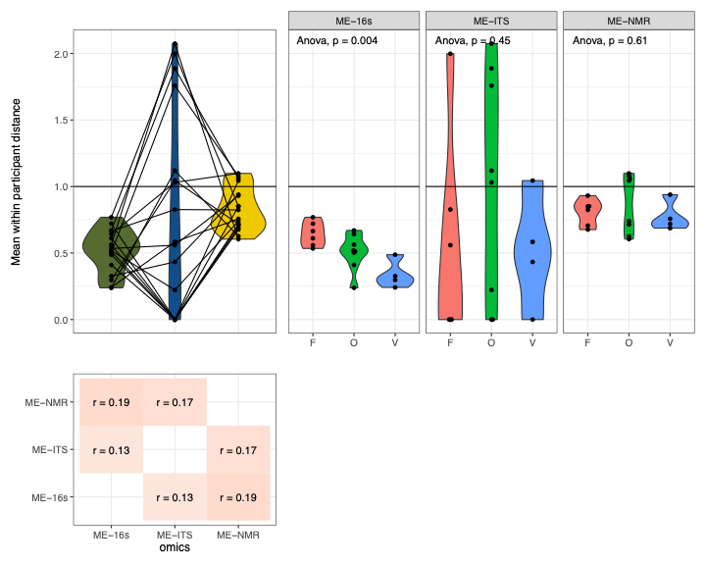
A
B
C
Notes:
Figure 4 Characterization of person-centric longitudinal stability of menstrual effluent components. A: Multivariate stability measure within each woman for bacteria (green), fungi (blue) and metabolites (yellow). A value of 1 means that within person variance is equal to mean variation, less value is less within-person variance. B: Variance stability in reference to dietary habits of bacteria, fungi and metabolites respectively (F=flexitarian, O=omnivore, V=vegetarian), numerical values have same definition as in A. C: Correlation between the stability values in between the different ME components.

Slide 12
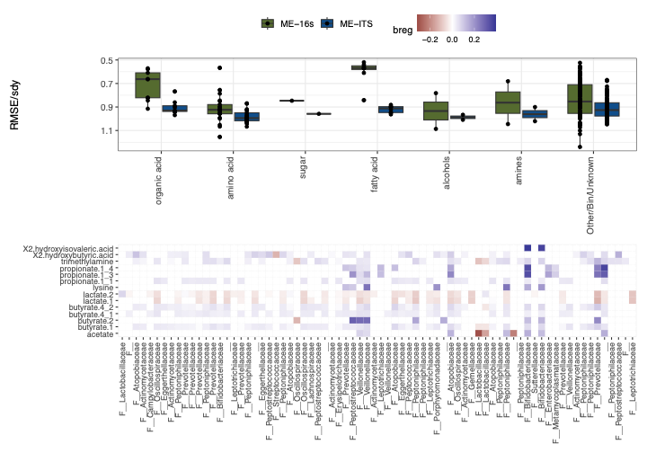
A
B
Notes:
Figure 5 Prediction of metabolomics levels from bacteria and fungi composition. A: Relative prediction uncertainty across metabolites. A value of 1 indicates no predictive power of the model, prediction improves with decreasing values. B: 16S bacteria regression coefficients for predictive metabolites. Red indicates negative correlation and blue indicates positive correlation in between metabolite and bacteria; color intensity increases with correlation.

