Slide 1
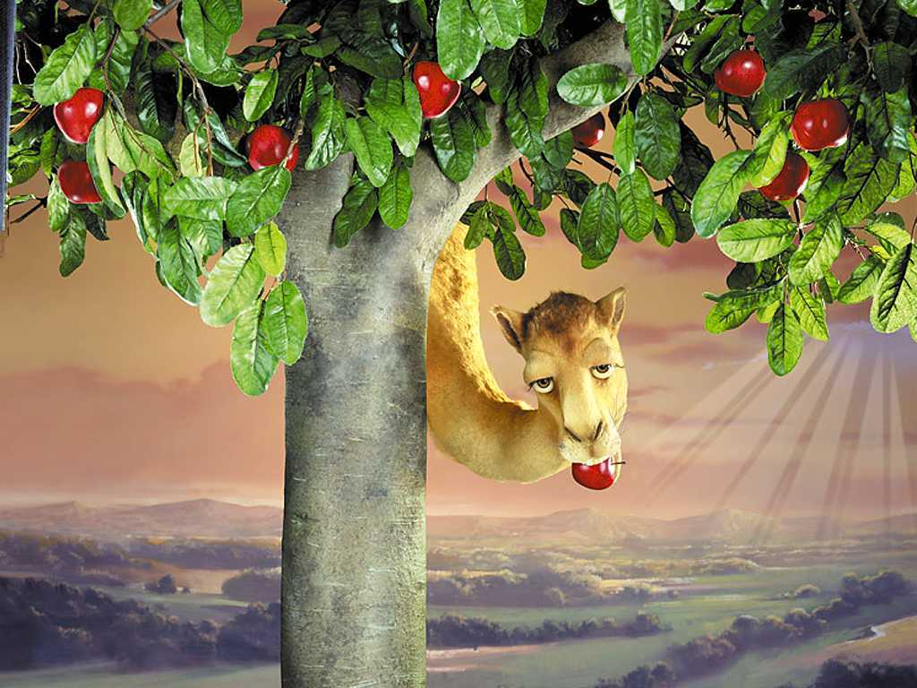
Hmm..weekend is coming....

Slide 2
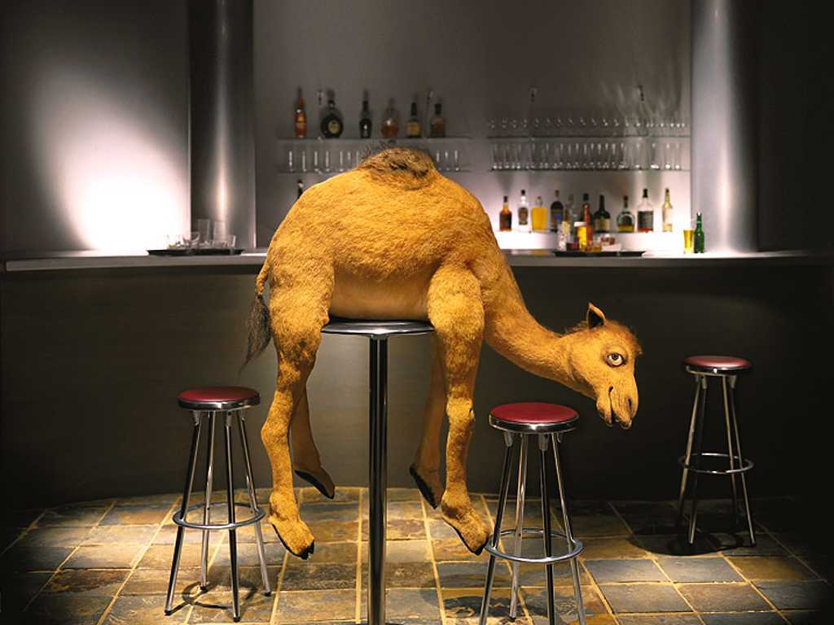
So don´t hang around!

Slide 3
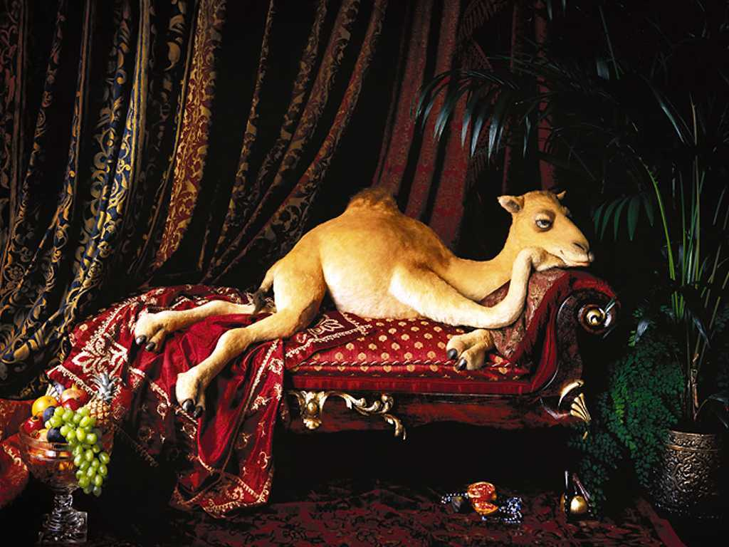
Just relax......

Slide 4
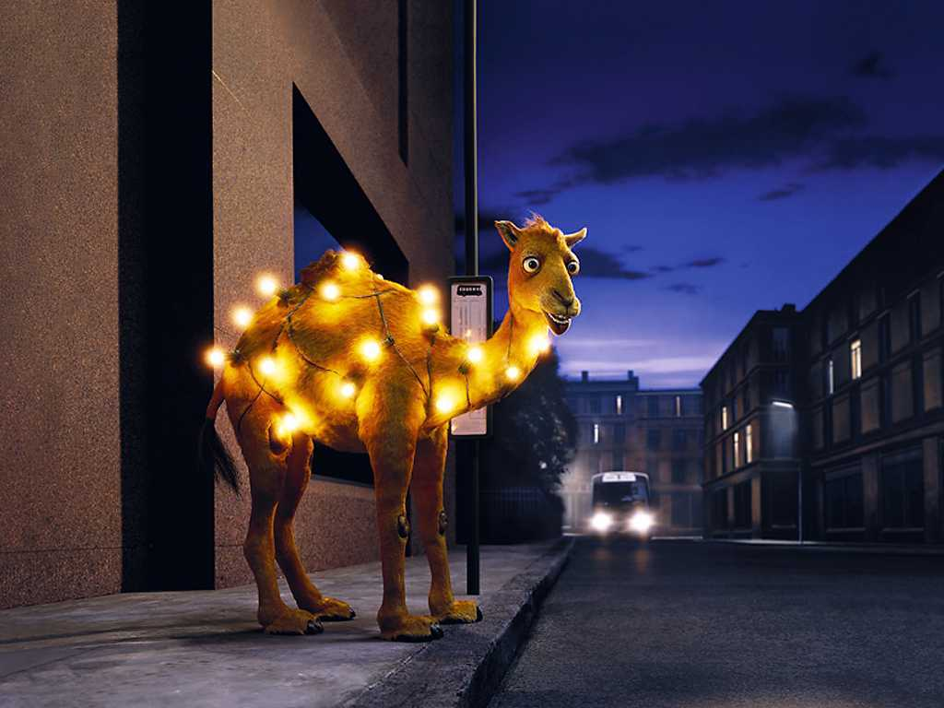
or be a bright spot in the city....

Slide 5
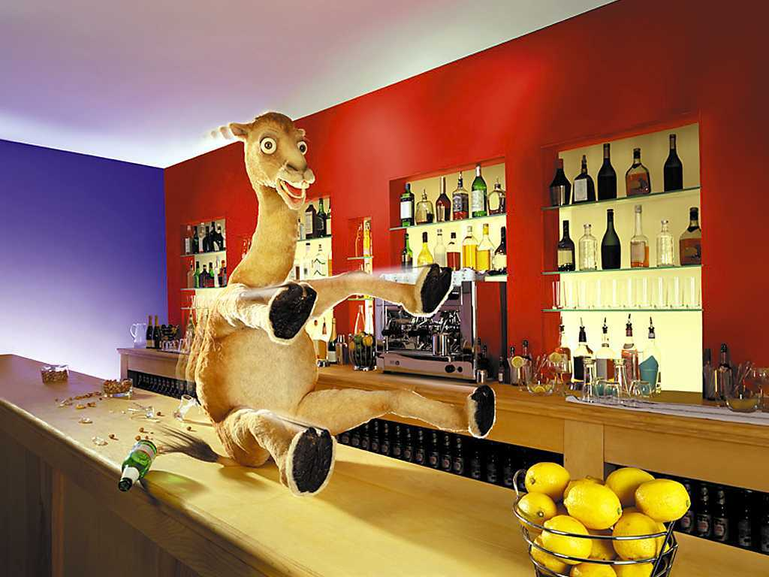
and have fun in the next bar!

Slide 6
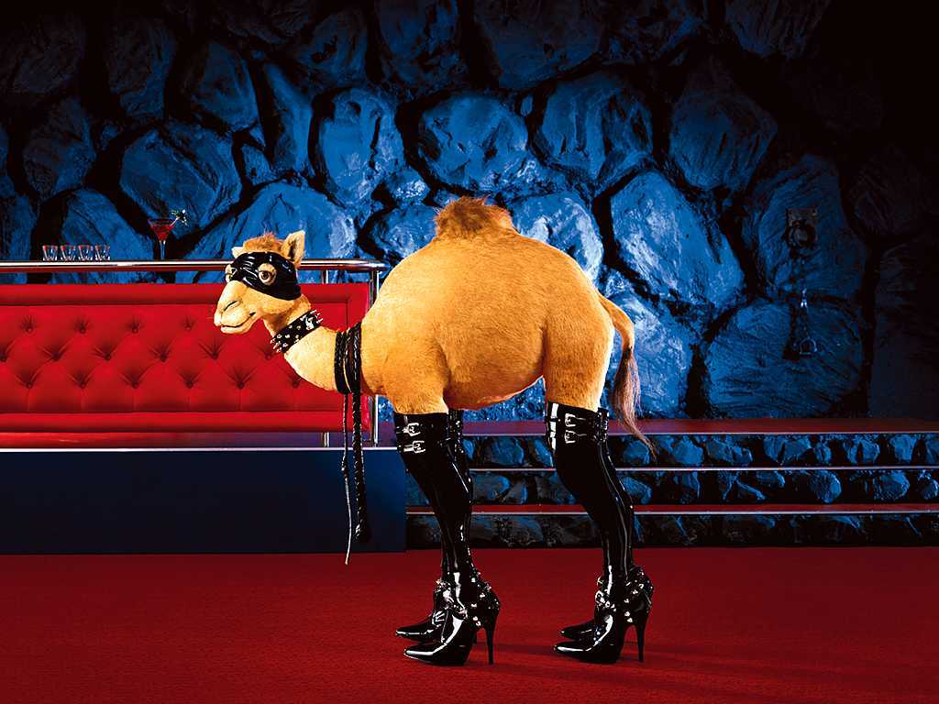
Or what about something new??

Slide 7
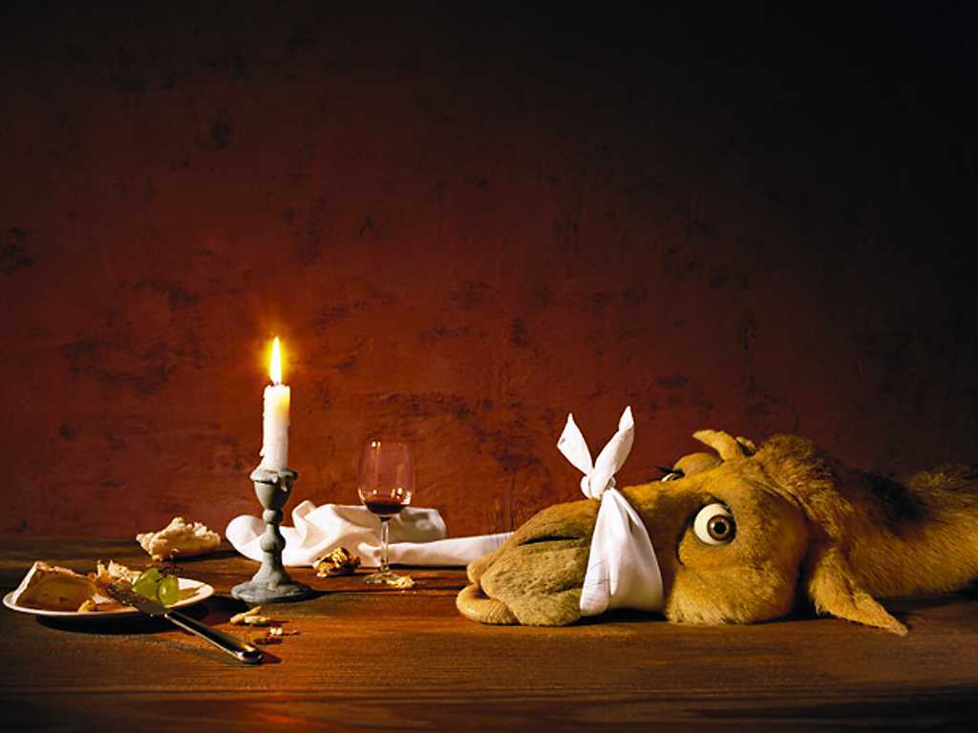
Or a Candlelight dinner ?

Slide 8
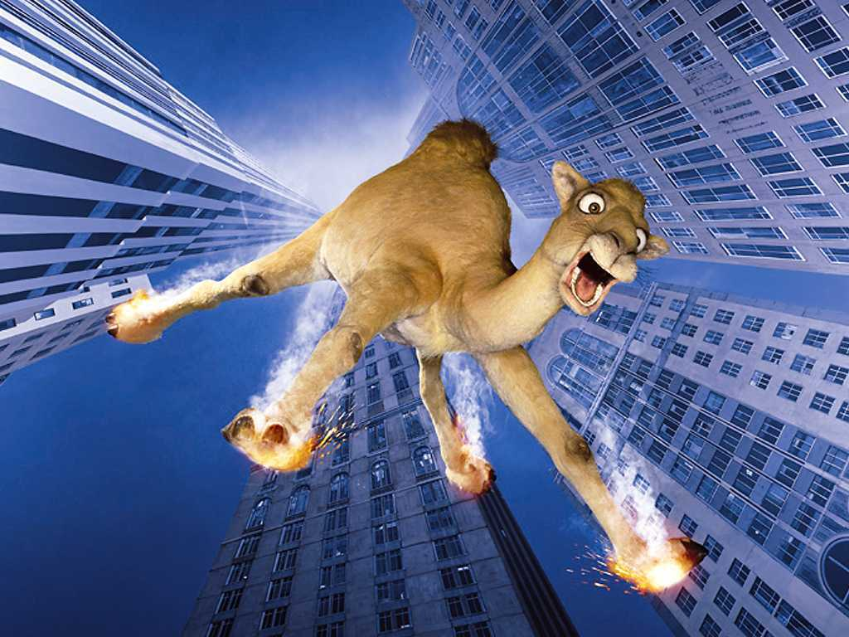
But don´t overdo anything!!!

Slide 9
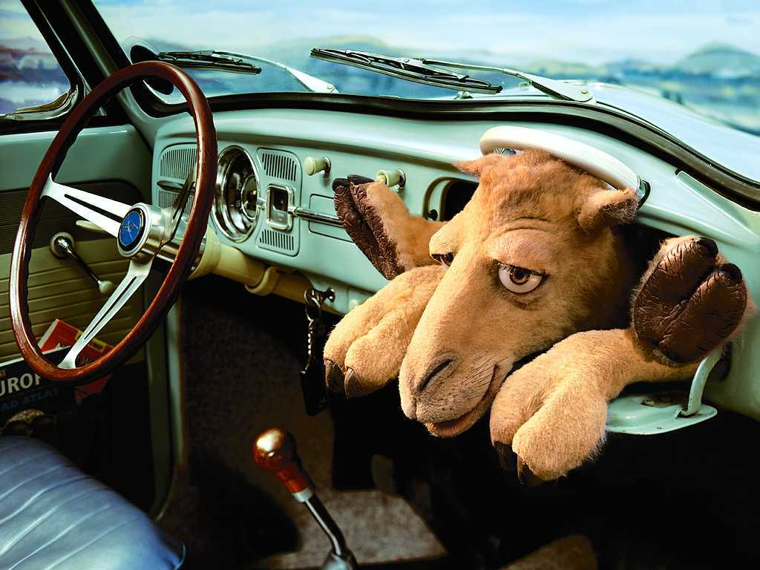
So, let´s go in the car ...

Slide 10
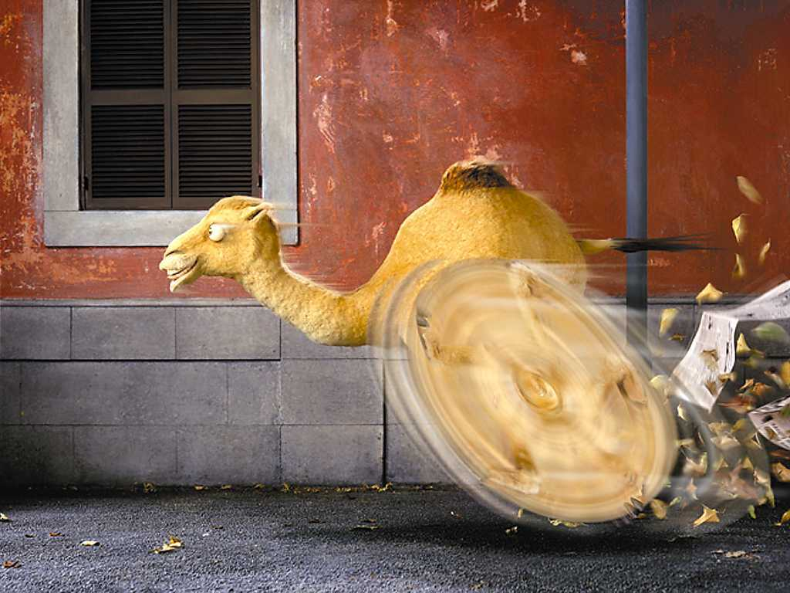
and hurry up!

Slide 11
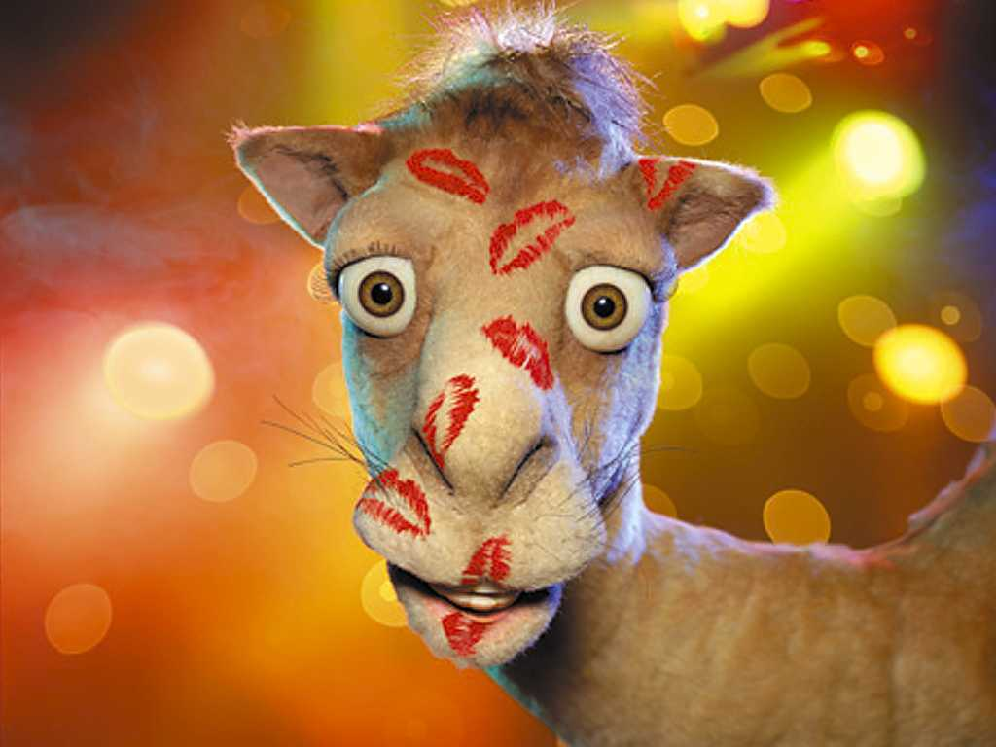
HAVE
A NICE WEEKEND!!!

