Slide 1
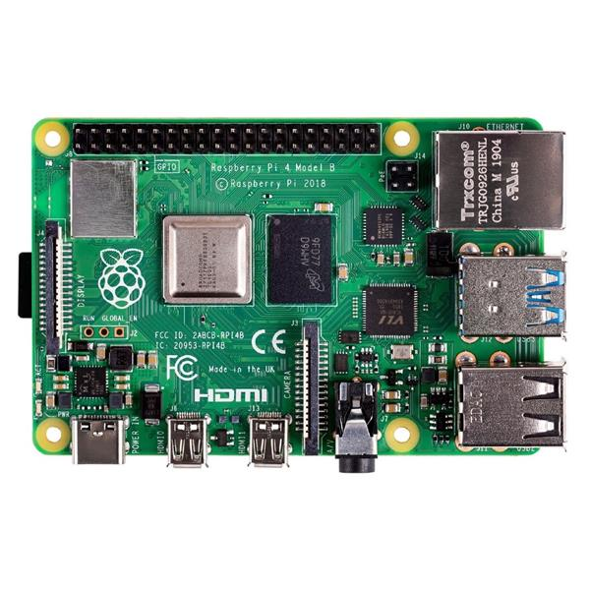
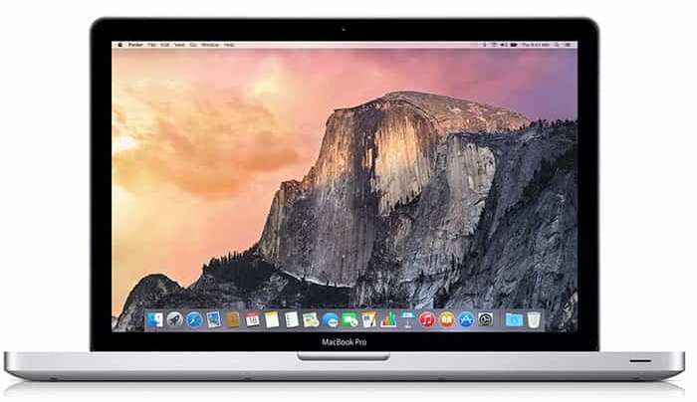
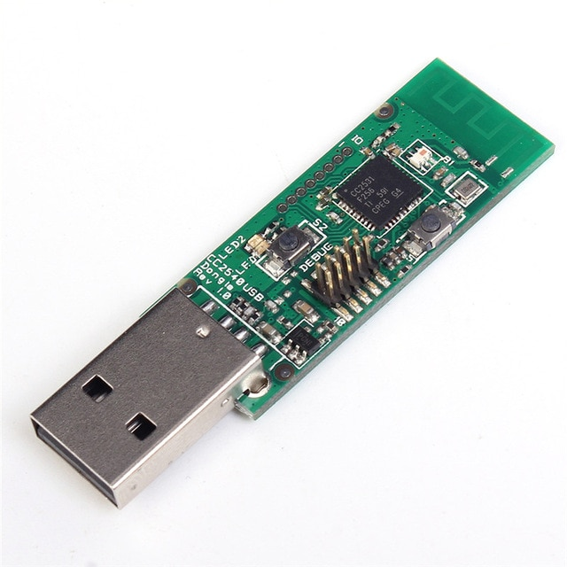

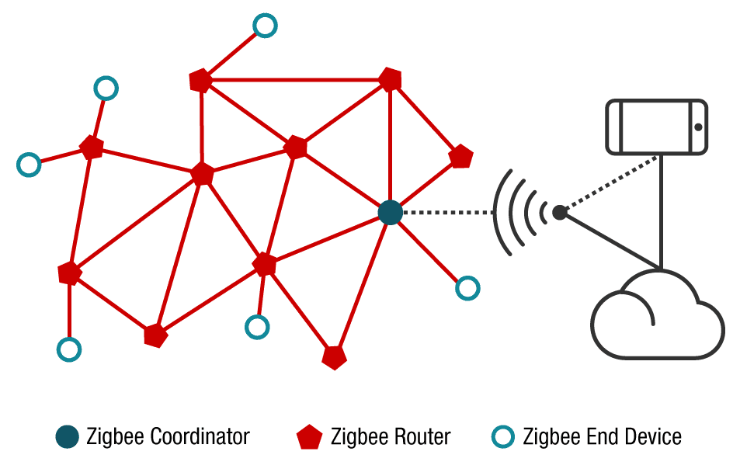
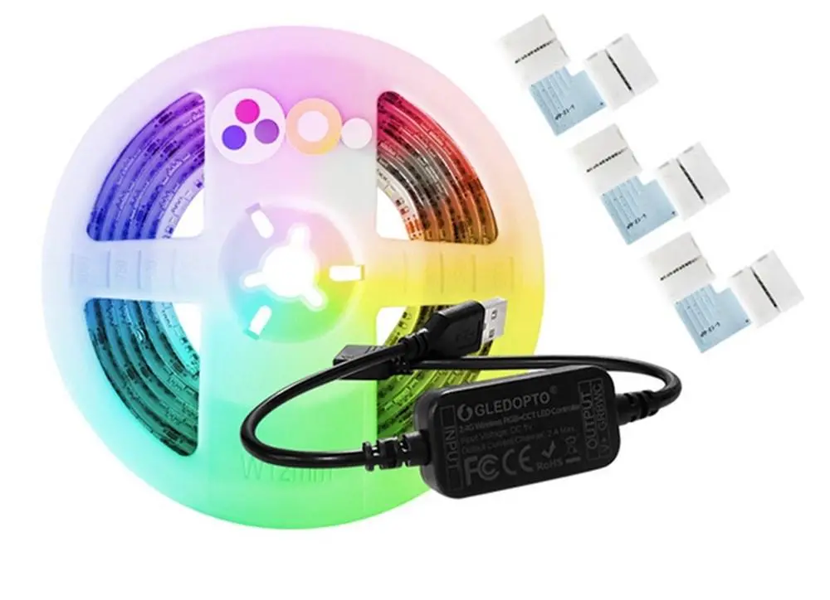
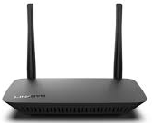
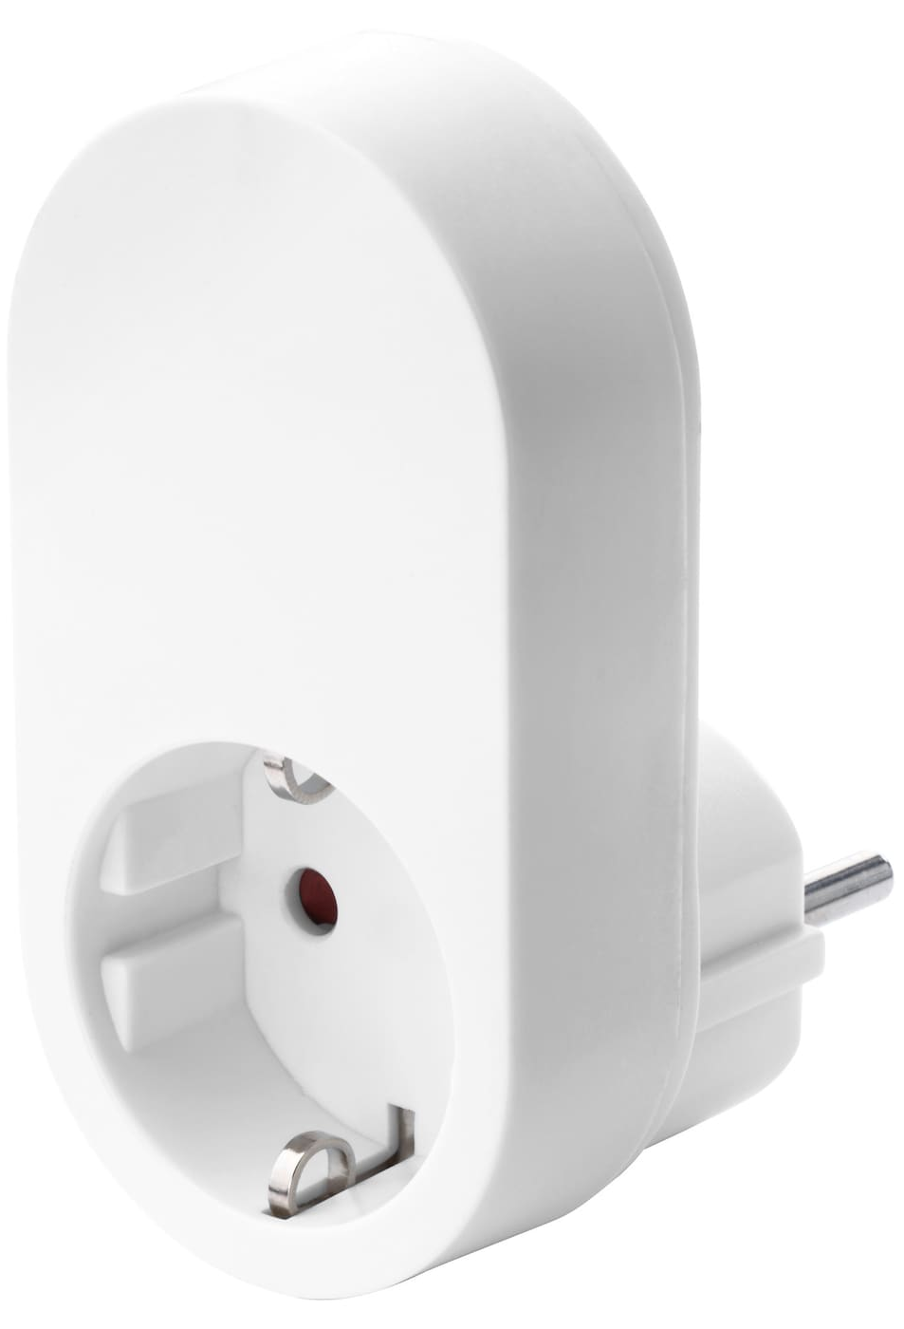
+
+
End Device: connected to one parent (only one), either the coordinator or a router, generally the closest device when it was paired; do not route traffic.
Router: end device capable of routing traffic between different nodes.
Coordinator: is a special router, responsible for forming the network
https://www.ti.com/wireless-connectivity/zigbee/overview.html

Slide 2
