Slide 1
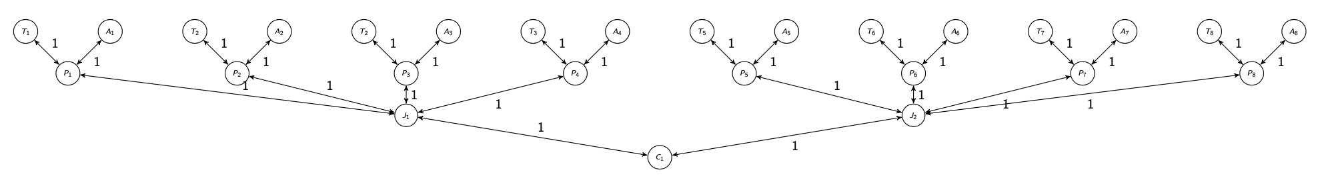



WHAT: Demonstrate proactive migration in a “real scenario”
Dynamic placement depending on inbound rate to J1 and J2
Real-world dataset:
PAMAP (Physical activity monitoring) – academic paper originally for machine learning => activity classification
High rate streams
8 subjects, with multiple high rate sensors
Heart-rate: 9 Hz (extrapolated to 100 Hz)
Temperature: 100 Hz
Topology – 8 persons (P₁, P₂, .. , P_{n}) with two sensors each
New Query:
For all measures below a certain threshold (source filter)
Find the minimum measured value of heartrate among the persons
WHY: Provoke “imbalance” in data streams (source filter) – thus that it actually makes sense to migrate the JOIN operator to intermediate nodes J1 and J2
Use larger window size because reviewer said so..

Slide 2
Link rate experiments
Aware protocol assumes migration time / freeze time is known
500 ms – but how does that suit the various link rates?
2 Mbps NA
3.5 Mbps: 850 ms
5 Mbps 250 ms – 5 new runs or keep 500?
7.5 Mbps 200 ms – 5 new runs
 | 35 | 50 | 75
Average of Freeze | 795,7 | 182,4 | 150,8

Slide 3
We can show that bandwidth is lower for Reactive than proactive measures
None still seem to outperform Aware algorithms despite control traffic gains
Do they ‘loose’ optimal placement due to ”waiting time”?
We cannot seem to find proof of migration impact on E2E delay

Slide 4
OLD slides:

Slide 5
Discoveries since last meeting
Implemented a placement score metric
Find optimal placement: Analyze from Wireshark packet captures where placement should be based on real bandwidth consumption outbound from stream sources
Find real placement: Read from logs exactly when and to where migration is executed. Point of interest is then the stream redirections
Score: Number of seconds where real placement matches with optimal placement
Discoveries:
Found bug in placement algorithm configuration introduced when switching a window query
Found that reactive strategies perform really really good! (.. And proactive algorithms with small future window (act almost as reactive approaches)

Slide 6
Placement timing criteria / Optimization goals
Criterion: Maximize placement score by migrating (stream redirect) close in time to context change
Criterion: Minimize E2E Latency by suspending migration if a flush is expected (collision avoidance)
Criterion: Minimize freeze time by always migrating when state is small (i.e., right after a flush)

Slide 7
Algorithms
Non-Aware: Schedules instantaneously as new optimal placement is either predicted or found
Aware: Suspends migration if flush is expected, thus M_{t} > F_{t} in many cases
Wait: Always suspend migration until next flush is complete, thus is M_{t} > F_{t}
Smart (Proactive): Sleeps until either window flush does not collide, or until context change (equal to Fw)
All can be run in combinations of proactive and reactive, but not all combinations makes sense

Slide 8
Algorithms and Criteria matching
 | Non-aware | Aware | Wait
Reactive | Satisfies C1 solely, NOT C2 and C3 Reacts to context change with instantaneous stream redirection | Satisfies C2 solely, NOT C1. To some degree C3. Always avoid migration during window flushing, and state in many cases will be small due to collision avoidance (C3) | Satisfies C2 and C3 solely, NOT C1 Score suffers from delayed migration. But can reduced state size make up for increase in BW due to lower score and reduce state size?
Proactive | C1, if F_{w} is very small, not C2 and C3 Strategy does not perfectly match any criteria, however C1 if F_{w} is small, because it effectively acts like Reactive | Satisfies C2, seldomly C1 to some degree C3 C1 can be satisfied because migration statistically is triggered before stream redirection which will occasionally match with context change. state in many cases will be small due to collision avoidance (C3) | Satisfies C2 and C3, to some degree C1 C1 can be satisfied because migration statistically is triggered before stream redirection, which will occasionally match with context change.

Slide 9
Experiment status
Metrics:
Score (placement compared to optimal placement calculated post experiment)
Overall Bandwidth consumption and control traffic bandwidth consumption
E2E latency
Migration time
Freeze time
Migration count
 | Non-aware | Aware | Wait
Reactive | V | V | V
Proactive | Fw = 10,20,30,40,60 | Fw = 10,20,30,40, 80,120 | Fw = 10,20,30,40, 80,120

Slide 10
Results: Score
No window awareness in a reactive setting (F_{w}=0) achieve higher performance than others
Aware achieve higher score with Fw=30, indicate that this value matches well with the amount of sleep
Unexpectedly high performance of 2 – Wait Reactive (Fw=0), and None with Fw=30
Expected that Wait would benefit from a higher FW than Aware

Slide 11
Overall Bandwidth
None
Not able to achieve as low consumption as others, since state probably larger
Less variation in results with increasing F_{w -} migration time sees less variability
Aware
Able to achieve low bandwidth with F_{w}=10, comparable with the best performing Wait strategy, but E2E latency is lower
Performance dependent on tuning of Fw, “V shape” expected
Wait
Able to achieve the lowest bandwidth consumption (with the cost of increased E2E latency)
High variability because of high variability in migration time
Potential outliers/ high standard variation in F_{w}=20

Slide 12
Bandwidth from control traffic
Wait achieve the lowest bandwidth consumption from control traffic, as expected
Impact from F_{w} comes from the fact that number of migrations is different (impacted by F_{w})
F_{w}=0 (Reactive): 20 migrations
F_{w}= 10: 22 migrations
F_{w}= 20, 30, 40: 24 migrations

Slide 13
Results: E2E Latency
Potential outlier in None F_{w} = 10
Very high stddev (x9) caused by one strange run, re-run?
Aware generally perform the best, as long F_{w} < 30
Aware and Wait achieves the lowest latency at F_{w} = 10, indicates that this fits well to migration time
But very low margin, re-use count of delayed tuples metric from simple pamap experiments?

Slide 14
Migration vs. freeze time and Migration count
Statement: Even though state size is smaller, Aware and Wait has a larger freeze time because of the way that the algorithm works (one step extra), where the node with the operator does the redirects et instead of the decider node..

Slide 15
Varying link rate between J1 and J2:
2 Mbps (1Mbps leads to full stop), 5 Mbps (exists) and 10 Mbps
FW = 0
Strat = 27
W Strat= Wait, Aware and Wait

Slide 16
Paper structure: Evaluation of timing strategies for migration
Section | Description | Status
1. Introduction |  | Rewrite with new focus
2. Background and related work |  | Update with new focus
3. Strategies |  | Mostly New
4. Testbed and CEPOverlay |  | Reuse from DEBS
5. Experiments -> 5.1 Synthetic Workloads Topology Results Discussion | De | Reuse from DEBS
5. Experiments -> Real-world PAMAP Workloads Topology Results Discussion |  | Mostly New

Slide 17
State size and control traffic
Overall control traffic
Average snapshot/state size

Slide 18
Expected results
# | What | Why | Actual | Explanation | Align with synthetic
1 | Wait and Aware achieves the lowest E2E latency | Avoids negatively impacting results delivery | True | .. But with very low margin | Yes
2 | Wait and Aware benefits from proactivity to make up for the ”wait for flush” time, benefits this on both score and lower bandwidth consumption | Future window parameter gives us time to do the wait | Partly | There is a high variability in the duration of the “wait for flush” time period, and therefore this is not true always | No
3 | Aware scores better than Wait | Wait compromise score for lower end to end delay | True | .. But BW is not obvious because state size is smaller | NA
4 | Wait lowers state size over aware | Since state is always kept as small as possible | True |  | NA
5 | High score align with configurations that achieve low bandwidth | High score yields optimal placement | Partly | Not simply possible to match one to one because of number of migrations changes (impacting Bw)
6 | Reactive score higher than proactive in terms of placement score | Because the score calculation focus on stream redirection, which happens instantaneously from a triggered migration | True | -- as expected | NA (did not calculate placement score in old paper)
7 | Stream redirection constitutes the point in time during migration which impact bandwidth consumption | This is when we benefit form shorter distance from high volume streams | True | The fact that Reactive strategy with no window awareness scores the highest builds upon this statement that is also intuitive

Slide 19
Next steps
Prepare parameters for a new run with bandwidth variations on link between J1 and J2 to see if this affects the selection of optimal strategy respective to window awareness
Start writing down all the stuff
Clean up in the results..

Slide 20
OUTDATED: Unexpected issues
Wait scores higher on than Aware on Reactive strategy!!
Wait should have significant lower freeze time than Aware since state is smaller, but we see only a 2% decrease (F_{w}=30) in freeze (while we see 8 % decrease in state size)
High score is not aligned with low bandwidth consumption
State size
Number of migrations
Static placement has fewer migration than proactive, which is not the same is previous results with older queries
There also seem that Fw=10 gives fewer migrations than Fw=20,30,40 which means they consume less bandwidth, and also does 27!!

Slide 21
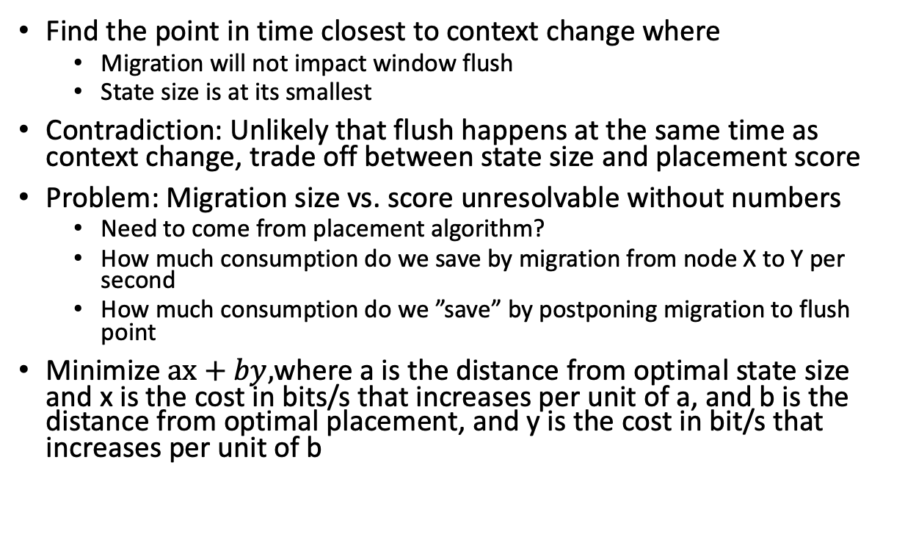
Can we make a new algorithm that fulfills all criteria using prediction?
Find the point in time closest to context change where
Migration will not impact window flush
State size is at its smallest
Contradiction: Unlikely that flush happens at the same time as context change, trade off between state size and placement score
Problem: Migration size vs. score unresolvable without numbers
Need to come from placement algorithm?
How much consumption do we save by migration from node X to Y per second
How much consumption do we ”save” by postponing migration to flush point
Minimize $ax+by,$where a is the distance from optimal state size and x is the cost in bits/s that increases per unit of a, and b is the distance from optimal placement, and y is the cost in bit/s that increases per unit of b

Slide 22
The Proactive Smart Algorithm
Proactiveness that can make up for sleep imposed by window size
Fw = window length
Figure out if

Slide 23
Score (left) and Bw (right) with variations of future window and window timing strategy

Slide 24
Fine-grained decision making
We argue from a bandwidth reduction viewpoint, migration should be initiated (source redirection) as close to the point in time of context change as possible
This may contradict the goal of minimizing delay, where the goal is to prevent late arrival of result tuples, i.e., in periods of times when the operator actually produces results
The state is also smaller if we migrate just after a window flush, which dictates when migration should happen
But with sufficient FW, we can calculate the point in time of migration that minimize the delay and maximize bw within the timeframe

Slide 25
Proposal
We avoid migrating during flush at any cost
Then there is the bandwidth trade-off
Migrate as close as possible to flush to reduce state size transfer
Migrate as close as possible to context switch to optimize placement
Problem:
We can calculate state size reduction from close to flush migration
We cannot easily calculate the reduction from optimal placement
… but we can measure this perhaps as theu correspond to two current strategies?

Slide 26
Algorithm with three objectives
Minimize state size by minimizing M_{e}-W_{f}
Maximize bandwidth reduction goal by minimizing Ms-C_{t}
Avoid that migration happens during a flush W_{f} >= M_{s}+M_{t}

Slide 27
Context change: the point in time when context changes, for example the change of stream rates.
Window flush: the point in time which the operator produces result in case of tumbling window
Freeze time (𝐹𝑡): time during which system is unresponsive due to migration
Migration time (𝑀𝑡): the total time it takes to migrate one operator from one node to another, including stream redirection..
Future window (𝐹𝑤): length of the time period into the future
Window size time-based or count-based
Placement score (𝑃𝑠): number of seconds in which placement is optimal with respect to stream rates (measured post experiment run)
How do you calculate Ps? Ultimately should represent how good placement is. At which point in migration does placement matter? Argument, stream redirection!
Realization: Means that proactiveness is not meaningful unless we are window aware / output result aware

