Slide 1
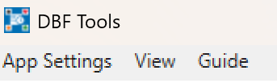
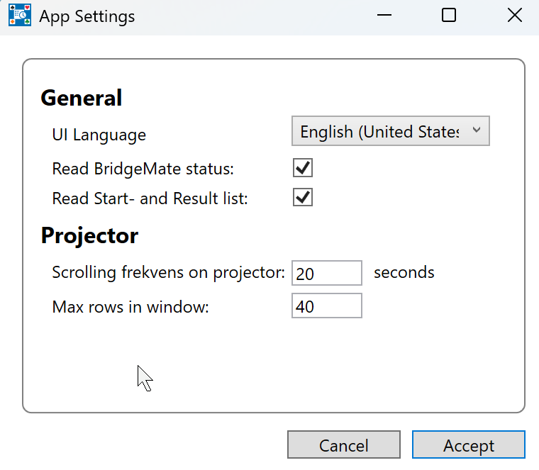
Please open App Settings on first run
Read BC3 Data (Denmark only)
When checked, the app will import tournaments, start lists, and results from BC3. Note that the app only reads the data sent from BC3 to the “homepage”.
Read BridgeMate Status
When checked, the app will continuously monitor the game status and signal the transition to the next round as soon as all tables have finished the current board, even if time remains on the timer.
Projector Scrolling Frequency
This is the interval between automatic scrolling steps on large start and result lists.
Max. Rows in Window
This controls the maximum number of rows displayed on a single page. Increasing this value may reduce the font size, and vice versa.

