Slide 1


Slide 2
Magical Lamp components

Slide 3
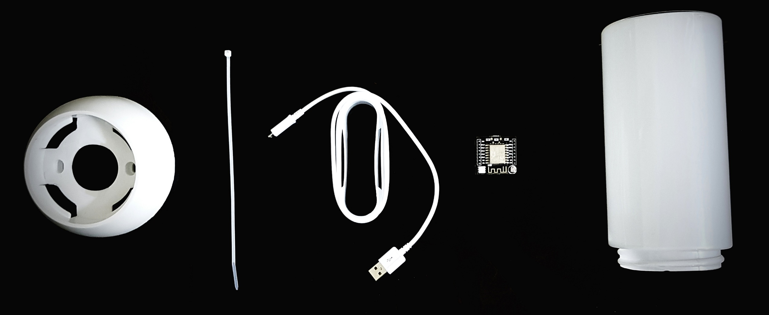

Slide 4
Steps for making Magical Lamp

Slide 5


Slide 6
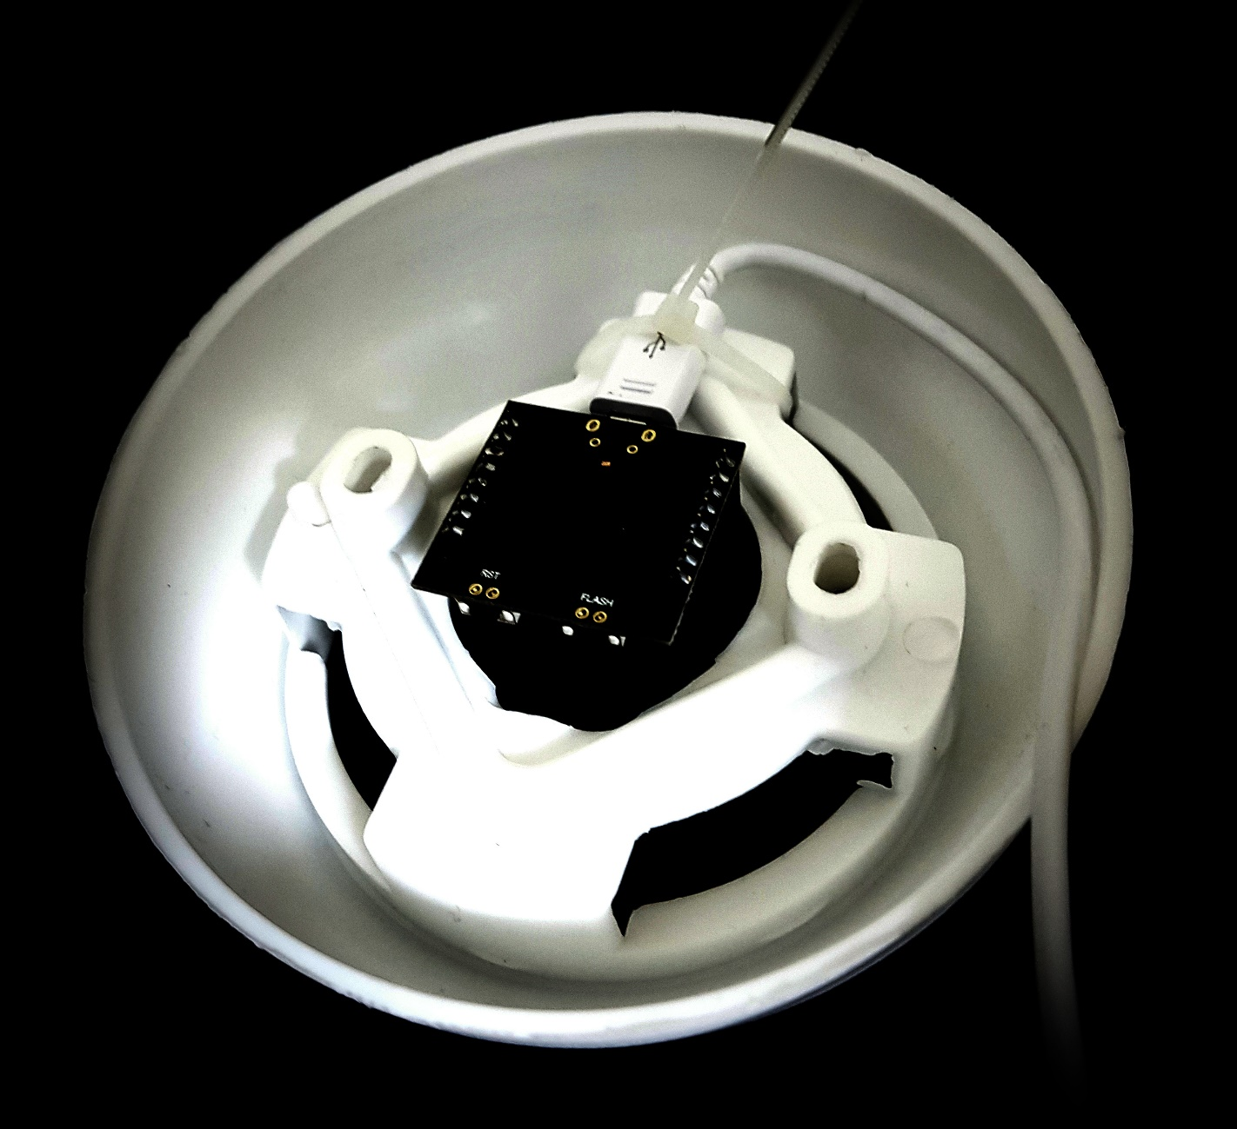

Slide 7
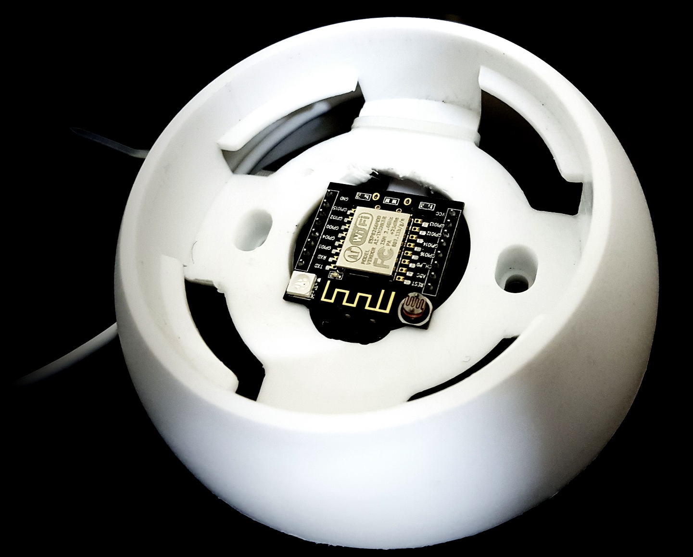

Slide 8
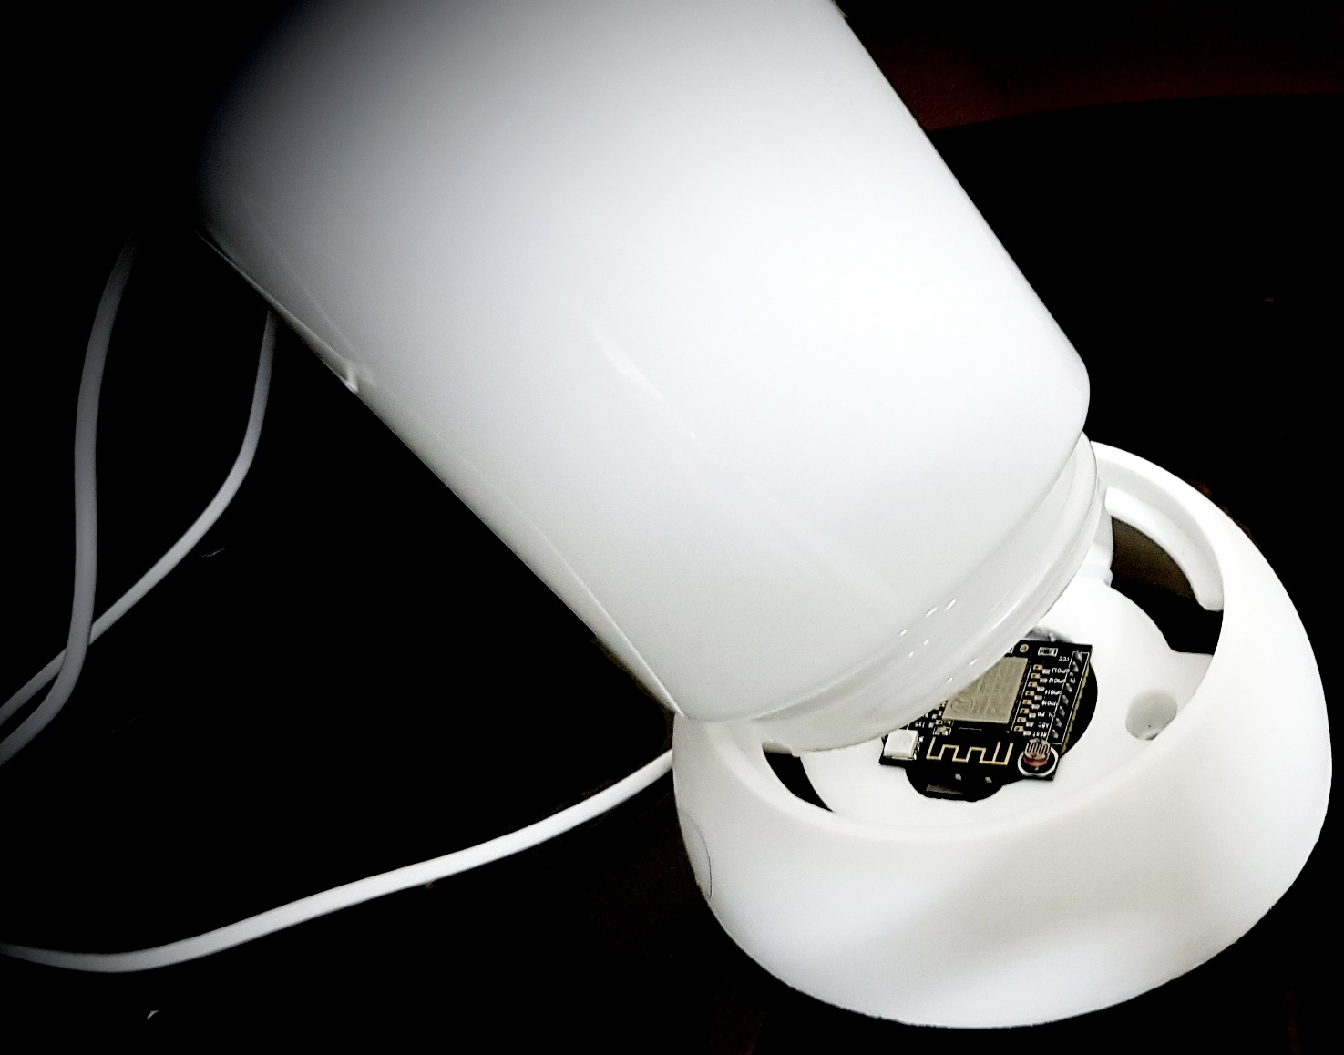

Slide 9


Slide 10
Magic Mode

Slide 11


Slide 12
Manual Mode

Slide 13
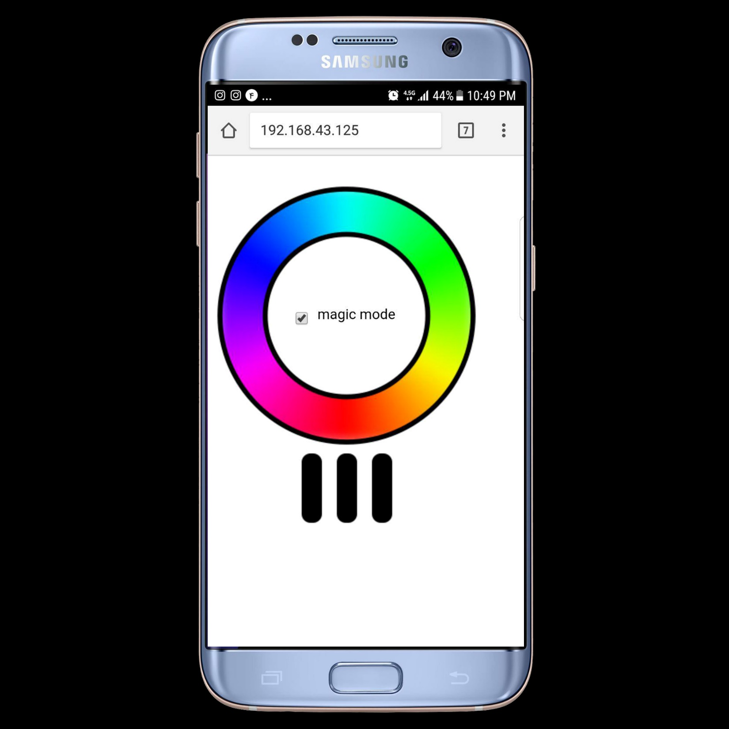

Slide 14
Development Tools

Slide 15


Slide 16
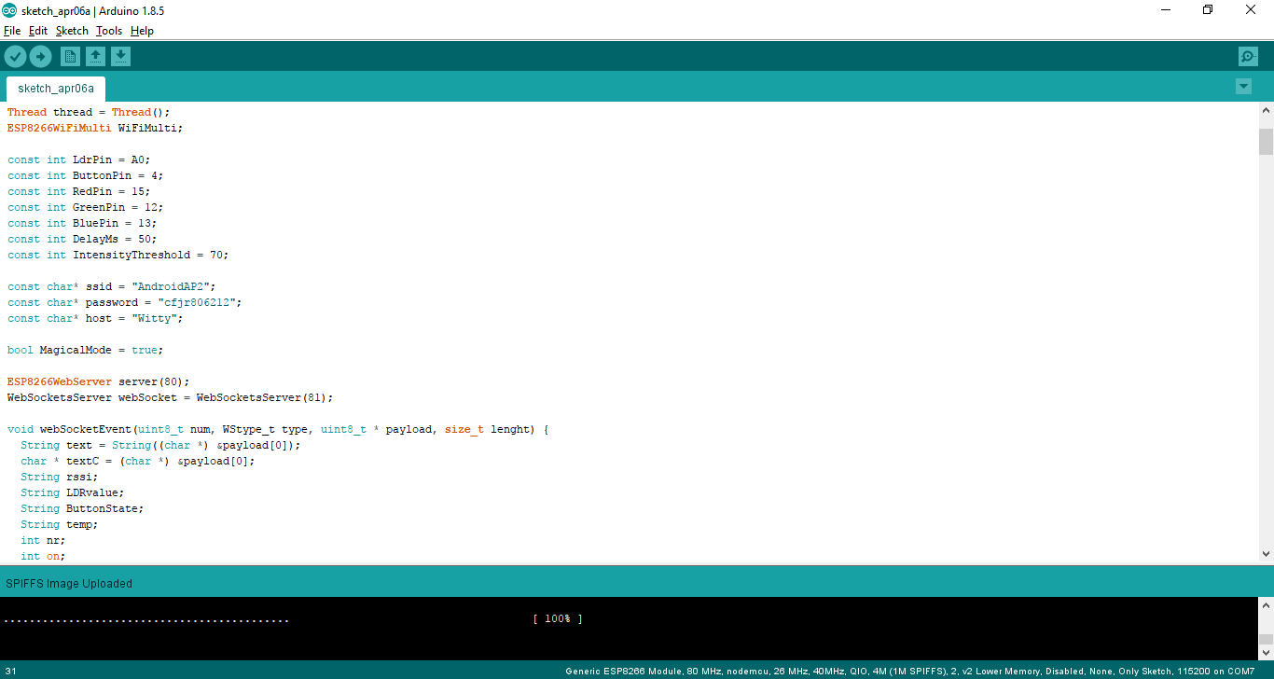

Slide 17
Install Libraries

Slide 18
Arduino core for ESP8266 WiFi chip
This project brings support for ESP8266 chip to the Arduino environment. It lets you write sketches using familiar Arduino functions and libraries, and run them directly on ESP8266, no external microcontroller required.
ESP8266 Arduino core comes with libraries to communicate over WiFi using TCP and UDP, set up HTTP, mDNS, SSDP, and DNS servers, do OTA updates, use a file system in flash memory, work with SD cards, servos, SPI and I2C peripherals.
https://github.com/esp8266/Arduino.git

Slide 19
Arduino ESP8266 filesystem uploader
Arduino plugin which packs sketch data folder into SPIFFS filesystem image, and uploads the image to ESP8266 flash memory.
https://github.com/esp8266/arduino-esp8266fs-plugin.git

Slide 20
WebSocket Server and Client for Arduino
A WebSocket Server and Client for Arduino based on RFC6455.
https://www.arduinolibraries.info/libraries/web-sockets
https://github.com/Links2004/arduinoWebSockets.git

Slide 21
Arduino Thread
ArduinoThreads is a library for managing the periodic execution of multiple tasks.
https://github.com/ivanseidel/ArduinoThread.git

Slide 22
Clone Magical Lamp Source Code

Slide 23


