Slide 1

By:
Morteza Shahbazi
August 2020
Simorgh Subsystem
Case Study: Tendermint

Slide 2
CAP Theorem
Consistency
Availability
Partition tolerance
when replicas cannot communicate, the system must either refuse requests (non-available) or return stale (non-consistent) data.

Slide 3
Strong/Eventual Consistency
Eventual Consistency
  Prefer Availability to Consistency
  Open Stack Swift
Strong Consistency
  Prefer Consistency to Availability
  Ceph

Slide 4
Strong Eventual Consistency¹
This is a special case of EC, that is valid only for certain data types.
Let's assume that the data object shared is a counter, and updates are made by add(int value) and substract(int value) operations. In this case, the order in which we apply updates does not matter! So if both nA and nB start with a counter value of 0, and if then nA runs add(10) and nB runs substract(5) (simultaneosly), they only need to send the update operation to each other without caring for conflict resolution, eventually it is ensured that they will reach the same value (remember that, in contrast, in the previous example for EC some conflict resolution could be required)!
Unfortunately SEC is only applicable in certain data types and operations that have specific properties (commutativity and others). Such data types are denoted Conflict-free Replicated Data Type (CRDT) .
Conflict-free replicated data-types (CRDT) + eventually consistent systems =
strong eventual consistency.
[1] https://stackoverflow.com/questions/29381442/eventual-consistency-vs-strong-eventual-consistency-vs-strong-consistency

Slide 5
Conflict-free replicated data type (CRDT)¹
CRDT is a data structure which can be replicated across multiple computers in a network, where the replicas can be updated independently and concurrently without coordination between the replicas, and where it is always mathematically possible to resolve inconsistencies that might come up.
Operation-based CRDTs
also called commutative replicated data types, or CmRDTs. CmRDT replicas propagate state by transmitting only the update operation. For example, a CmRDT of a single integer might broadcast the operations (+10) or (−20). Replicas receive the updates and apply them locally. The operations are commutative. However, they are not necessarily idempotent. The communications infrastructure must therefore ensure that all operations on a replica are delivered to the other replicas, without duplication, but in any order.
Pure operation-based CRDTs are a variant of operation-based CRDTs that reduces the metadata size.
State-based CRDTs
State-based CRDTs are called convergent replicated data types, or CvRDTs. In contrast to CmRDTs, CvRDTs send their full local state to other replicas, where the states are merged by a function which must be commutative, associative, and idempotent. The merge function provides a join for any pair of replica states, so the set of all states forms a semilattice. The update function must monotonically increase the internal state, according to the same partial order rules as the semilattice.
Delta state CRDTs (or simply Delta CRDTs) are optimized state-based CRDTs where only recently applied changes to a state are disseminated instead of the entire state.
[1] https://en.wikipedia.org/wiki/Conflict-free_replicated_data_type

Slide 6
Failures
Crash/Stop Failure
Byzantine Failure

Slide 7
BlockChain
Trx
Block
Hash
  Sha256
Consensus

Slide 8
What is Tendermint¹
Replicated State Machine
  Securely
    works even if up to 1/3 of machines fail in arbitrary ways
  Consistently
    every non-faulty machine sees the same transaction log and computes the same state
Similar to Two Classes of Software
  distributed key-value stores
    Zookeeper, etcd, and consul
  blockchain technology
    Bitcoin and Ethereum
[1] https://docs.tendermint.com/master/introduction/what-is-tendermint.html#

Slide 9
Tendermint vs. X
Zookeeper, etcd, consul
  BFT
Bitcoin, Ethereum
  Modular

Slide 10
Tendermint Components
Tendermint Core
  consensus engine
Application BlockChain Interface (ABCI)
  any programming language!

Slide 11
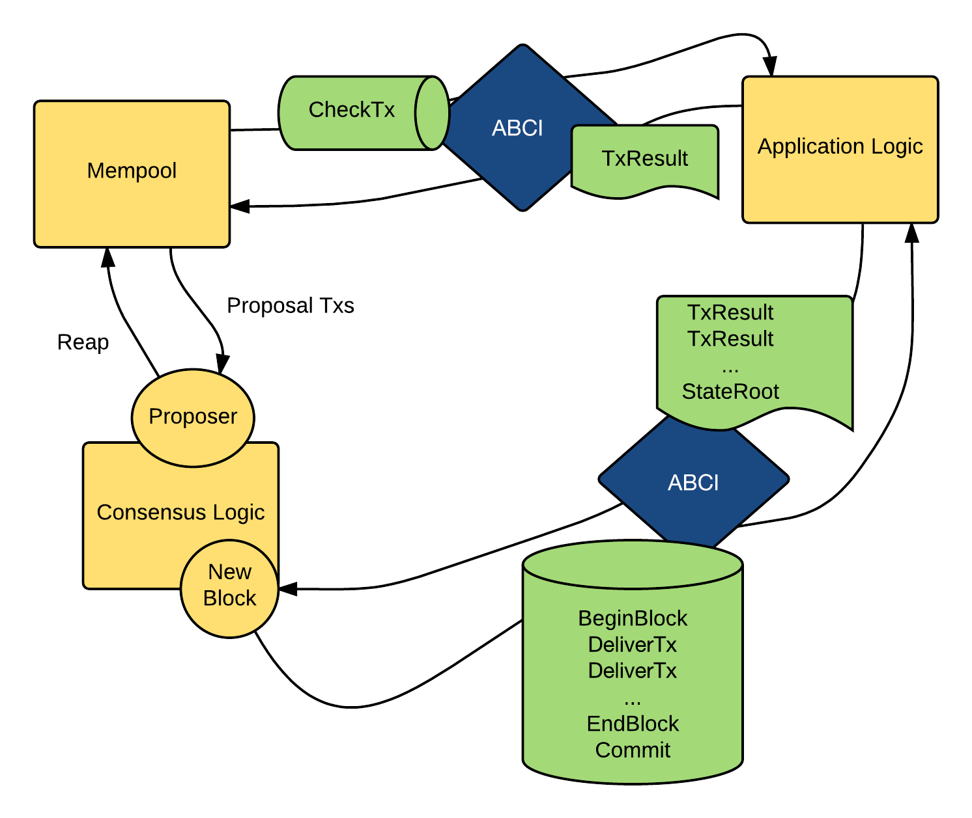
ABCI
Chech_Tx , Deliver_Tx, Commit

Slide 12
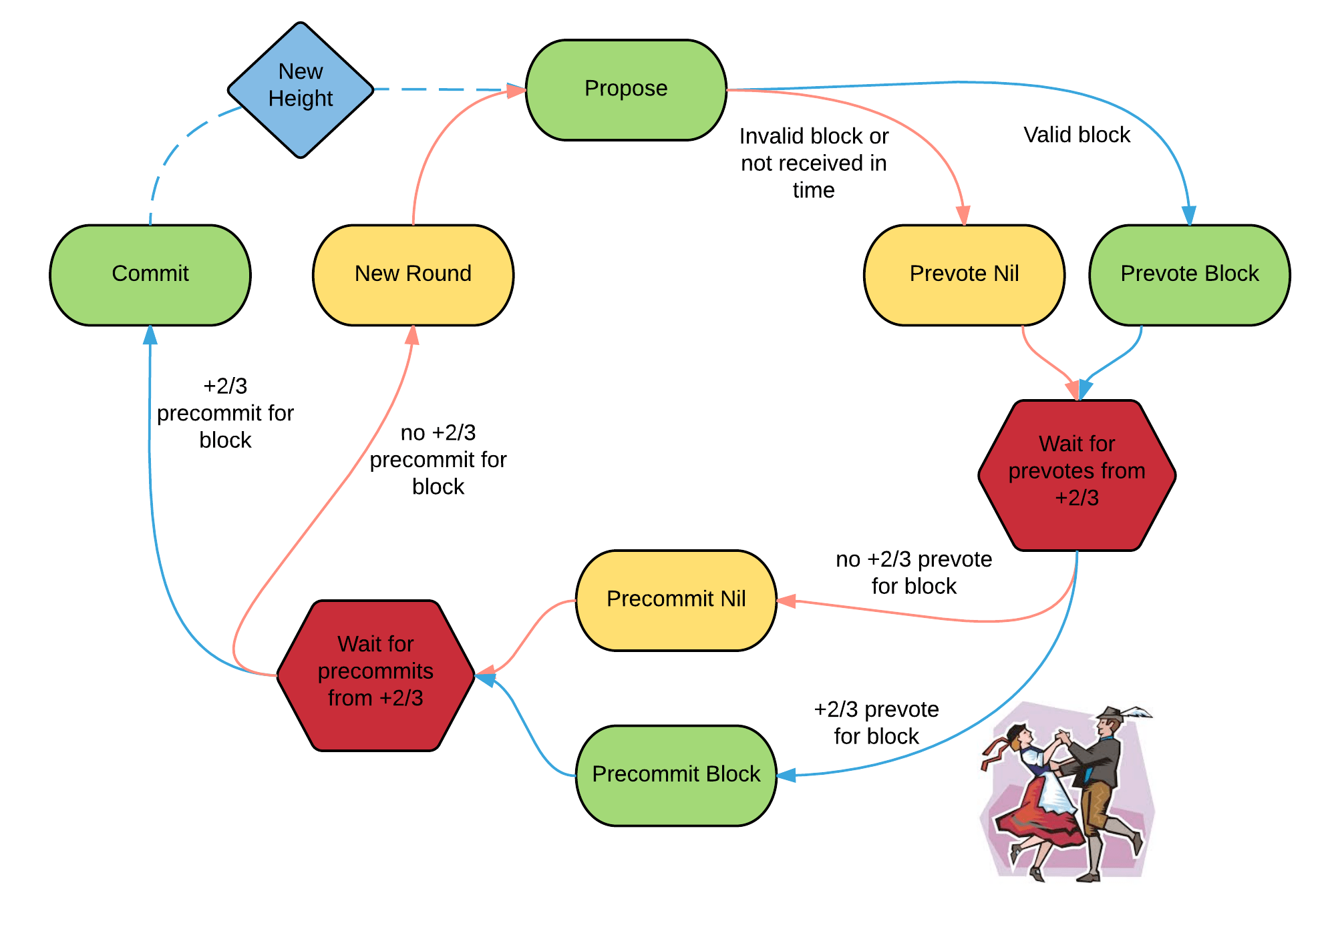
Consensus Overview

Slide 13
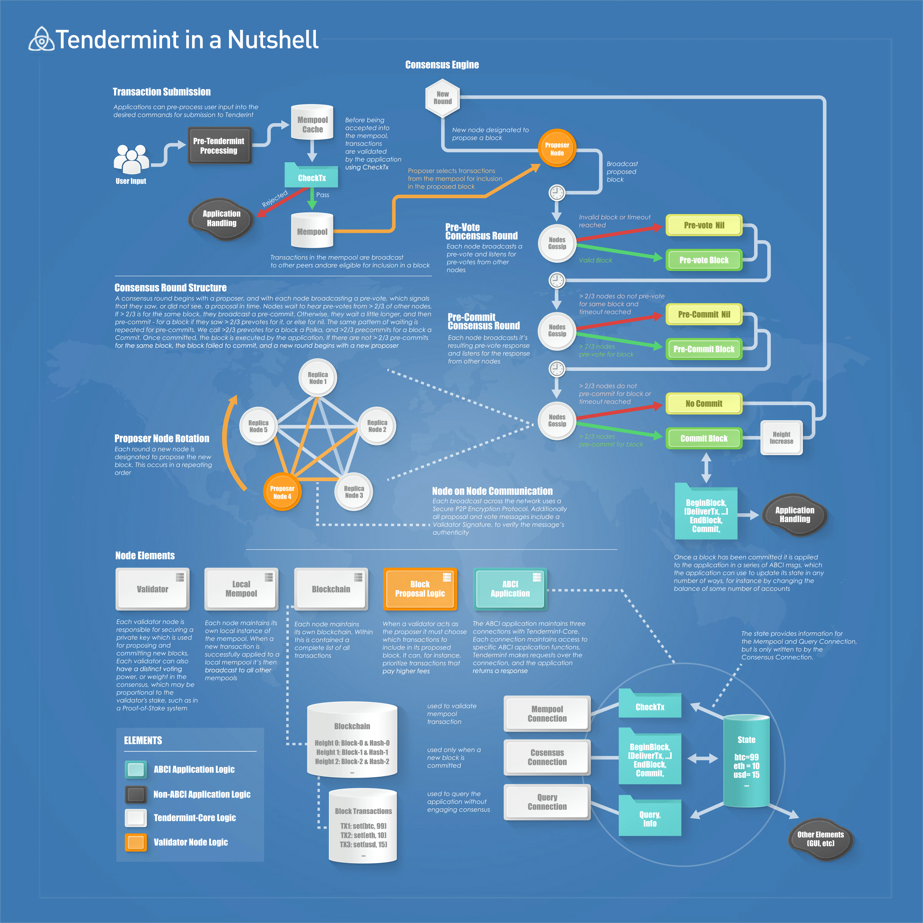
Tendermint in a Nutshell

Slide 14
Distributed System Models
Asynchronous
  the delay when sending a message from one node to another is finite but can be unbounded. In this model, a node cannot tell if its message is lost or being delayed. One consequence is that the node cannot use time-out/ping to detect failure.
Synchronous
  delay in sending a message is bounded, and finite by extension.

Slide 15
FLP Theorem
In an asynchronous network, it is not possible to achieve safety and liveness when there may be one crash failure!
any solution to distributed consensus in asynchronous model can have at most 2 out of the 3 properties. In other words, no algorithms can be safe, live and fault-tolerant at the same time.

Slide 16
FLP Terminology
Safety :
  the nodes agree on a valid value proposed by one of the node
Liveness
  the nodes eventually reach agreement, i.e. the system must make progress
Tendermint prefer Safety to Liveness
Solution:
  partial synchrony

Slide 17
Cluster of Nodes¹
  Node0
    IP1 : 192.168.122.168
    ID1: 33eb7e32babd174be1588f9b1ede292fa351fc7c
  Node1
    IP2: 192.168.122.142
    ID2: 90f2b19034f5bd139fb4fe2d8ec4f1cec8d06e96
  Node2
    IP3: 192.168.122.176
    ID3: d635da945c4da374a2a47298c87695c007a94f84
  Node3
    IP4: 192.168.122.163
    ID4: 564f9a4056fdb000ed86598bb39ce6ccc0c97752
[1] https://docs.tendermint.com/master/introduction/quick-start.html

Slide 18
How To Run?
Node0
  tendermint node --home ./mytestnet/node0 --proxy_app=kvstore --p2p.persistent_peers="ID1@IP1:26656,ID2@IP2:26656,ID3@IP3:26656,ID4@IP4:26656"
Node1
  tendermint node --home ./mytestnet/node1 --proxy_app=kvstore --p2p.persistent_peers="ID1@IP1:26656,ID2@IP2:26656,ID3@IP3:26656,ID4@IP4:26656"
Node2
  tendermint node --home ./mytestnet/node2 --proxy_app=kvstore --p2p.persistent_peers="ID1@IP1:26656,ID2@IP2:26656,ID3@IP3:26656,ID4@IP4:26656"
Node3
  tendermint node --home ./mytestnet/node3 --proxy_app=kvstore --p2p.persistent_peers="ID1@IP1:26656,ID2@IP2:26656,ID3@IP3:26656,ID4@IP4:26656"
  Or in config.toml : persistent_peers = "ID1@IP1:26656,ID2@IP2:26656,ID3@IP3:26656,ID4@IP4:26656"
  tendermint node --home ./mytestnet/node3 --proxy_app=kvstore

Slide 19
Anatomy of Each Node
~/testnet/node[0-3]/
    config
      addrbook.json, config.toml, genesis.json, node_key.json, prev_validator_key.json
    data
      Blockstore.db, cs.wal, evidence.db, state.db, tx_indexd.db, priv_validator_state.json

Slide 20
genesis.json Fields¹
genesis_time
chain_id
consensus_params
  block, evidence, validator, version
validators
  address, pub_key, power, name
app_hash
[1] https://docs.tendermint.com/master/tendermint-core/using-tendermint.html#genesis

Slide 21
Evidence¹
Evidence in Tendermint is used to indicate breaches in the consensus by a validator
DuplicateVoteEvidence
  represents a validator that has voted for two different blocks in the same round of the same height
AmnesiaEvidence
  represents a validator that has incorrectly voted for another block in a different round to the the block that the validator was previously locked on.
LunaticValidatorEvidence
  represents a validator that has signed for an arbitrary application state.
[1] https://docs.tendermint.com/master/spec/core/data_structures.html#evidence

Slide 22
fork accountability¹
We say that a fork is a case in which there are two commits for different blocks at the same height of the blockchain. The proplem is to ensure that in those cases we are able to detect faulty validators and incentivize therefore validators to behave according to the protocol specification.
forks are the result of faulty validators deviating from the protocol. In principle several such deviations can be detected without a fork actually occurring:
  double proposal
  double signing
  lunatic validator
  amnesia
  spurious messages
[1] https://docs.tendermint.com/master/spec/consensus/light-client/accountability.html

Slide 23
addrbook.json
Address of the other three nodes

Slide 24
config.toml
Main Base Config Options
RPC Server Configuration Options
P2P Configuration Options
Mempool Configurattion Option
State Sync Configuration Options
Fast Sync Configuration Connections
Consensus Configuration Options
Transaction Indexer Configuration Options
Instrumentation Configuration Options

Slide 25
Run sample kvstore.py
Active virtualenv
  source venv/bin/activate
Create genesis.json file
  TMHOME="/home/morteza/tendermint" tendermint init
Run app
  python3 kvstore.py
Create node in another terminal:
  TMHOME="/home/morteza/tendermint" tendermint node --proxy_app= tcp://127.0.0.1:26658
  tendermint node –proxy_app=tcp://127.0.0.1:26658
Send tx in another terminal
  curl -s 'localhost:26657/broadcast_tx_commit?tx="tendermint=rocks"'
Query
  curl -s 'localhost:26657/abci_query?data="tendermint"'

Slide 26
Fix Errors
abci version 0.6.1 is compatible with tendermint 0.32.6 and abci-cli 0.16.1 and dont run in tendermint latest version (0.34.0) so download tendermint 0.32.6 binary file from:
https://github.com/tendermint/tendermint/releases/tag/v0.32.6
And unzip then move to usr/local/bin then run tendermint init to check run.
mv tendermint usr/local/bin

Slide 27
  No Empty Blocks
run Tendermint with this additional flag:
  tendermint node –consensus.create_empty_blocks=false
or set the configuration via the config.toml file:
  [consensus]
  create_empty_blocks = false

Slide 28
Monitoring Tendermint¹
curl -s localhost:26657/status
curl -s localhost:26657/net_info
curl -s localhost:26657/validators
curl -s localhost:26657/health
curl -s localhost:26657/dump_consensus_state
[1] https://docs.tendermint.com/master/tendermint-core/running-in-production.html#monitoring-tendermint

Slide 29
App Developement
from abci import (
ABCIServer,
BaseApplication,
ResponseInfo,
ResponseInitChain,
ResponseCheckTx,
ResponseDeliverTx,
ResponseQuery,
ResponseCommit,
CodeTypeOk,
)

Slide 30
Basic Functions
class RingManager(BaseApplication):
  def init_chain(self, req):
    pass
  def check_tx(self, tx):
    pass
  def deliver_tx(self, tx):
    pass
  def commit(self):
    pass
  def query(self, req):
    pass

Slide 31
Tendermint Networks¹
Adding a Non-Validator Node
Adding a Validator Node
[1] https://docs.tendermint.com/master/tendermint-core/using-tendermint.html#tendermint-networks

Slide 32
Adding Validator Node
TMHOME="~/testnet/node4" tendermint init
Get IDs
  TMHOME="~/testnet/node0" tendermint show_node_id
  TMHOME="~/testnet/node1" tendermint show_node_id
  TMHOME="~/testnet/node2" tendermint show_node_id
  TMHOME="~/testnet/node3" tendermint show_node_id
Update config.toml
  persistent_peers = "ID0@IP0:26656,ID1@IP1:26656,ID2@IP2:26656,ID3@IP3:26656"
  create_empty_blocks = false
Update genesis.json in all nodes
Run Cluster:
  TMHOME="~/testnet/node0" tendermint node --proxy_app=kvstore
  TMHOME="~/testnet/node1" tendermint node --proxy_app=kvstore
  TMHOME="~/testnet/node2" tendermint node --proxy_app=kvstore
  TMHOME="~/testnet/node3" tendermint node --proxy_app=kvstore

Slide 33
Seed Node¹
Seed nodes are nodes that accept incoming P2P connections. They are the first nodes contacted by a freshly started node. In that sense they serve as an entry point into the network. Once a node has entered the network it will receive additional node addresses from its peers, so all nodes can connect to each other.
[1] https://dev.bitshares.works/en/master/development/apps/node_types.html

Slide 34
P2P vs RPC
P2P Port is the one used to connect with the other nodes on the network (or locally in some cases).¹
The p2p network is designed primarily to communicate blocks and transactions between full nodes. It has also been extended over time to allow SPV clients to request filtered data, as well as to communicate alerts for full nodes and to distribute address information for full nodes that accept incoming connections.²
RPC port (Remote Procedure Call) is used to let other applications such as simplewallet or the GUI interact with the daemon
The RPC interface is designed to allow users to operate Bitcoin Core, either manually or programatically. About half of its calls are related to Bitcoin Core's optional built-in wallet, with the other half being split among control functions, data retrieval functions, and utility functions. A new HTTP REST interface also provides some data retrieval functions.
[1] https://monero.stackexchange.com/questions/604/what-ports-does-monero-use-rpc-p2p-etc
[2] https://bitcoin.stackexchange.com/questions/36113/whats-the-difference-between-the-bitcoins-peer-to-peer-protocol-and-the-rpc-ap

Slide 35
Error¹
E[2020-08-23|07:33:39.091] Error dialing seed module=p2p err="incompatible: Peer is on a different network. Got test-chain-kJO1ec, expected test-chain-mY1YgM" seed=6cb6ee00509e92c48fdb1f2d2dfa1edb731a1791@192.168.122.42:26656
ebuchman commented on Jan 21, 2016
  ah of course! the chain_id is saved in the data so if you're starting things over defntly need to clear ~/.tendermint/data. apologies for not suggesting that earlier, I take it for granted sometimes. All good?
Dont work! Tendermint cant start without data.
[1] https://github.com/tendermint/tendermint/issues/180

Slide 36
Error¹
Error dialing seed module=p2p err="connection with 89e4e68f4134de2313c2fa773761018ed7308216@192.168.122.42:26656 has been established or dialed"
By occuring this error, trx is done and we can query in both nodes and everything seems OK!
curl -s localhost:26657/status
  has same result in both nodes.
These errors are mostly benign. Persistent Peers ≠ Seeds. Make sure you have some valid seed nodes or a valid persistent peer. Preferably both.
[1] https://github.com/cosmos/cosmos-sdk/issues/2585

Slide 37
Error¹
Error dialing seed module=p2p err="connection with 6cb6ee00509e92c48fdb1f2d2dfa1edb731a1791@192.168.122.42:26656 has been established or dialed"
ebuchman commented on May 31, 2018
  Are there other nodes on the network? OId nodes on an old network ? Tendermint gossip peers but it has to get them from somewhere ...
  Something must be wrong in your config or networking setup.
  Make sure you can reach your nodes with normal networking tools
melekes commented on Jun 1, 2018
  I don't know where all others IPs are coming from. Do you know if it might be something related to Tendermint ?
  I suspect those are old containers IPs. because you're mounting the same directory and Tendermint is using addrbook.json to store peer IPs, when you start it again (with different set of IPs), Tendermint will try to connect to IPs from the addrbook and fail (because old containers are down obviously).
[1] https://github.com/tendermint/tendermint/issues/1644

Slide 38
Scenorio #1 – create 2 nodes cluster
Create monster cluster with node0.
Add non-validator node1 to monster cluster.
Copy node0 genesis.json to node1.
Configure config.toml in node1:
  seeds=”ID0@IP0:26656”
  create_empty_blocks=false
Run tendermint node –proxy_app=kvstore in both nodes
Get error in node1 : Couldn't connect to any seeds module=p2p
E[2020-08-23|09:43:19.507] Error dialing seed module=p2p err="connection with 89e4e68f4134de2313c2fa773761018ed7308216@192.168.122.42:26656 has been established or dialed" seed=89e4e68f4134de2313c2fa773761018ed7308216@192.168.122.42:26656

Slide 39
Scenario#1 continue
Trx commit and query in both nodes:
  curl -s 'localhost:26657/broadcast_tx_commit?tx="name=satoshi"'
  curl -s 'localhost:26657/abci_query?data="name"'
curl -s localhost:26657/status
  Has same result in both nodes.

Slide 40
Scenario#2 – create 3 nodes cluster
Add non-validator node2 to monster cluster.
Copy node0 genesis.json to node2.
Configure config.toml in node2:
  seeds=”ID0@IP0:26656”
  create_empty_blocks=false
Run tendermint node –proxy_app=kvstore in three nodes
Get error in node1 & node2 : Couldn't connect to any seeds module=p2p
E[2020-08-23|09:43:19.507] Error dialing seed module=p2p err="connection with 89e4e68f4134de2313c2fa773761018ed7308216@192.168.122.42:26656 has been established or dialed" seed=89e4e68f4134de2313c2fa773761018ed7308216@192.168.122.42:26656

Slide 41
Scenario#2 continue
Trx commit and query in three nodes:
  curl -s 'localhost:26657/broadcast_tx_commit?tx="name=satoshi"'
  curl -s 'localhost:26657/abci_query?data="name"'
curl -s localhost:26657/status
  Has same result in three nodes.

Slide 42
Scenario#3 – create 4 nodes cluster
Add non-validator node3 to monster cluster.
Copy node0 genesis.json to node3.
Configure config.toml in node3:
  seeds=”ID0@IP0:26656”
  create_empty_blocks=false
Run tendermint node –proxy_app=kvstore in four nodes
Get error in node1 & node2 & node3 : Couldn't connect to any seeds module=p2p
E[2020-08-23|09:43:19.507] Error dialing seed module=p2p err="connection with 89e4e68f4134de2313c2fa773761018ed7308216@192.168.122.42:26656 has been established or dialed" seed=89e4e68f4134de2313c2fa773761018ed7308216@192.168.122.42:26656

Slide 43
Scenario#3 continue
Trx commit and query in four nodes:
  curl -s 'localhost:26657/broadcast_tx_commit?tx="name=satoshi"'
  curl -s 'localhost:26657/abci_query?data="name"'
curl -s localhost:26657/status
  Has same result in four nodes.

Slide 44
Fix error
E[2020-08-23|09:43:19.507] Error dialing seed module=p2p err="connection with 89e4e68f4134de2313c2fa773761018ed7308216@192.168.122.42:26656 has been established or dialed" seed=89e4e68f4134de2313c2fa773761018ed7308216@192.168.122.42:26656
By settings in config.toml:
  seed_mode=true

Slide 45
Important configs in config.toml
seeds=””
craete_empty_blocks=false
seed_mode=true (except node0)
prometheus = true
unsafe=true

Slide 46
Debugging¹
tendermint debug kill <pid> </path/to/out.zip> --home=</path/to/app.d>
  This command dont support in tendermint v0.32.6
will write debug info into a compressed archive. The archive will contain the following:
  ├── config.toml
  ├── consensus_state.json
  ├── net_info.json
  ├── stacktrace.out
  ├── status.json
  └── wal
Under the hood, debug kill fetches info from /status, /net_info, and /dump_consensus_state HTTP endpoints, and kills the process with -6, which catches the go-routine dump.
  curl -s localhost:26657/status
  curl -s localhost:26657/net_info
  curl -s localhost:26657/dump_consensus_state
[1] https://docs.tendermint.com/master/tools/debugging.html

Slide 47
Tendermint Breaking chnage¹
Tendermint Dubugging commands are Implemented in > v0.33
  tendermint debug kill
  tendermint debug dump
but we can get these infos from HTTP endpoints:
  curl -s localhost:26657/status
  curl -s localhost:26657/net_info
  curl -s localhost:26657/dump_consensus_state
[1] https://github.com/tendermint/tendermint/blob/master/CHANGELOG.md

Slide 48
show detail logs
Use this flag: --log_level=debug
For example:
  TMHOME="/home/morteza/cluster/node0/" tendermint node --proxy_app=kvstore --log_level=debug

Slide 49
monitoring
we should set configs in:
  node
  prometheus
  grafana

Slide 50
node config
Just we need set prometheus in config.toml :
  prometheus=true
Curl 192.168.122.42:26660
  tendermint_mempool_tx_size_bytes_bucket{chain_id="dockerchain",le="3"} 0
  tendermint_mempool_tx_size_bytes_bucket{chain_id="dockerchain",le="9"} 0
  tendermint_mempool_tx_size_bytes_bucket{chain_id="dockerchain",le="27"} 3
  tendermint_mempool_tx_size_bytes_bucket{chain_id="dockerchain",le="81"} 3
Then we can use each of above metrics in grafana query inspector

Slide 51
prometheus config
install prometheus:
  sudo docker run --name prometheus -p 9090:9090 -v /tmp/prometheus.yml:/etc/prometheus/prometheus.yml prom/prometheus¹
we should create /tmp/prometheus.yml file with correct content:²
global:
scrape_interval: 15s
external_labels:
monitor: 'monster'
scrape_configs:
- job_name: 'prometheus'
scrape_interval: 5s
static_configs:
- targets: ['192.168.122.42:26660']
[1] https://prometheus.io/docs/prometheus/latest/installation/
[2] https://prometheus.io/docs/prometheus/latest/getting_started/

Slide 52
grafana configs
install
  docker run -d --name=grafana -p 3000:3000 grafana/grafana¹
data source
  type : prometheus
  url : http://172.17.0.3:9090²
  Instant : 192.168.122.42:26660
Query inspector Metrics (for example)
  tendermint_state_block_processing_time_bucket{chain_id="dockerchain",le="1"}
  tendermint_mempool_tx_size_bytes_sum{chain_id="dockerchain"}
  ...
[1] https://hub.docker.com/r/grafana/grafana/
[2] sudo docker network inspect bridge

Slide 53
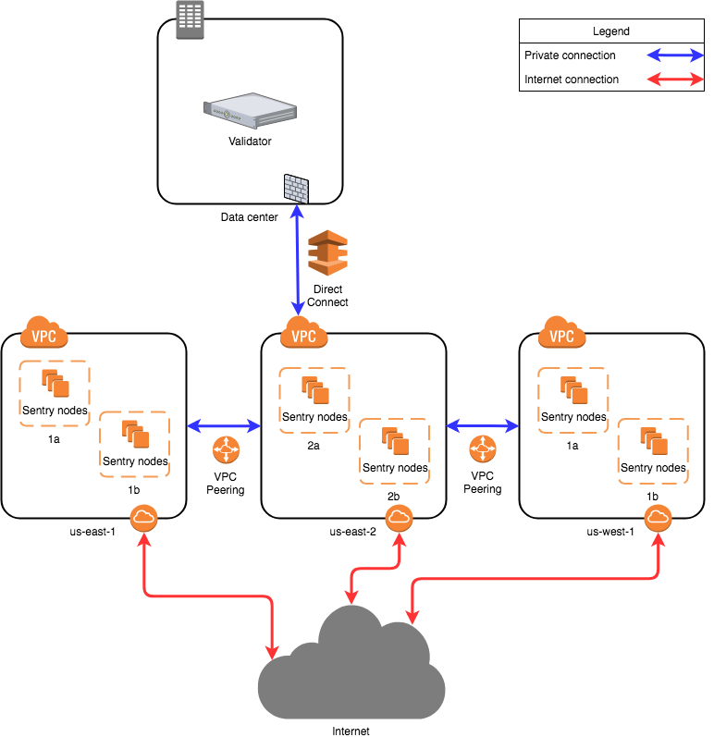
Setting up a Validator¹
When setting up a validator there are countless ways to configure your setup. This guide is aimed at showing one of them, the sentry node design. This design is mainly for DDOS prevention.
[1] https://docs.tendermint.com/master/tendermint-core/validators.html

Slide 54
The proposed network diagram is similar to the classical backend/frontend separation of services in a corporate environment. The “backend” in this case is the private network of the validator in the data center. The data center network might involve multiple subnets, firewalls and redundancy devices, which is not detailed on this diagram. The important point is that the data center allows direct connectivity to the chosen cloud environment. Amazon AWS has “Direct Connect”, while Google Cloud has “Partner Interconnect”. This is a dedicated connection to the cloud provider (usually directly to your virtual private cloud instance in one of the regions).
All sentry nodes (the “frontend”) connect to the validator using this private connection. The validator does not have a public IP address to provide its services.

Slide 55
Local Configuration¹
Validator Node Configuration
sentry Node Configuration
Config option | addr_book_strict
pex | false
persistent_peers | list of sentry nodes
private_peer_ids | none
unconditional_peer_ids | optionally sentry node IDs
addr_book_strict | false
double_sign_check_height | 10
Config option | addr_book_strict
pex | true
persistent_peers | validator node, optionally other sentry nodes
private_peer_ids | validator node ID
unconditional_peer_ids | validator node ID, optionally sentry node IDs
addr_book_strict | false
[1] https://docs.tendermint.com/master/tendermint-core/validators.html

Slide 56
The validator node should have pex=false so it does not gossip to the entire network. The persistent peers will be your sentry nodes. Private peers can be left empty as the validator is not trying to hide who it is communicating with. Setting unconditional peers is optional for a validator because they will not have a full address books.
The sentry nodes should be able to talk to the entire network hence why pex=true. The persistent peers of a sentry node will be the validator, and optionally other sentry nodes. The sentry nodes should make sure that they do not gossip the validator's ip, to do this you must put the validators nodeID as a private peer. The unconditional peer IDs will be the validator ID and optionally other sentry nodes.

Slide 57
What is peer?¹
The network is composed of optionally connected nodes. Nodes directly connected to a particular node are called peers.
[1] https://docs.tendermint.com/master/spec/consensus/consensus.html

