Slide 1
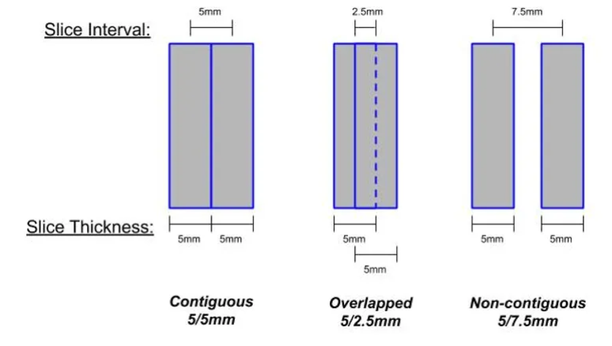
I need to find case with Slice_interval < Slice_thickness:
Inputs
mean
mean
mean
mean
mean
dcms = dir([ipath '\CT*']); %get the *.dcm files
num = size(dcms, 1);
dicom_tags{i} = dicominfo([ipath '\' dcms(i).name]);
Slice_interval = abs((dicom_tags{end}.ImagePositionPatient(3) - dicom_tags{1}.ImagePositionPatient(3))/(num - 1));
Slice_thickness = dicom_tags{1}.SliceThickness;

Slide 2
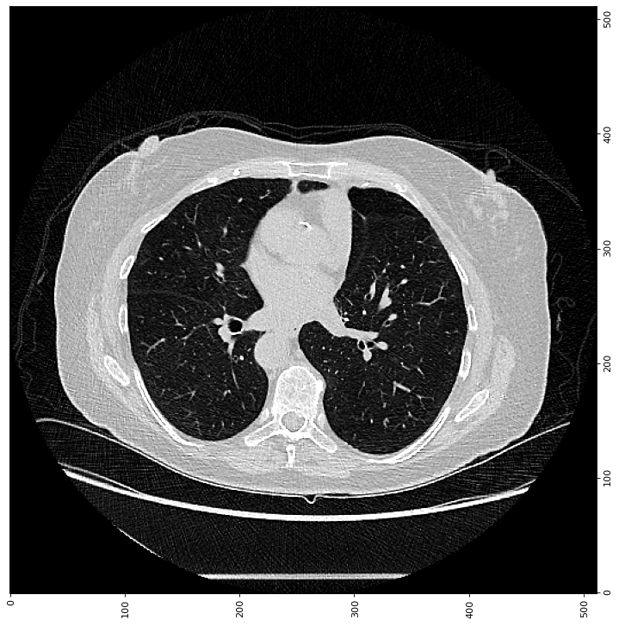
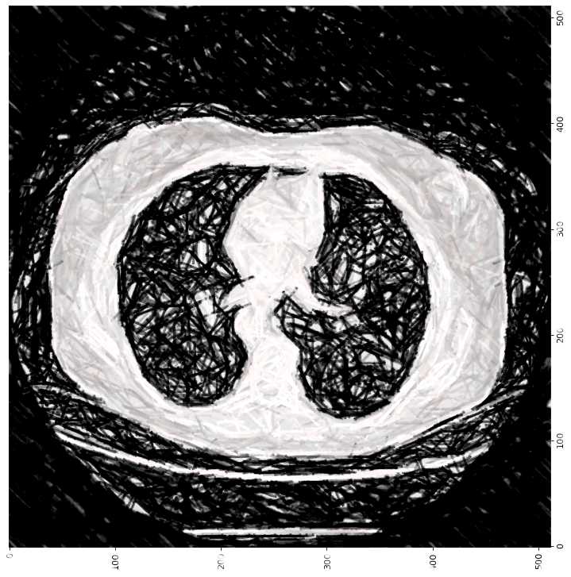
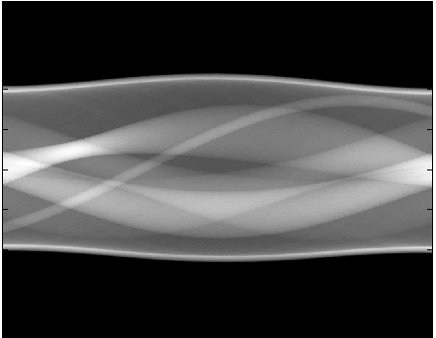
a
Selecting 15 consecutive slides from regular CT where the interval for example is less than 1mm, for example, let’s fix it to 1mm for here.
The mean of 3 slides leaves 5 good quality slides with interval of 3mm for example. (these 5 slides or only their middle one will be the output of the CNN).
The 5 middle slides (with the interval of 3mm) are selected to get noisier and finally become the input of the CNN.
b
h
g
CNN
FBP on each
c
…
Low-dose CT
configuration (random)
Forward projection (Adding random Poisson noise)

Slide 3
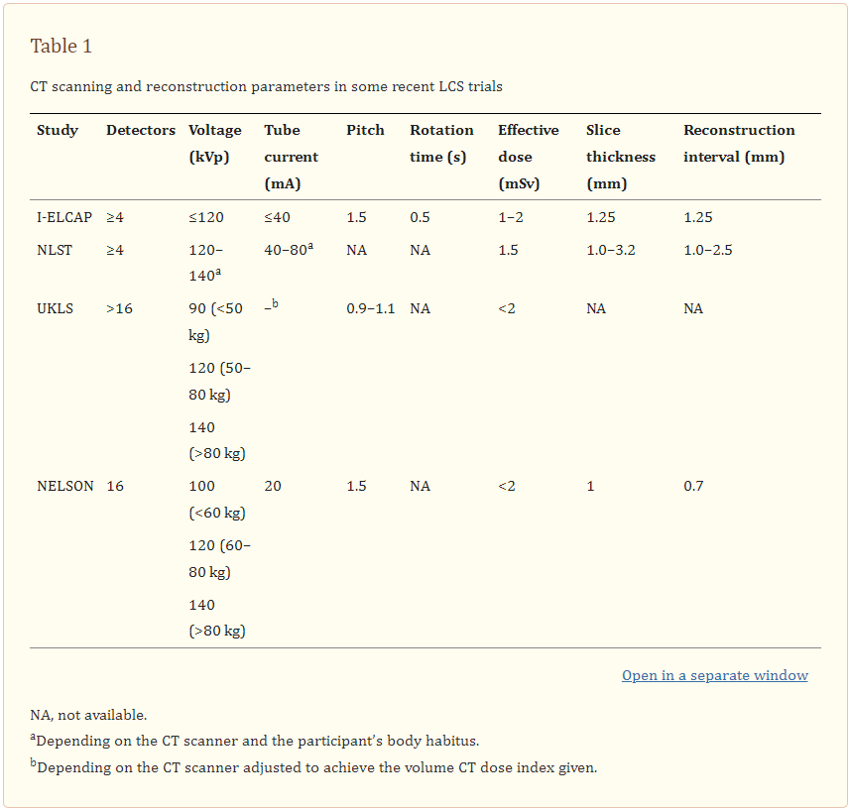
Low-dose CT: technique, reading methods and image interpretation
The collimation of LDCT should be set with the purpose of achieving thin-section reconstruction images, which allow the use of CAD and an optimal volumetric analysis. Therefore, reconstructed slice thickness, at least equal to or lower than 1.5 mm, should be used^{[2]}. It is advisable to set the section interval lower than the slice thickness in order to reduce partial volume artifacts. This is critical for accurate nodule volume assessment.
The reconstruction kernel can affect the volume measurement of pulmonary nodules from LDCT examinations. In a previous study, the repeatability of volume measurements of pulmonary nodules obtained at 1-mm section thickness combined with a soft kernel was almost twice as good as the reconstruction obtained with a 2-mm section thickness combined with a soft kernel, and almost 4 times better than those obtained at 2-mm section thickness combined with a sharp kernel^{[10]}.
Influence of CT acquisition and reconstruction parameters on radiomic feature reproducibility

Slide 4
01.1232773 160209 ; Interval:2.50 thichness:3.00
01.1232773 160912 ; Interval:1.00 thichness:2.00
01.1232773 170313 ; Interval:2.00 thichness:3.00
01.1232773 180521 ; Interval:0.80 thichness:1.00
01.1232773 190916 ; Interval:3.27 thichness:3.75
01.1232773 200113 ; Interval:0.80 thichness:1.00
03.660237 131018 ; Interval:2.00 thichness:2.50
03.660237 191208 ; Interval:0.80 thichness:1.00
03.660237 200916 ; Interval:1.00 thichness:1.25
03.660237 210320 ; Interval:1.00 thichness:1.25
03.660237 211107 ; Interval:0.80 thichness:1.00
07.2066870 160811 ; Interval:0.80 thichness:1.00
07.2066870 190604 ; Interval:1.00 thichness:1.25
07.2066870 220518 ; Interval:1.00 thichness:1.25
08.2115615 171209 ; Interval:0.80 thichness:1.00
08.2115615 190501 ; Interval:0.80 thichness:1.00
08.2115615 191204 ; Interval:0.80 thichness:1.00
08.2115615 200615 ; Interval:0.80 thichness:1.00
08.2115615 201214 ; Interval:0.80 thichness:1.00
08.2115615 210607 ; Interval:0.80 thichness:1.00
08.2115615 210917 ; Interval:0.80 thichness:1.00
08.2115615 220118 ; Interval:0.80 thichness:1.00
08.2115615 220418 ; Interval:0.80 thichness:1.00
09.375590 110913 ; Interval:1.35 thichness:2.50
10.2374256 190523 ; Interval:1.25 thichness:2.50
11.868417 150814 ; Interval:0.63 thichness:1.25
11.868417 180910 ; Interval:0.80 thichness:1.00
15.1055725 151009 ; Interval:1.00 thichness:2.00
15.1055725 160408 ; Interval:1.00 thichness:2.00
19.1080879 150519 ; Interval:1.00 thichness:2.00
19.1080879 210426 ; Interval:1.00 thichness:1.25
19.1080879 210823 ; Interval:1.00 thichness:1.25
19.1080879 220131 ; Interval:1.00 thichness:1.25
19.1080879 221003 ; Interval:1.00 thichness:1.25
23.756949 180823 ; Interval:3.27 thichness:3.75
23.756949 200905 ; Interval:1.00 thichness:1.25
23.756949 210306 ; Interval:0.80 thichness:1.00
23.756949 210918 ; Interval:0.80 thichness:1.00
23.756949 220319 ; Interval:0.80 thichness:1.00
23.756949 220917 ; Interval:0.80 thichness:1.00
26.1100559 150123 ; Interval:3.27 thichness:3.75
26.1100559 150330 ; Interval:1.00 thichness:2.00
26.1100559 170419 ; Interval:2.50 thichness:2.50
26.1100559 190717 ; Interval:2.00 thichness:3.00
26.1100559 200611 ; Interval:1.00 thichness:1.25
26.1100559 210120 ; Interval:1.00 thichness:1.25
26.1100559 210407 ; Interval:1.00 thichness:1.25
26.1100559 210728 ; Interval:1.00 thichness:1.25
26.1100559 220106 ; Interval:1.00 thichness:1.25
26.1100559 220413 ; Interval:1.00 thichness:1.25
26.1100559 220727 ; Interval:1.00 thichness:1.25
32.944982 150330 ; Interval:1.00 thichness:2.00
32.944982 180319 ; Interval:2.48 thichness:2.50
32.944982 180917 ; Interval:2.48 thichness:2.50
32.944982 220523 ; Interval:2.00 thichness:2.00
34.863978 160628 ; Interval:0.63 thichness:1.25
34.863978 201230 ; Interval:1.00 thichness:1.25
40.1055725 151009 ; Interval:1.00 thichness:2.00
40.1055725 160408 ; Interval:1.00 thichness:2.00

Slide 5
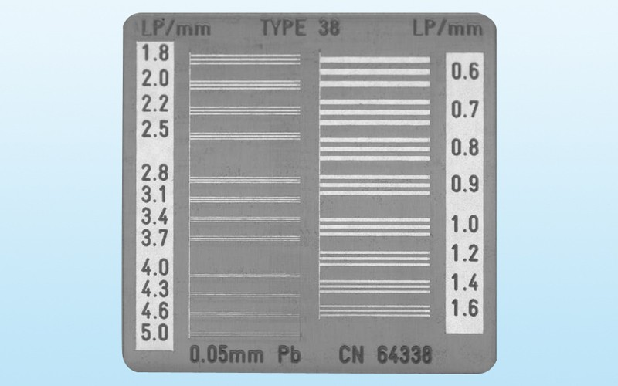
https://www.upstate.edu/radiology/education/rsna/ct/reconstruction.php
CT images are reconstructed from approximately 1000 projections that are acquired as the x-ray tube rotates through 360º around the object (patient).
The acquisition FOV is typically 250 mm for head CT scans, but can be as large as 500 mm for body imaging.
the achievable spatial resolution performance in normal CT imaging is ~ 0.7 lp/mm
A corollary of this finding is that if the reconstructed FOV is selected so that it is larger than the object being imaged (Figure H), there will be a loss of spatial resolution performance being of the increased pixel size.
A special filter, known as the ramp filter, will achieve a perfect reconstruction, but will also contain high levels of image noise. It is possible to modify the shape of the reconstruction filter to reduce the amount of image noise, but at the price of some loss in spatial resolution performance. Most commercial CT scanners offer the user a choice of reconstruction filters where each filter offers varying degrees of image noise, but at the price of some loss of spatial resolution performance.

Slide 6
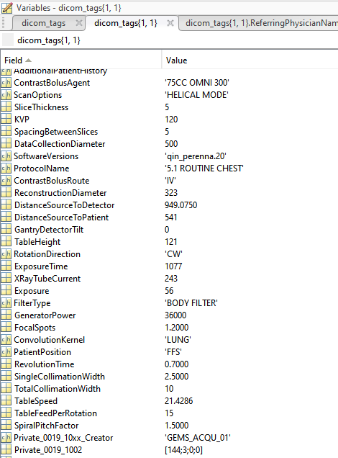
What are your achievements since joining, and are we on track for your career dream?
Your evaluation of the research performance so far. How can we learn from past experiences?
In your current projects, are you anticipating of significant contribution on the technological, clinical, or translational sides? What will be the expected timeline for these projects? Any bottleneck we need to address?
What will be the research plan for this year? Let’s list some milestones and deliverables.

Slide 7
Github
CT denoising code
Photo (what to were?)
Card
Muhammad
Iman
Session
English

