Slide 1
The Hanabi Challenge
A New Frontier for AI Research
Mortimer von Chappuis

Slide 2
What Hanabi?
3
1
1
1
2
1
6/8
3/3
Stack
Deck
Discard
5
3
5
2
4
5
2
2
P1
P2
P3

Slide 3
What Hanabi? — Moves
Discard
  draw a card
  increment hint counter
Play
  draw a card
  on failure: decrement live counter
  on stack finish: increment hint counter
Hint
  decrement hint counter
  tell a player all cards of a given RANK or COLOUR

Slide 4
What Hanabi? — Termination
No cards left in deck
No lives left
All stacks full
The score is the number of played cards.

Slide 5
Why Hanabi?
partially observable
multi agent
cooperative
cheap compute
com-actions are grounded
Grounded information is not sufficient!
Theory of mind is needed to infer unobserved parts of state space from other actions

Slide 6
Why Hanabi?
Selfplay
(possible) conventions „handshakes“
easy
Otherplay
no conventions
reasoning on intentions
hard
„Playing with yourself is easy since you already know what your about to do, while playing with someone else is hard since you don’t!“

Slide 7
Wut Hanabi?!
3
1
1
1
2
1
6/8
3/3
Stack
Deck
Discard
5
3
5
2
1
2
3
4
5
◾
◾
◾
◾
◾
1
2
3
4
5
◾
◾
◾
◾
◾
1
2
3
4
5
◾
◾
◾
◾
◾
1
2
3
4
5
◾
◾
◾
◾
◾
4
5
3
2
P1
P2
P3

Slide 8
Off Belief Learning
Mortimer von Chappuis

Slide 9
What is Belief?
Environment Perspective
Agent Perspective
Agent Belief

Slide 10
Handshakes are bad
How do we achive informationally grounded behavior?
By not assuming

Slide 11
Becoming Agnostic
agnostic policy independent of
agnostic expectation
bellman equation

Slide 12
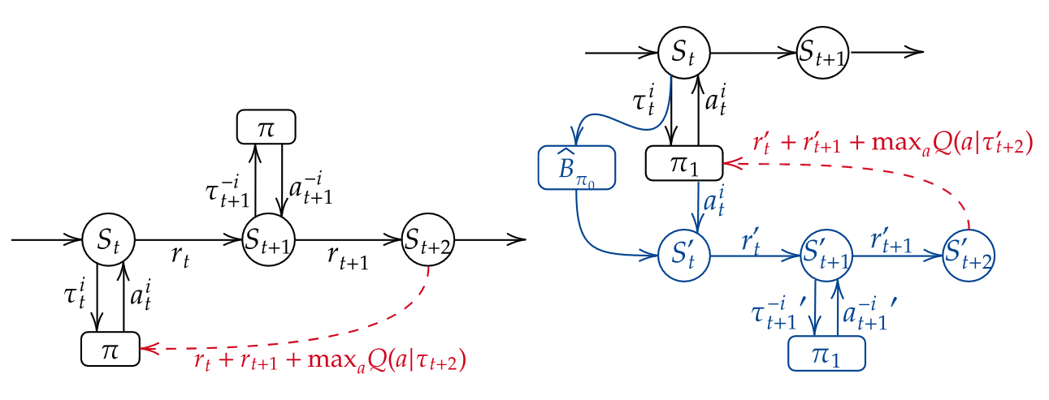
Training Off Belief

Slide 13
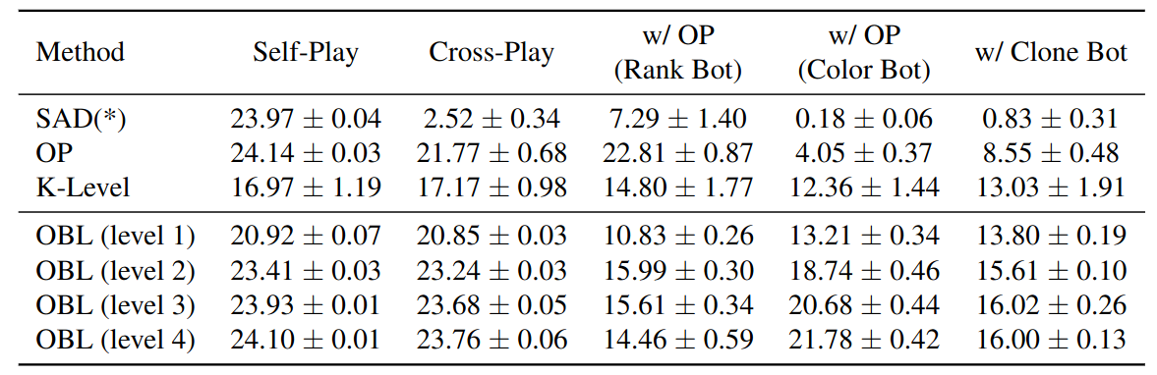
Results

