Slide 1
CHEAP TALK DISCOVERY AND UTILIZATION
IN MULTI-AGENT REINFORCEMENT LEARNING
Mortimer von Chappuis

Slide 2
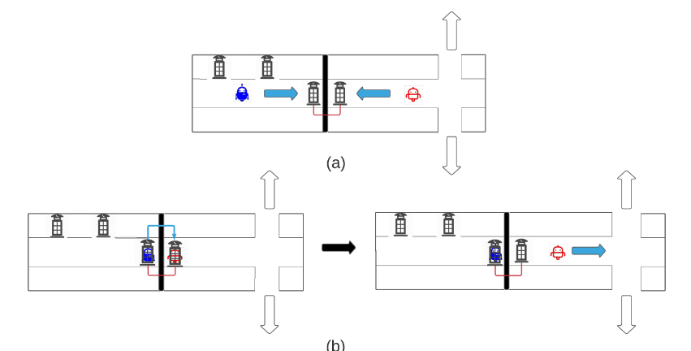
Discovery and Utilization

Slide 3
Discovery with OBL

Slide 4
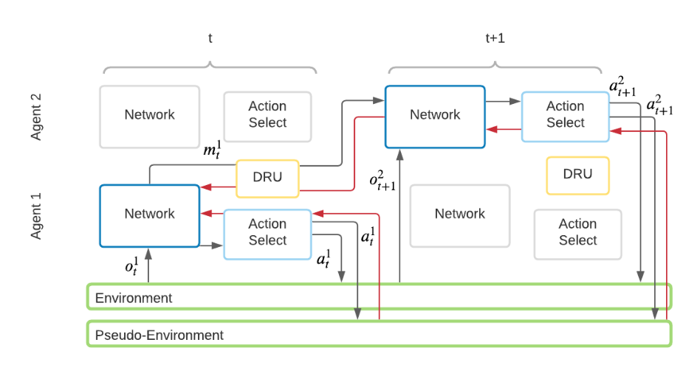
Utilization with IQL

Slide 5
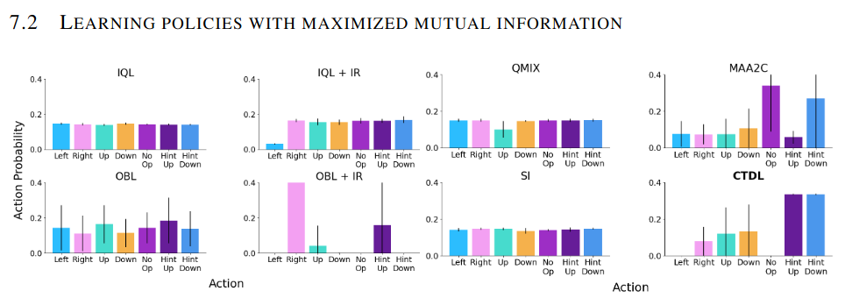
Results

Slide 6
Learning Attentional Communication for
Multi-Agent Cooperation
Mortimer von Chappuis

Slide 7
Deciding on Communication
When?
com is costly
Whom?
com should be directed
What?
com should be intentional

Slide 8
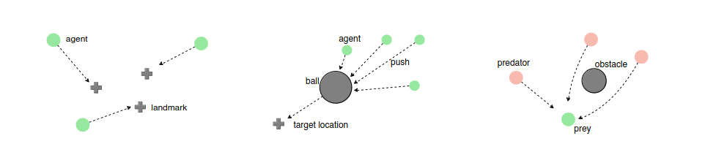
Scenarios

Slide 9
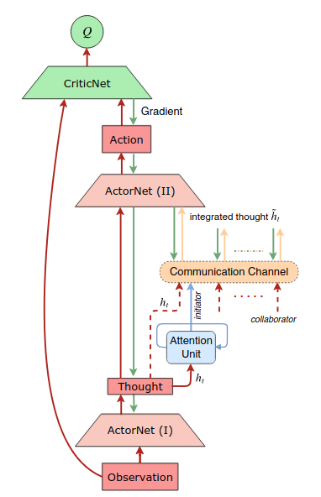
Attentional Communication
create a „thought“
  simple observation to vector mapping
decide on com group
  RNN or MLP attention over com partners
  com groups are constructed from attention output
exchange thoughts
  thoughts are passed through a bidirectional LSTM
  agents in multiple groups reuse their current thoughts, exchanging info between groups
act informed

Slide 10
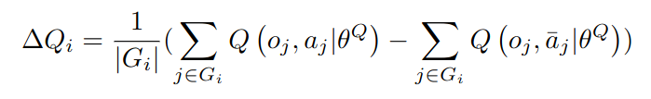

Specs
Deep Deterministic Policy Gradients
Recurrent Attention Model

Slide 11
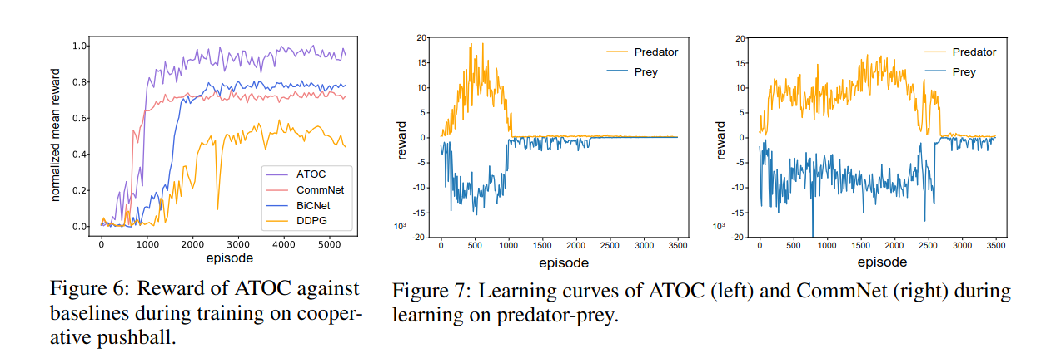
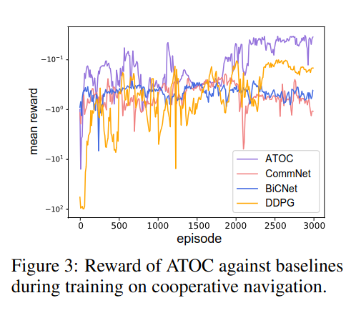
Results

Slide 12
Research Idea — Incentivize informative content
Mortimer von Chappuis

Slide 13
Decentralizing CTDUL
Mutual information is obtainable from
the policy and a language model alone
Agent is incentivized to describe
observations precisely

Slide 14
Implementing Attention Explicitely
Agent models the others assumed belief
The agent chooses utterances such, that the assumed
belief is maximally informed, based on the previous extension

