Slide 1

Managerial Accounting
Marcelo Ortiz

Slide 2
Topic 1: Financial Statements Part A Foundations
1. What is Accounting
2. Transactions as accounting events
3. Basic concepts
4. Accounting Equation

Slide 3
1. What is Accounting
2. Transactions as accounting events
3. Basic concepts
4. Balance Sheet Equation

Slide 4
1. What is Accounting
Definitions and uses
Information system
Process information from transactions and production
Measure economic activity
Business Language
Capture and distribute data across the organization
POS
Profitability
Liquidity
Inventories
HHRR, etc.
Productivity
Internal Reports
External Reports
Compensations
2. Transaction as accounting events
3. Basic concepts
4. Balance Sheet Equation

Slide 5
1. What is Accounting
2. Transaction as accounting events
3. Basic concepts
4. Balance Sheet Equation

Slide 6
1. What is Accounting
2. Transactions as accounting events
What information is important to capture, process, and aggregate?
Who would be interested in that information?
Purchasing Merchandise or Raw Materials
Hiring news employees
Contracting an insurance
Product sales
Returns of Raw Materials
Distributing Dividends
3. Basic concepts
4. Balance Sheet Equation

Slide 7
2. Transactions as accounting events
3. Basic concepts
1. What is Accounting
4. Balance Sheet Equation

Slide 8
2. Transactions as accounting events
3. Basic concepts
1. What is Accounting
Transactions modify specific economic components of an organization.
Obligations with the owner
Obligations with third parties
Property or control rights
4. Balance Sheet Equation

Slide 9
2. Transactions as accounting events
3. Basic concepts
1. What is Accounting
Transactions modify specific economic components of an organization.
Equity
Obligations with the owner
Obligations with third parties
Property or control rights
Assets
Liabilities
4. Balance Sheet Equation
Notes:
Asset definition does not mention where the assets are located, nor its tangibility. It just matter the property or control rights and their hability to produce revenues.
Liability definition also include an economic transference to cancel such obligation.

Slide 10
2. Transactions as accounting events
3. Basic concepts
1. What is Accounting
Share Capital
Amounts received by transactions with owners
Retained Earnings
Previous profits that have not been distributed as dividends to the owner
Dividends Payments
Economic transference of current profits to owners
Equity
Assets
+ Obligations with the owner
Liabilities
4. Balance Sheet Equation
+ Property or control Rights
+ Obligations with third parties

Slide 11
2. Transactions as accounting events
3. Basic concepts
1. What is Accounting
Current
Cash
Noncurrent
Tangibble:
Account receivables
Inventory
Vehicles
Intangible:
Property, Plant, Equipment
Patents
Equity
Assets
+ Obligations with the owner
Liabilities
4. Balance Sheet Equation
+ Property or control Rights
+ Obligations with third parties

Slide 12
2. Transactions as accounting events
3. Basic concepts
1. What is Accounting
Current
Account Payables
Noncurrent
Long term Loans
Contingent
Litigations
Salaries
Liabilities
Assets
Equity
+ Obligations with the owner
4. Balance Sheet Equation
+ Property or control Rights
+ Obligations with third parties

Slide 13
3. Basic concepts
2. Transactions as accounting events
4. Accounting Equation
1. What is Accounting
Assets = Liability + Equity
Transaction 1
Starting the Business
Silvana invests $30,000 of her own money to start the business.
She deposits $30,000 in a bank account entitled "Silvana eTravel SA".

Slide 14
3. Basic concepts
4. Accounting Equation
2. Transactions as accounting events
1. What is Accounting
Assets = Liability + Equity
Transaction 2
Purchase of Office
Silvana purchases an office, paying $20,000 in cash.
Depreciation: $200

Slide 15
3. Basic concepts
4. Accounting Equation
2. Transactions as accounting events
1. What is Accounting
Assets = Liability + Equity
Transaction 3
Purchase office supply
Silvana buys office supplies, agreeing to pay $500 within 30 days.
These supplies will last til end of year

Slide 16
3. Basic concepts
4. Accounting Equation
2. Transactions as accounting events
1. What is Accounting
Assets = Liability + Equity
Transaction 4
Earnings of Service revenue
Silvana eTravel earns service revenue by providing travel services for clients.
She earns $5,500 revenue and collects this amount in cash.
The labor cost of providing the service was $600.

Slide 17
3. Basic concepts
2. Transactions as accounting events
4. Accounting Equation
1. What is Accounting
Assets = Liability + Equity
Transaction 5
Revenue on Account
Silvana eTravel performs services for clients who do not pay immediately.
In return for her travel services, Silvana receives clients’ promises to pay $3,000 within one month.
The labor cost of the service was $200.

Slide 18
3. Basic concepts
2. Transactions as accounting events
4. Accounting Equation
1. What is Accounting
Assets = Liability + Equity
Transaction 6
Payment of Expenses
Silvana eTravel during the month pays with cash:
Office rent, $1,100.
Web Hosting, $1,200.
Utilities, $400.

Slide 19
3. Basic concepts
2. Transactions as accounting events
4. Accounting Equation
1. What is Accounting
Assets = Liability + Equity
Transaction 7
Long-term debt
Silvana borrows $5.000 using a bank credit. The first year will pay $35 on interest expenses.

Slide 20
Topic 1: Financial Statements Part B Reports
1. Aggregation
2. Balance Sheet
3. Income and Cash Flow Statement
4. Owners' equity and Reports

Slide 21
1. Aggregation
Assets
Liability
Historic Cost
Acquisition cost
Production cost
Fair Value
Market Value
Approx. MV
Fair Value
Market Value
Present Value of Future Payments
Expected PVFP
Each transaction or economic event requires to determine an economic amount affecting the basic accounting elements.
There are some rules, written in norms or regulations, that help us to define these amounts
Consistency across time and across transaction is Key!
2. Balance Sheet
3. Income and Cash Flow Statement
4. Notes and Auditor Reports

Slide 22
1. Aggregation
Once we have registered all the transactions using the same rules, we can aggregate them for producing Financial Statements.
Purpose of Financial Statements
Inform to Stakeholders about firm's economic situation.
Stakeholders are interested in the performance of an organization for various reasons.
Discuss what type of aggregated information about the firm each stakeholders might want to know.
How can they affect their decision-making?
What is a Stakeholder
A stakeholder is someone affected by decisions made by a company.
Stakeholders can have different conflicting interests with the firm.
- investors,
- creditors,
- employees,
- managers,
- regulators,
- customers,
- suppliers
2. Balance Sheet
3. Income and Cash Flow Statement
4. Notes and Auditor Reports

Slide 23
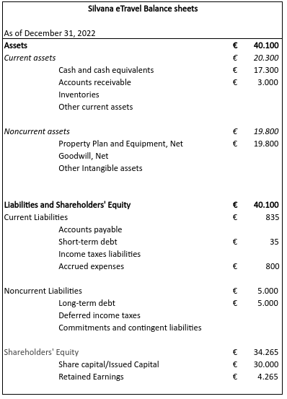
1. Aggregation
2. Balance Sheet
The balance sheet is a statement that lists what the organization owns (assets), what it owes (liabilities), and what it is worth (equity) on a specific date.
3. Income and Cash Flow Statement
4. Notes and Auditor Reports
Notes:
Mention that Liabilities= topic 2
Mention that Assets = topic 3

Slide 24
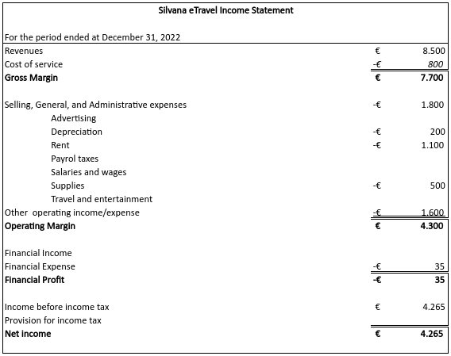
2. Balance Sheet
3. Income Statement
1. Aggregation
The Income Statements shows the organization’s financial performance for a given period of time.
Its main components are:
4. Notes and Auditor Reports
Notes:
Comprehensive income?

Slide 25
2. Balance Sheet
3. Income Statement
1. Aggregation
Balance Sheet: 31 dic 2021
Balance Sheet: 31 dic 2020
Liab
Assets
Liab
Assets
Equity
Equity
Income Statements: 2021
+ Revenues
Costs
= Earnings before tax
Tax
= Earnings after tax
4. Notes and Auditor Reports

Slide 26
2. Balance Sheet
3. Cash Flow Statement
1. Aggregation
The Cash Flow Statement describes the firm's cash inflows and outflows (receipts and payments) during a specified period of time.
It is important since some revenues and expenses reported in the IS are not a good proxy for the cash transactions and balance.
± Cash Flows from Operating Activities
± Cash Flows from Investing Activities
± Cash Flows from Financing Activities
4. Notes and Auditor Reports
Notes:
Agregar link con income statement?

Slide 27
3. Income and Cash Flow Statement
4. Owners' equity and Reports
2. Balance Sheet
1. Aggregation
Statement of changes in equity reports how the equity of an organization has changed over a specified period of time.
In general, the focus is on what elements affected the two main components of Equity during the period: Common Stock and Retained Earnings.
Why other stakeholders could be interested on this?
-Creditors check if the company is reinvesting enough. Each dollar paid as dividend, is a dollar that cannot be paid later on to credits.
- External investors also see if the company is increasing its capital base. It is indicative that currents shareholders see growth opportunities that need to be financed.
Beginning balances in the stockholders’ equity accounts.
Retained Earnings.
- current year’s dividends.
Main focus: Common stock and Retained earnings
End-of-the-year balances in the stockholders’ equity accounts.
+ current year’s net income.
Common stock/ Subscribed capital
+ capital increases
-capital decreases

Slide 28
3. Income and Cash Flow Statement
4. Owners' equity and Reports
2. Balance Sheet
1. Aggregation
How the industry and the business has evolved?
What are the main risks and uncertainties for the future
How are expected to change some key performance indicators in the following years?
What are the drivers of the results and financial situation?
Managerial Report

Slide 29








3. Income and Cash Flow Statement
4. Owners' equity and Other Reports
2. Balance Sheet
1. Aggregation
Auditors Reports:
When a company's accounts are audited, the resulting report increases its reliability.
This reliability increases the most when the auditor’s report includes an unqualified opinion which means that the auditor has a positive opinion without objections.
The company: From transactions to Financial Statements.
The auditor accesses (confidentially) the process to evaluate it.
Are the managers reporting everything correctly?

Slide 30
Topic 1: Financial Statements Part C Financial Metrics
1. Context and types of analyses
2. Metrics

Slide 31
1. Context and types of analyses
As managers, we can use financial statements to evaluate the financial performance and efficiency of the overall company and different business segments… this analysis is very similar to the approach of an external investor deciding to price our company.
But as managers, we have an advantage relative to external investors: we can get more data, and request reports tailored to specific managerial questions…. That will be the focus on Topics 6 to 9.
Now, we will study a general framework for financial analysis (meaning, using the same data that an external investor would have), trying to get managerial insights from it:
- how is our company growing? Type of assets, funding.
- do we need to change our liquidity/solvency policy?
- are we using our assets efficiently?
- what is driving our profits/losses?
… not only useful for our evaluating our company (or business unit), but also competitors, suppliers, and customers.
2. Liquidity, Debt, and Asset Mgmt
3. Return and Profitability
4. Stock Market

Slide 32
1. Context and type of analyses
Economic Factors
Industry Factors
Company Factors
Interest rate
Unemployment
Inflation
Demand elasticity
Competition
New technologies
Business strategty
Financial situation
2. Balance Sheet
3. Income and Cash Flow Statement
4. Notes and Auditor Reports

Slide 33


1. Context and type of analyses
Business Strategy
Operating Decisions
Transactions
Financial Statements
Product differentiation
Cost differentiation
2. Balance Sheet
3. Income and Cash Flow Statement
4. Notes and Auditor Reports

Slide 34

1. Context and types of analyses
Industry:
Automobile manufacturer and car manufacturer in Europe.
Products:
The group develops vehicles, vehicle software, passenger cars, light commercial vehicle, truck, buses and motorcycles.
It also offers dealer and customer financing, leasing, banking and insurance, and fleet management services. (…)
Brands:
It markets its vehicles under multiple brand names, including Audi, SEAT, Skoda, Bentley, Bugatti, Porsche, Ducati, Volkswagen Commercial Vehicles, Scania, and Cupra.
Location:
It has manufacturing facilities in Salzgitter, Germany and China. Volkswagen has business presence the Americas, Europe, Asia-Pacific and the Middle East. The company is headquartered in Wolfsburg, Germany.
Volkswagen AG
2. Liquidity, Debt, and Asset Mgmt
3. Return and Profitability
4. Stock Market

Slide 35
1. Context and type of analyses
First, we need to know the background (also called "qualitative analysis").
How is the industry evolving in terms of:
- technologies?
- product demand?
- input costs or supply chain?
- the number of competitors?
2. Balance Sheet
3. Income and Cash Flow Statement
4. Notes and Auditor Reports

Slide 36
1. Context and type of analyses
After having a clear perspective of the context, we can move to the quantitative analysis (also called financial analysis).
1) Comparison across time:
How is the company doing relative to previous years?
What has internally and externally changed?
internally: new CEO, new products, new production technology.
externally: changes in demand, stricter financing conditions.
2) Comparison within industry peers:
What explains cross-sectional differences?
different shocks
differences in efficiencies
differences in innovation or products
2. Balance Sheet
3. Income and Cash Flow Statement
4. Notes and Auditor Reports

Slide 37
1. Context and type of analyses
2. Metrics
1) Component
Balance sheet elements as a percentage of Total Assets.
(1) Is the company growing? Total assets, Annual growth, CAGR.
(2) How are current assets distributed? Is any new type of assets in the company?
(3) How are current liabilities distributed? Is any new type of funding?
(4) Equity: new emissions? Positive retained earnings?
2) Ratios and Measures
(1) Liquidity: does the firm have enough liquidity to meet its financial obligations when they should be paid?
(2) Debt level or Solvency: does the firm have too much debt? Can it pay it in the long-term?
(3) Asset management: how efficient is the company in using its assets to produce sales/revenues?
3. Income and Cash Flow Statement
4. Notes and Auditor Reports

Slide 38
1. Context and type of analyses
2. Metrics
Liquidity
Debt
Assets
Working Capital
Liabilities
Liabilities+Equity
Sales
FA turnover
FA
WK: CA-CL
WK needs/operative:
WK - (Other CA-Other CL)
CA
Current R.
CL
Debt
Sales
CA turnover CA
CL
Quality
Liabilities
CA – Inv.
Liquidity
CL
Days
Fin. expenses
Sales
Inventories
Daily cost of sales
Receivables.
Days Rec.
Daily Sales²
Financial
Expenses
Stock days
Cash
CL
Payables.
Days Pay.
Daily COGS
Cash Cycle = DR+SD- DP
Acid test
Cash flow
Total Loans
Return
capacity
¹: for a growing firm, use the average value in the balance sheet ítems for ratios that also need info from the income statement.
²: it is better to use "sales on credit", but this item is rarely reported.
3. Return and Profitability
4. Notes and Auditor Reports

