Slide 1

Managerial Accounting
Marcelo Ortiz

Slide 2
Cost and Decision Making
1. Pricing Decisions
2. Cost Terminology in Differential Analysis
3. Make-Or-Buy Decision
4. Closing part of a company

Slide 3
1. Pricing Decisions
Previously: How profitable is each product? What costly activity is absorving most of the profits?
This topic includes two new components: Pricing and Incremental analysis.
- how to determine the sale price of a product?
- should the company produce parts/pieces internally or externally (outsource)?
- should the company close a business unit?
2. Pricing Decisions
3. Make-Or-Buy Decision
4. Closing part of a company

Slide 4
1. Cost Terminology
2. Pricing Decisions
What price should a company charge for its product?
Factors:
(1) Pricing Objectives: Gain market share? Achieve a target rate of return?
(2) Demand: how price-sensitive the demand is? What is the socio-economic status of the Clients?
(3) Cost Considerations: how flexible is our cost structure? Is any economy of scale in the cost structure?
(4) Environment: patents or copyrights protections, political influence.
3. Make-Or-Buy Decision
4. Closing part of a company

Slide 5
1. Cost Terminology
2. Pricing Decisions
Pricing in a Competitive Market (“Target Costing”).
- no company in the industry can influence the price to a significant degree.
- therefore, companies must focus on controlling their costs to earn a profit.
- the company must define a target cost that generates the desired profit:
Market Price – Desired Profit = Target Cost
3. Make-Or-Buy Decision
4. Closing part of a company

Slide 6
1. Cost Terminology
2. Pricing Decisions
Steps:
1) identify the market.
2) define market niche (luxury, quality, basic).
4) market research and determine target price.
5) set the desired profit.
6) compute the target cost.
7) team from multiple areas design and develop the product that can meet quality specifications without exceeding the target cost (including all period and product costs needed)
3. Make-Or-Buy Decision
4. Closing part of a company

Slide 7
1. Cost Terminology
2. Pricing Decisions
Example
Outdoor Lunch Inc. manufactures lunch boxes. The CEO is considering introducing a child design to enter the market of school lunch boxes. Market research suggests that 200.000 units can be sold if the price is equal to or less than $20 per unit. If OL enters the market, it will need to invest $1 million in new machines. The company requires a minimum rate of return of 25% on all investments.
Determine the target cost per unit.
3. Make-Or-Buy Decision
4. Closing part of a company

Slide 8
1. Cost Terminology
2. Pricing Decisions
Example
Outdoor Lunch Inc. manufactures lunch boxes. The CEO is considering introducing a child design to enter the market of school lunch boxes. Market research suggests that 200.000 units can be sold if the price is equal to or less than $20 per unit. If OL enters the market, it will need to invest $1 million in new machines. The company requires a minimum rate of return of 25% on all investments.
Determine the target cost per unit.
Investment=$1 million
Desired profit=0.25*1 million=$250.000 in total, or $1.25 per unit ($250/200 units)
Target cost= $20-1.25=$18.75 per unit.
3. Make-Or-Buy Decision
4. Closing part of a company

Slide 9
1. Cost Terminology
2. Pricing Decisions
Pricing in a Less Competitive Market (“Cost-plus Pricing systems”).
A) Total Cost-Plus Pricing
- When the company has a greater ability to set a product's price, it usually defines it as a function of the cost of the product.
Where the Cost Base, in this case, is the sum of all the costs required to produce and sell the product.
Example:
Recording Glasses Inc. is in the process of setting the selling price of its new video-camera glass. This glass can record up to 20 hours and is waterproof. The investment needed was $1 million. The cost structure per unit is (considering a production of 10.000 units):
Cost Base + Markup (Profit) = Target Selling Price | Eq. 1
Cost Base + Markup % x Cost Base = Target Selling Price | Eq. 2
3. Make-Or-Buy Decision
4. Closing part of a company

Slide 10
1. Cost Terminology
2. Pricing Decisions
 | Per Unit
Direct Materials Direct Labour | $23 $17
Variable manufacturing overhead. Variable S&A expenses | $12 $8
Total Variable cost per unit | $60
Fixed manufacturing overhead | $280,000/10,000=$28
Fixed S&A expenses | $240,000/10,000=$24
Total Fixed cost per unit | $52
Total cost | $112
3. Make-Or-Buy Decision
4. Closing part of a company

Slide 11
1. Cost Terminology
2. Pricing Decisions
 | Per Unit
Direct Materials Direct Labour | $23 $17
Variable manufacturing overhead. Variable S&A expenses | $12 $8
Total Variable cost per unit | $60
Fixed manufacturing overhead | $280,000/10,000=$28
Fixed S&A expenses | $240,000/10,000=$24
Total Fixed cost per unit | $52
Total cost | $112
If the company wants a 20% ROI, then the markup per unit is:
(20% x $1 million)/(10,000 units)=$20
Eq. 1: Selling price = 112+20=$132.
Alternatively, we can use Eq. 2.
Markup % = (markup per unit)/(cost base)
Markup % =$ 20 / $ 112=17.86%
Eq. 2: Selling price = 112 +(112*17.86%)=$132
3. Make-Or-Buy Decision
4. Closing part of a company

Slide 12
1. Cost Terminology
2. Pricing Decisions
Advantages of the cost-plus approach:
1) simple to compute and does not require so detailed cost-accounting information.
2) easily justifiable for the client, judges, and government.
Cons of the approach:
1) it forgets the demand side of the market.
2) how to estimate sales volume? (the critical value for per-unit computations)
3) promotes cost inefficiencies
4) uses historical rather than market value or opportunity costs.
How much would change the previous selling price if the sales volume were 8,000 instead of 10,000 units?
Total variable cost still $60.
But the fixed cost per unit raises to $65 (since we have fewer units to spread this cost)
And the desired ROI raises to $25 (since we have fewer units to reach the same profit but with fewer products)
Thus, the selling price would be $150!
3. Make-Or-Buy Decision
4. Closing part of a company
Notes:
Cons: The lower the sales volume, for example, the higher the price Thinkmore must charge to meet its desired ROI

Slide 13
1. Cost Terminology
2. Pricing Decisions
B) Absorption cost-plus: same idea, same results (we have just one product!), but for companies using absorption costing.
Steps:
1) calculate manufacturing cost per unit (of course, including manufacturing overhead).
2) calculate S&A expenses per unit (fixed and variable).
3) define the desired ROI per unit (in $).
4) compute the markup percentage as {(ROI per unit)+(S&A expenses per unit)}/(manufacturing cost per unit)
3. Make-Or-Buy Decision
4. Closing part of a company
Notes:
Go to page 528 and use the examples in class with the White board.

Slide 14
1. Cost Terminology
2. Pricing Decisions
Steps:
1) calculate manufacturing cost per unit (of course, including manufacturing overhead).
2) calculate S&A expenses per unit (fixed and variable). Notice, not all product-lines should have the same S&A expenses allocation in absorption costing.
3) define desired ROI per unit (in $).
4) compute the markup percentage as {(ROI per unit)+(S&A expenses per unit)}/(manufacturing cost per unit)
In the example before (10.000 units)
- Manuf. Cost per unit = 23+17+12+28 =$80.
- S&A expenses per unit = 8+24=$32.
- ROI per unit= 20% or $20
- Markup % = (20+32)/80=65%
Selling price = Manuf. Cost+ (markup % * Manuf. Cost)=$132
Selling price = Manuf. Cost + (ROI$+S&A$)
3. Make-Or-Buy Decision
4. Closing part of a company
Notes:
Go to page 528 and use the examples in class with the White board.

Slide 15
1. Cost Terminology
2. Pricing Decisions
Pros:
- because data on S&E expenses are already classified and registered, it is cost-effective to use them for pricing.
- as the total cost-plus approach, it is easy to justify to clients, government, judges, etc.
Limitations:
- it is inconsistent with traditional cost-volume-profit analyses that managers use to proxy profit implications of changes in price and volume.
-it is also inconsistent with ABC costing: arbitrary allocations of common fixed costs to individual products.
- it does not clarify how the company's costs change with the changes in sale volume.
3. Make-Or-Buy Decision
4. Closing part of a company
Notes:
Go to page 528 and use the examples in class with the White board.

Slide 16
1. Cost Terminology
2. Pricing Decisions
C) Variable Cost-Plus Pricing: same idea, same results, but for companies using variable costing.
Now, the cost base is all of the variable costs associated with a product: manufacturing and S&A included.
Since fixed costs are not included in the base, the markup must cover all fixed cost and the ROI.
Again, remember that both variable and fixed costs will differ across product-lines. In our case, we have just one product so we have the same result than with the other methods.
Steps
1) calculate Variable cost per unit: in our example, $60 (=23+17+12+8)
2) compute markup percentage: {(ROI per unit)+(Fixed costs)}/ Variable cost = (20+28+24)/60=120%
3) set the selling price: Variable Cost+ (markup % * Variable . Cost) = 60+(120%*60)=$132
3. Make-Or-Buy Decision
4. Closing part of a company
Notes:
Go to page 528 and use the examples in class with the White board.

Slide 17
1. Cost Terminology
2. Pricing Decisions
Advantages
- close to traditional cost-volume-profit analysis.
- it matches better changes in costs with changes in volume sold, and, thus, profitability.
- less arbitrary assignation of fixed cost to product lines.
Disadventages
- managers may set prices too low.
- basic accounting data can be less accessible (fixed vs. variable S&A).
3. Make-Or-Buy Decision
4. Closing part of a company

Slide 18
1. Cost Terminology
2. Pricing Decisions
Will the company reach the desired ROI?
Only if reaches sales volume with the budgeted/estimated costs.
This applies for any of the method (total cost, absorption costs, and variable costs).
Other factors: market conditions, customers preferences, competitors' actions.
3. Make-Or-Buy Decision
4. Closing part of a company

Slide 19
2. Cost Terminology in Differential Analysis
A differential (or incremental) analysis is an economic comparison among alternative courses of action.
The main goal is to identify what revenues and expenses vary across alternatives.
Of course, both variable and fixed costs can vary across alternatives, so the identification of the types of revenues and expenses that are relevant for the comparison might not be trivial.
 | Alternative A | Alternative B | Increase (Decrease)
Revenues
Cost
Net Income
2. Pricing Decisions
3. Make-Or-Buy Decision
4. Closing part of a company
Notes:
Go to page 528 and use the examples in class with the White board.

Slide 20
2. Cost Terminology in Differential Analysis
Managers need a differential analysis that compares the relevant costs and revenues of potential alternatives.
What is "relevant"?
Concept | Definition
Relevant cost | Costs that are different for each alternative and that will occur in the future.
Irrelevant cost | A cost that does not influence the decision because it is included (or excluded) with the same amount in all the potential solutions.
Differential cost | A cost that is included in some but not all the potential solutions
Avoidable cost | A cost that can be eliminated (in whole or in part) by choosing one alternative over another
Sunk cost | A cost that cannot be avoided because it has already occurred or are unavoidable
Opportunity cost | The cost associated with not choosing the other best alternative use for the resource.
2. Pricing Decisions
3. Make-Or-Buy Decision
4. Closing part of a company

Slide 21
2. Cost Terminology in Differential Analysis
Connection with Activity-Based Costing
The main motivation for ABC is that it results in a more accurate allocation of overhead costs.
This better mapping between increases in overhead costs with increases in manufacture is quite useful for differential analysis.
Activity Base Costing --> better identification of relevant costs --> better incremental analysis.
Types of incremental analysis decisions:
(1) accept and order at a special price
(2) make or buy components or finished products
(3) eliminate or retain an unprofitable business segment.
2. Pricing Decisions
3. Make-Or-Buy Decision
4. Closing part of a company

Slide 22
1. Cost Terminology
3. Make-Or-Buy Decision
Outsourcing: the act of using another company to provide goods or services that your company requires.
Why? It is a matter of expertise and/or cost-benefit.
This course: cost-benefit analyses.
A cost analysis can be performed by studying the cost of buying a component (acquisition cost) versus the cost to produce the component, focusing only on unavoidable and avoidable costs: direct materials, direct labor, and overhead.
Buy: avoidable costs go away, but the unavoidable costs will remain and need to be considered in the analysis.
2. Pricing Decisions
4. Closing part of a company

Slide 23
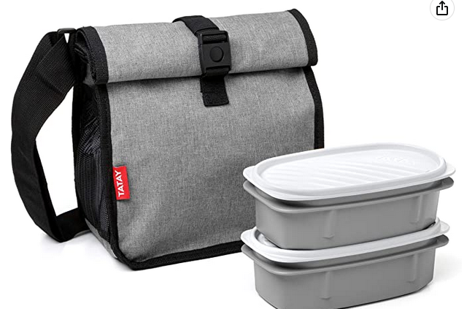
1. Cost Terminology
3. Make-Or-Buy Decision
Example
Outdoor Lunch Inc. manufactures lunch boxes. The company's most sold product is a thermal set that includes a bag that keeps the food warm for up to 24 hrs. The cost to produce a new bag is $2.19.
D. Material: $0.87
D. Labor: $0.45
Fixed Overhead: $0.51
Var. Overhead: $0.36
Total Unit Cost: $2.19
Tatax bags Inc. has approached OL and offered to produce 120.000 thermal bags at a unit price of $1.75.
Is it a good deal for OL?
2. Pricing Decisions
4. Closing part of a company

Slide 24
1. Cost Terminology
3. Make-Or-Buy Decision
Example
Outdoor Lunch Inc. manufactures lunch boxes. The company most sold product is a thermal set that includes a bag that keep the food warm up to 24 hrs. The cost to produce a new bag is $2.19.
 | Internal | Buy from Tatax
D. Material: | 0.87
D. Labor: | 0.45
Var. Overhead | 0.36
Total Relevant Cost per unit | 1.68 | 1.75
# units | 120,000 | 120,000
Total Relevant Cost | 201,600 | 210,000
Diff |  | +8,400
D. Material: $0.87
D. Labor: $0.45
Fixed Overhead: $0.51
Var. Overhead: $0.36
Total Unit Cost: $2.19
Tatax Bags Inc. has approached OL and offered to produce 120.000 thermal bags at a unit price of $1.75.
Is it a good deal for OL?
2. Pricing Decisions
4. Closing part of a company
Notes:
At first glance, it appears that management should purchase the bags for $1.75
But no, because we can reasonably asume that all F-OC are unavoidable, and thus not relevant.

Slide 25
1. Cost Terminology
3. Make-Or-Buy Decision
Example
How would the analysis change if a portion of the fixed costs were avoidable?
Out of the F-OC $0.51, just $0.12 are avoidable (insurance)
 | Internal | Buy from Tatax
D. Material: | 0.87
D. Labor: | 0.45
Var. Overhead Fix Overhead Avoidable | 0.36 0.12
Total Relevant Cost per unit | 1.80 | 1.75
# units | 120,000 | 120,000
Total Relevant Cost | 216,000 | 210,000
Diff |  | -6,000
2. Pricing Decisions
4. Closing part of a company
Notes:
We only include what is avoidable since this type of cost behaves as a variable cost.

Slide 26
1. Cost Terminology
3. Make-Or-Buy Decision
The cost analysis is a fundamental step in the decision.
However, it is not the only variable to consider when deciding to outsource:
- product quality.
- flexible production process (scale up or down in the short term).
- hold-up problem with suppliers.
- employees' morale?
Importantly, in some cases, outsourcing frees up capital and resources for alternative uses. If these alternatives are more valuable, they should be included in the comparison as opportunity costs.
2. Pricing Decisions
4. Closing part of a company
Notes:
Go to page 528 and use the examples in class with the White board.

Slide 27
1. Cost Terminology
3. Make-Or-Buy Decision
Example
If OL buys the lunch boxes, then it will use the released productive capacity to generate additional income by $30.000 by producing another product. Include now the opportunity cost.
 | Internal | Buy from Tatax
D. Material: | 0.87
D. Labor: | 0.45
Var. Overhead Fix Overhead Avoidable | 0.36 0.12
Total Relevant Cost per unit | 1.80 | 1.75
# units | 120,000 | 120,000
Total Relevant Cost | 216,000 | 210,000
Opportunity costs | 30.000
Total Cost | 246.000 | 210.000
Diff |  | -36.000
2. Pricing Decisions
4. Closing part of a company

Slide 28
3. Make-Or-Buy Decision
1. Cost Terminology
4. Closing part of a company
A segment is a portion of the company that management believes has sufficient similarities: product line, geo-locations, and customers.
It can be a product, a product line, or a department.
How to detect when a department, product line, or entire subsidiary is profitable?
And then, how to decide if Keep or Discontinue?
2. Pricing Decisions

Slide 29
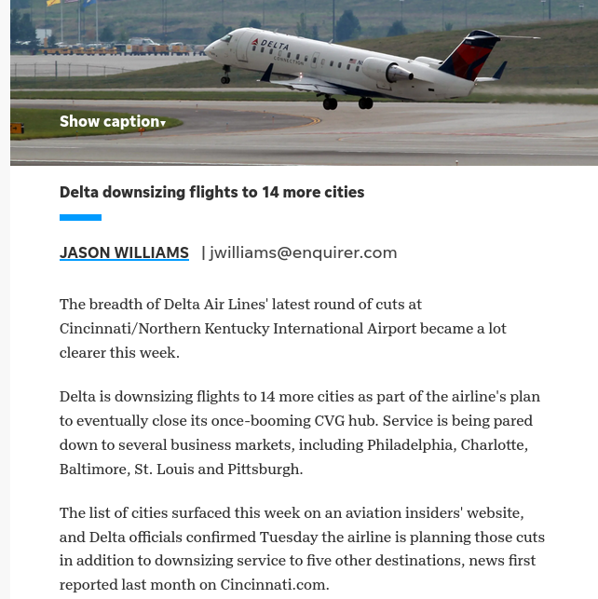
3. Make-Or-Buy Decision
1. Cost Terminology
4. Closing part of a company
2. Pricing Decisions

Slide 30
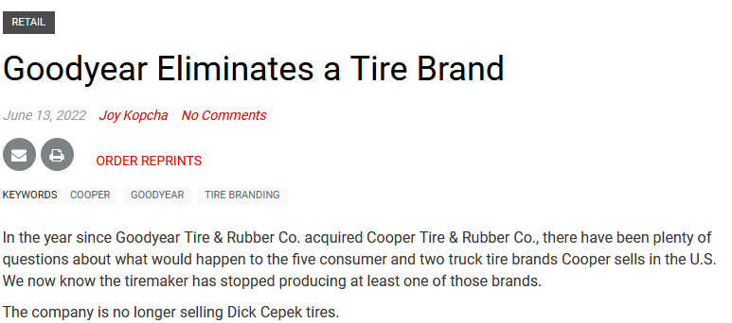
3. Make-Or-Buy Decision
1. Cost Terminology
4. Closing part of a company
2. Pricing Decisions

Slide 31
3. Make-Or-Buy Decision
1. Cost Terminology
4. Closing part of a company
Keep or Discontinue a product line?
The simplest solution: compare contribution margins and fixed costs (with and without the segment)
Most common mistake: using gross or operating income.
Why is this problematic?
Traditional Income Statements do not separate relevant from non-relevant costs.
Furthermore, the costs of non-manufacturing services in the company (accounting, HR) are allocated by some arbitrary formula but are not triggered by any product.
Not ABC allocation possible since no cost driver would make sense.
Finally, some fixed manufacturing expenses (e.g., factory rent) will continue to exist regardless if the company closes the business segment.
2. Pricing Decisions
Notes:
Go to page 528 and use the examples in class with the White board.

Slide 32
3. Make-Or-Buy Decision
1. Cost Terminology
4. Closing part of a company
Example
Outdoor Lunch Inc. manufactures lunch boxes. They developed three models: Thermal, Ultra Resistant, and Basic This is their condensed Income Statement (in thousands)
 | Thermal | Ultra Resistant | Basic | Total
Sales | 800 | 300 | 100 | 1.200
Var. Expenses | 520 | 210 | 90 | 820
Contribution Margin | 280 | 90 | 10 | 380
Fixed Expenses | 80 | 50 | 30 | 160
Net income | 200 | 40 | -20 | 220
Will the net income increase by $20, to $240 if the company eliminates the Basic Lunch Box?
2. Pricing Decisions

Slide 33
3. Make-Or-Buy Decision
1. Cost Terminology
4. Closing part of a company
Example
Outdoor Lunch Inc. manufactures lunch boxes. They developed three models: Thermal, Ultra Resistant, and Basic This is their condensed Income Statement (in thousands)
 | Thermal | Ultra Resistant | Basic | Total
Sales | 800 | 300 | 100 | 1.200
Var. Expenses | 520 | 210 | 90 | 820
Contribution Margin | 280 | 90 | 10 | 380
Fixed Expenses | 80 | 50 | 30 | 160
Net income | 200 | 40 | -20 | 220
Will the net income increase by $20, to $240 if the company eliminates the Basic Lunch Box?
NO! The other products Will have to absorb its fixed expenses.
2. Pricing Decisions

Slide 34
3. Make-Or-Buy Decision
1. Cost Terminology
4. Closing part of a company
Example
Outdoor Lunch Inc. manufactures lunch boxes. They developed three models: Thermal, Ultra Resistant, and Basic This is their condensed Income Statement (in thousands)
 | Thermal | Ultra Resistant | Basic | Total
Sales | 800 | 300 |  | 1.100
Var. Expenses | 520 | 210 |  | 730
Contribution Margin | 280 | 90 |  | 370
Fixed Expenses | 80+20 | 50+10 |  | 160
Net income | 180 | 40 |  | 210
Will the net income increase by $20, to $240 if the company eliminates the Basic Lunch Box?
NO! The other products Will have to absorb its fixed expenses.
2. Pricing Decisions

Slide 35
3. Make-Or-Buy Decision
1. Cost Terminology
4. Closing part of a company
The same, but following the Incremental Analysis "format".
 | Keep | Discontinue | Increase/Decrease
Sales | 100 |  | -100
Var. Expenses | 90 |  | 90
Contribution Margin | 10 |  | -10
Fixed Expenses | 30 | 30 | 0
Net income | -20 | -30 | -10
We could just exclude Fixed expenses in the comparison since it is an unavoidable cost. The result is the same.
2. Pricing Decisions

Slide 36
3. Make-Or-Buy Decision
1. Cost Terminology
4. Closing part of a company
The problem of detecting relevant vs non-relevant costs is less severe when the decision is about an entire subsidiary or business unit arranged as a different legal entity (business groups).
1) the costs from operations and supporting services are independent across legal entities or at least are less related.
2) by regulation, they might be legally forced to keep separate accounts.
2. Pricing Decisions

Slide 37

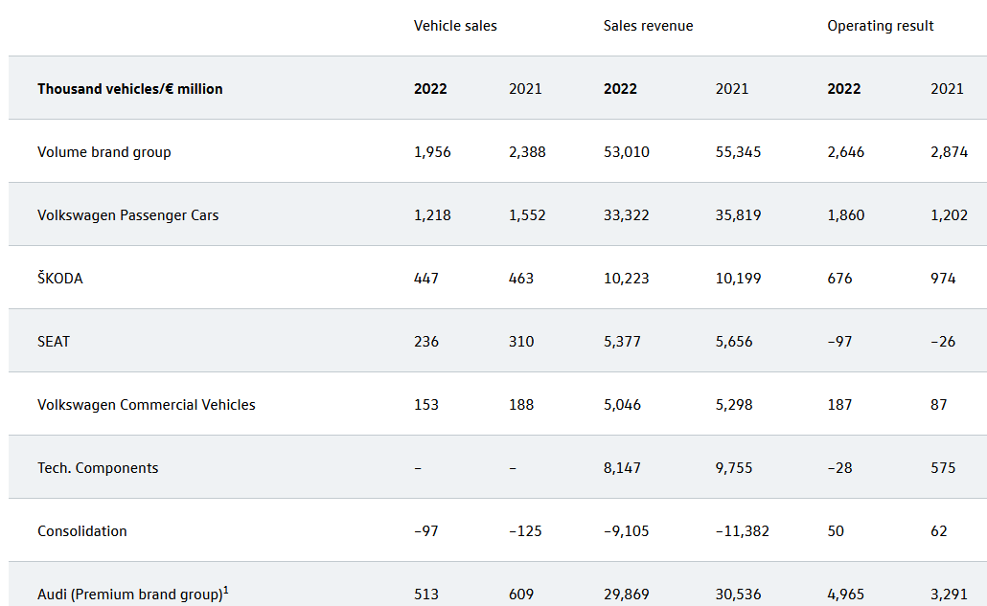
3. Make-Or-Buy Decision
1. Cost Terminology
4. Closing part of a company
2. Pricing Decisions

Slide 38
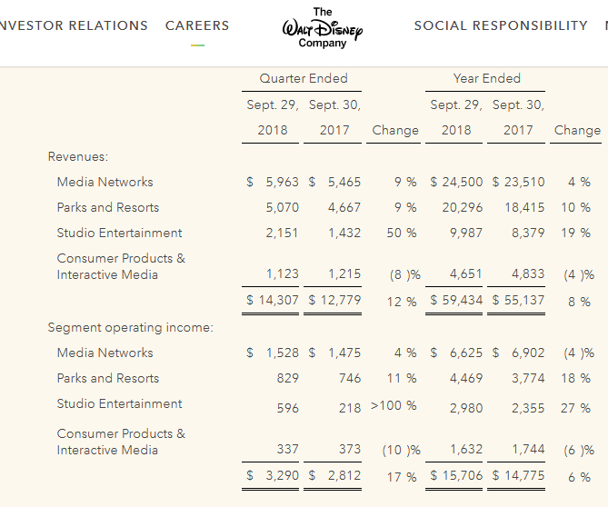
3. Make-Or-Buy Decision
1. Cost Terminology
4. Closing part of a company
2. Pricing Decisions

Slide 39
3. Make-Or-Buy Decision
1. Cost Terminology
4. Closing part of a company
Example
The contribution to net income is a fundamental step in the decision. However, it is not the only variable to consider when deciding to close a department/product:
- product complementarity (print and inks)
- product strategy (Trojan horse)
2. Pricing Decisions
Notes:
Go to page 528 and use the examples in class with the White board.

