Slide 1

Managerial Accounting
Marcelo Ortiz

Slide 2
Cost Analysis
1. Cost Behavior and Assignment
2. Traditional Full Costing
3. ABC

Slide 3
1. Cost Behavior and Assignment
Managers need cost information for key business decisions:
- Prioritizing resource allocation across products
- Planning for the coming year (budgeting)
- Expanding or discontinuing a product or service
This cost information is dispersed across the organization, probably distributed among different IT systems, and likely not very well connected.
- Historic material purchases
- Utilities and services (rent, insurance, internet, phone, mortgages, leases)
- Historic production: what, where, who, when?
- Salaries: wages and bonuses (product-line employees, supervisors, sales agents, HR staff, IT staff)
Of course, cost information in the Income Statement is way too aggregated to be useful for these managerial decisions
This class: What cost information is needed and how to evaluate it?
2. Traditional Full Costing
3. ABC/ABM
Notes:
Committed fixed costs are fixed costs that typically cannot be eliminated if the company is going to continue to function. An example would be the lease of factory equipment for a production company.
Discretionary fixed costs generally are fixed costs that can be incurred during some periods and postponed during other periods but which cannot normally be eliminated permanently. Examples could include advertising campaigns and employee training. Both of these costs could potentially be postponed temporarily, but the company would probably incur negative effects if the costs were permanently eliminated. These classifications are generally used for long-range planning purposes.
There are also "mixed costs" for example, hotels in tourist areas pay a tax that is partially fixed and partially variable on the number of rooms rented during the month.

Slide 4
1. Cost Behavior and Assignment
Connecting business decisions to cost information:
Decision | Cost Information
Product strategy | What product is more costly to produce? What cost element needs more attention? How profitable are they? How does the cost vary with the level of production?
Discontinue a product line | Gains from reducing costs: - labor? - material? - other costs?
Add second production shift | Labor cost, and potential overhead increases (eg., security).
Open additional retail outlets | Fixed cost per outlet, the potential increase in administrative expenses at the headquarters.

Slide 5
1. Cost Behavior and Assignment
Cost Behavior Patterns I:
Fixed Cost
Unavoidable operating expense that does not change in total over the short term nor depends on the level of activity.
Rent, insurance, managers' salaries, equipment leases.
Committed vs discretionary fixed costs.
Variable Cost
Expenses that vary in direct proportion to the level of activity in the business.
Raw materials, sales agent bonuses.
Cost driver: any activity that causes the organization to incur a variable cost: direct labor hours, machine hours.
Remain fixed in total but change on a per-unit basis
Remain the same per unit but change in total relative to the level of activity in the business.
2. Traditional Full Costing
3. ABC/ABM
Notes:
Committed fixed costs are fixed costs that typically cannot be eliminated if the company is going to continue to function. An example would be the lease of factory equipment for a production company.
Discretionary fixed costs generally are fixed costs that can be incurred during some periods and postponed during other periods but which cannot normally be eliminated permanently. Examples could include advertising campaigns and employee training. Both of these costs could potentially be postponed temporarily, but the company would probably incur negative effects if the costs were permanently eliminated. These classifications are generally used for long-range planning purposes.
There are also "mixed costs" for example, hotels in tourist areas pay a tax that is partially fixed and partially variable on the number of rooms rented during the month.

Slide 6
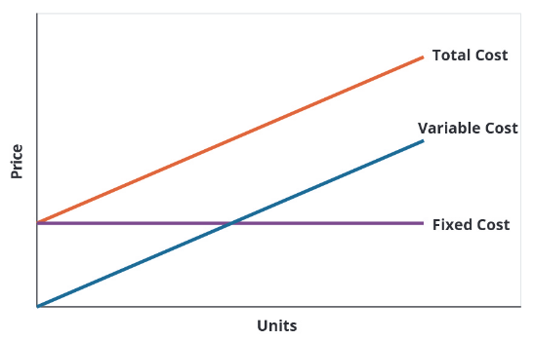
1. Cost Behavior and Assignment

Slide 7
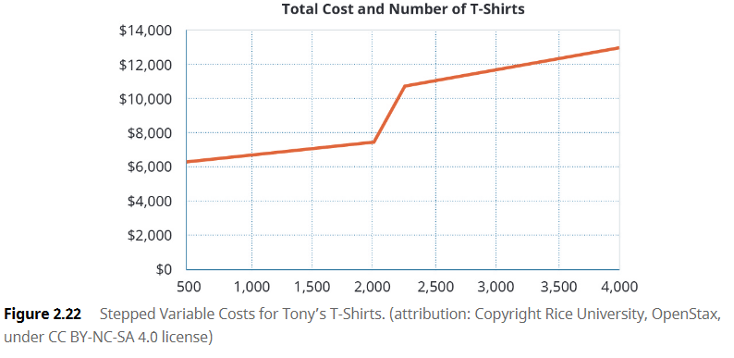
1. Cost Behavior and Assignment
Are total costs linear?
- Predictability
- Cost Planning

Slide 8
1. Cost Behavior and Assignment
Assignments: Product versus Period Costs
Decisions:
Production: How much does this product X cost?
- Including the fixed costs incurred for its production.
How are the costs reported in the financial statement?
- Separation of cost of products sold and administrative expenses.
- Relevant for measuring gross and operative margins.

Slide 9
1. Cost Behavior and Assignment
Cost Behavior Patterns II:
Product Cost
All costs associated with the acquisition or production of goods and products.
Period Cost
Expenses that are not product costs.
Easy matching with the respective sales revenues in the Income Statement.
Selling and Administrative Expenses (S&A expenses).
Period costs are treated as expenses in the period in which they occur (accruals).
Manufacturing firms: materials, labor, and overhead.
Merchandising firms: acquisition costs.
Direct material: Cake: flour, sugar, eggs, milk. They are traceable to a specific unit.
Direct labor.
Overhead: not traceable but support the production of Good: supervisor salaries, depreciation of the factory, insurance, utilities

Slide 10
1. Cost Behavior and Assignment
Item | Fixed or variable | Cost Month January
Lease on factory | Fixed | $15.000 per month
Plant supervisor salary | Fixed | $12.000 per month
Machine maintenance | Variable | $5 per unit produced
Production worker wages | Variable | $11 per unit produced
Direct Material | Variable | $75.000 total
The workload in January:
-1.000 unit
-2.000 hours of production labor
Workload in February: 1.500 units
Workload in March: 2.000 units
Workload in April: 2.500 units

Slide 11
1. Cost Behavior Patterns and Assignment
Item | Fixed or variable | Cost Month January
Lease on factory | Fixed | $15.000 per month
Plant supervisor salary | Fixed | $12.000 per month
Machine maintenance | Variable | $5 per unit produced
Production worker wages | Variable | $11 per hour
Direct Material | Variable | $75.000 total
Total Fixed Cost=15.000+12.000=$27.000
Total Variable Cost per unit =5+11+75.000/1.000 =$91 per unit
Month | Activity Level | VC per unit | Total VC | Fixed Cost | Total Cost
February | 1.500 units | $91 | $136.500 | $27.000 | 163.500
March | 2.000 units | $91 | $182.000 | $27.000 | 209.000
April | 2.500 units | $91 | $227.500 | $27.000 | 254.500
The workload in January:
-1.000 unit
-2.000 hours of production labor
Workload in February: 1.500 units
Workload in March: 2.000 units
Workload in April: 2.500 units
2. Traditional Full Costing
3. ABC/ABM

Slide 12
1. Cost Behavior Patterns and Assignment
2. Traditional Full Costing
Determining costs per product unit is not as easy as most people assume.
Example:
Consider a company with just two products (A and B):
- Measure all costs incurred/needed during production of all products (e.g. total production cost $100: 30 material, 30 labor, 40 fixed). Here, the difficulties are driven by technological feasibility: ¿ Can we link all the databases?
- Assign these costs per product line (e.g., the cost of product incurred with A is only $40: 20, 10, and 10, respectively).
Here the problem is not technological, but the managerial decision on how to allocate these costs:
Case 1: production supervisors are monitoring both product lines A and B. Where to allocate these costs?
Case 2: Both product lines share some machines that need maintenance: Where to allocate these costs?
We will start by learning the traditional cost allocation method.
3. ABC/ABM
Notes:
Example of overhead: a company of fruit juice: apples and pears. How to assign the electricity bill? Which fruits triggers more electricity consumption in the squeezing machine?

Slide 13
1. Cost Behavior Patterns and Assignment
2. Traditional Full Costing
Key concepts:
Direct Material
Direct Labor
Overhead: indirect material, labor, and other costs are closely associated with the manufacturing process but not tied to a specific product.
Indirect material: e.g., cleaning wipes for machine maintenance.
Indirect labor: supervisors' and maintenance staff's wages, engineers' and scientists' wages.
Other: depreciation of the factory, insurance expenses of machinery and factory building, electricity bill.
The assignment (to product) of direct costs is trivial, but what about overhead costs?
The economic relevance of overhead costs has increased with technology as less labor force is used in manufacturing.
3. ABC/ABM
Notes:
Example of overhead: a company of fruit juice: apples and pears. How to assign the electricity bill? Which fruits triggers more electricity consumption in the squeezing machine?

Slide 14
1. Cost Behavior Patterns and Assignment
2. Traditional Full Costing
-Example: maintenance costs for a manufacturer.
Assignment options:
(a) equally across departments.
(b) by the number of machines used in each department.
(c) by the number of labor hours used in maintenance.
And what about the cost of quality inspection? Machine set-up costs?
In this course, we will explore two assignment systems.
Let's start with the Traditional Full Costing.
Total Cost
Direct Costs
Overhead cost:
Labor
Materials
All costs other than direct material, direct labor, or selling and administrative costs
3. ABC/ABM

Slide 15
1. Cost Behavior Patterns and Assignment
2. Traditional Full Costing
How do we measure the cost per product?
Direct Material: job order costing, process costing.
Direct Labor: Time cards or another electronic mechanism for measuring labor input.
Overhead (OH):
Indirect material: total cost cleaning wipes.
Indirect labor: total supervisors and maintenance staff's wages
Overhead: How do we assign this cost to each product?
Step 1: Compute (o estimate) the manufacturing overhead ($) and total activity level. This step needs prior knowledge of how overhead costs vary with the company's activity.
Step 2: compute the "overhead rate" as the ratio of the overhead costs to the activity level.
Step 3: Use overhead rate to assign OH cost to each product.
3. ABC/ABM

Slide 16
1. Cost Behavior Patterns and Assignment
2. Traditional Full Costing
What activity measures should be used to calculate the overhead rate across products?
Key principle: It should have a causal relationship between the metric and the related (overhead) costs.
These activity measures are technically called "cost drivers."
Most common cost drivers
in manufacturing: unit produced, direct labor hours, direct labor cost, machine hours.
in customer service costs: number of product returns or client calls.
In cleaning costs: square meters.
in office supplies: number of employees.
In website costs: number of online orders.
3. ABC/ABM

Slide 17
1. Cost Behavior Patterns and Assignment
2. Traditional Full Costing
Example
Product Details: Your company manufactures two products: A and B.
Direct Costs per Unit:
Product A: $20 for materials, $15 for labor
Product B: $30 for materials, $25 for labor
Total Overhead Costs: $60,000 for the period.
Total Production Units: 3,000 (1,000 units of A + 2,000 units of B)
¿What is the total cost of manufacturing one unit of each product? Use total production units as the cost driver.
3. ABC/ABM
Notes:
Calculate Direct Costs for Each Product Type:
Direct Costs (Product A) = (Material cost + Labor cost) * Units
Direct Costs (Product B) = (Material cost + Labor cost) * Units
Calculate the Overhead Rate:
Overhead rate = Total Overhead Costs / Total Production Units
Calculate Overhead Costs Allocated to Each Product:
Overhead for Product A = Overhead rate * Units of A
Overhead for Product B = Overhead rate * Units of B
Calculate the Total Cost per Unit for Each Product:
Total Cost per Unit (Product A) = Direct Cost per Unit (A) + Allocated Overhead per Unit (A)
Total Cost per Unit (Product B) = Direct Cost per Unit (B) + Allocated Overhead per Unit (B)
Calculations:
Calculate Direct Costs for Each Product Type
Direct Costs (Product A) = ($20 for materials + $15 for labor) * 1,000 units = $35,000
Direct Costs (Product B) = ($30 for materials + $25 for labor) * 2,000 units = $110,000
Step 1: Information already provided.
Step 2: Calculate the Overhead Rate
Overhead rate = $60,000 (Total Overhead Costs) / 3,000 (Total Production Units)
Overhead rate = $20 per unit
Step 3: Calculate Overhead Costs Allocated to Each Product
Overhead for Product A = $20 (Overhead rate) * 1,000 (Units of A) = $20,000
Overhead for Product B = $20 (Overhead rate) * 2,000 (Units of B) = $40,000
Finally Calculate the Total Cost per Unit for Each Product
Total Cost per Unit (Product A) = ($35,000 Direct Cost + $20,000 Overhead) / 1,000 units = $55 per unit
Total Cost per Unit (Product B) = ($110,000 Direct Cost + $40,000 Overhead) / 2,000 units = $75 per unit

Slide 18
1. Cost Behavior Patterns and Assignment
3. ABC
2. Traditional Full Costing
In the last decades, progress in robotics and IT has changed the ratio between direct labor and overhead.
More and more overhead costs are linked to drivers other than direct labor or machine hours.
This situation created severe biases in the allocation of overhead costs.
Companies needed more information to be able to track the activities triggering overhead costs and assign the cost of these activities to the product…
That is how the Activity-Based Product Cost (ABC) assignment emerged.
The rationale behind ABC cost allocation is simple: products consume activities, and activities consume resources.

Slide 19

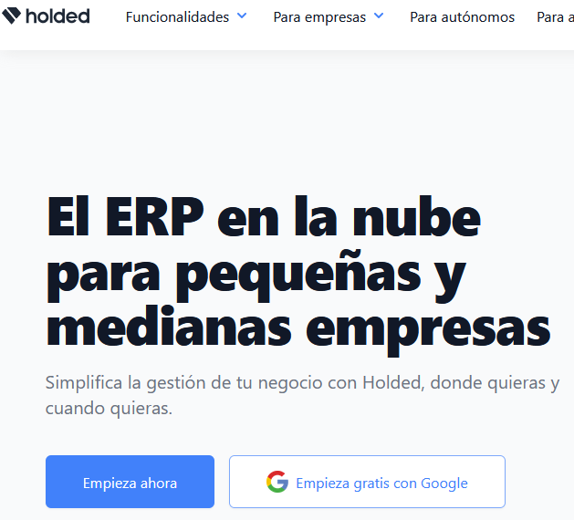
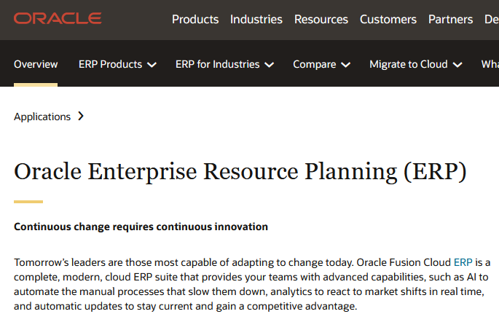
1. Cost Behavior Patterns and Assignment
3. ABC
2. Traditional Full Costing
MRP or ERP systems help management to organize planning, scheduling, and tracking of materials and job orders. ERP also connects that information with accounting systems.

Slide 20
1. Cost Behavior Patterns and Assignment
3. ABC
2. Traditional Full Costing
ABC assignment is more precise than the traditional allocation of overhead costs since it assigns these costs to the products based on the use of the activities triggering overhead costs.
Steps:
1. List the activities performed in the factory
2. Aggregate activities into cost pools
3. Estimate the level of activity and cost for each cost pool.
4. Compute the overhead ABC rate for each cost pool.
5. Allocate overhead costs to products using ABC rates.
Notes:
Next year, use the 4 steps in pag 404 of the book of Weygandt.

Slide 21
1. Cost Behavior Patterns and Assignment
3. ABC
2. Traditional Full Costing
Steps:
1. List the activities performed in the factory
Activities: action or process involved in the production of inventory.
Examples of common manufacturing activities (and overhead costs):
• Taking orders
• Setting up machines
• Purchasing material
• Assembling products (ie, order assembling in Mcdonald)
• Inspecting products
• Providing customer service during the ordering process

Slide 22
1. Cost Behavior Patterns and Assignment
3. ABC
2. Traditional Full Costing
Steps:
2. Aggregate activities into cost pools
Overhead costs are assigned to each activity to become a cost pool. A cost pool is a list of costs incurred when related activities are performed.
Examples:
Activities | Cost Pool
Taking orders Verifying/confirming orders | Customer Order
Setting up machines Machine insurances, utilities | Production Machines
Preparing purchaes of materials Cost to move materials from receiving into production department | Purchasing Materials
Inspection/Quality staff costs | Inspect Products
Cost of assembly machine Cost of label machine | Assemble Products
Computers' depreciation Online store maintenance | Technological production

Slide 23
1. Cost Behavior Patterns and Assignment
3. ABC
2. Traditional Full Costing
Steps:
3. Estimate the level of activity and cost for each cost pool.
What activities drive the costs in that pool? (again, the concept of "cost driver", but now, not only one)
Examples:
Activity Cost Pool | Estimated Activity of the Cost drivers
Customer Order | # of orders
Production Machines | # of machine setups
Purchasing Materials | # Purchases requests
Inspect Products | # Inspectors or Hrs.
Assemble Products | # direct labor hours
Technological production | # online orders or visits.
How to determine the cost driver for an activity pool?
(1) Managers analyze the indirect activities needed in the production
(2) classify activities in similar functional groups ("pools")
(3) find an objective metric with a causal relationship with the cost of the activity pool ("the driver").

Slide 24
1. Cost Behavior Patterns and Assignment
3. ABC
2. Traditional Full Costing
Steps:
4. Compute the overhead ABC rate for each cost pool.
This step is similar to finding the traditional overhead rate.
However, each cost driver will have its overhead rate.
This is why ABC is a more accurate method of allocating overhead.

Slide 25
1. Cost Behavior Patterns and Assignment
3. ABC
2. Traditional Full Costing
Steps:
5. Allocate overhead costs to products using ABC rates.
This step is equivalent to the last step in the traditional approach
Summary of the 5-step process into just 2 stages:
First, allocating overhead costs to the various activities to get a cost per activity.
Second, allocating the cost per activity to each product based on that product’s usage of the activities.

Slide 26
1. Cost Behavior Patterns and Assignment
3. ABC
2. Traditional Full Costing
Example:
Product Details: Your company manufactures two products: A and B.
Units Produced:
1,000 units of Product A
2,000 units of Product B
Direct Costs per Unit:
Product A: $20 for materials, $15 for labor
Product B: $30 for materials, $25 for labor
Total Overhead Costs: $60,000 for the period.
Activity Pools and Costs:
Machine Setup: $20,000
Quality Control: $25,000
Packaging: $15,000
Activity Metrics:
Machine Setups: 50 for Product A, 50 for Product B
Quality Control Tests: 200 for Product A, 100 for Product B
Packaging Instances: 1,000 for Product A, 2,000 for Product B
Compute total cost using the ABC method and compare it with the Traditional approach.
Notes:
Steps 1 to 3: information already provided.
Step 4: Calculate ABC Rates for Each Pool
Machine Setup rate = $20,000 / 100 setups = $200 per setup
Quality Control rate = $25,000 / 300 tests = $83.33 per test
Packaging rate = $15,000 / 3,000 packages = $5 per package
Step 5: Allocate Overhead Costs Based on Activities
Overhead for Product A = (50 setups * $200) + (200 tests * $83.33) + (1,000 packages * $5) = $10,000 + $16,666 + $5,000 = $31,666
Overhead for Product B = (50 setups * $200) + (100 tests * $83.33) + (2,000 packages * $5) = $10,000 + $8,333 + $10,000 = $28,333
Finally, calculate the Total Cost per Unit for Each Product
Total Cost per Unit (Product A) = ($35,000 Direct Cost + $31,666 Overhead) / 1,000 = $66.67 per unit
Total Cost per Unit (Product B) = ($110,000 Direct Cost + $28,333 Overhead) / 2,000 = $69.17 per unit
Conclusion: now the cost allocation is far more even. And more precise!

Slide 27
1. Cost Behavior Patterns and Assignment
3. ABC
2. Traditional Full Costing
Example in MS Excel: Melody Electronics

Slide 28
1. Cost Behavior Patterns and Assignment
3. ABC
2. Traditional Full Costing
Comparing and contrasting both cost allocation methods.
 | Traditional system | ABC
PROS | Simple to explain and implement. Cheap cost-information system. | More Accurate. Identify opportunities for improvements and unprofitable business.
CONS | Allocation base can be arbitrary Penalizes products with high volumen. | Complex to implement Expensive to implement, more sophisticated information system.

Slide 29
1. Cost Behavior Patterns and Assignment
3. ABC
2. Traditional Full Costing
Hierarchy of activity levels
It is a Good practice to classify the activities into four levels to have a clearer path to causality with costs increase.
Level | Type of Activity | Example of Cost Driver
Unit-level | Labor-related: assembling, painting, sanding, sewing. Machine-related: drilling, cutting, trimming, pressing. | direct labor hours or costs Machine hours
Batch-level | Machine set-ups. Purchase ordering quality inspections, material handling | # set-ups # purchase orders # inspectors or inspections # material transportations
Product-level | Product design Engineering changes | # desings or tests # changes
Facility-level | Plant management salaries Plant depreciation Utilities | # employees # square metres # square metres
Notes:
From Figure 1 we can reach the following conclusions: ◆ With the exception of production-related costs, a sig- nificant proportion of costs is not assigned to cost objects. ◆ For production costs, standard costing is still “king of the hill” with a usage rate of 42%. ◆ Contrary to common belief, ABC methods are used across the entire value chain at approximately the same rate. ABC is not a production-specific method

Slide 30
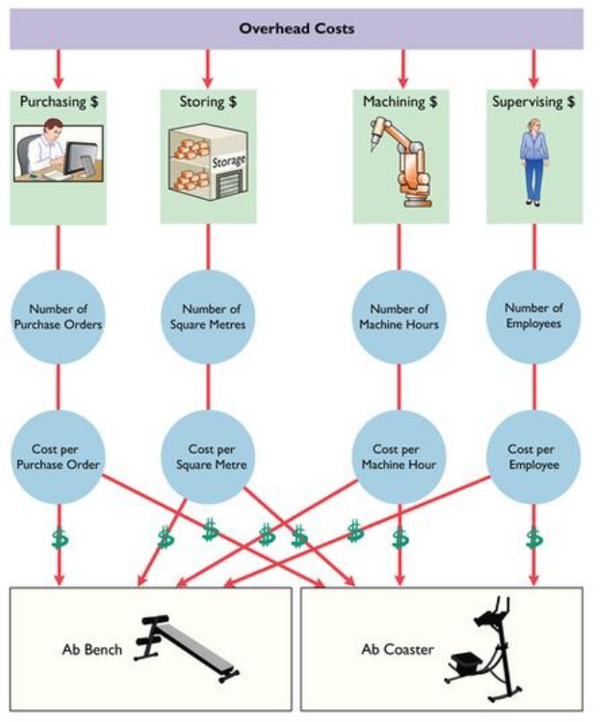
1. Cost Behavior Patterns and Assignment
3. ABC
2. Traditional Full Costing
How many Cost Activity Pools are appropriate?
Empirical evidence indicates that manufacturers identify between 50-150 activities with the respective cost drivers.
The number depends on:
- complexity of the production process.
a) manufacturing steps
b) number of different raw materials
c) coordination among divisions
d) level of automatization
- complexity of the product.
a) relevance of quality
b) number of elements or parts
Weygandt et al (2018)

Slide 31
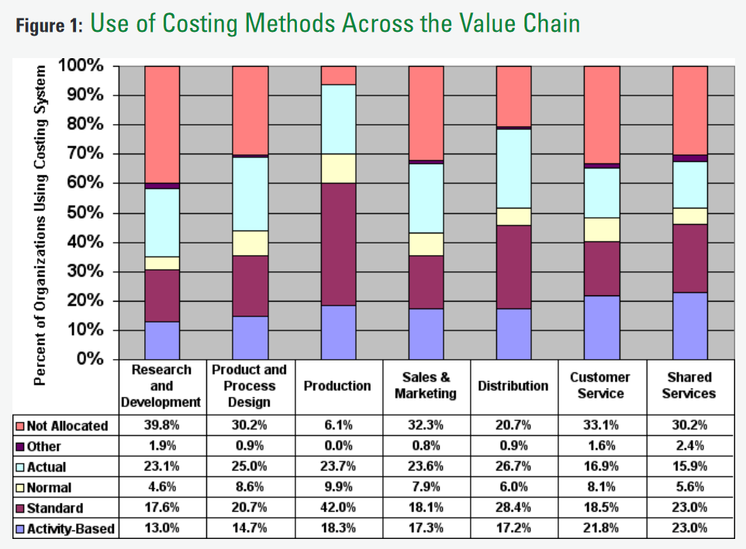
1. Cost Behavior Patterns and Assignment
3. ABC
2. Traditional Full Costing
How common is the ABC system?
“Many companies abandoned activity-based costing because it did not capture the complexity of their operations, took too long to implement and was too expensive to build and maintain.”(Kaplan and Anderson)
But what about companies that implemented it well?
Lawson (2009)
Notes:
From Figure 1 we can reach the following conclusions: ◆ With the exception of production-related costs, a sig- nificant proportion of costs is not assigned to cost objects. ◆ For production costs, standard costing is still “king of the hill” with a usage rate of 42%. ◆ Contrary to common belief, ABC methods are used across the entire value chain at approximately the same rate. ABC is not a production-specific method

Slide 32
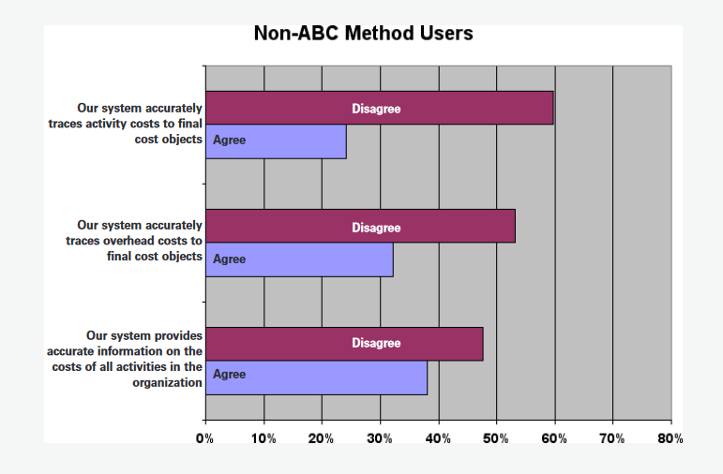
1. Cost Behavior Patterns and Assignment
3. ABC
2. Traditional Full Costing
How common is the ABC system?
Lawson (2009)
Notes:
From Figure 1 we can reach the following conclusions: ◆ With the exception of production-related costs, a sig- nificant proportion of costs is not assigned to cost objects. ◆ For production costs, standard costing is still “king of the hill” with a usage rate of 42%. ◆ Contrary to common belief, ABC methods are used across the entire value chain at approximately the same rate. ABC is not a production-specific method

Slide 33
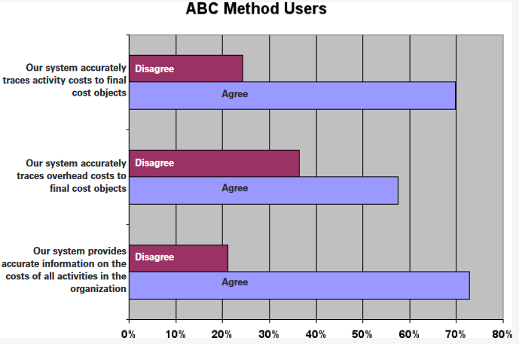
1. Cost Behavior Patterns and Assignment
3. ABC
2. Traditional Full Costing
How common is the ABC system?
Lawson (2009)
Notes:
From Figure 1 we can reach the following conclusions: ◆ With the exception of production-related costs, a sig- nificant proportion of costs is not assigned to cost objects. ◆ For production costs, standard costing is still “king of the hill” with a usage rate of 42%. ◆ Contrary to common belief, ABC methods are used across the entire value chain at approximately the same rate. ABC is not a production-specific method

Slide 34
1. Cost Behavior Patterns and Assignment
3. ABC
2. Traditional Full Costing
How does a company know when to use ABC?
1) Product lines are very different in terms of volume of production or manufacturing complexity?
2) Product lines require many supporting services (cleaning, set-ups, utilities, inspections, moving parts/materials, coordination, and building maintenance).
3) Overhead Cost is a large % of total costs.
4) Managers are ignoring data provided by the existing cost system when deciding pricing or other producto decisions.
Notes:
From Figure 1 we can reach the following conclusions: ◆ With the exception of production-related costs, a sig- nificant proportion of costs is not assigned to cost objects. ◆ For production costs, standard costing is still “king of the hill” with a usage rate of 42%. ◆ Contrary to common belief, ABC methods are used across the entire value chain at approximately the same rate. ABC is not a production-specific method

Slide 35
1. Cost Behavior Patterns and Assignment
Summary
2. Traditional Full Costing
Cost Types:
Fixed and Variable, Cost Planning.
Product and Period.
Direct Material, Direct Labor, Overhead.
Costing Method:
Traditional
- Activity and Cost Driver.
- overhead rate.
ABC
- Activity, Cost Pool, and Cost Drivers.
Product profitability.
Cost Decisions
Notes:
From Figure 1 we can reach the following conclusions: ◆ With the exception of production-related costs, a sig- nificant proportion of costs is not assigned to cost objects. ◆ For production costs, standard costing is still “king of the hill” with a usage rate of 42%. ◆ Contrary to common belief, ABC methods are used across the entire value chain at approximately the same rate. ABC is not a production-specific method

