Slide 1

Managerial Accounting
Marcelo Ortiz

Slide 2
Differential Analysis
1. Intro. Incremental Analysis
2. Make-Or-Buy Decision
3. Closing part of a company

Slide 3
1. Intro. Incremental Analysis
A differential (or incremental) analysis is an economic comparison among alternative courses of action.
The main goal is to identify what revenues and expenses vary across alternatives.
Of course, both variable and fixed costs can vary across alternatives, so the identification of the types of revenues and expenses that are relevant for the comparison might not be trivial.
 | Alternative A | Alternative B | Increase (Decrease)
Revenues
Cost
Net Income
2. Pricing Decisions
3. Make-Or-Buy Decision
4. Closing part of a company
Notes:
Go to page 528 and use the examples in class with the White board.

Slide 4
1. Intro. Incremental Analysis
Managers need a differential analysis that compares potential alternatives' relevant costs and revenues.
What is "relevant"?
Concept | Definition
Relevant cost | Costs that are different for each alternative and that will occur in the future.
Irrelevant cost | A cost that does not influence the decision because it is included (or excluded) with the same amount in all the potential solutions.
Differential cost | A cost that is included in some but not all the potential solutions
Avoidable cost | A cost that can be eliminated (in whole or in part) by choosing one alternative over another
Sunk cost | A cost that cannot be avoided because it has already occurred or are unavoidable
Opportunity cost | The cost associated with not choosing the other best alternative use for the resource.
2. Pricing Decisions
3. Make-Or-Buy Decision
4. Closing part of a company

Slide 5
1. Intro. Incremental Analysis
Connection with Activity-Based Costing
The main motivation for ABC is that it results in a more accurate allocation of overhead costs.
This better mapping between overhead costs and manufacturing increases is useful for differential analysis.
Activity Base Costing --> better identification of relevant costs --> better incremental analysis.
Types of incremental analysis decisions:
(1) Accept and order at a special price
(2) Make or buy components or finished products
(3) Eliminate or retain an unprofitable business segment.
2. Pricing Decisions
3. Make-Or-Buy Decision
4. Closing part of a company

Slide 6
1. Cost Terminology
2. Make-Or-Buy Decision
Outsourcing is using another company to provide goods or services that your company requires.
Why? It is a matter of expertise and/or cost-benefit.
This course: cost-benefit analyses.
Cost analysis can be performed by studying the cost of buying a component (acquisition cost) versus the cost to produce the component, focusing on unavoidable and avoidable costs: direct materials, direct labor, and overhead.
Buy: avoidable costs go away, but the unavoidable costs will remain and must be considered in the analysis.
2. Pricing Decisions
4. Closing part of a company

Slide 7
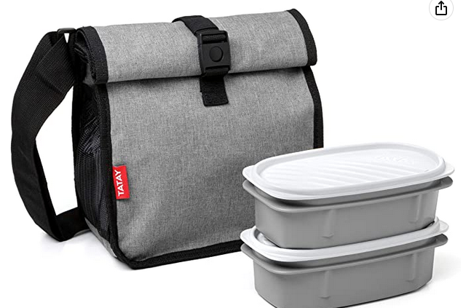
1. Cost Terminology
2. Make-Or-Buy Decision
Example
Outdoor Lunch Inc. manufactures lunch boxes. The company's most sold product is a thermal set that includes a bag that keeps the food warm for up to 24 hrs. The cost to produce a new bag is $2.19.
D. Material: $0.87
D. Labor: $0.45
Fixed Overhead: $0.51
Var. Overhead: $0.36
Total Unit Cost: $2.19
Tatax bags Inc. has approached OL and offered to produce 120.000 thermal bags at a unit price of $1.75.
Is it a good deal for OL?
2. Pricing Decisions
4. Closing part of a company

Slide 8
2. Make-Or-Buy Decision
Example
Outdoor Lunch Inc. manufactures lunch boxes. The company most sold product is a thermal set that includes a bag that keep the food warm up to 24 hrs. The cost to produce a new bag is $2.19.
 | Internal | Buy from Tatax
D. Material: | 0.87
D. Labor: | 0.45
Var. Overhead | 0.36
Total Relevant Cost per unit | 1.68 | 1.75
# units | 120,000 | 120,000
Total Relevant Cost | 201,600 | 210,000
Diff |  | +8,400
D. Material: $0.87
D. Labor: $0.45
Fixed Overhead: $0.51
Var. Overhead: $0.36
Total Unit Cost: $2.19
Tatax Bags Inc. has approached OL and offered to produce 120.000 thermal bags at a unit price of $1.75.
Is it a good deal for OL?
2. Pricing Decisions
4. Closing part of a company
Notes:
At first glance, it appears that management should purchase the bags for $1.75
But no, because we can reasonably asume that all F-OC are unavoidable, and thus not relevant.

Slide 9
1. Cost Terminology
2. Make-Or-Buy Decision
Example
How would the analysis change if some fixed costs were avoidable?
Out of the F-OH $0.51, just $0.12 are avoidable (insurance)
 | Internal | Buy from Tatax
D. Material: | 0.87
D. Labor: | 0.45
Var. Overhead Fix Overhead Avoidable | 0.36 0.12
Total Relevant Cost per unit | 1.80 | 1.75
# units | 120,000 | 120,000
Total Relevant Cost | 216,000 | 210,000
Diff |  | -6,000
2. Pricing Decisions
4. Closing part of a company
Notes:
We only include what is avoidable since this type of cost behaves as a variable cost.

Slide 10
1. Cost Terminology
2. Make-Or-Buy Decision
The cost analysis is a fundamental step in the decision.
However, it is not the only variable to consider when deciding to outsource:
- Product quality.
- Flexible production process (scale up or down in the short term).
- Hold-up problem with suppliers.
- Employees' morale?
Importantly, in some cases, outsourcing frees up capital and resources for alternative uses. If these alternatives are more valuable, they should be included in the comparison as opportunity costs.
2. Pricing Decisions
4. Closing part of a company
Notes:
Go to page 528 and use the examples in class with the White board.

Slide 11
1. Cost Terminology
2. Make-Or-Buy Decision
Example
If OL buys the lunch boxes, then it will use the released productive capacity to generate additional income by $30.000 by producing another product. Include now the opportunity cost.
 | Internal | Buy from Tatax
D. Material: | 0.87
D. Labor: | 0.45
Var. Overhead Fix Overhead Avoidable | 0.36 0.12
Total Relevant Cost per unit | 1.80 | 1.75
# units | 120,000 | 120,000
Total Relevant Cost | 216,000 | 210,000
Opportunity costs | 30.000
Total Cost | 246.000 | 210.000
Diff |  | -36.000
2. Pricing Decisions
4. Closing part of a company

Slide 12
3. Make-Or-Buy Decision
1. Cost Terminology
3. Closing part of a company
A segment is a portion of the company that management believes has sufficient similarities: product line, geo-locations, and customers.
It can be a product, a product line, or a department.
How to detect when a department, product line, or entire subsidiary is profitable?
And then, how to decide if Keep or Discontinue?
2. Pricing Decisions

Slide 13
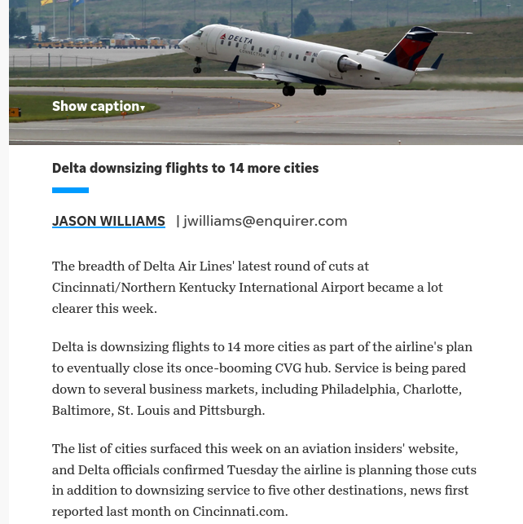
3. Make-Or-Buy Decision
1. Cost Terminology
3. Closing part of a company
2. Pricing Decisions

Slide 14
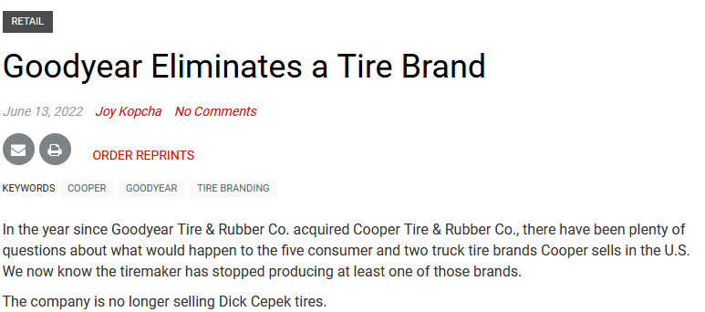
3. Make-Or-Buy Decision
1. Cost Terminology
3. Closing part of a company
2. Pricing Decisions

Slide 15
3. Make-Or-Buy Decision
1. Cost Terminology
3. Closing part of a company
Keep or Discontinue a product line?
The simplest solution: compare contribution margins and fixed costs (with and without the segment)
Most common mistake: using gross or operating income.
Why is this problematic?
Traditional Income Statements do not separate relevant from non-relevant costs.
Furthermore, the costs of non-manufacturing services in the company (accounting, HR) are allocated by some arbitrary formula but are not triggered by any product.
Not ABC allocation possible since no cost driver would make sense.
Finally, some fixed manufacturing expenses (e.g., factory rent) will continue to exist regardless if the company closes the business segment.
2. Pricing Decisions
Notes:
Go to page 528 and use the examples in class with the White board.

Slide 16
3. Make-Or-Buy Decision
1. Cost Terminology
3. Closing part of a company
Example
Outdoor Lunch Inc. manufactures lunch boxes. They developed three models: Thermal, Ultra Resistant, and Basic. This is their condensed Income Statement (in thousands)
 | Thermal | Ultra Resistant | Basic | Total
Sales | 800 | 300 | 100 | 1.200
Var. Expenses | 520 | 210 | 90 | 820
Contribution Margin | 280 | 90 | 10 | 380
Fixed Expenses | 80 | 50 | 30 | 160
Net income | 200 | 40 | -20 | 220
Will the net income increase by $20, to $240 if the company eliminates the Basic Lunch Box?
2. Pricing Decisions

Slide 17
3. Make-Or-Buy Decision
1. Cost Terminology
3. Closing part of a company
Example
Outdoor Lunch Inc. manufactures lunch boxes. They developed three models: Thermal, Ultra Resistant, and Basic This is their condensed Income Statement (in thousands)
 | Thermal | Ultra Resistant | Basic | Total
Sales | 800 | 300 | 100 | 1.200
Var. Expenses | 520 | 210 | 90 | 820
Contribution Margin | 280 | 90 | 10 | 380
Fixed Expenses | 80 | 50 | 30 | 160
Net income | 200 | 40 | -20 | 220
Will the net income increase by $20, to $240 if the company eliminates the Basic Lunch Box?
NO! The other products Will have to absorb its fixed expenses.
2. Pricing Decisions

Slide 18
3. Make-Or-Buy Decision
1. Cost Terminology
3. Closing part of a company
Example
Outdoor Lunch Inc. manufactures lunch boxes. They developed three models: Thermal, Ultra Resistant, and Basic This is their condensed Income Statement (in thousands)
 | Thermal | Ultra Resistant | Basic | Total
Sales | 800 | 300 |  | 1.100
Var. Expenses | 520 | 210 |  | 730
Contribution Margin | 280 | 90 |  | 370
Fixed Expenses | 80+20 | 50+10 |  | 160
Net income | 180 | 30 |  | 210
Will the net income increase by $20, to $240 if the company eliminates the Basic Lunch Box?
NO! The other products Will have to absorb its fixed expenses.
2. Pricing Decisions

Slide 19
3. Make-Or-Buy Decision
1. Cost Terminology
3. Closing part of a company
The same, but following the Incremental Analysis "format".
 | Keep | Discontinue | Increase/Decrease
Sales | 100 |  | -100
Var. Expenses | 90 |  | 90
Contribution Margin | 10 |  | -10
Fixed Expenses | 30 | 30 | 0
Net income | -20 | -30 | -10
We could just exclude Fixed Expenses in the comparison since it is an unavoidable cost. The result is the same.
2. Pricing Decisions

Slide 20
3. Make-Or-Buy Decision
1. Cost Terminology
3. Closing part of a company
The problem of detecting relevant vs non-relevant costs is less severe when the decision is about an entire subsidiary or business unit arranged as a different legal entity (business groups).
1) the costs from operations and supporting services are independent across legal entities or at least are less related.
2) by regulation, they might be legally forced to keep separate accounts.
2. Pricing Decisions

Slide 21

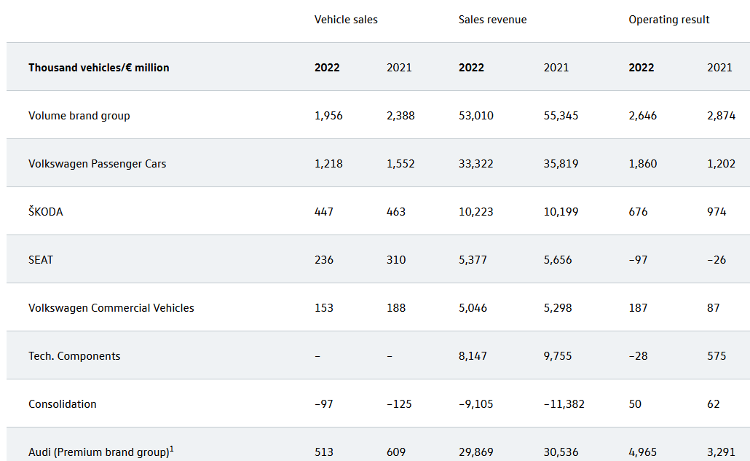
3. Make-Or-Buy Decision
1. Cost Terminology
3. Closing part of a company
2. Pricing Decisions

Slide 22
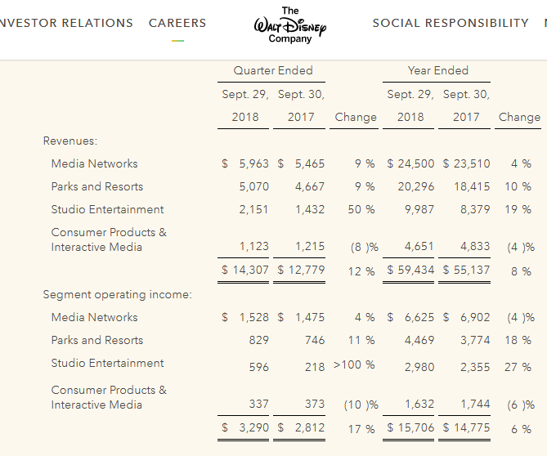
3. Make-Or-Buy Decision
1. Cost Terminology
3. Closing part of a company
2. Pricing Decisions

Slide 23
3. Make-Or-Buy Decision
1. Cost Terminology
3. Closing part of a company
Example
The contribution to net income is a fundamental step in the decision. However, it is not the only variable to consider when deciding to close a department/product:
- product complementarity (print and inks)
- product strategy (Trojan horse)
2. Pricing Decisions
Notes:
Go to page 528 and use the examples in class with the White board.

