Slide 1
LSA | 主題 1 | 主題 2 | 主題 3
字詞 1 | rate | growth | octob
字詞 2 | price | member | septemb
字詞 3 | inflat | expans | novemb
字詞 4 | market | inventori | rang
字詞 5 | econom | price | august
字詞 6 | growth | quarter | committe
字詞 7 | increas | sale | third
字詞 8 | quarter | year | percent
字詞 9 | particip | product | rate
字詞 10 | continu | demand | juli
字詞 11 | committe | juli | total
字詞 12 | year | restraint | restraint
字詞 13 | would | consider | monitor
字詞 14 | expect | economi | reserv
字詞 15 | remain | aggreg | veloc
字詞 16 | polici | industri | object
字詞 17 | recent | moder | lower
字詞 18 | declin | rang | monetari
字詞 19 | month | twelv | financi
字詞 20 | consum | direct | develop
LDA | 主題 1 | 主題 2 | 主題 3
字詞 1 | april | april | octob
字詞 2 | particip | juli | novemb
字詞 3 | march | august | august
字詞 4 | juli | march | septemb
字詞 5 | june | februari | decemb
字詞 6 | hurrican | particip | januari
字詞 7 | novemb | januari | juli
字詞 8 | may | decemb | particip
字詞 9 | octob | octob | februari
字詞 10 | august | novemb | third
字詞 11 | pce | june | fourth
字詞 12 | agenc | guidanc | agenc
字詞 13 | medium | threshold | june
字詞 14 | septemb | restraint | twelv
字詞 15 | fomc | agenc | loan
字詞 16 | loan | program | restraint
字詞 17 | februari | mb | march
字詞 18 | decemb | loan | al
字詞 19 | district | recoveri | fomc
字詞 20 | gdp | fourth | pce

Slide 2
升息樣本 (39 個) |  | 降息樣本 (30 個) |  | 利率不變樣本 (153 個)
連續次數 | 次數 | 連續次數 | 次數 | 連續次數 | 次數
1 (無連續) | 14 | 1 (無連續) | 3 | 1 (無連續) | 12
2 | 1 | 2 | 3 | 2 | 2
3 | 2 | 3 | 2 | 3 | 2
17 | 1 | 6 | 1 | 4 | 5
 |  | 9 | 1 | 6 | 1
 |  |  |  | 7 | 2
 |  |  |  | 8 | 2
 |  |  |  | 9 | 1
 |  |  |  | 11 | 1
 |  |  |  | 55 | 1

Slide 3
升息樣本 (39 個) |  | 降息樣本 (30 個)
利率改變幅度 | 次數 | 利率改變幅度 | 次數
0.25 % | 33 | 0.25 % | 12
0.50 % | 5 | 0.50 % | 12
0.75 % | 1 | 0.75 % | 2
 |  | 1.00 % | 4

Slide 4
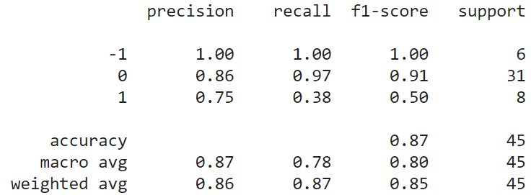
LR + 1.5 倍率指標 (210 f) 的混淆矩陣 (confusion matrix)
 |  | Predicted
 |  | -1 | 0 | 1
Actual | -1 | 6 | 0 | 0
 | 0 | 0 | 30 | 1
 | 1 | 0 | 5 | 3

Slide 5
Other Findings
(1) All | unemploy: ['forc', 'workweek', 'hire', 'age', 'popul', 'reason', 'jobless', 'save', 'underutil', 'interest', 'hour', 'sideway', 'summari', 'quit', 'group', 'delinqu', 'addendum', 'converg', 'work', 'fill']
(2) Up | unemploy: ['forc', 'african', 'hispan', 'workweek', 'american', 'hour', 'underutil', 'men', 'job', 'white', 'jobless', 'claim', 'worker', 'civilian', 'popul', 'monthli', 'lowest', 'payrol', 'war', 'ii']
(3) Down | unemploy: ['popul', 'african', 'age', 'civilian', 'workweek', 'forc', 'claim', 'hour', 'group', 'steadi', 'hispan', 'white', 'american', 'job', 'averag', 'insur', 'hurrican', 'payrol', 'employ', 'roughli']
(4) Unchanged | unemploy: ['forc', 'popul', 'age', 'workweek', 'hire', 'jobless', 'delinqu', 'work', 'addendum', 'save', 'lengthi', 'weekli', 'worker', 'job', 'reason', 'suspend', 'manifest', 'interest', 'payrol', 'durat']
[1] Words appear in all 4 categories: 'forc’, 'workweek’, 'popul’
[2] Words appear only in up & down: 'african', 'hispan', 'white’, 'american’, 'civilian'

