Slide 1
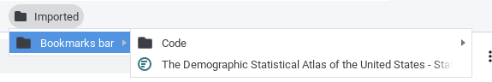
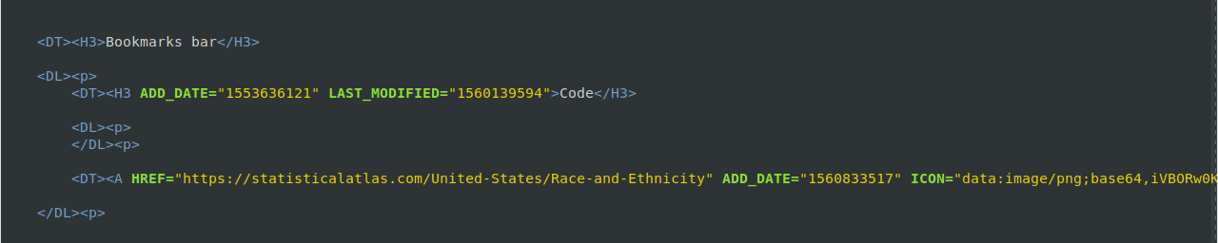


Slide 2
Bookmarks Merger
Input
Process
Output

