Slide 1
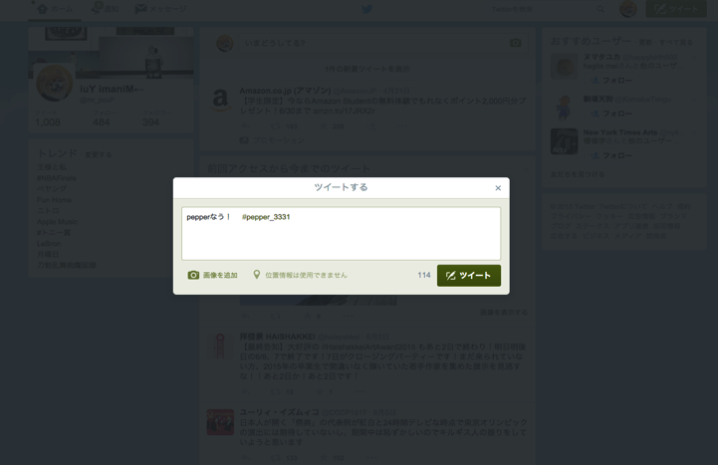
【Preparation for Workshop #3】
In Workshop #3, we will aim for complex conversation with Pepper.
Please bring in the distributed material:
ws3_textfile_forwindows or ws3_textfile_formac
ここのスペースは写真OK！
Please do tweet with the tag below.
#pepper_3331

Slide 2
Workshop #3 Choregraphe2.3
Atelier Akihabara

Slide 3
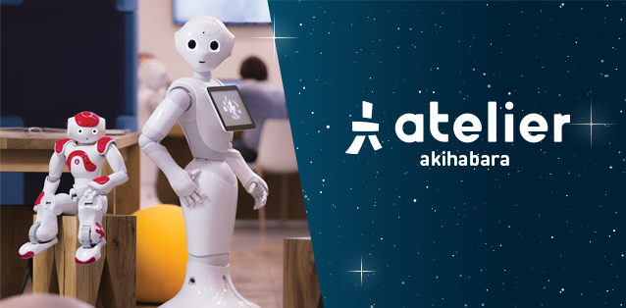

About the Atelier
Enhance the development with actual experiences and the community.
Atelier
Community
Mutual Promotion
Experience the development of Pepper apps.
Share the experience and know-hows.
2

Slide 4
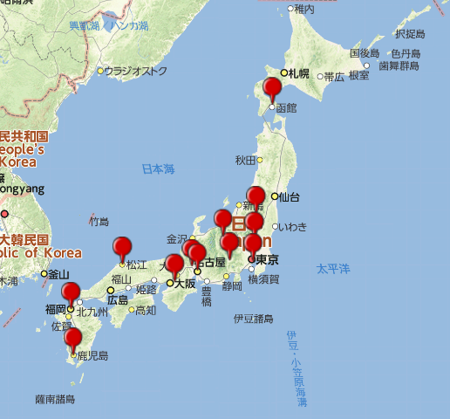
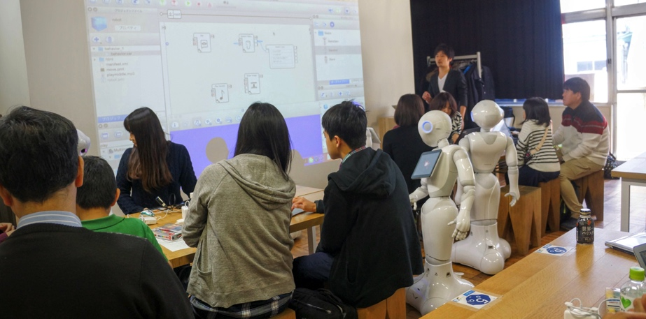
About the Atelier
Enhance the development with actual experiences and the community.
Atelier Satelites
Community
Mutual Promotion
Atelier Satelites established throughout Japan
Seminar by developers
2

Slide 5
Introduction
One minute per person
Your name
Affiliation (group or association you belong to)
Your enthusiasm
Notes:
みなさんのレベルを聞いてみる。TechFes参加者。開発経験。はじめて。

Slide 6
Today’s Lesson
1. The basics of Qichat
2. Internal Storage Event
3. Emotion recognition API
4. Extra

Slide 7
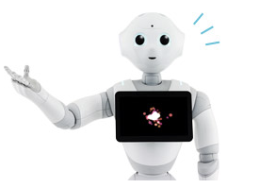
What is Qichat？
15

Slide 8
Characteristics of Qichat
①Various expressions from simple scripts
-Scripts specialized for communication with a human
-Other apps or movements used in Animated Say
You can create dialogue with Pepper just like writing a play script.
②Corresponds to human-like input -picks up hem and haw, rephrasing, changes in word order
You can make it sound like dialogue between actual humans, which was difficult with Speech Reco. Box (Keyword recognition).
16

Slide 9
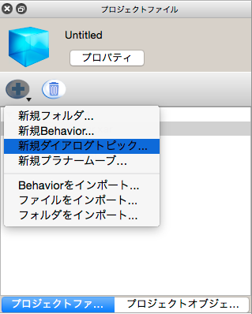
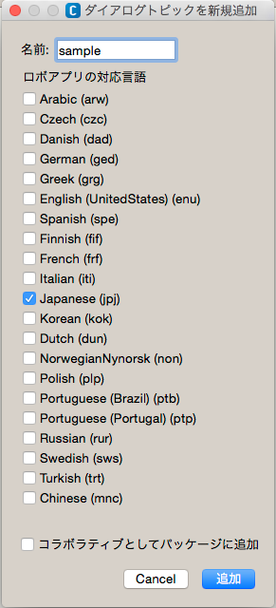
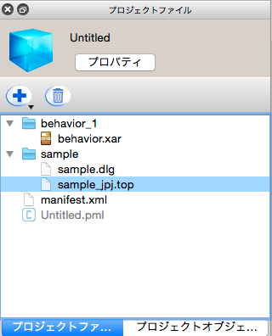
How to make a Dialogue topic①
①Select [New Dialogue topic]
②Decide the title, and put a check on [Japanese]
③Topic file is created
17

Slide 10
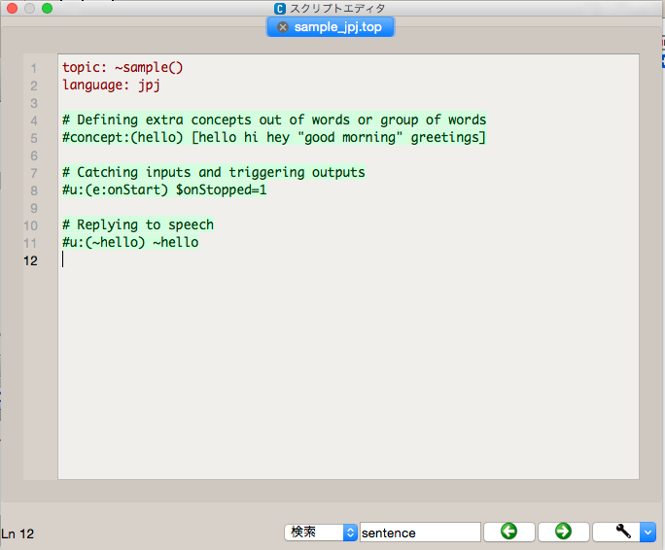
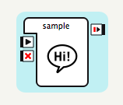
How to make a Dialogue topic ②
①Drag and drop *.dlg file from your topic folder. Then it turn into a box whitch you can use link it like other boxes.
②Edit the contents of dialogue by double-clicking *_jpj.top file.
18

Slide 11
Basics of Qichat
19

Slide 12
ーSentence 1ー The basic format
User rule
u:(I’m home) Welcome back.
How Pepper responds
What human said or did
20
Notes:
#コメントアウト ここからワークショップ
コピペして
・空の行が最後残っていると、再生されない
・逐次保存される
動いているか確かめるために、ダイアログウィンドウを出してください ％があれば問題無いです。
直接入れてみてください。100%になります。
60%に以上でないと、認識してくれません。

Slide 13
User rule
Input in Script Editor
Dialogue（that appears）
u:(I’m home.) Welcome back.
or
u:(I’m home)
Welcome back.
human：I’m home.
Pepper：Welcome back.
20
Notes:
#コメントアウト ここからワークショップ
コピペして
・空の行が最後残っていると、再生されない
・逐次保存される
動いているか確かめるために、ダイアログウィンドウを出してください ％があれば問題無いです。
直接入れてみてください。100%になります。
60%に以上でないと、認識してくれません。

Slide 14
ーSentence 2ー flow of the dialogue
User subrule
u: (about animals) Do you have a dog or a cat?
u1: (dog) Is it a big dog?
u2: (Yes) You would need a big space.
u2: (No) It must be cute.
u1:(cat) Do you live in the countryside?
u2:(Yes) Does it go outside on its own？
u3:(Yes) Does it hunt mice？
u2:(No) You must live in a big house.
u1:(No) Neither do I.
20
Notes:
逐次保存がうまくいかない時がある
どんどん移動してしまうが、移動してほしくない時がある もっかい同じ階層で繰り返して欲しい時
u:(何の話だっけ)犬か猫を買っていますか^stayInscope

Slide 15
User subrule
Script Editor
Dialogue
u:(about animals) Do you have a dog or a cat?
u1:(dog) Is it a big dog?
u2:(Yes) You would need a big space.
u2:(No) It must be cute.
u1:(cat) Do you live in the countryside?
u2:(Yes) Does it go outside on its own?
u3:(Yes) Does it hunt mice？
u2:(No) You must live in a big house.
u1:(No) Neither do I.
Human：about animals
Pepper：Do you have a dog or a cat?
human：Dog.
Pepper：Is it a big dog?
human：No.
Pepper：It must be cute.
21
Notes:
逐次保存がうまくいかない時がある
どんどん移動してしまうが、移動してほしくない時がある もっかい同じ階層で繰り返して欲しい時
u:(何の話だっけ)犬か猫を買っていますか^stayInscope

Slide 16
ーSentence 3ー A wild card for ambiguous expressions.
Choice
u:(My name is *)
Nice to meet you.
*→anything
Script Editor
ダイアログ
u:(My name is * ) Nice to meet you.
u:(I like *) Cool.
人間：My name is Tarou.
Pepper：Nice to meet you.
人間：I like music.
Pepper: Cool.
23
Notes:
u:(私の名前は_{*}です) $1さんよろしくお願いします

Slide 17
ーSentence 4ー concept of response
Concept
concept:(yes) [yes yeah right fine]
concept:(no) [No “Not at all” “Not good”]
u:(Hello) Hello, How are you?
u1:(~yes) Me too!
u1:(~no) Are you all right?
→Convenient for long sentences！
20
Notes:
Pepper側につかうこともできます
u1:(~yes) ~yes ボクも元気ですー！

Slide 18
Concept
Script Editor
Dialogue
concept:(yes) [Yes Yeah “That’s right” “I’m fine” Good “Not bad” “You’re right” Exactly Indeed]
concept:(no) [No “Not at all” “Not good”]
u:(Hello) Hello, how are you?
u1:(~yes) Me too!
u1:(~no) Are you all right？
Human：Hello.
Pepper：Hello, how are you?
Human：Not bad.
Pepper：Me too!
Human：Hello.
Pepper：Hello, how are you?
Human：Good.
Pepper：Me too!
Human：Hello.
Pepper：Hello, how are you?
Human：I’m fine.
Pepper：Me too!
26
Notes:
Pepper側につかうこともできます
u1:(~yes) ~yes ボクも元気ですー！

Slide 19
ーSentence 5ー “OR” for ambiguous response
Choice
u:([Hello “Good morning” “Good evening”])
[Hello “Good morning” “Good evening”]
Let’s make it a good day!
→[] and a space gets the same result as “OR”
20
Notes:
ユーザーの方もPepperの方も両方使える
どっちも聞いてくれる
基本的には交互、順番に返答してくれる
ランダムにしたいときは^rand
自分の返事に合わせてもらう
変数引っ張ってくる
(_[こんにちは おはよう] $1 今日もがんばろう

Slide 20
ーSentence 5ー “OR” for ambiguous response
Choice
Script Editor
Dialogue
u:([Hello Good morning Good evening]) [Hello “Good morning” “Good evening”] Let’s make it a good day!
Human：Hello.
Pepper：Hello. Let’s make it a good day!
Human：Good morning.
Pepper：Good morning. Let’s make it a good day!
Human：Good evening.
Pepper：Good evening. Let’s make it a good day!
→a space has the same meaning as “OR”
23
Notes:
ユーザーの方もPepperの方も両方使える
どっちも聞いてくれる
基本的には交互、順番に返答してくれる
ランダムにしたいときは^rand
自分の返事に合わせてもらう
変数引っ張ってくる
(_[こんにちは おはよう] $1 今日もがんばろう

Slide 21
ーSentence 6ー Using variables
input_storing
u:(_[Hello “Good morning” “Good evening”])
$1 Let’s make it a good day!
→Input after “_” becomes variables that can be recalled by $1.
20
Notes:
ユーザーの方もPepperの方も両方使える
どっちも聞いてくれる
基本的には交互、順番に返答してくれる
ランダムにしたいときは^rand
自分の返事に合わせてもらう
変数引っ張ってくる
(_[こんにちは おはよう] $1 今日もがんばろう

Slide 22
ーSentence 6ー Using variables
input_storing
Script Editor
Dialogue
u:(_[Hello Good morning Good evening])
$1 Let’s make it a good day!
Human：Hello.
Pepper：Hello. Let’s make it a good day!
Human：Good morning.
Pepper：Good morning. Let’s make it a good day!
Human：Good evening.
Pepper：Good evening. Let’s make it a good day!
23
Notes:
ユーザーの方もPepperの方も両方使える
どっちも聞いてくれる
基本的には交互、順番に返答してくれる
ランダムにしたいときは^rand
自分の返事に合わせてもらう
変数引っ張ってくる
(_[こんにちは おはよう] $1 今日もがんばろう

Slide 23
ーSentence 7ー Input as variables
Variable
u:(I want _[Chocolate Cheese]) OK. $askedFood=$1
u:(What did I request?) $askedFood
You can enter anything for $1.
Notes:
Uのいち業でしか保持できない
新しく英数字で保持する必要がある
このばあいはaskedfoodの中に入れてます。
(注文キャンセルで) ^clear(askdfood)
Typeが数のoutputという名前の出力を追加
$出力数
u:(回って)わかった $output = 1

Slide 24
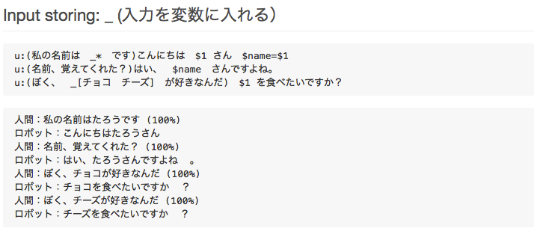
Variable
u:(I want_[Chocolate Cheese]) OK. $askedFood=$1
u:(What did I request？) $askedFood
u:(I want to cancel the request)OK. ^clear(askedFood)
Human：I want chocolate.
Pepper：OK.
Human：What did I request?
Pepper：Chocolate.
Human：I want cheese.
Pepper：OK.
Human：What did I request?
Pepper：Cheese.
27
Notes:
Uのいち業でしか保持できない
新しく英数字で保持する必要がある
このばあいはaskedfoodの中に入れてます。
(注文キャンセルで) ^clear(askdfood)
Typeが数のoutputという名前の出力を追加
$出力数
u:(回って)わかった $output = 1

Slide 25
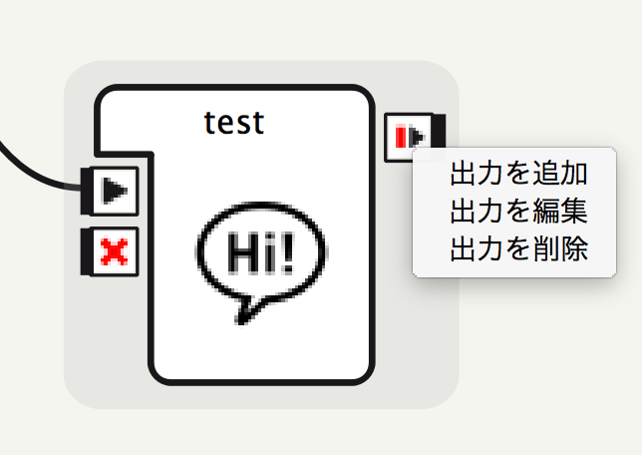
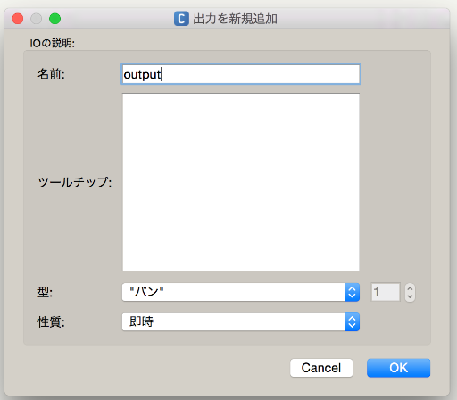
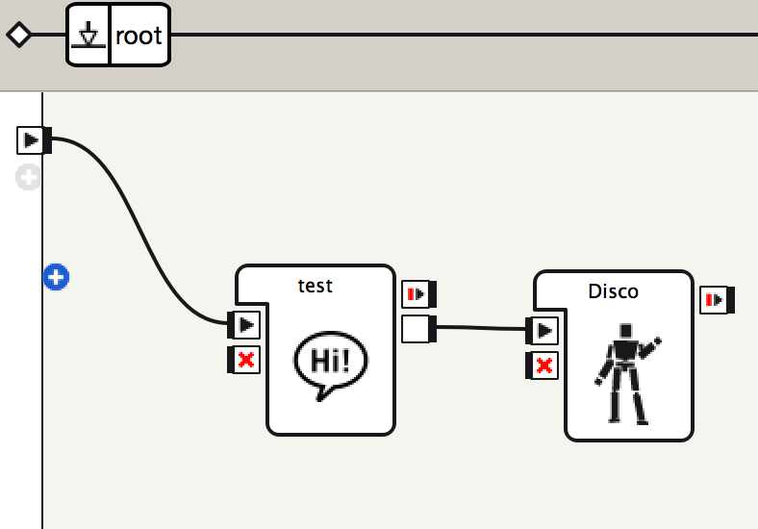
ーSentence 8ー Interlocking with other boxes
u:(Dance) OK. $output = 1
You can increase the number of outputs from the dialogue box.
Notes:
Uのいち業でしか保持できない
新しく英数字で保持する必要がある
このばあいはaskedfoodの中に入れてます。
(注文キャンセルで) ^clear(askdfood)
Typeが数のoutputという名前の出力を追加
$出力数
u:(回って)わかった $output = 1

Slide 26
Robot events
27

Slide 27
ーSentence 1ー Basic format
User rule
u:(I’m home)Hello.
How Pepper responds
What human said or did
20
Notes:
#コメントアウト ここからワークショップ
コピペして
・空の行が最後残っていると、再生されない
・逐次保存される
動いているか確かめるために、ダイアログウィンドウを出してください ％があれば問題無いです。
直接入れてみてください。100%になります。
60%に以上でないと、認識してくれません。

Slide 28
ーSentence 9-13ー What is internal storage events?
You can easily start up the events with primarily installed programmes.
u:(e:RightBumperPressed) The right bumper was pressed.
→pronounced when the right bumper is pressed.
u:(e:onStart）Starting dialogue
→pronounced when onStart of the BOX receives a signal.
u:(e:Dialog/NotUnderstood)I did not get it.
→pronounced when Pepper did not understand.
Notes:
Syntax見せる
U(e:LeftBumperPressed)痛いよ
U:(e:Dialog/NotUnderstood)ごめん聞き取れなかった
プラスボタンを押すとたくさんあるイベント見れる
例えばbuttely
Enterでロボッtビューの数字

Slide 29
ーSentence 7-9ー Various kinds of internal storage events
A list of internal storage events
Search by “Nao Event index”
http://doc.aldebaran.com/1-14/naoqi-eventindex.html
20

Slide 30
Reference
What we introduced you here is only a small fraction of how to write the script for QiChat.
For other scripts and detailed explanation, please refer to the online document.
http://doc.aldebaran.com/2-1/naoqi/audio/dialog/dialog-syntax_full.html
You can also check the document for Choregraphe2.3 from [Help]→[Choregraphe]
30

Slide 31
Let’s use Emotion Recognition API
31

Slide 32
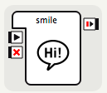
Creating a smile-recognition app.
①Make a new dialogue box
（Title it “smile” just for the convenience.)
②Write the script below in the topic file of the dialogue.
concept:(yes) [Yes Please Right “Let’s do it” Good]
concept:(no) [No “No thank you” “Next time”]
u: (e:onStart) Hello. Let’s do a “smile check.”
u1: (~yes)
^start(animations/Stand/Emotions/Positive/Happy_4)
OK
^wait(animations/Stand/Emotions/Positive/Happy_4)
\vct=110\ Look at me, and \pau=1000\ \vct=170\ Smile! \vct=110\
$checksmile=1
u1: (~no) All right. Tell me if you need anything.
32

Slide 33
Reference： Adjustment by tags
High-level control is possible by writing “\tag\“ in the script.
Parameter | Meaning | Tag
Voice Shaping | Parameter that decides the pitch of the voice | \vct=（number 50〜200）\
Speed | Parameter that decides the speed of the voice | \rspd=（number 50〜400）\
Pause | Inserts a pause of any length (by millisecond) | \pau=（number）\
Reset | Resets all parameter to the initial setting | \rst\
＜Tip＞
Voice shaping135%（\vct=135\）、Speed110%（\rspd=110\）is recommended.
29

Slide 34
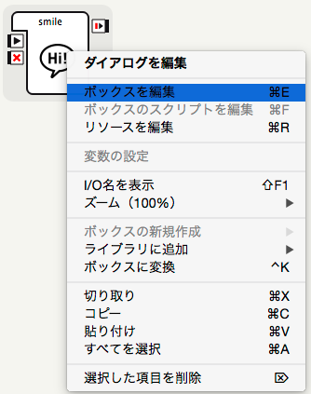
Creating a smile-recognition app.②
③Right-click the box and select [Edit Box]
33

Slide 35
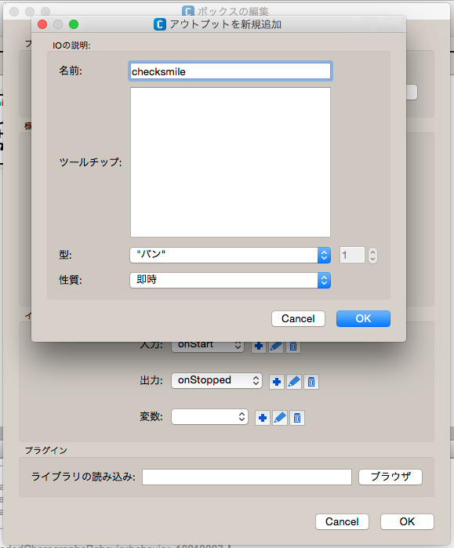
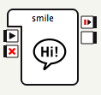
Creating a smile-recognition app. ③
④[A]Click[+] for Output, [B]enter ”checksmile“ for its title, and select [OK]
B
⑤New output “checksmile” is added to the smile box.
A
34

Slide 36
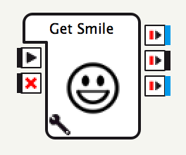
Creating a smile-recognition app.④
Get Smile Box
Output if the smile exceeds the threshold value (Value by three levels)
little smile
middle smile
big smile
Output if the smile falls below the threshold value
Error output (three cases)
No face detected
Multiple faces detected
Timeout
35
Parameter button
Confidence Threshold（Threshold value of smile）
Timeout

Slide 37
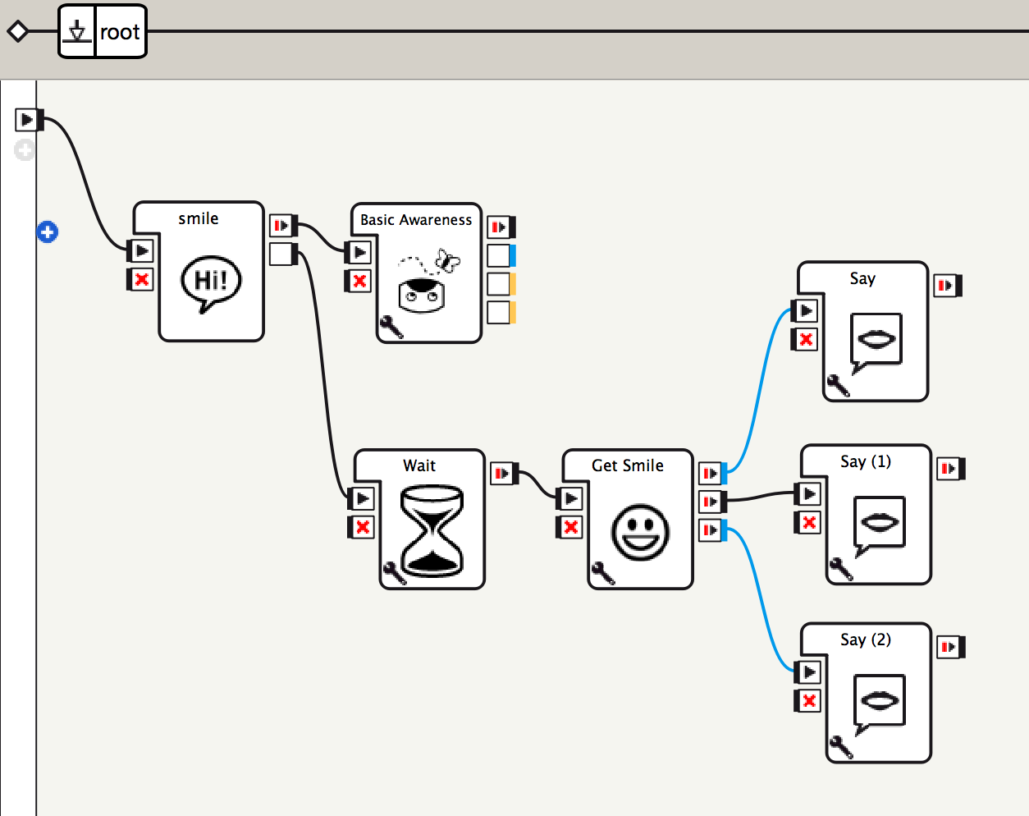
Creating a smile-recognition app. ⑤
⑥Place the boxes as shown left.
⑦ Change the time out of [Wait] box and the text of [Say] box.
36

Slide 38
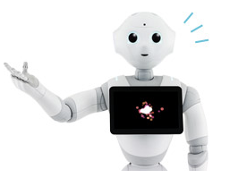
And a bit more…

Slide 39
Information for development
Pepper Developer Portal
Search by “Pepper developer”
https://developer.softbankrobotics.com/jp-ja
A portal website that has gathered information for Pepper developer.
・Document on techniques
・Showcase that shares examples
・Downloads of Pepper SDK for Android Studio
・The latest news

Slide 40
Information for development
Pepper Atelier Akihabara with SoftBank
Search by “Atelier Akihabara Blog”
・Useful posts about Pepper development
・Introducing upcoming events and event reports.
・Get convenient tools for development from [tips].

Slide 41
Information for development
Atelier Akihabara FB Group
Search by “Atelier Akihabara FB”
・A Facebook group of Atelier Akihabara
・You can share information and ask questions.

Slide 42
Information for development
Qiita
Search by “Qiita pepper”
・Information exchanging website for engineers
・Search by Pepper tag for various kinds of technical information about Pepper

Slide 43
Thank you for you attention！
This will be the end of Workshop #3
We will be happy to see you in Workshop #4

