Slide 1
EcoTrack Website

Slide 2
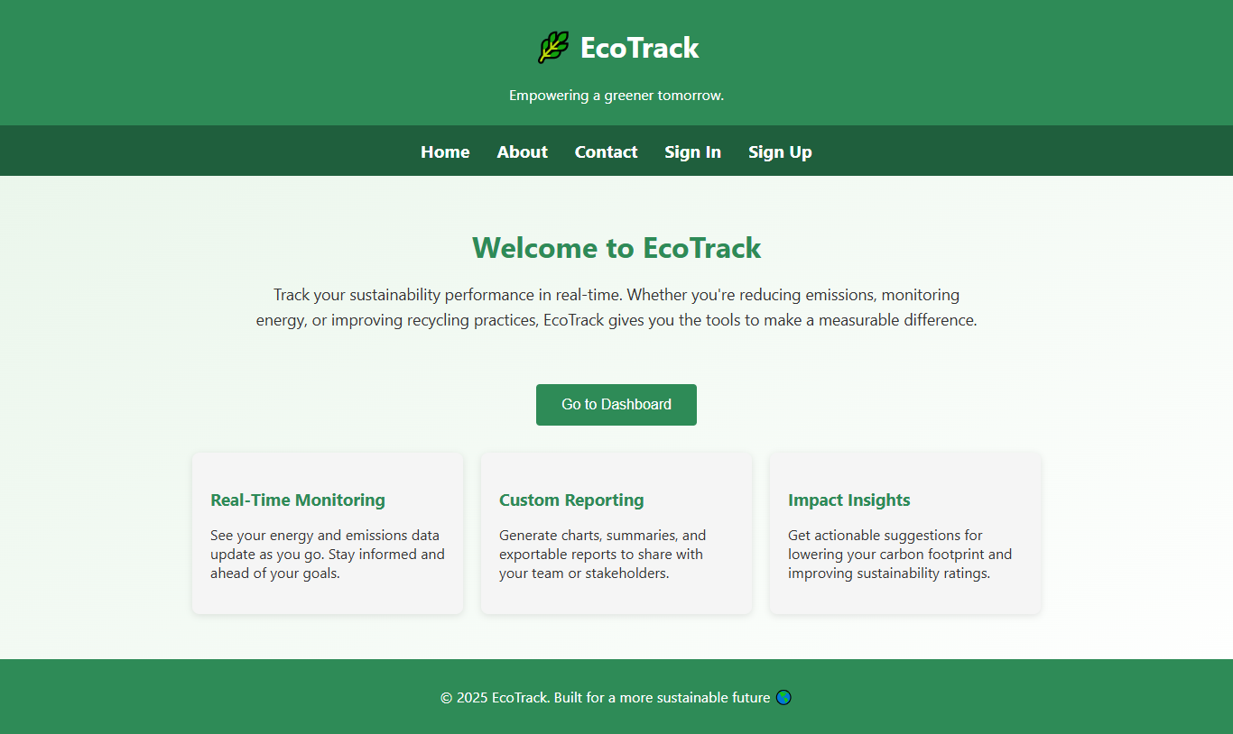
Introduction
EcoTrack sustainability and tracking platform.
Targets the individuals and SMEs.
Tracks the energy, CO₂ emissions, recycling.
Easy to use, accessible design (Gao et al., 2021).
Local installable ZIP package.
Secure and modular system.
Homepage (Author work)
Notes:
Ecotrack is designed to empower the individuals and small businesses to monitor its environmental impact. This fills the difference where complex systems are often out of the access. The ecotrack allows users to track the use of the electrical use, CO, emissions and recycling in a simple, user friendly way. The system comes as the zip package for easy installation. This combines with strong safety and ease of use with modularity, so it can grow with the future needs. The presentation examines the design, features and capacity of the ecotrack.

Slide 3
Aim & Objective
Aim: Promote the environmental awareness.
Aim: Make sustainability tracking accessible.
Objective: Make daily impact tracking.
Objective: Provide the secure, simple user tools.
Objective: Support eco-friendly habit building.
Objective: Prepare for future data insights.
Notes:
The purpose of the ecotrack is to promote environmental awareness and to make stability tracking accessible for all, from individuals to small businesses. The platform empowers users to monitor their energy use, carbon emissions and recycling the rates without the need for technical expertise. This purpose is to provide safe, easy -to -use equipment that encourage daily tracking of the environmental impact and help users to build environmentally friendly habits. The modular design of Ecotrack prepares for the future promotion like visual data insights and exportable reports. The ecotrac bridges the gap between technology and stability for all users.

Slide 4
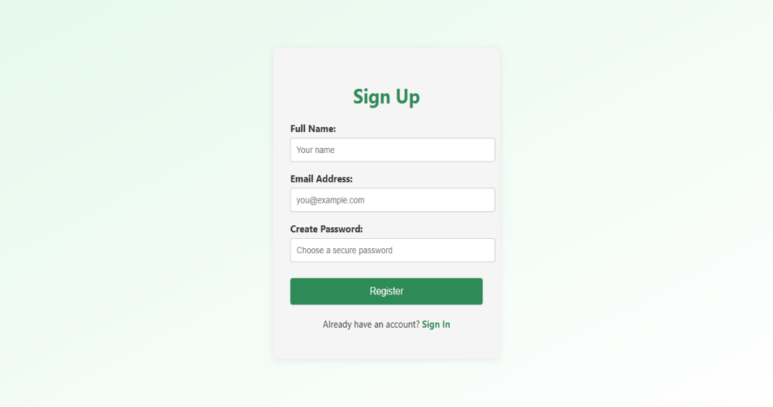
Methodology
User-centered design.
Identify the key user needs.
Plan the secure sign-up and dashboard flows.
Use modular, scalable structure.
Manual testing during
development (Dobles et al., 2019).
Clear documentation and guides.
Sign Up (Author work)
Notes:
The ecotrack was developed using the user-centric method. The team first identified the most important user needs, especially for simple sign-up, safe login and a spontaneous dashboard. The planning emphasized modular design, so the future expansion is easy. By Manual tests ensured forms, database connections, and error handling acted as an intention. Apparent documentation was created to install the users and help using platforms without the need for advanced technical skills.

Slide 5
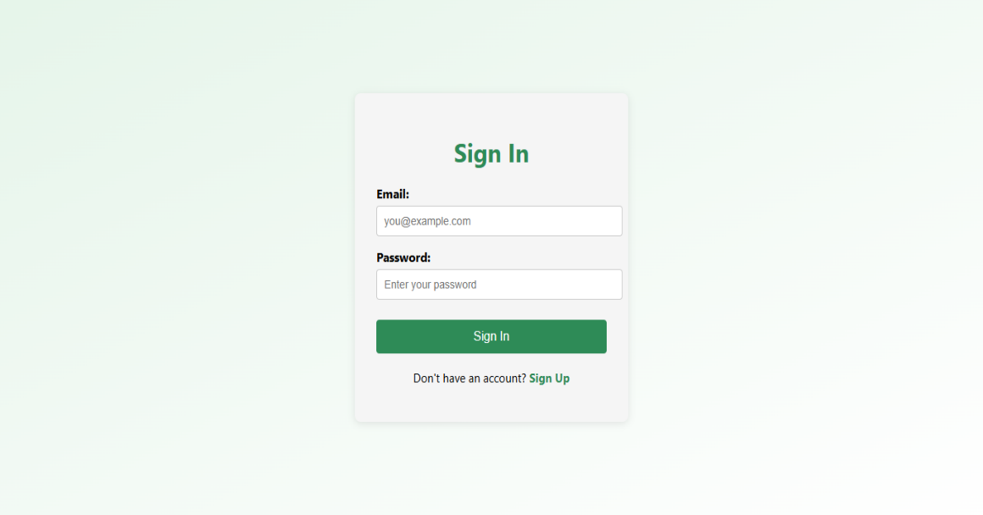
Planning & Design
Security-first approach (password safety).
Modular the backend for future growth.
Visual theme with green/off-white colors.
Simple, modern UI without frameworks.
Responsive, clean layouts.
Accessibility-friendly design.
Sign In (Author work)
Notes:
The planning phase preferred safety and scalability. Passwords are preserved, and the backend structure supports future features. The visual design uses the environmental theme with green and off-white tone, which aims to simplicity and clarity. Instead of relying on the framework, the fronts uses plain HTML, CSS and JavaScript, which make light pages. Access and responsible layouts were considered from the beginning, making equipment usable in the equipment.

Slide 6
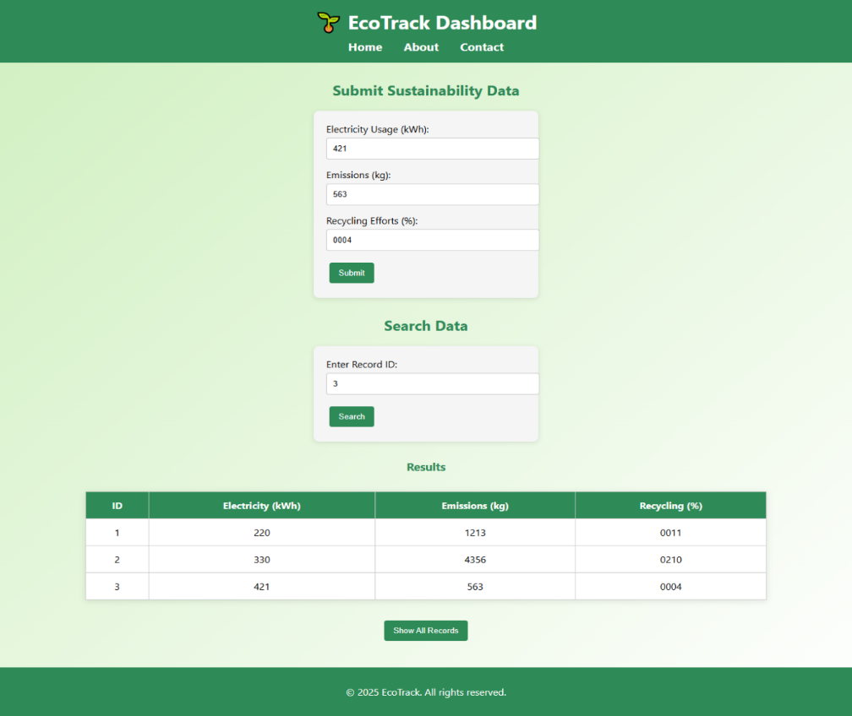
Development
Node.js and Express backend
(Dalbard et al., 2021).
API for routes.
MongoDB and Mongoose for data.
Modular files: models, routes, configs.
Plain HTML/CSS/JS frontend.
Fetch API for frontend-backend link.
Dashboard (Author work)
Notes:
The development of the ecotrack used node.Js and express to make a restful backand API. Mongodb, combined with the Mongoose, handles the user data and stability records. The code is conducted in module models, routes and configuration files for the maintenance. Using the Fetch requests to communicate with the backend, the fronts are kept minimal with plain HTML, CSS and JavaScript. This approach keeps the app lighter, easy to debug and ready for the future extensions.

Slide 7
Testing & Documentation
Manual form the validation tests (Jia et al., 2019).
Connection tests to the MongoDB.
Error handling tested for bad inputs.
Feedback for invalid or duplicate data.
Clear code comments and guides.
Simple installation.
Notes:
The tests were focused on the manual checks to make correctly valid input and database connections were stable. Error cases like the duplicate accounts or invalid login were tested to give useful response. The code includes comments explaining the purpose of the each module. Documentation was written for an easy setup, which was supported by the mission of ecotrack, without the need for Github knowledge. Users can install and configure the app after simple guide.

Slide 8
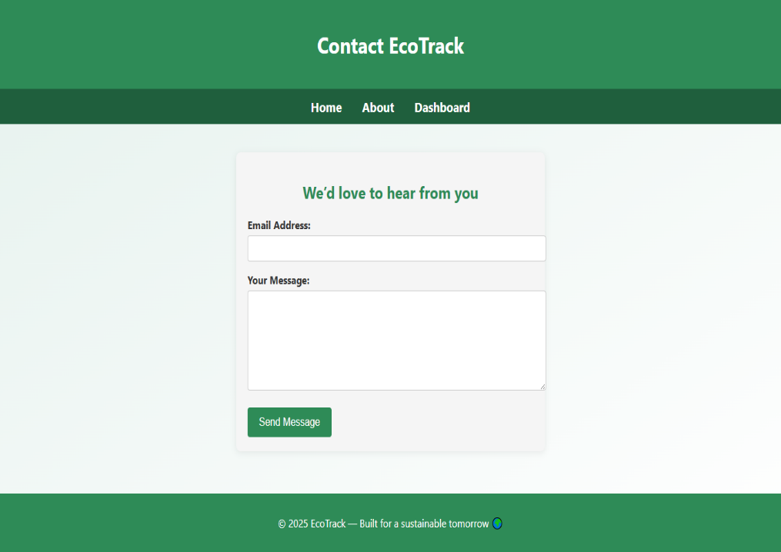
Tools & Technologies
Node.js for the server logic.
Express.js for the routing.
MongoDB NoSQL database.
Mongoose for DB modeling.
HTML5 + CSS3 + JavaScript.
API for Fetching Data.
Contact Page (Author work)
Notes:
Ecotrack uses the modern but minimum technique stack. Node.JS gives power to the server, for express.js handles routing and middleware. Mongodb the flexible Nosql database, stores user and stability data, making Mongos modeling easier. Frontends depend on HTML5, CSS3, and Javascript without framework, keeping it lighter. Bcryptjs add strong password to secure user credentials. These devices were selected for scalability, performance and simplicity.

Slide 9
Core Features
User registration with the validation.
Secure login with the passwords (Bhana et al., 2022).
Personalized dashboard.
Track electricity, CO₂, recycling.
Responsive, accessible UI.
Simple forms for data submission.
Notes:
The main features of the Ecotrack focus on user experience and environmental tracking. Users can register accounts with both frontend and backend verification. The login has access is safe with the password. Once logged in, the users reach the dashboard that displays their stability data, including electrical use, carbon emissions and recycling rates. UI is clean, responsible and easy to navigate, for data submission is done through simple forms.

Slide 10
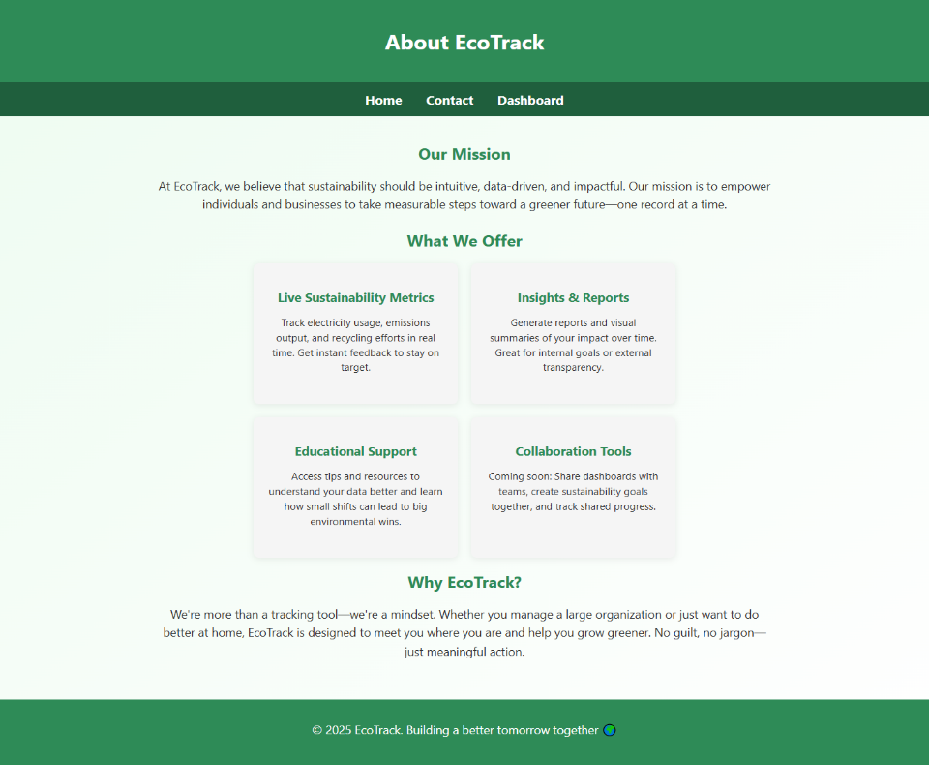
Pages Overview
Home page: intro the CTAs.
About page: mission & vision.
Contact page: static form.
Sign up / Sign in the pages.
Dashboard: sustainability the data.
Future-ready for charts, exports.
About Page (Author work)
Notes:
There are six main pages of ecotrac. The homepage introduces ecotrac and encourages users to sign up. The Shares the mission and vision about the page. The contact page includes a form, although it is not for associated with email. Sign up and sign in pages. Handle the user authentication. The dashboard presented stability data with plans for future facilities like charts and data exports. The design aims is clarity and ease of use.

Slide 11
Scalability & Modularity
Modular the backend files.
Easy to add the features.
Easy to track the emission.
Potential for session-based auth.
Cross-platform compatibility (Segun-Falade et al., 2024).
Low memory usage.
Notes:
Ecotrac's architecture was designed for the scalability and modularity. This becomes easier to add new features to the composition of the backend, such as data visualization system like sessions or tokens-based authentication. This is compatible in platforms and is designed to use minimal memory, which also helps it to run efficiently on small servers. These properties make the ecotrack a flexible, future-proof equipment.

Slide 12
Conclusion & Next Steps
Strong foundation for the sustainability tracking.
Accessible for the non-technical users.
Secure, scalable backend.
Ready for the charts, export features.
Future work: session auth, email integration.
Potential for large-scale adoption.
Notes:
Ecotrack provides the strong foundation for stability tracking with focus on accessibility, safety and scalability. This is designed for users who may not have technical expertise, for still providing a strong backend. The platform is ready to expand with features like data, data export and email integration. This will make it even more secure by adding session-based certification. With these enhancements, ecotrac can become a powerful tool for the mass environmental impact tracking.

Slide 13
References
Gao, C. H., Yu, G., & Cai, P. (2021). ggVennDiagram: an intuitive, easy-to-use, and highly customizable R package to generate Venn diagram. Frontiers in genetics, 12, 706907.
Dobles, I., Martínez, A., & Quesada-López, C. (2019, June). Comparing the effort and effectiveness of automated and manual tests. In 2019 14th Iberian Conference on Information Systems and Technologies (CISTI) (pp. 1-6). IEEE.
Dalbard, A., & Isacson, J. (2021). Comparative study on performance between ASP. NET and Node. js Express for web-based calculation tools.
Jia, Z., Li, S., Yu, T., Liao, X., Wang, J., Liu, X., & Liu, Y. (2019, November). Detecting error-handling bugs without error specification input. In 2019 34th IEEE/ACM International Conference on Automated Software Engineering (ASE) (pp. 213-225). IEEE.
Bhana, B., & Flowerday, S. V. (2022). Usability of the login authentication process: passphrases and passwords. Information & Computer Security, 30(2), 280-305.
Segun-Falade, O. D., Osundare, O. S., Kedi, W. E., Okeleke, P. A., Ijomah, T. I., & Abdul-Azeez, O. Y. (2024). Developing cross-platform software applications to enhance compatibility across devices and systems. Computer Science & IT Research Journal, 5(8), 2040-2061.

