Slide 1


Data Governance @ SneakerPark
Prepared by:
Submitted on:

Slide 2
Background
SneakerPark is an online shoe reseller that allows people to buy and sell used and new shoes. Buyers can bid for shoes or buy them outright, and sellers can set a price or sell to the highest bidder.
Each buyer and seller must have an active account in order to sell, bid, or purchase sneakers using SneakerPark’s website.
SneakerPark authenticates the shoes before shipping them to the buyer, so before listing an item, the seller must ship it to SneakerPark’s warehouse. Upon receipt, SneakerPark assigns an item number to each pair of sneakers and notifies the seller that they are now free to list their item. If the item is not listed within 45 days, SneakerPark returns it to the seller and sends an invoice to the seller for the shipping cost.
If the item is found to be inauthentic or in an unacceptable condition, it is also returned back to the seller in a similar fashion.
When the item sells, the buyer’s account is credited with the purchase price minus the SneakerPark service fee and shipping fees to deliver the item to the buyer.
Currently, SneakerPark only supports sales within the United States.

Slide 3
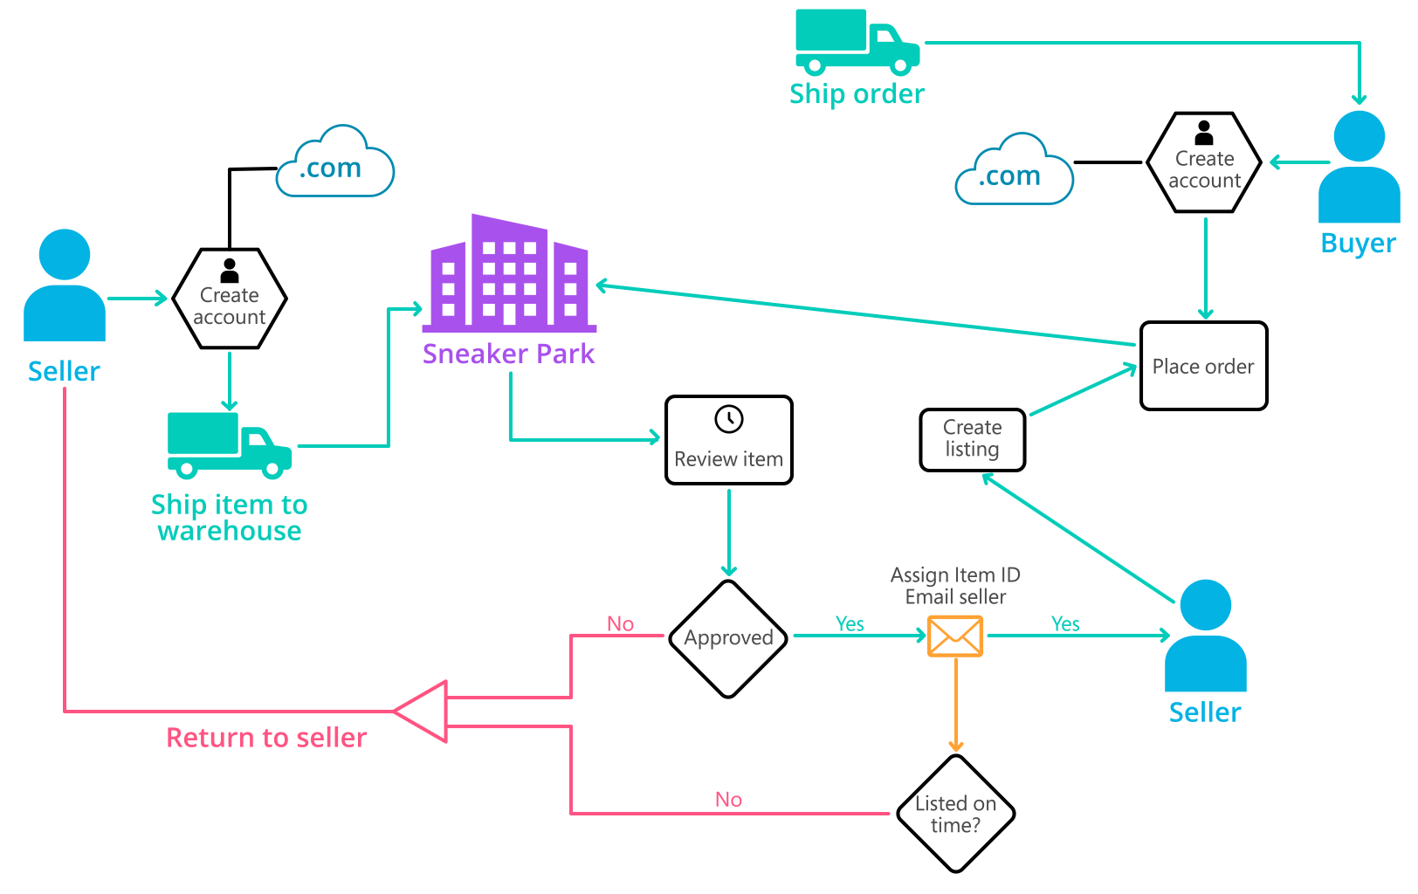
Background (cont’d)
Below you can see a diagram that will hopefully help you visualize some of SneakerPark's business processes. Keep in mind that it does not capture ALL processes and every nuance, but simply serves as another artifact to use in your project.

Slide 4
Step 1
Enterprise Data Catalog Part 1: Enterprise Data Model

Slide 5
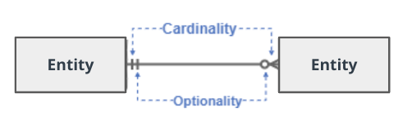
Create a conceptual data model that will provide SneakerPark with a holistic view of its data systems and help you grasp the organization's important entities and relationships, which will be instrumental as you move further in the project. You can use Lucidchart or any other diagramming tool of your choice, but please use the Crow’s Foot/IE Notation and please be sure to indicate both cardinality (the type of a relationship such as 1:N or N:N) and optionality (whether the relationship is optional or mandatory).

Slide 6
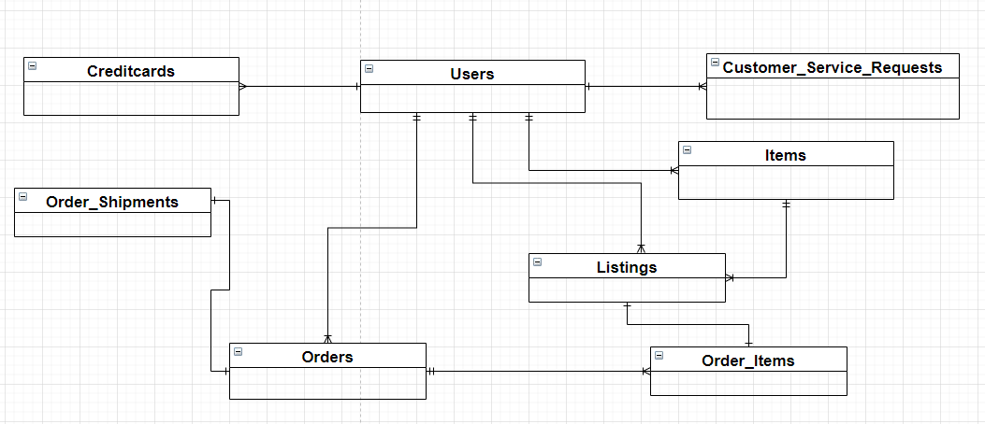
Enterprise Data Model

Slide 7
Step 2
Enterprise Data Catalog Part 2: Metadata

Slide 8
Create the first version of the Metadata Catalog by documenting the metadata from all systems in the "Data Dictionary" and the “Enterprise Data Catalog” tabs of the provided Sheets template.
Please note that you are required to fill out all fields in both tabs.
Look at the excel file called sneakerpark-templates.xlsx

Slide 9
Step 3
Data Quality
Part 1: Profiling and Cleansing

Slide 10
Profile the data to identify at least 3 data quality issues you see in the data. Also provide at least 1 data quality issue that you haven’t yet seen in the data, but can foresee occurring in the future. Based on the issues you’ve identified, come up with the data quality rule for each data quality issue, including for the one that you foresee.
Make sure you fill out all columns in the "Data Quality Issues" tab with your answers in the provided Sheets template.

Slide 11
Step 4
Data Quality
Part 2: Monitoring

Slide 12
Using the metrics you've created in the last step, please create a mock-up of a data quality monitoring dashboard that will be used to monitor the data to ensure compliance with your data quality rules.

Slide 13
Using the metrics you've created in the last step, please create a mock-up of a data quality monitoring dashboard that will be used to monitor the data to ensure compliance with your data quality rules.

Slide 14
Step 5
Master Data Management
Part 1: MDM Architecture

Slide 15
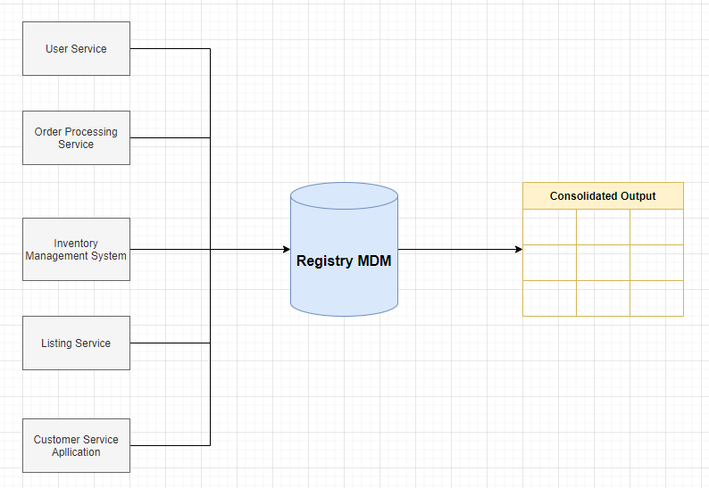
REGISTRY MDM - Diagram

Slide 16
REGISTRY MDM – Table

Slide 17
Explanation: I chose Registry as MDM architecture because it is the first time that the company decide to invest in an Enterprise Data Management Program and Registry MDM is the most suitable architecture if a company never had a MDM Architectur. In addiction, it is easy to implement in the future

Slide 18
Step 6
Master Data Management
Part 2: Master Record

Slide 19
In this step, you will define a set of matching rules that will be used by the SneakerPark's MDM Hub to match item and customer entities between the company's different systems.
Please come up with 4 rules - 2 for Items and 2 for Customers and list them below.
1 – Item: same ItemName and sellerID . Match the ItemID records on the Item Name from Item and the SellerID from Listings.
2 – Item: same BrandName, ArrivalDate and SellerID. Match the ItemID records on the Brand Name and Arrival Date from Item and Seller ID from Listings.
3 – Customer: same LastName, CreditCardNumber and CreditCardExpirationDate. Match the UserID records on the LastName of Users and the Credit Card Number and Credit Card ExpirationDate from Credit cards.
4 – Customer: Same Email and OrderID. Match the UserID records on the Email from Users and OrderID from Customer Service Requests

Slide 20
Step 7
Data Governance:
Roles and Responsibilities

Slide 21
Write 1-2 paragraphs discussing what data governance roles and responsibilities will be necessary to oversee this new Data Management initiative.
I think it is very important to take care about the process of Data Quality by performing data profiling, identifing the issues, computing the data quality scores and data quality thresholds.
It is also important to create a Metadata Management that have an Enterprise Data Model and an Enterprise Data Catalog.
Instead for the MDM is a good idea to focus on remediating the actual Enterprise Data Warehouse in order to improve the data quality and have a centralize business information across the company for analytics and decision making.
For now, it is not necessary to hire new employees because the MDM architecture can be managed by me and the actual employees. A good idea could be to reskilling Jake and Jessica.

