Slide 1
入口網站權限管控 以 出院準備與長照2.0 為例
施岳勳

Slide 2
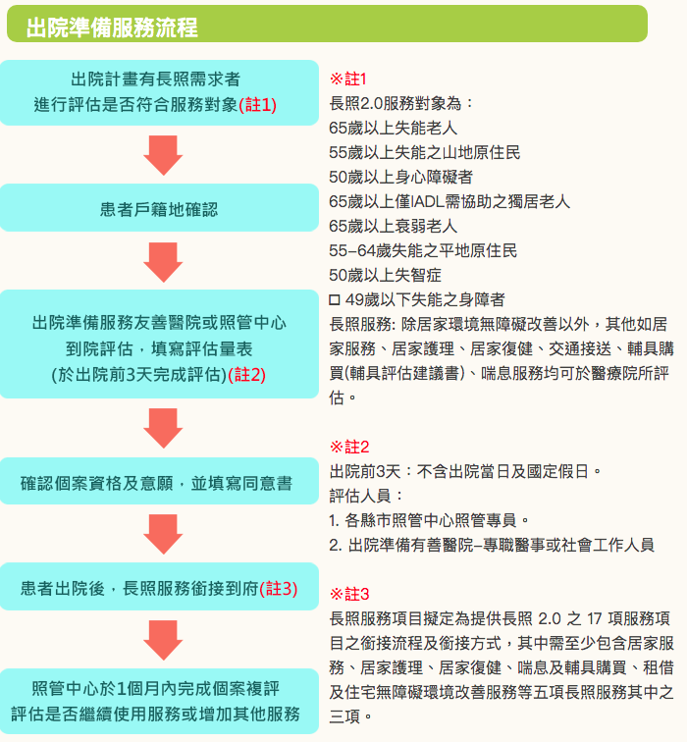
Ref:https://www.ilong-termcare.com/Home/discharge

Slide 3
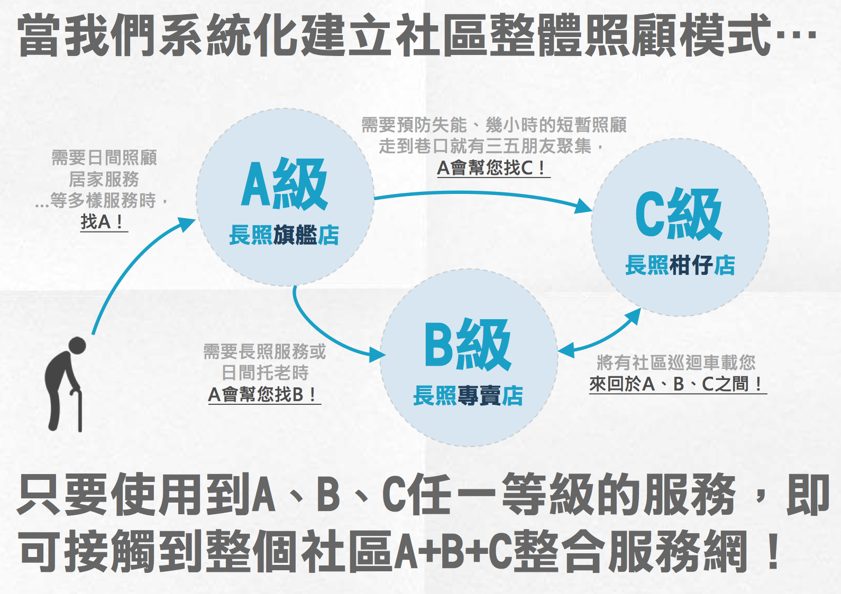
Ref: (0829更新)衛生福利部_長照2.0懶人包【PDF版】.pdf

Slide 4
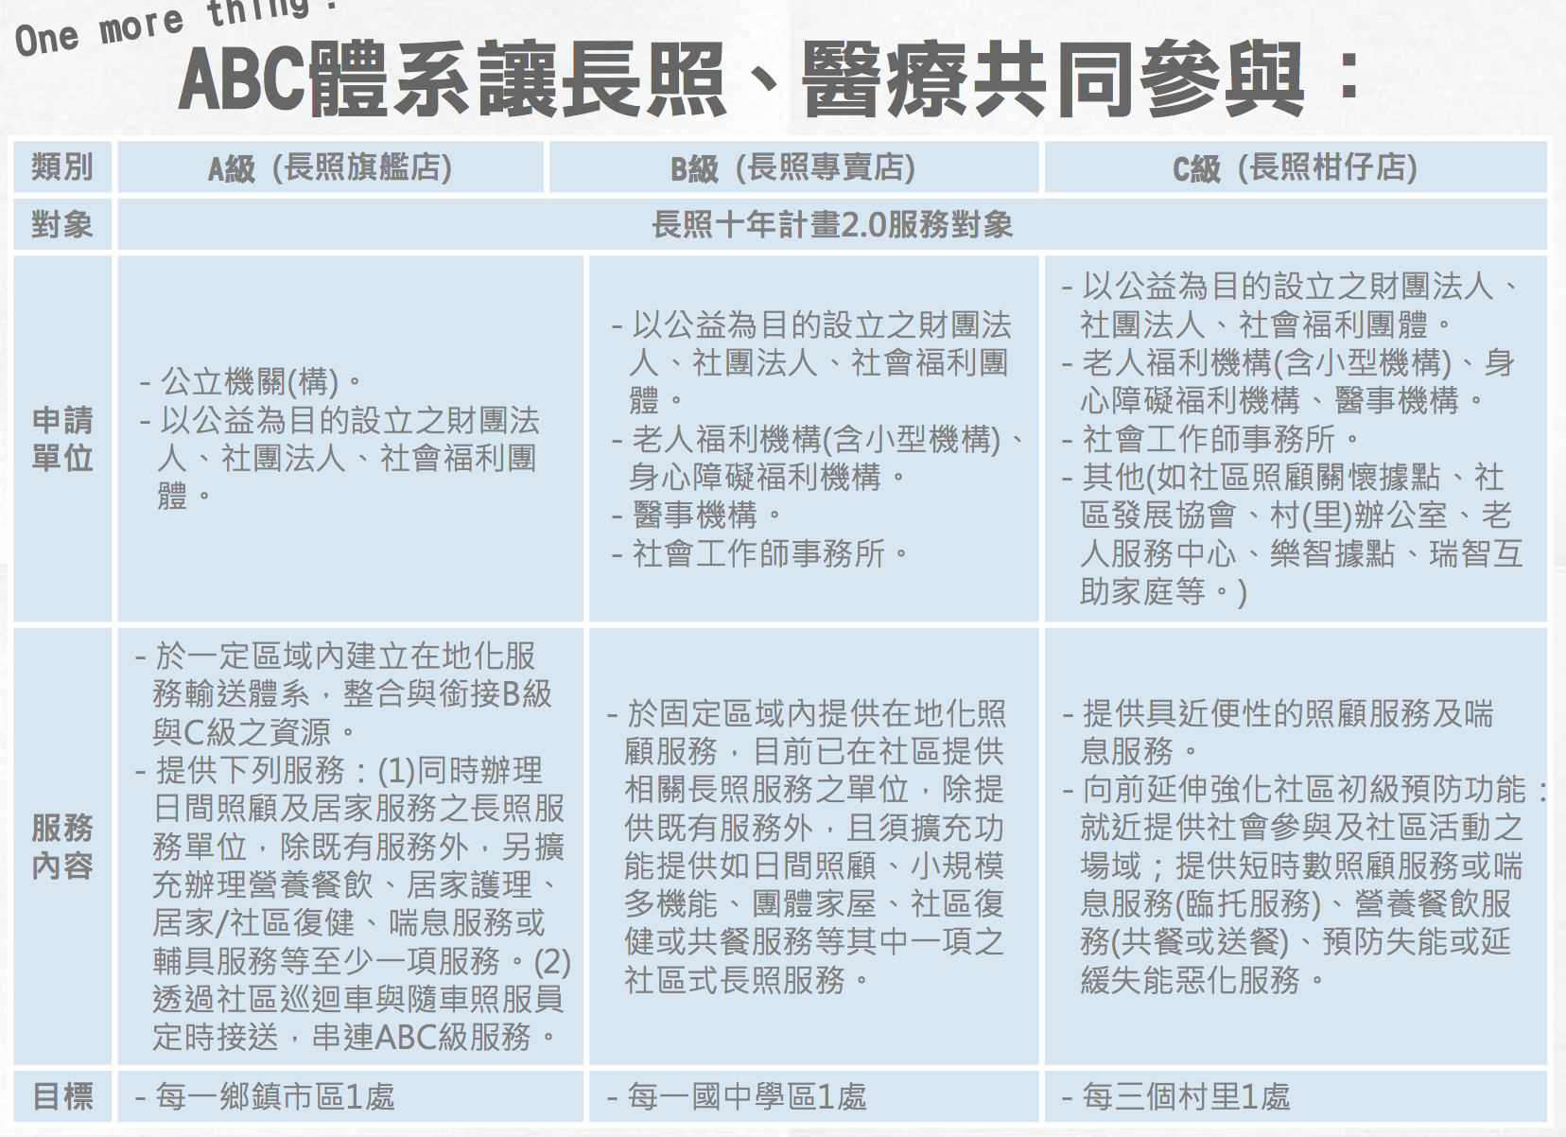
Notes:
舉例 秀林鄉衛生所 反應 看不到醫師資料

Slide 5
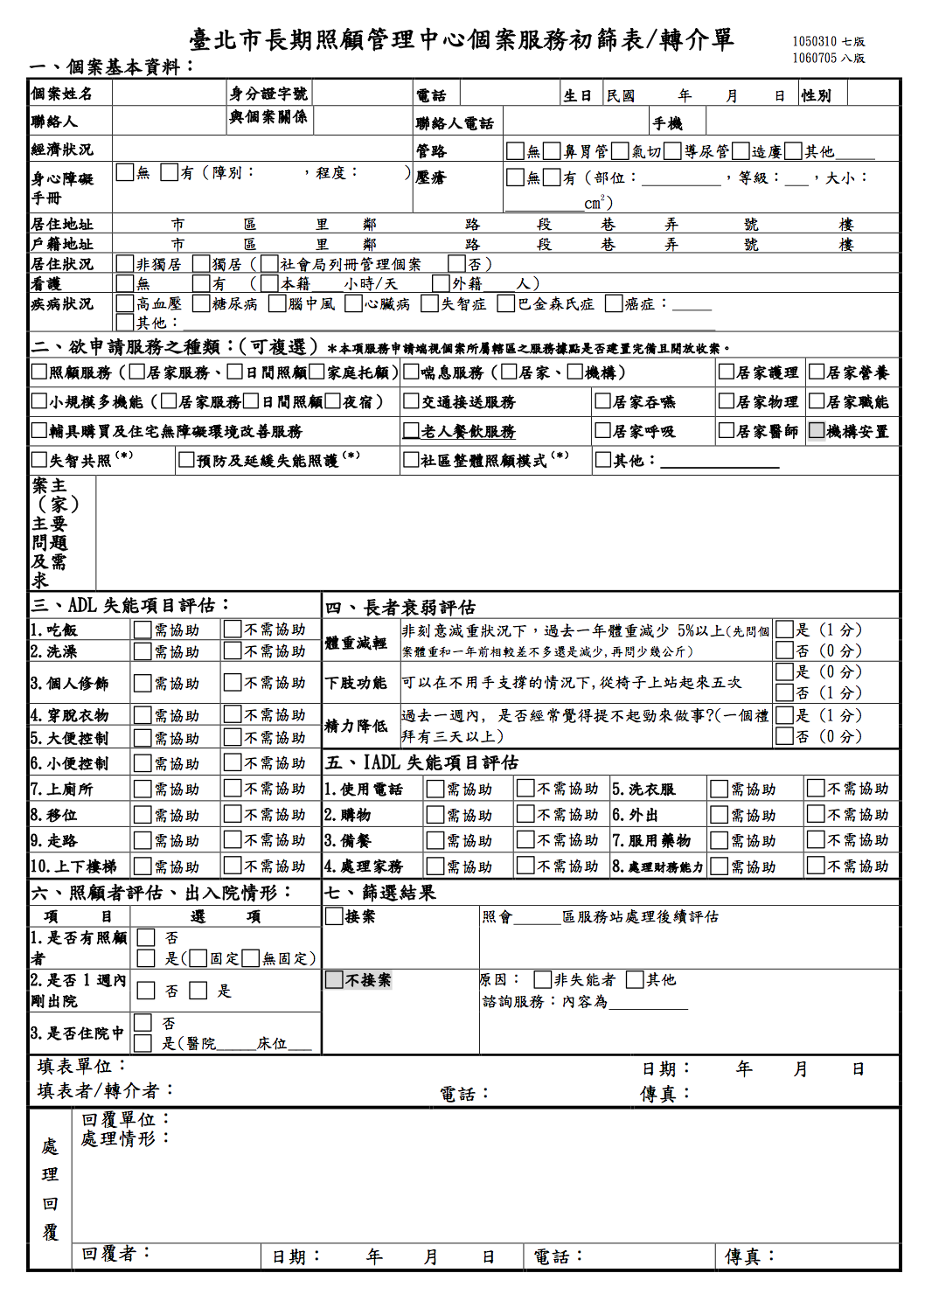
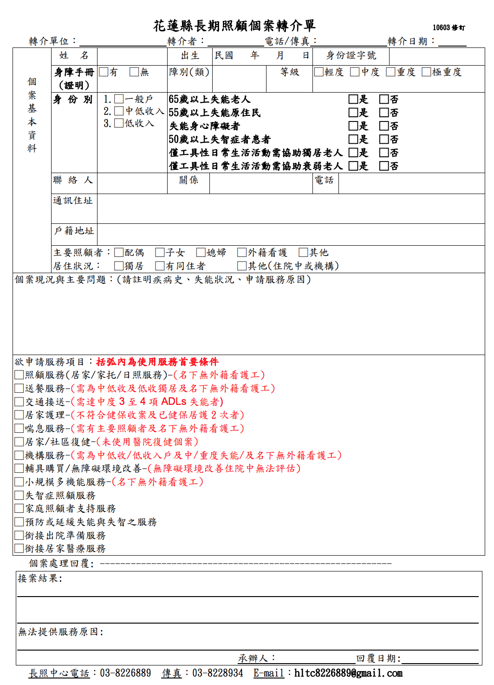
Notes:
表單種類繁多 但FHIR共享、權限資訊 可以跳脫表單 取得需要的資訊

Slide 6
出院準備與長期照護
相關單位
就診醫療院所、長照轉介單位（A）、長照單位（A, B, C）、居家
相關角色
就診醫療院所的醫療從業人員、病患、長照評估員、照護人員（護理師）、家人
相關資源
病患基本資料
病患就診紀錄、檢查報告、住院記錄
醫師評估
轉介單
權限驗證
對應人員、組織、授權範圍、動作
Notes:
包含醫師、護理師、個案管理師、社工師、營養師、復健師、藥師、居家護理師等，
提供有關病人長期照護的各項家庭準備、出院安置、社會福利資源、醫療器材準備、持續性及完整性的諮詢服務。

Slide 7
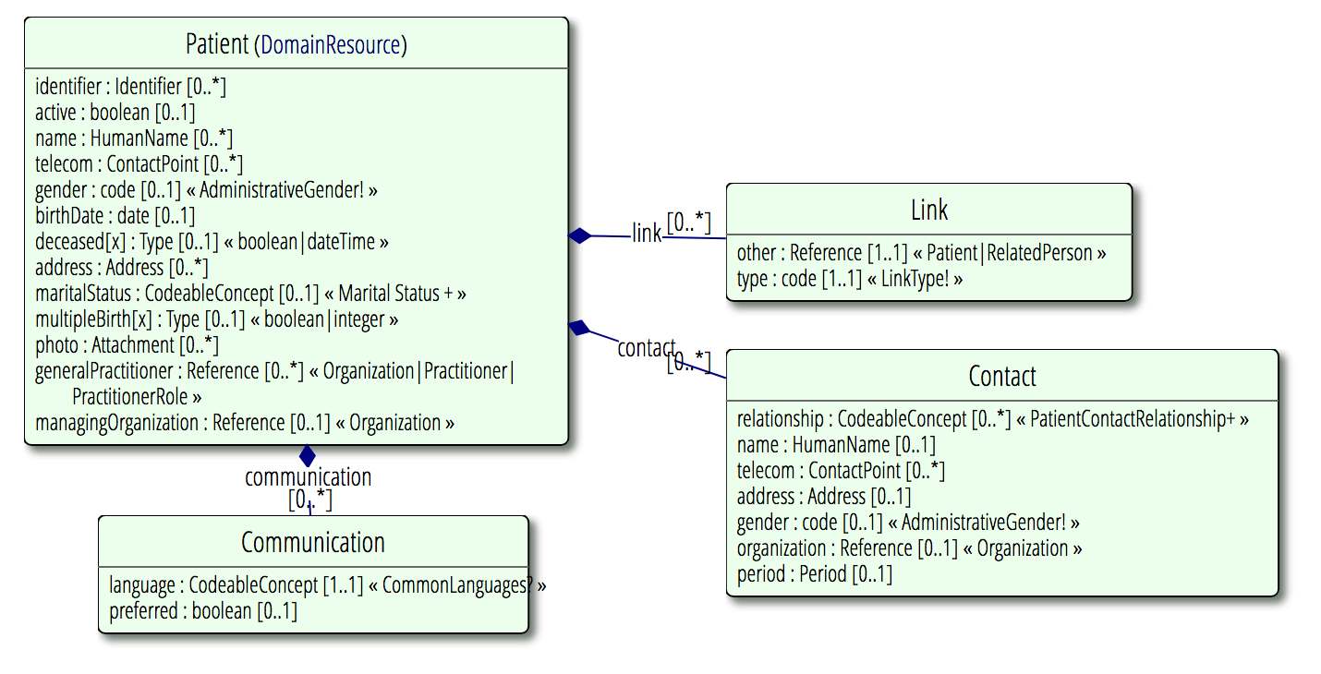
Patient
Code | Display | Definition
replaced-by | Replaced-by | The patient resource containing this link must no longer be used. The link points forward to another patient resource that must be used in lieu of the patient resource that contains this link.
replaces | Replaces | The patient resource containing this link is the current active patient record. The link points back to an inactive patient resource that has been merged into this resource, and should be consulted to retrieve additional referenced information.
refer | Refer | The patient resource containing this link is in use and valid but not considered the main source of information about a patient. The link points forward to another patient resource that should be consulted to retrieve additional patient information.
seealso | See also | The patient resource containing this link is in use and valid, but points to another patient resource that is known to contain data about the same person. Data in this resource might overlap or contradict information found in the other patient resource. This link does not indicate any relative importance of the resources concerned, and both should be regarded as equally valid.
接受醫療組織服務之患者行政訊息（院內）
可定義為此患者接受服務的醫療組織

Slide 8
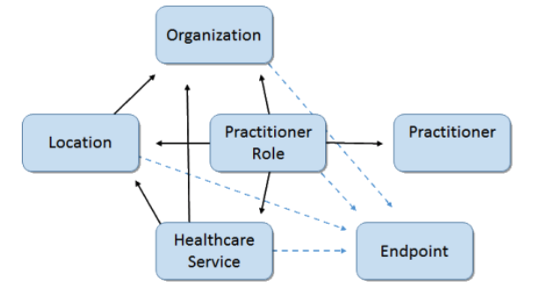
正式或非正式的人員或組織集團
A formally or informally recognized grouping of people or organizations formed for the purpose of achieving some form of collective action. Includes companies, institutions, corporations, departments, community groups, healthcare practice groups, payer/insurer, etc.
從業角色
A specific set of Roles/Locations/specialties/services that a practitioner may perform at an organization for a period of time.
醫療從業人員
A person who is directly or indirectly involved in the provisioning of healthcare.

Slide 9
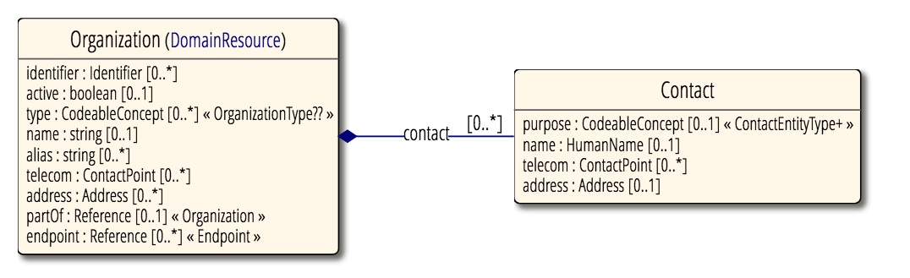
Organization
OrganizationType組織類型
Code | Display | Definition
prov | Healthcare Provider 提供醫療照護服務的組織 | An organization that provides healthcare services.
dept | Hospital Department 醫院內的部門或病房 | A department or ward within a hospital (Generally is not applicable to top level organizations)
team | Organizational team 醫院內部的特殊需求組成的團隊 （vip或急救團隊或部門） | An organizational team is usually a grouping of practitioners that perform a specific function within an organization (which could be a top level organization, or a department).
govt | Government 政府機構 | A political body, often used when including organization records for government bodies such as a Federal Government, State or Local Government.
ins | Insurance Company 保險機構 | A company that provides insurance to its subscribers that may include healthcare related policies.
pay | Payer 慈善機構或政府組織，代表患者處理索陪或像提供者付款 | A company, charity, or governmental organization, which processes claims and/or issues payments to providers on behalf of patients or groups of patients.
edu | Educational Institute 教育或研究機構 | An educational institution that provides education or research facilities.
reli | Religious Institution 宗教機構 | An organization that is identified as a part of a religious institution.
crs | Clinical Research Sponsor 製藥 / 臨床研究贊助商 | An organization that is identified as a Pharmaceutical/Clinical Research Sponsor.
cg | Community Group 未成立的社區團體 | An un-incorporated community group.
bus | Non-Healthcare Business or Corporation 未被識別的企業或公司 | An organization that is a registered business or corporation but not identified by other types.
other | Other | Other type of organization not already specified.
依此建立組織樹

Slide 10
{
"resourceType": "Organization",
"id": " 1145010010 ",
"active": "true",
"text":
{
"status": "generated",
"div": "<div xmlns=\"http://www.w3.org/1999/xhtml\">...</div>"
},
"identifier": [
{
"use": "official",
"system": "urn:oid:2.16.886.101.20003.20065.20022",
"value": "1145010010 "
}
],
"type": [
{
"coding": [
{
"system": "http://terminology.hl7.org/CodeSystem/organization-type",
"code": "prov",
"display": "Healthcare Provider"
}]
}],
“name”: “花蓮慈濟醫院",
"telecom": [
{
"system": "phone",
"value": " 02-2312-3456 ",
"use": "work"
}],
"address": [
{
"use": "work",
"line": [
"No. 707, Sec. 3, Zhongyang Rd. "
],
"city": “Hualian",
"postalCode": ”97071",
"country": "TW"
},
]
}
//url : http://…/Organization/1145010010
//usual | official | temp | secondary | old (If known)
//醫事機構代碼
醫院A
醫療部
醫事部
護理部
總務室
綜合事務室
...等
復健科
家庭醫學科
藥劑科
檢驗醫學科
營養科
...等
//提供醫療照護服務的組織
Notes:
Ref :
http://www.chut.ntuh.gov.tw/releaseRedirect.do?unitID=1&pageID=332

Slide 11
{
"resourceType": "Organization",
"id": "0401180014_Div1",
"active": "true",
"text":
{
"status": "generated",
"div": "<div xmlns=\"http://www.w3.org/1999/xhtml\">...</div>"
},
"identifier": [
{
"use": "official",
"system": "urn:oid:2.16.886.101.20003.20065.20022.0401180014",
"value": “Div1"
}
],
"type": [
{
"coding": [
{
"system": "http://terminology.hl7.org/CodeSystem/organization-type",
"code": “dept",
"display": "Hospital Department"
}]
}],
“name”: “醫療部",
"telecom": [
{
"system": "phone",
"value": " 02-2312-3456 ",
"use": "work"
}],
"address": [
{
"use": "work",
"line": [
"No. 707, Sec. 3, Zhongyang Rd. "
],
"city": “Hualian",
"postalCode": ”97071",
"country": "TW"
},
],
"partOf": { "reference": "Organization/ 0401180014" }
}
//url : http://…/Organization/0401180014_Div1
//醫院內的代碼
醫院A
醫療部
醫事部
護理部
總務室
綜合事務室
...等
復健科
家庭醫學科
藥劑科
檢驗醫學科
營養科
...等
//醫院內的部門或病房
Notes:
Ref :
http://www.chut.ntuh.gov.tw/releaseRedirect.do?unitID=1&pageID=332

Slide 12
{
"resourceType": "Organization",
“d”: “0401180014_Div1_Dep1",
"active": "true",
"text":
{
"status": "generated",
"div": "<div xmlns=\"http://www.w3.org/1999/xhtml\">...</div>"
},
"identifier": [
{
"use": "official",
"system": "urn:oid:2.16.886.101.20003.20065.20022.0401180014",
"value": “Dep1"
}
],
"type": [
{
"coding": [
{
"system": "http://terminology.hl7.org/CodeSystem/organization-type",
"code": “dept",
"display": "Hospital Department"
}]
}],
“name”: “家庭醫學科",
"telecom": [
{
"system": "phone",
"value": " 02-2312-3456 ",
"use": "work"
}],
"address": [
{
"use": "work",
"line": [
“East Wing, floor 2, room2001"
]
},
],
"partOf": { "reference": "Organization/ 0401180014_Div1" }
}
//url : http://…/Organization/0401180014_Div1 _Dep1
//醫院內的代碼
醫院A
醫療部
醫事部
護理部
總務室
綜合事務室
...等
復健科
家庭醫學科
藥劑科
檢驗醫學科
營養科
...等
//醫院內的部門或病房
Notes:
Ref :
http://www.chut.ntuh.gov.tw/releaseRedirect.do?unitID=1&pageID=332

Slide 13
{
"resourceType": "Organization",
"id": "2345110010 ",
"active": "true",
"text":
{
"status": "generated",
"div": "<div xmlns=\"http://www.w3.org/1999/xhtml\">...</div>"
},
"identifier": [
{
"use": "official",
"system": "urn:oid:2.16.886.101.20003.20065.20022",
"value": "0401180014"
}
],
"type": [
{
"coding": [
{
"system": "http://terminology.hl7.org/CodeSystem/organization-type",
"code": "prov",
"display": "Healthcare Provider"
}]
}],
“name”: “秀林鄉衛生所",
"telecom": [
{
"system": "phone",
"value": "03-8612122",
"use": "work"
}],
"address": [
{
"use": "work",
"line": [
" No. 88, Xiulin, Xiulin Township, Hualien County"
],
"postalCode": ”972",
"country": "TW"
},
]
}
//url : http://…/Organization/2345110010
//usual | official | temp | secondary | old (If known)
//醫事機構代碼
秀林鄉衛生所
//提供醫療照護服務的組織
Notes:
Ref :
http://www.chut.ntuh.gov.tw/releaseRedirect.do?unitID=1&pageID=332

Slide 14
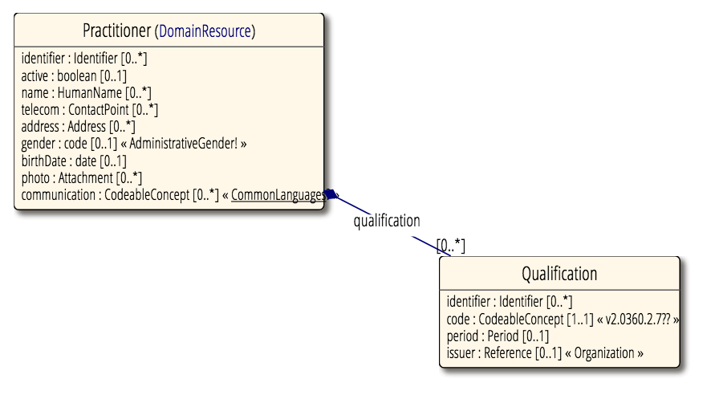
Practitioner
[醫療從業人員] 基本資料

Slide 15
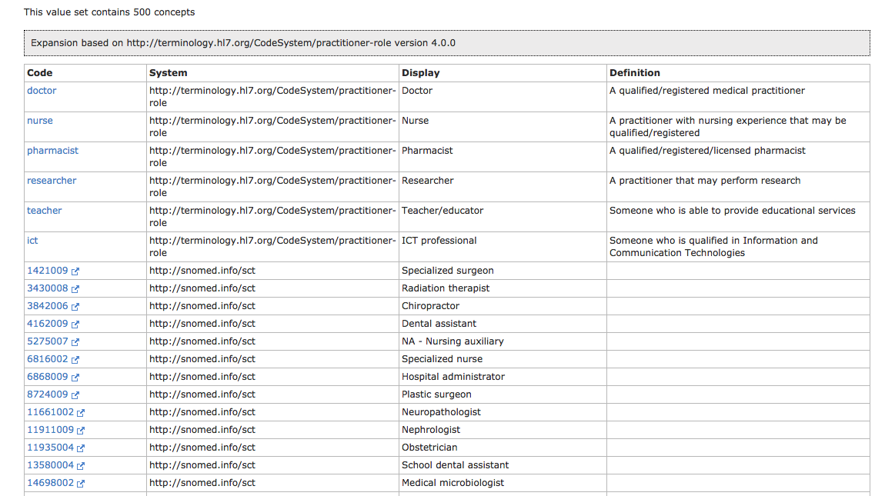
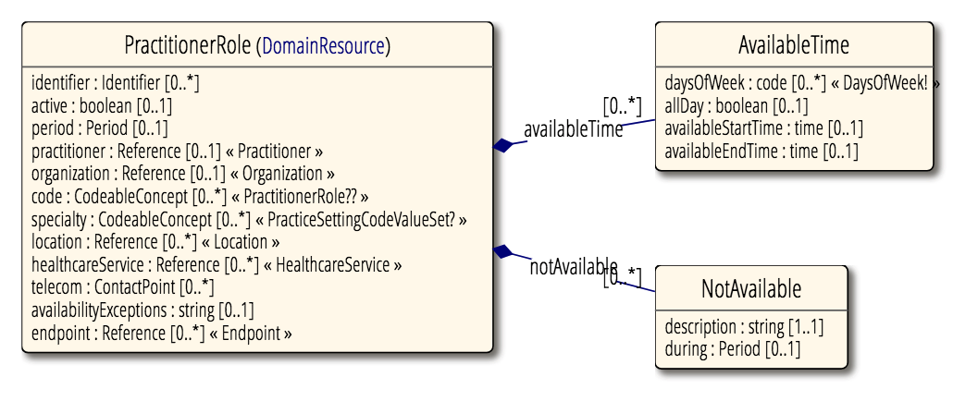
PractitionerRole
描述 [醫療從業人員] 在[就職機構] 的記錄
表示此practitioner在組織被授權的角色編碼
https://www.hl7.org/fhir/valueset-practitioner-role.html
表示此practitioner的特殊專長
https://www.hl7.org/fhir/valueset-c80-practice-codes.html
Practitioner 的角色說明
一個practitioner可以有多個角色

Slide 16
Notes:
描述科內的人或系統授權

Slide 17
預設條件
各醫院組織建立
如：醫院-管理單位-科別
各醫療從業人員 practionerRole建立
流程定義
Request and Actions
如：轉診：目的醫院需取得轉診病患相關病歷、醫師主囑
Request type : referral , Actions : [get] referral’s reference EMR
流程與角色授權
Portal 設定流程與相關角色權限
如：轉診相關病歷、摘要、檢驗報告等，設定 {Organization}.{PractitionerRole} （存於portal）
如：{Organization}.doctor , {Organization}.nurse
入口網站功能
組織管理
紀錄與驗證 流程與角色授權
jwt 產生，單一登入
Notes:
新增健康照護人員
PractitionerRole 組織成員

Slide 18
[2] select referral’s EMR references
Client A
FHIR server
[1] request referral
[4] [post] referral request
Documentreference 註冊到portal
Portal
healthcare service server
[3] find & reply organization
[5] Query referrals
Client B
Client B 查詢轉介資訊, documentreference列表

Slide 19
[3] find & reply JWT
Request type: request referral’s references
Actions : [get] referral references
Authorization role : {organization}.doctor, {organization}.nurse
scopes
系統如何記錄是轉診醫院的request
FHIR server
Portal
healthcare service server
Jwt scope 改成用json描述
文件 FHIR document bundle
影像從 image
[2] request referral’s references
with client B’s [practitionerRole]
[4] [get] retrieve referral’s references
[1] query & [get] referral request
Client B

